Slide 1
Pathology of Kidney and the Urinary tract
Dr. Amar C. Al-Rikabi
Dr. Hala Kasouf Kfouri

Slide 2
Pathology of the Nephrotic and Nephritic Syndromes. (glomerular diseases)
Lectures - 3and 4

Slide 3
Structure of the kidney

Slide 4
Ultrastructure of the glomerulus

Slide 5
The glomeruli are normal by LM, but with diffuse effacement of foot processes by EM.
Minimal change disease/ glomerulonephritis.

Slide 6
Minimal change disease. Glomeruli appear unremarkable by light microscopy, and in young patients there is no tubulionterstial fibrosis, as in this patient.

Slide 7
Minimal change disease. Extensive foot process effacement and microvillous transformation of visceral epithelial cells in MCD

Slide 8
FSGS. There is sharply defined segmental sclerosis, defined as obliteration of capillary loops and increased matrix, without deposits and with diffuse foot process effacement by EM. Adhesions can also be present.
Focal segmental glomerulosclerosis.

Slide 9
FSGS. The typical segmental sclerotic lesion in FSGS is characterized by increased matrix and obliteration of capillary lumina, frequently with hyalinosis and adhesions, as illustrated here.

Slide 10
Membranous glomerulopathy. There is no evident proliferation by light microscopy, with global subepithelial deposits, which may be visualized by light microscopy by the glomerular basement membrane spike reaction on silver stain.
Membranous glomerulopathy

Slide 11
Membranous glomerulopathy. There are well-developed spikes and holes in tangential sections in stage-2 membranous glomerulopathy.

Slide 12
Membranous glomerulopathy. There is an evenly distributed granular capillary loop pattern of positively in membranous glomerulopathy.

Slide 13
Diabetic nephropathy. The lesions in diabetic nephropathy are characterized by arteriolar hyalinization, mesangial matrix expansion and glomerular basement thickening.

Slide 14
Diabetic nephropathy. Diabetic nephropathy may manifest either as diffuse mesangial increase, or with nodular glomerulosclerosis as in this case.

Slide 15
Diabetic nephropathy. The lamellated appearance of the Kimmelstiel-Wilson nodule characteristic of the nodular sclerosis form of diabetic nephropathy is shown, along with arteriolar hyalinization and surrounding tubulointerstitial fibrosis.

Slide 16
Amyloidosis. Massive amyloid deposits are present in glomeruli and arterioles.

Slide 17
Amyloidosis. Tubular involvement with amyloid is verified by apple-green birefringence under polarized light.

Slide 18
Amyloidosis. Randomly oriented, 8-10nm fibrils, typical of amyloid within the mesangium.

Slide 19
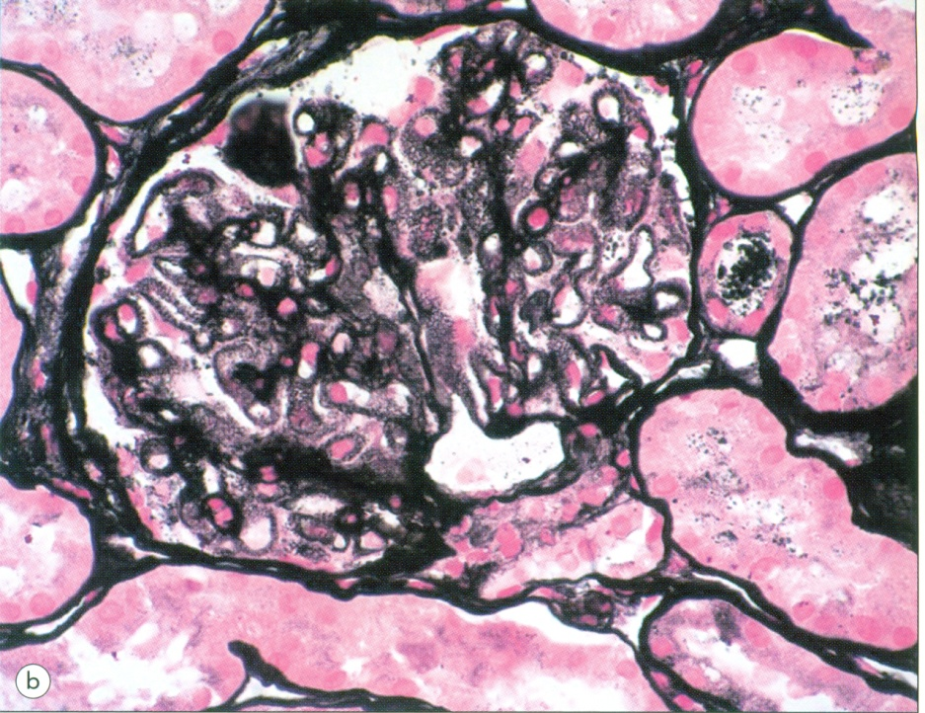
(b) Silver methenamine (jones) stains reveal a spike and dome pattern to be present along the peripheral capillary loops where the wall of the capillaries cut tangentially; there is a moth-eaten appearance of the capillary wall.
Lupus nephritis.
(a) Class V lesion or lupus membranous glomerulopathy. There is diffuse thickening of the peripheral capillary walls associated with an increase in mesangial matrix.

Slide 20
Lecture - 3and 4 Part2
(continued- Nephritic Syndrome)

Slide 21
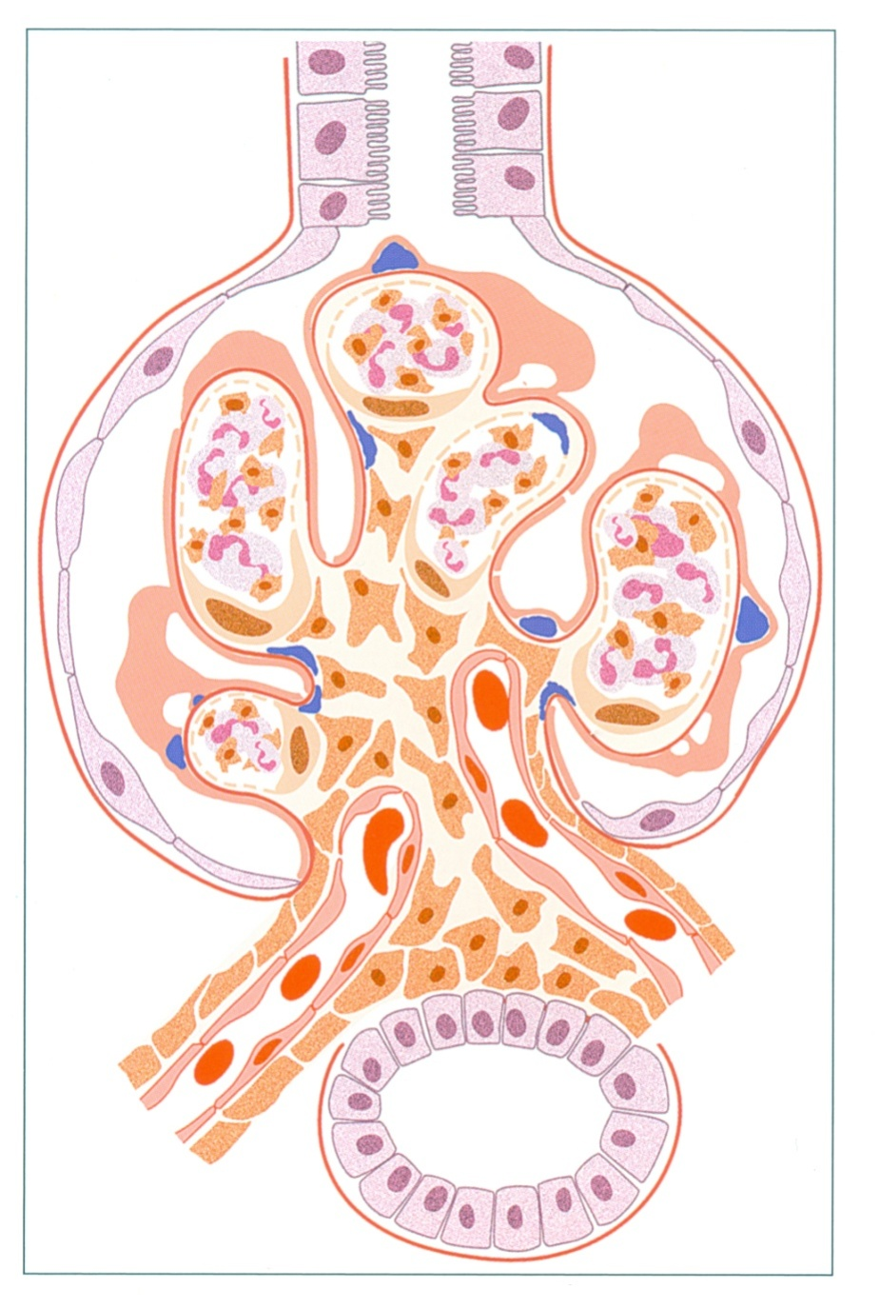
Acute post-infectious glomerulonephritis. There is an exudative proliferation with numerous PMNs and endocapillary proliferation, with scatted mesangial and large hump-shaped sub-epithelial deposits.

Slide 22
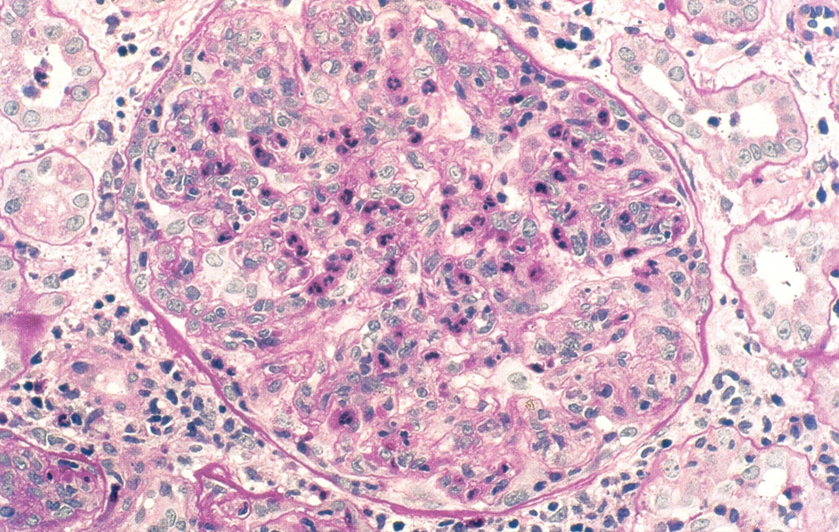
Acute post-infectious glomerulonephritis. There is diffuse, global exudative proliferation with prominent endocapillary proliferation and numerous neutrophils.

Slide 23
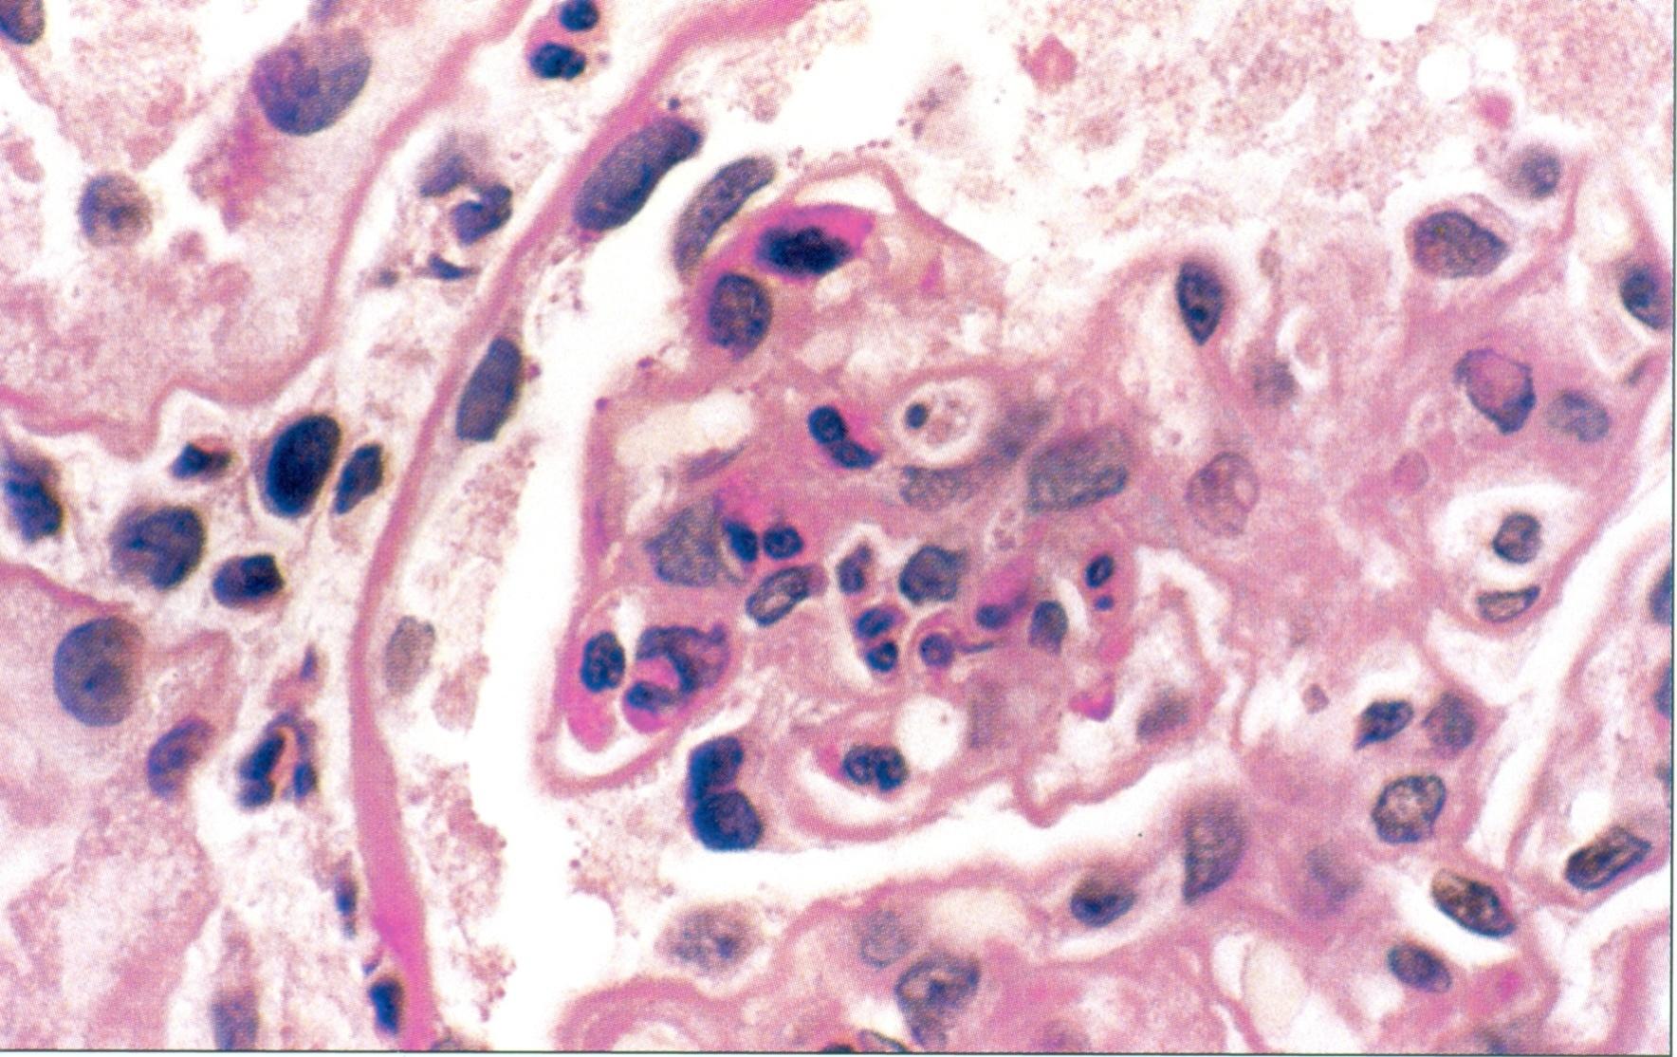
Acute post-infectious glomerulonephritis. Endocapillary proliferation and numerous PMNs both within capillary loops and within the mesangial area are present.

Slide 24
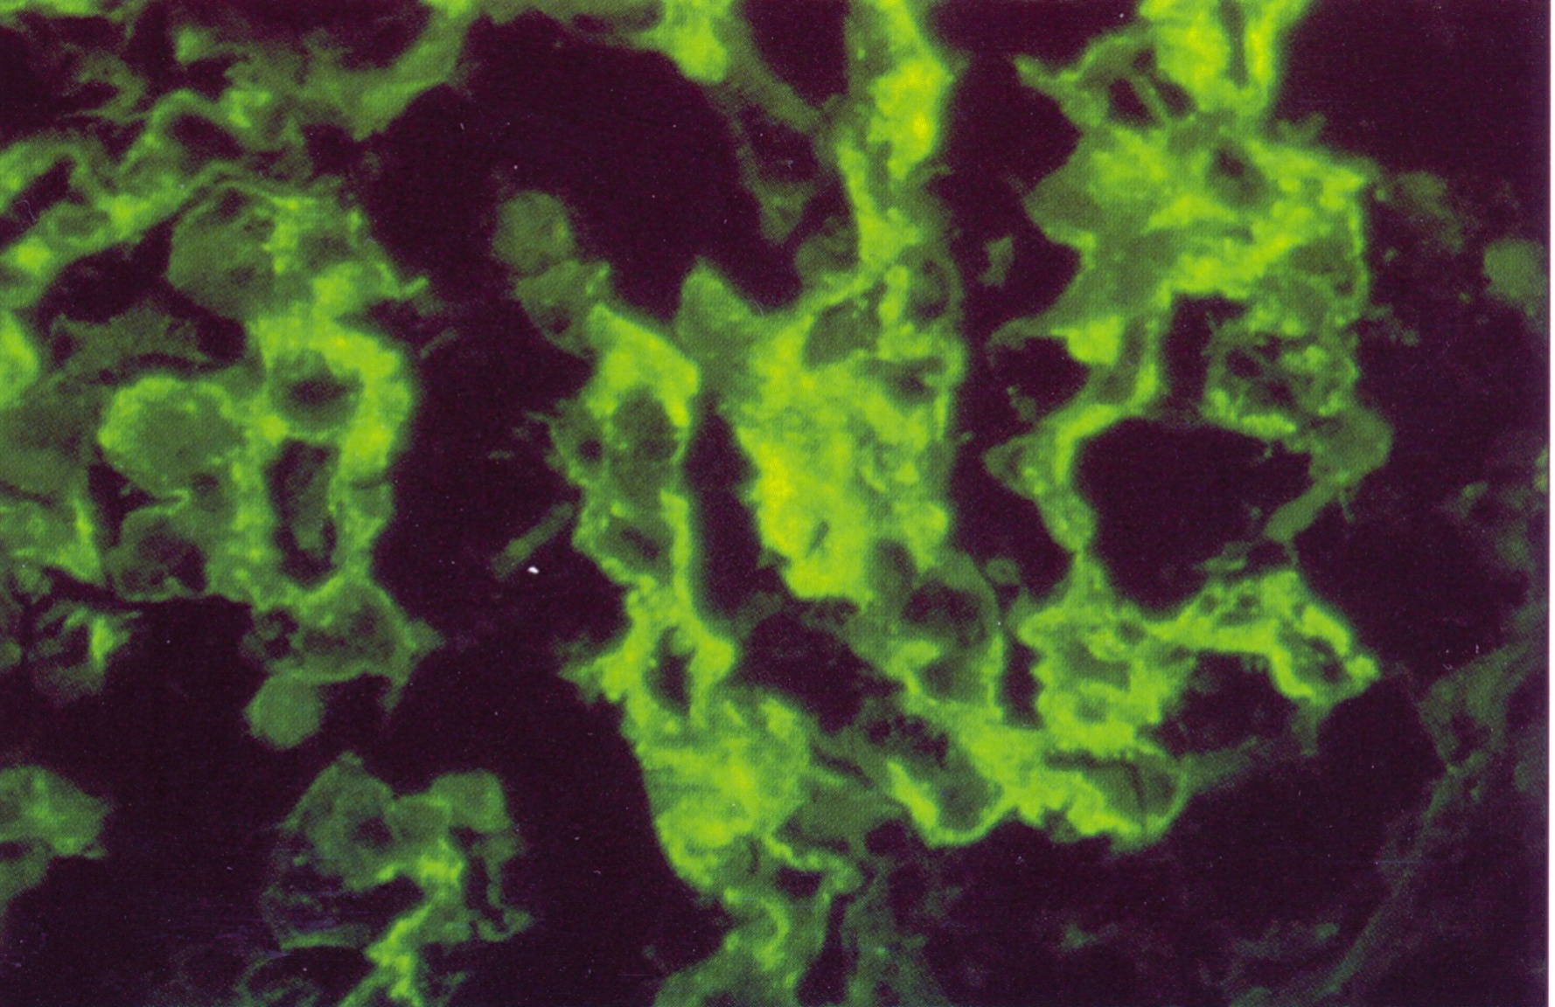
Acute post-infectious glomerulonephritis. A more extensive garland pattern with elongated peripheral loop deposits is illustrated, along with occasional small mesangial deposits.

Slide 25
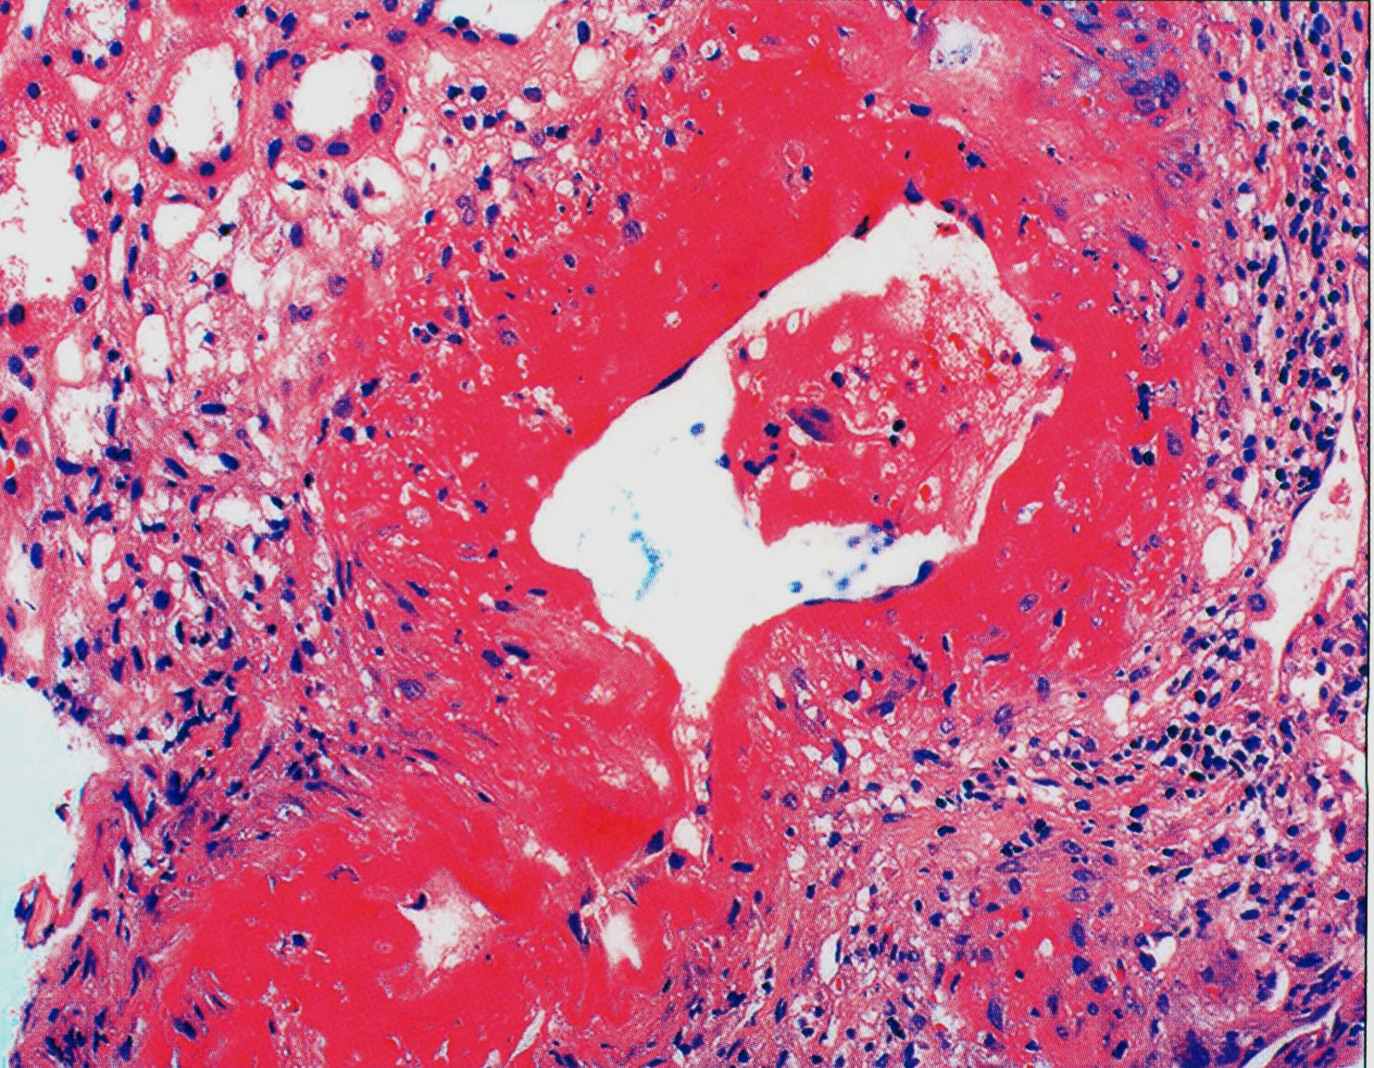
Wegener’s granulomatosis / microscopic polyangiitis. Vessel with transmural necrosis involving the vessels circumferentially with a significant inflammatory infiltrate with mixed polymorphonuclear leukocytes and mononuclear cells.

Slide 26
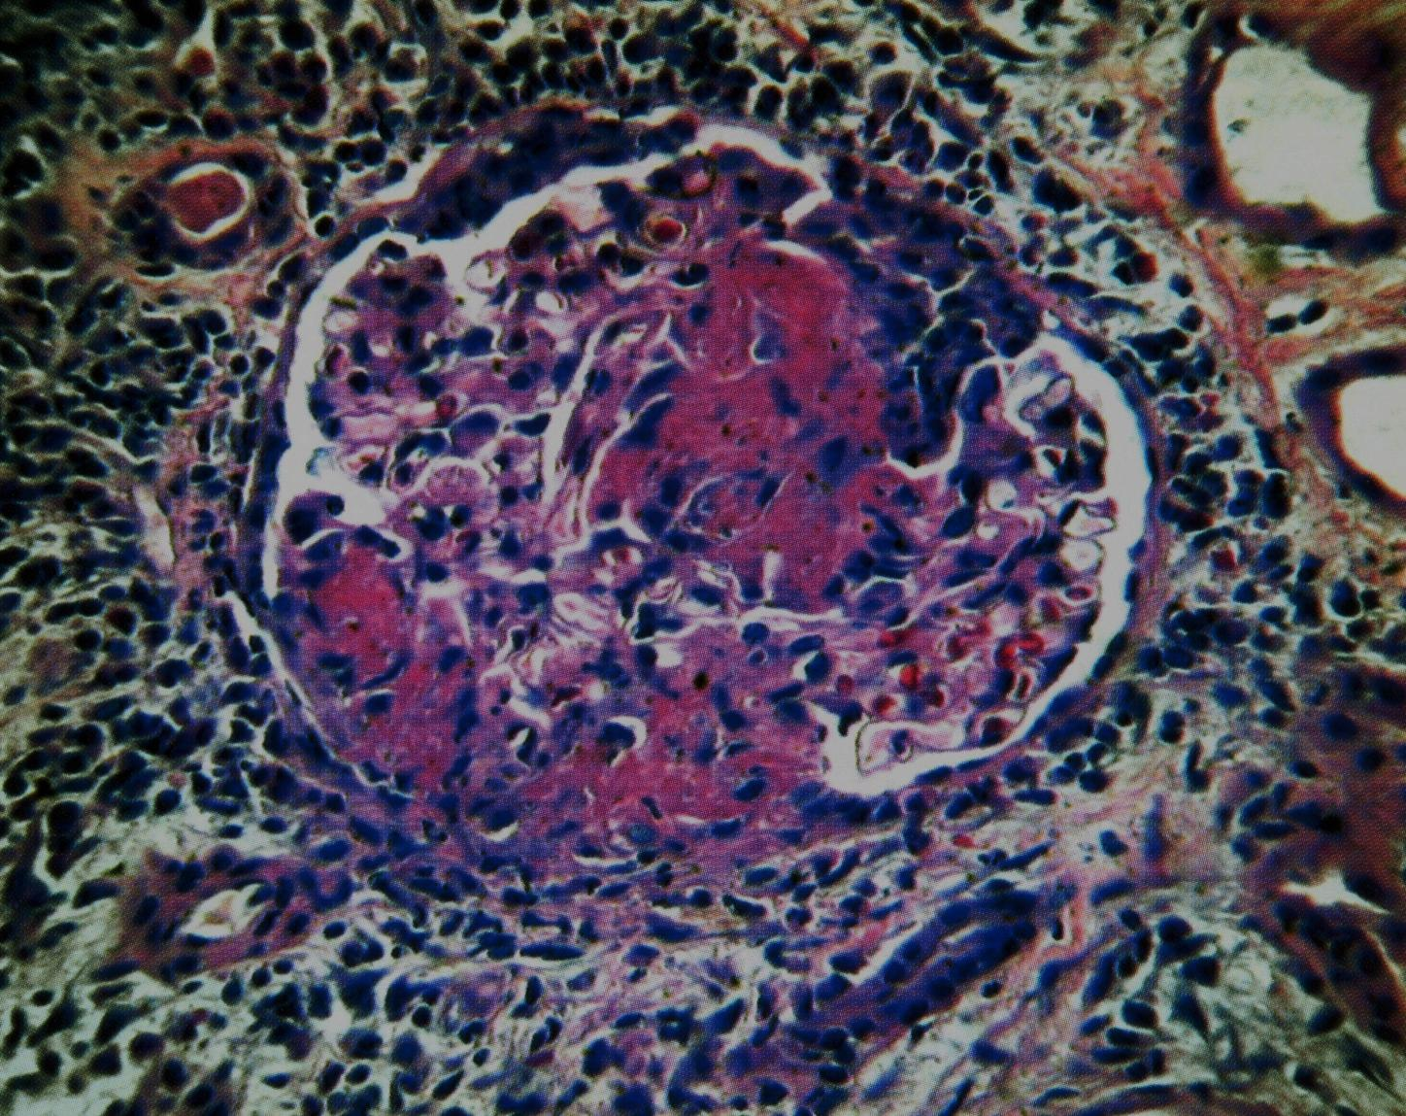
Wegener’s granulomatosis / microscopic polyangiitis. Glomerulus demonstrating focal and segmental necrosis with adhesion to Bowman’s capsule and proliferation of parietal epithelium.

Slide 27
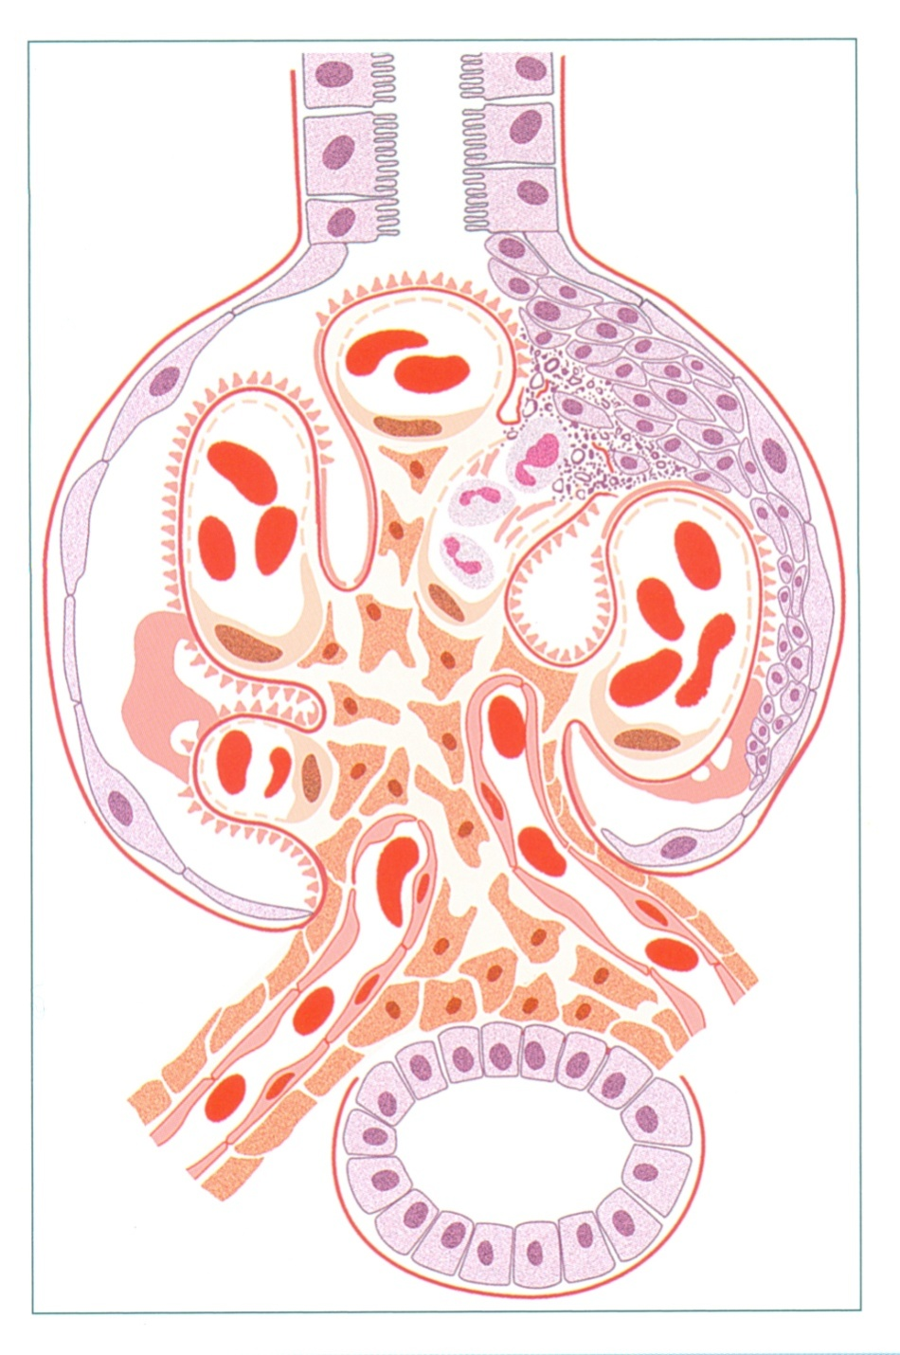
There is segmental necrosis with a break of the glomerular basement membrane, and fibrinoid necrosis and PMNs in the area, with a cellular crescent developing in response to this GBM break.
Anti-GBM-antibody mediated glomerulonephritis (Goodpasture’s Syndrome).

Slide 28
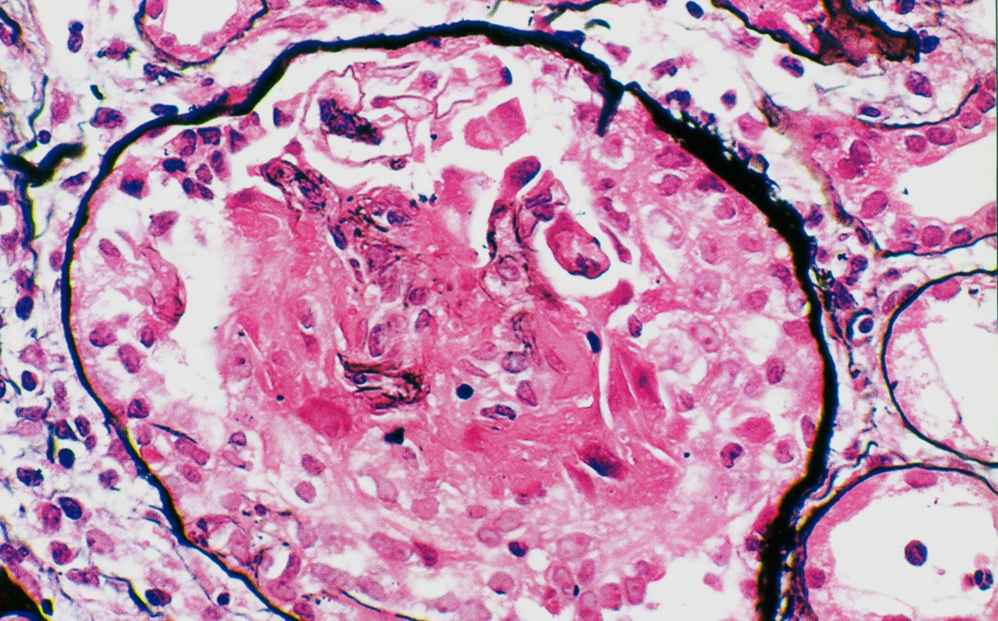
Anti-GBM antibody-mediated glomerulonephritis with karyorrhexis and ruptured fragments of GBM, with a small remaining intact portion of the glomerulus at the top.

Slide 29
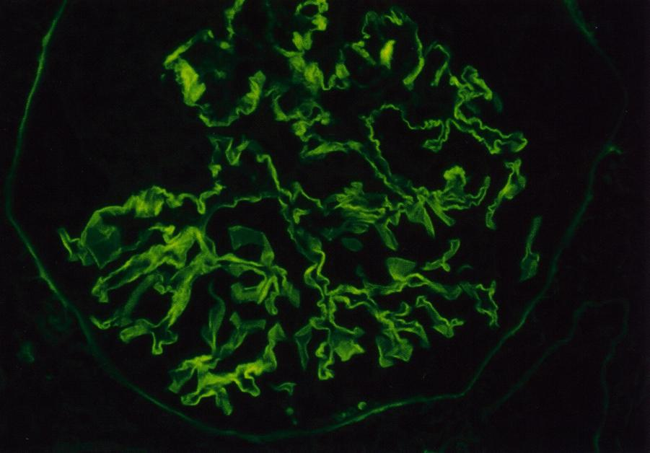
Anti-GBM antibody-mediated glomerulonephritis. Linear glomerular basement membrane staining with lgG is diagnostic of this disease in this setting.

Slide 30
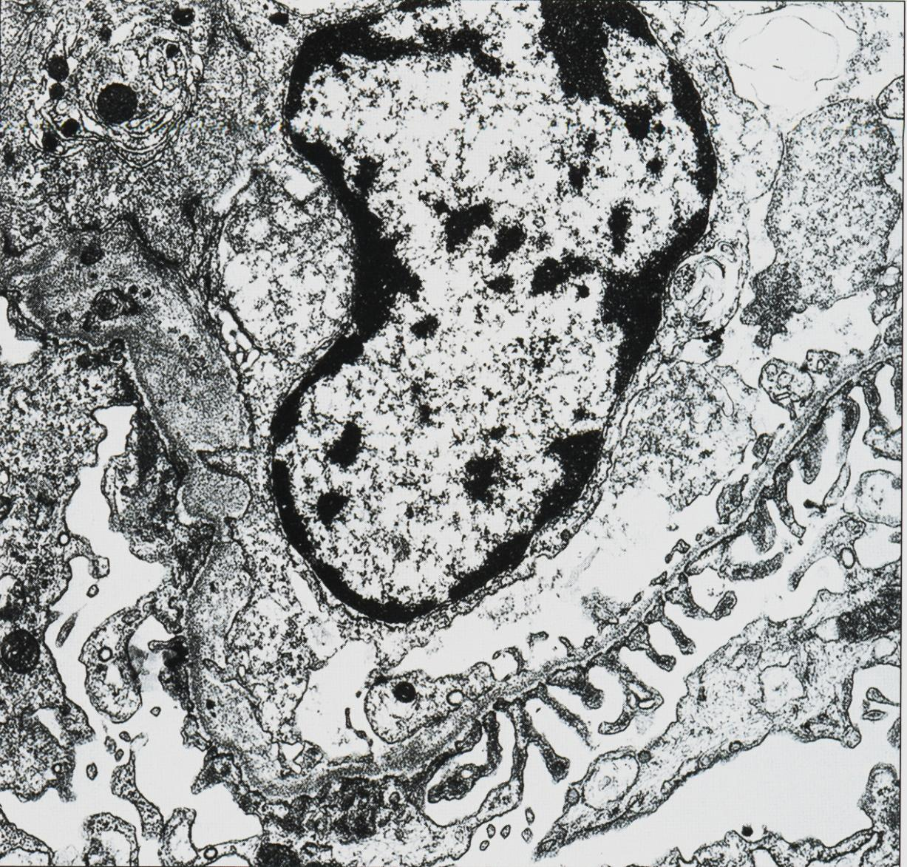
Alport syndrome. Alternating areas of extreme thinning of the glomerular basement membrane (~120 nm) with thick, irregular areas with basket weaving are shown.

Slide 31
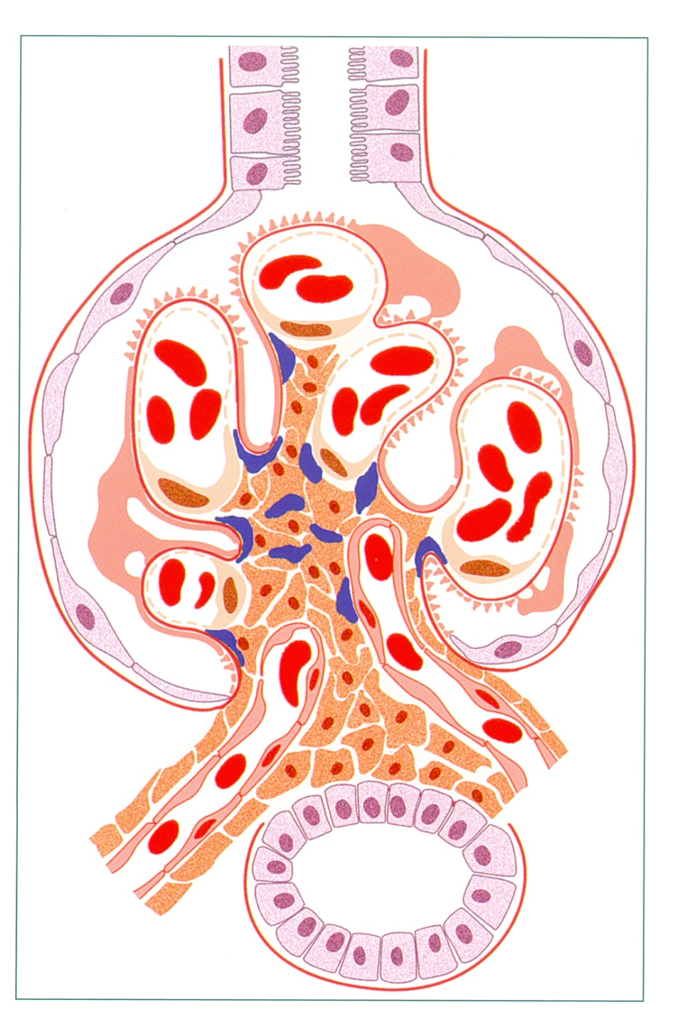
IgA nephropathy. There is mesangial cell and matrix increase, with mesangial deposits.

Slide 32
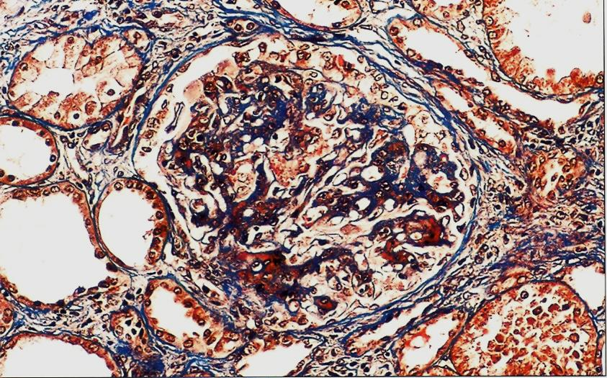
IgA nephropathy. There is marked mesangial expansion, with segmental proliferation extending out to peripheral capillary loops, and early focal proliferative lesion.

Slide 33
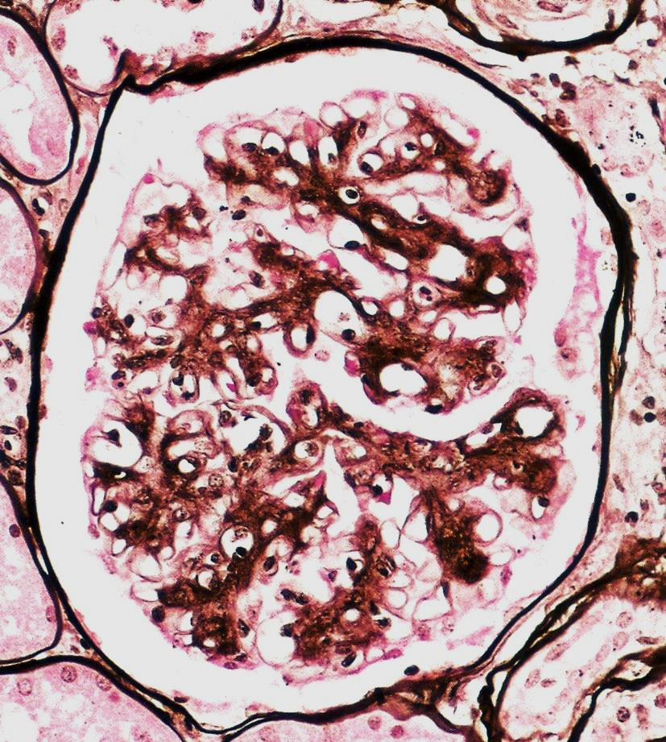
IgA nephropathy. There is diffuse mesangial proliferation with segmental endocapillary proliferation and occasional peripheral basement membrane splitting, evidence of deposits extending to peripheral loops.

Slide 34
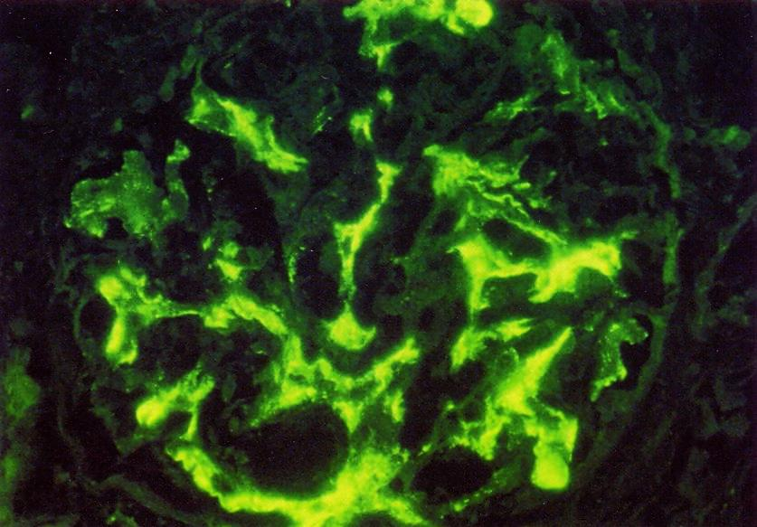
IgA nephropathy. Definitive diagnosis is made by immunofluorescence, showing dominant or codominant staining with IgA in a predominantly mesangial pattern, as shown here.

Slide 35
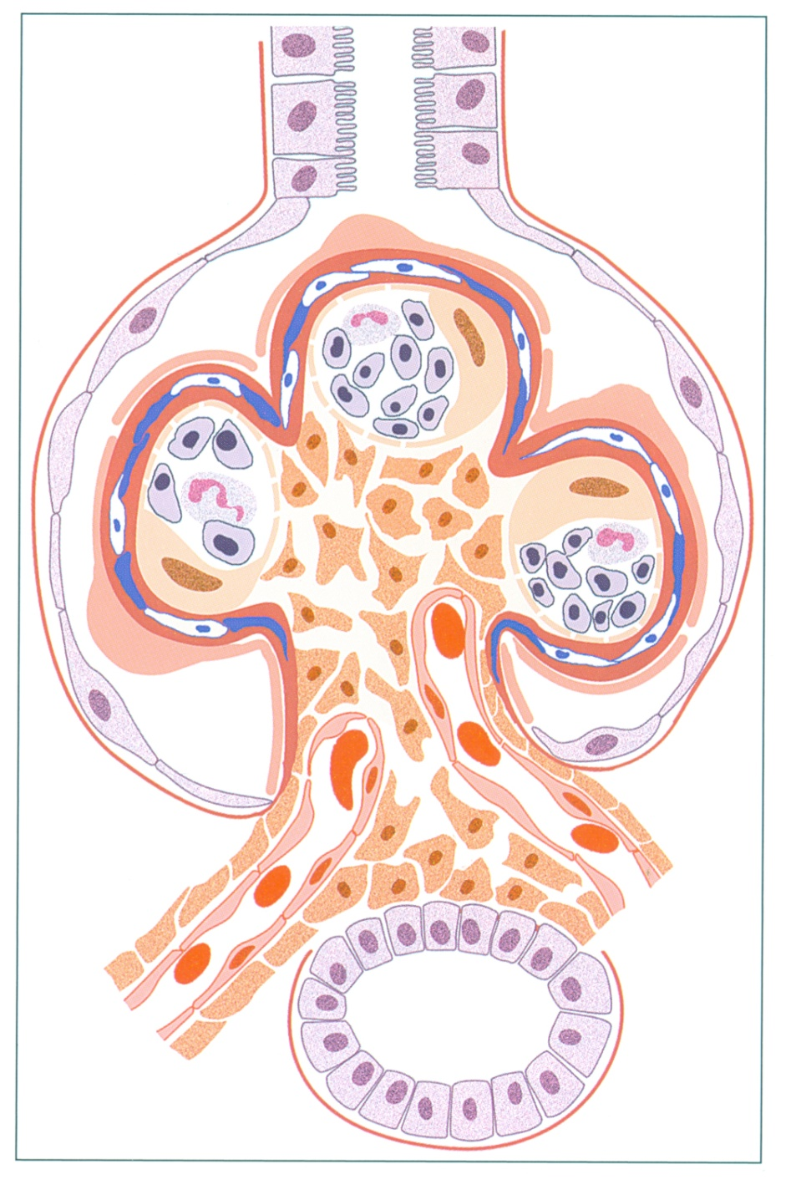
There is endocapillary proliferation and glomerular basement membrane splitting, due to mesangial and subendothelial deposits, with resultant interposition and new basement membrane being laid down, causing the split appearance.
Membranoproliferative glomerulonephritis

Slide 36
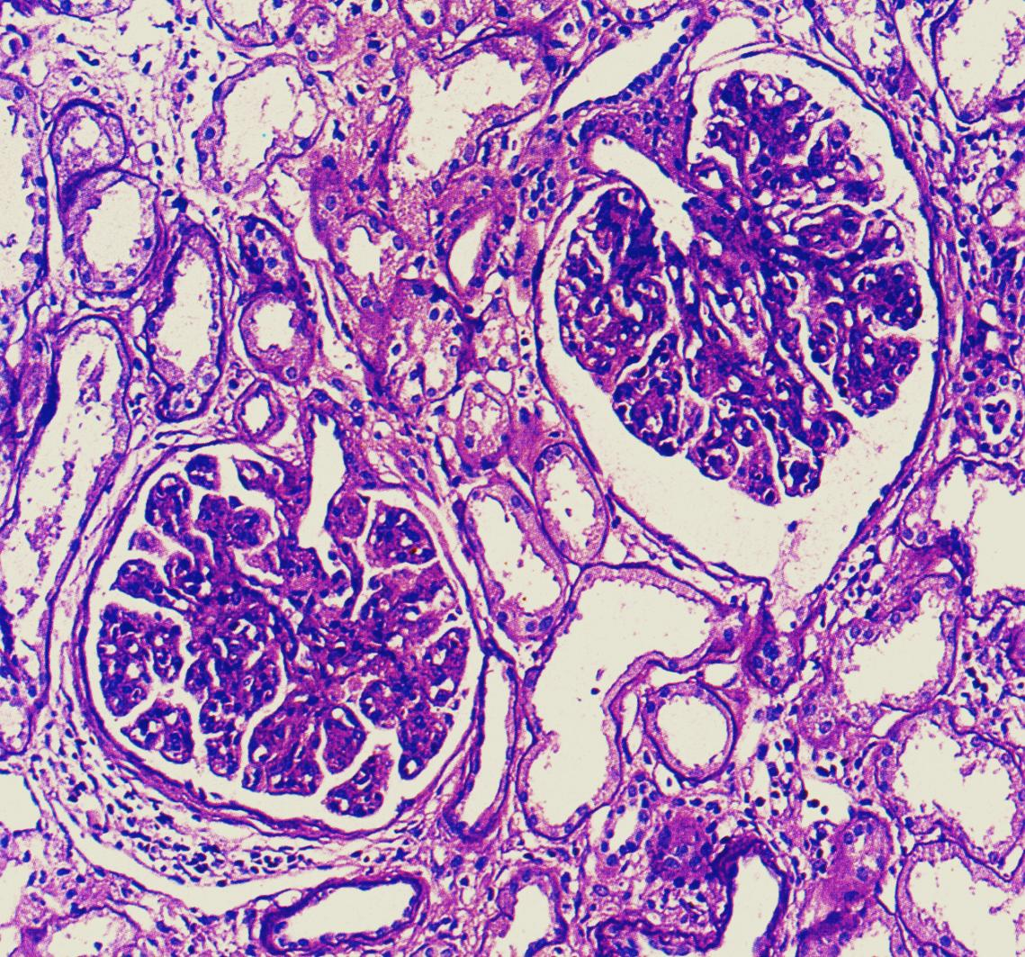
MPGN type I. MPGN is characterized by diffuse endocapillary proliferation, which results in a lobular, uniform appearance of glomeruli.

Slide 37
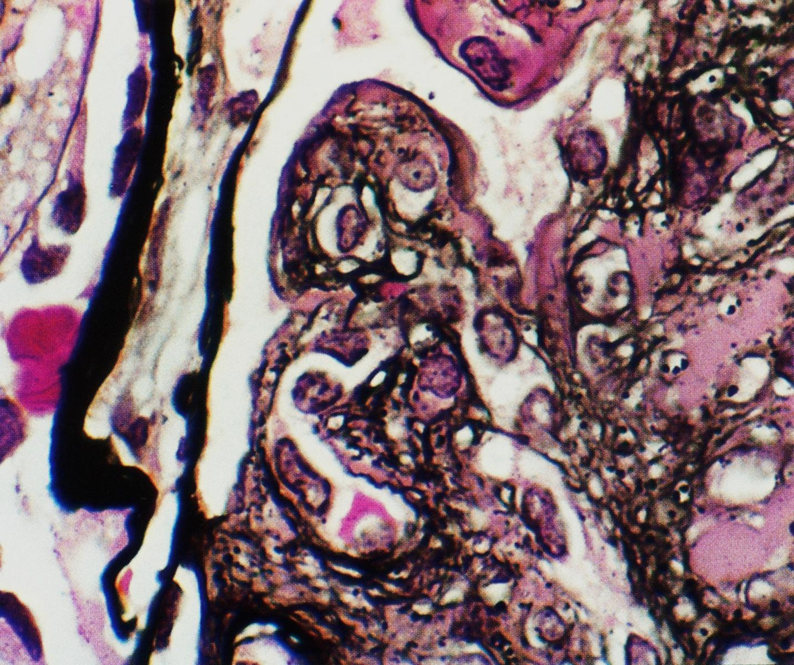
MPGN type I. There is segmental interposition of cells which splitting of peripheral capillary GBM along with subendothelial deposits.

Slide 38
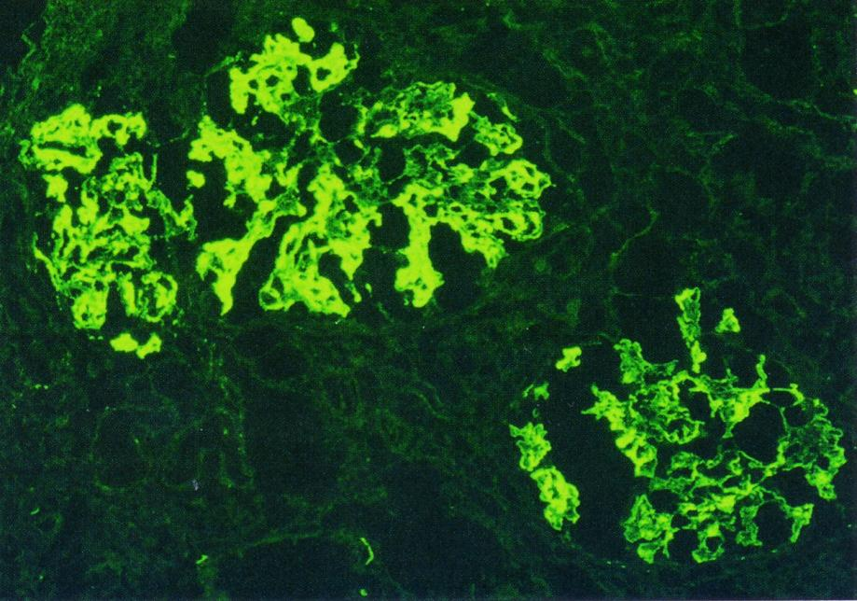
MPGN type I. in addition to IgG, there is often very prominent complement deposition in MPGN with prominent mesangial and coarse, chunky peripheral loop deposits, corresponding to the subendothelial deposits.

Slide 39
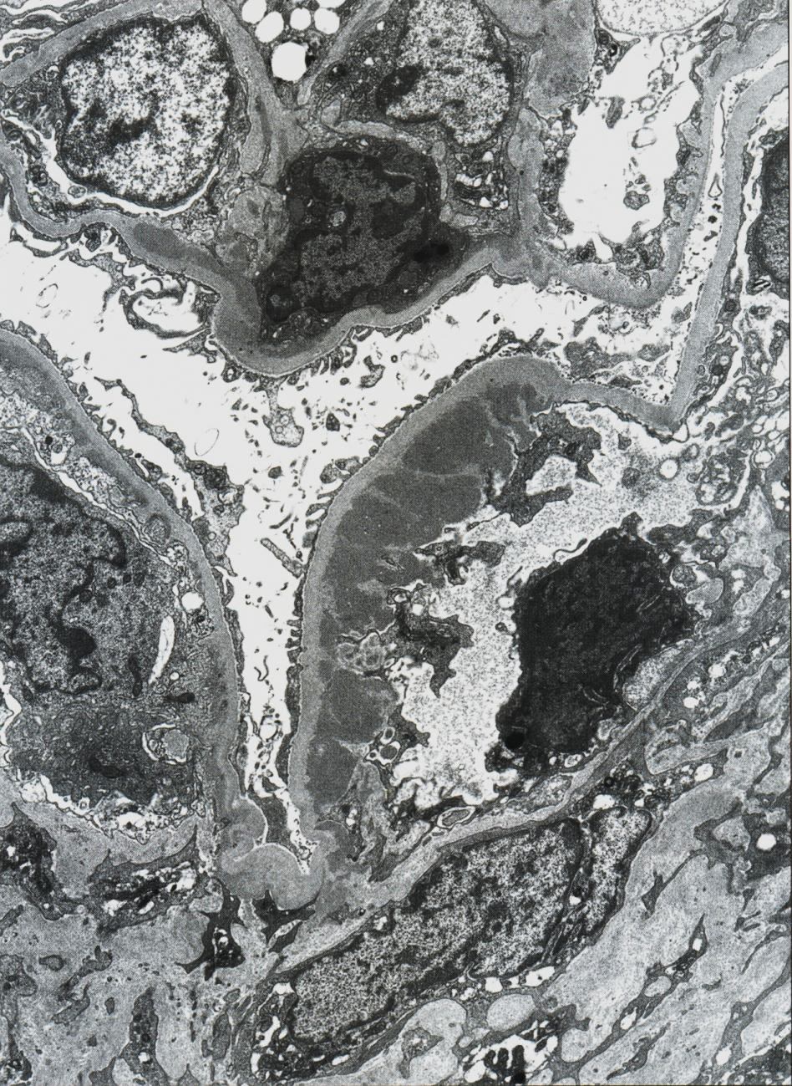
MPGN type I There are massive subendothelial deposits in the right loop, with minimal endocapillary proliferation, and small, silver-like deposits on the left and top loops, with associated proliferation.

Slide 40
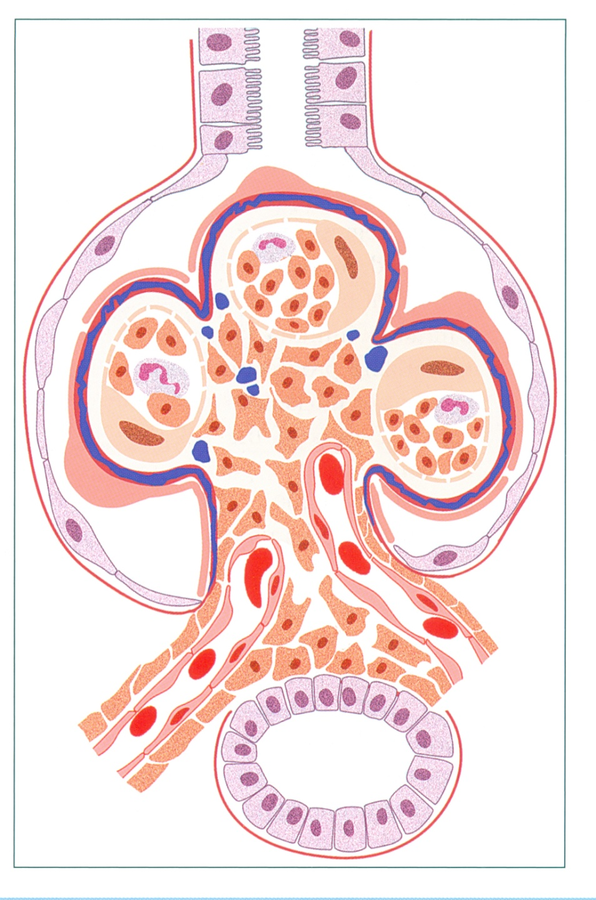
The glomerulus shows a membranoproliferative pattern, with endocapillary proliferation and GBM splitting
Dense deposit disease
(DDD).

Slide 41
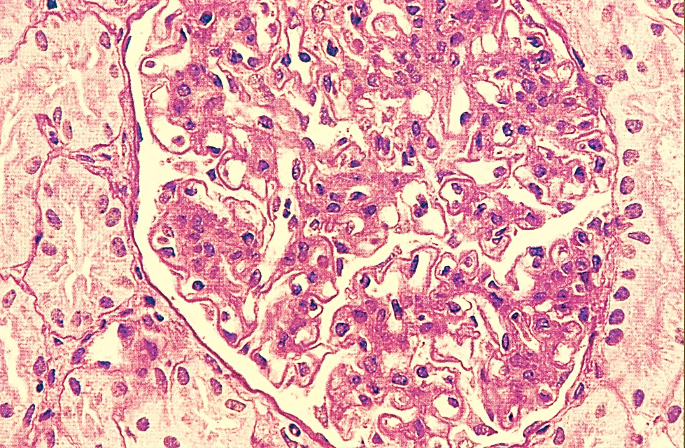
DDD Dense deposit disease has membranoproliferative features by light microscopy, with diffuse, global mesangial and often endocapillary proliferation, and frequent glomerular basement membrane splitting.

Slide 42
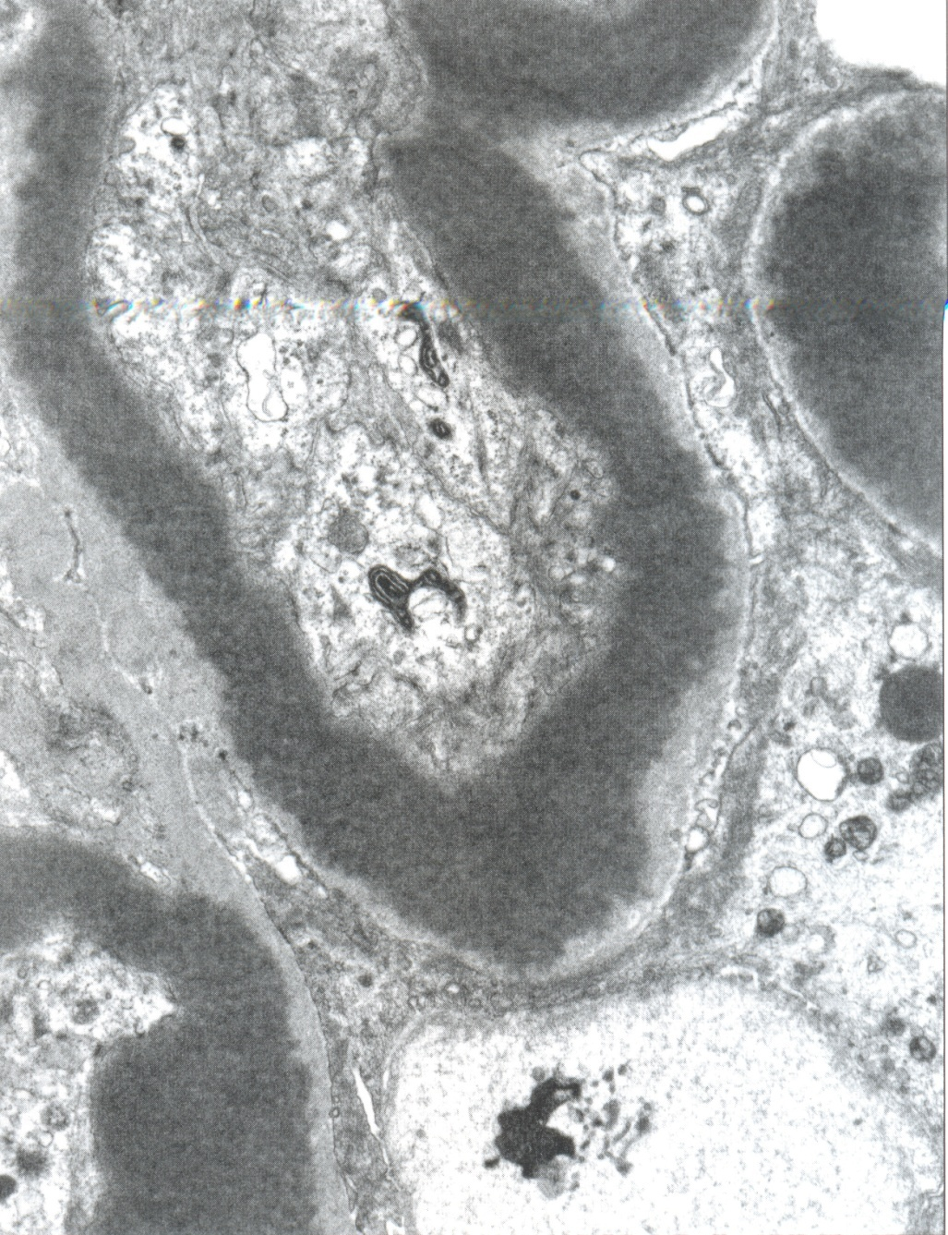
DDD. There is dense transformation of nearly the entire thickness of the glomerular basement membrane, with associated endocapillary proliferation.

