Slide 1
DIURETICS
By:
Prof. A. Alhaider
1433 H

Slide 2
Anatomy and Physiology of Renal system
Remember the nephron is the most important part of the kidney which regulates fluid and electrolytes.
Urine formation:
Glomerular filtration How many liters per 24 H?
Tubular re-absorption (around 98%)
Tubular secretion

Slide 3
How could urine output be increased ?
↑ Glomerular filtration Vs ↓ Tubular reabsorption (the most important clinically)
Purpose of Using Diuretics
1. To maintain urine volume ( e.g.: renal failure)
2. To mobilize edema fluid (e.g.: heart failure, liver failure; nephrotic syndrome)
3. To control high blood pressure.

Slide 4
What are the renal transport mechanisms in:
Proximal convoluted tubule 60-70%
(Isotonic)
Thick portion of ascending limb of the loop of Henle. 25%
Distal convoluted tubule 5-10%
Cortical collecting tubule 5% (Aldosterone and ADH)

Slide 5
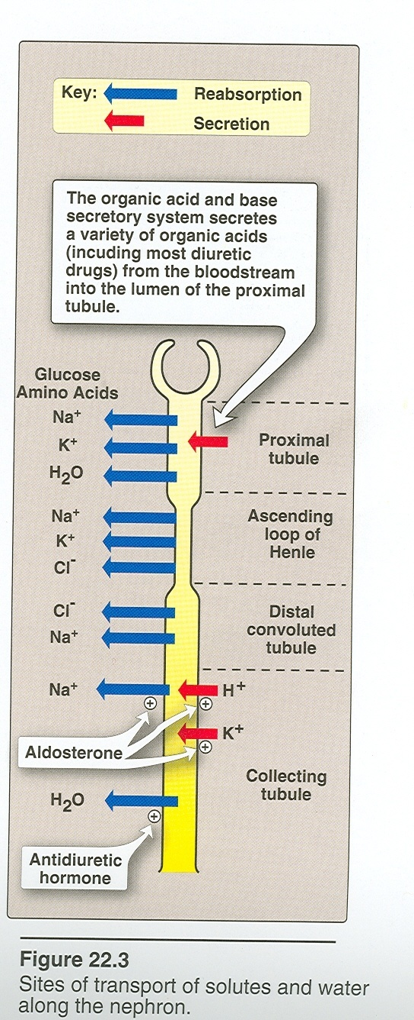

Slide 6
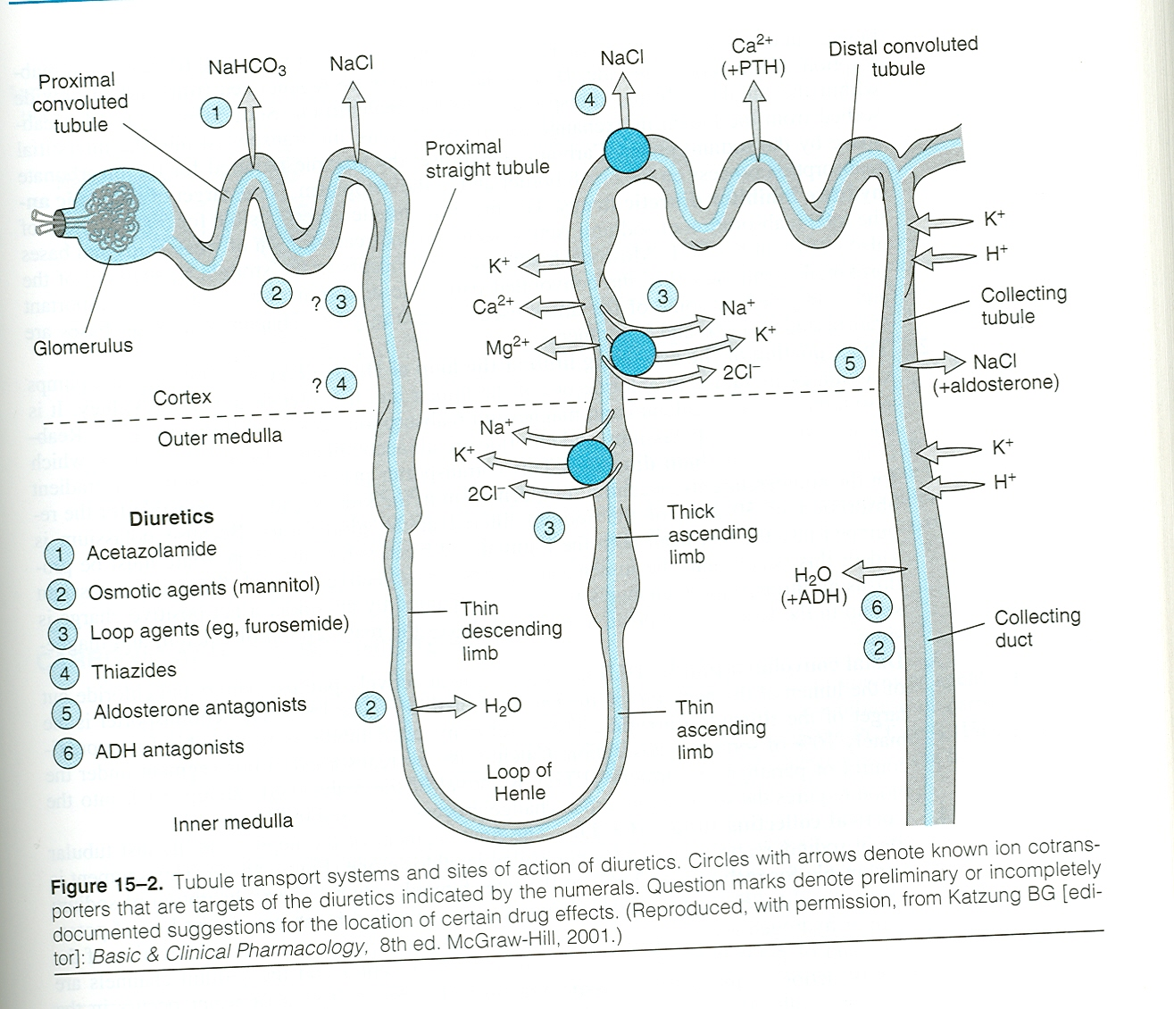

Slide 7
Classification of Diuretics
The best way to classify diuretics is to look for their Site of action in the nephron
A) Diuretics that inhibit transport in the Proximal Convoluted Tubule (Osmotic diuretics M; Carbonic Anhydrase Inhibitors)
B) Diuretics that inhibit transport in the Medullary Ascending Limb of the Loop of Henle (Loop diuretics)
C) Diuretics that inhibit transport in the Distal Convoluted Tubule(Thiazides : Indapamide ; Metolazone)
D) Diuretics that inhibit transport in the Cortical Collecting Tubule (Potassium spring diuretics)

Slide 8
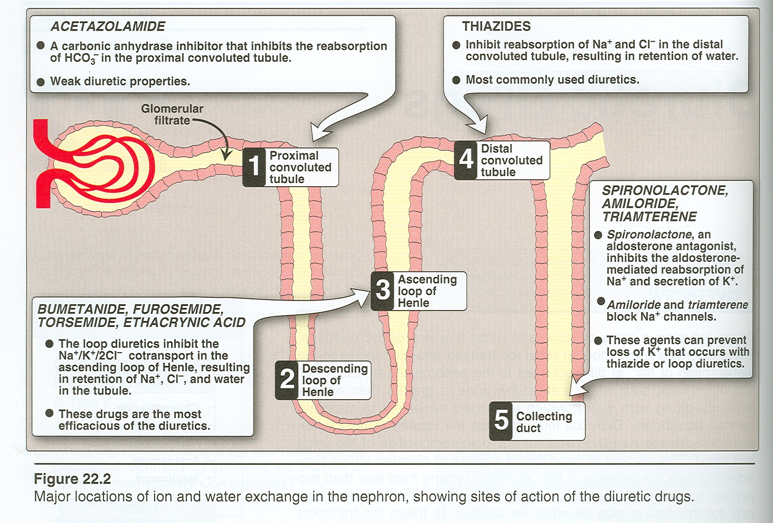

Slide 9
A. Diuretics that inhibit transport in the Convoluted Proximal Tubule
Osmotic Diuretics (e.g.: Mannitol)
MOA: They are hydrophilic compounds that are easily filtered
through the glomerulus with little re-absorption and thus
increase urinary output via osmosis..
PK: Given i.v
Can it be given orally?
Indications:
- to decrease intracranial pressure in neurological condition
- to decrease intraocular pressure in acute glaucoma
- to maintain high urine flow in acute renal failure
during shock

Slide 10
Adverse Reactions of Manitol:
- Extracellular water expansion and dehydration
- Hypernatremia due to loss more water than sodium
Can you conceder Osmotic Agents as good Diuretics?

Slide 11
Carbonic Anhydrase Inhibitors (Acetazolamide (Oral) ; Dorsolamide (Ocular) ; Brinzolamide (Ocular)
MOA see figure 2-4) Simply inhibit reabsorption of sodium and bicarbonate by inhibiting carbonic anhydrase
What are the Compensatory?
Side Effects:
- Hyperchloremic Acidosis
-Hypokalemia
- Renal Stone How?
-Drowsiness and parwthesia at high doses
Contraindication:
Hepatic failure due to decrease elimination of ammonium

Slide 12
Clinical Uses of Carbonic Anhydrase Inhibitors:
Why Acetazolamide is not used as a diuretic ?
Glaucoma Mechanism?
Alkalization of urine and metabolic alkalosis.
Epilepsy; Benign intracranial hypertension
Acute mountain sickness
What are the differences between acetazolamide and dorzolamide or brinzolamide? Oral vs Topical

Slide 13
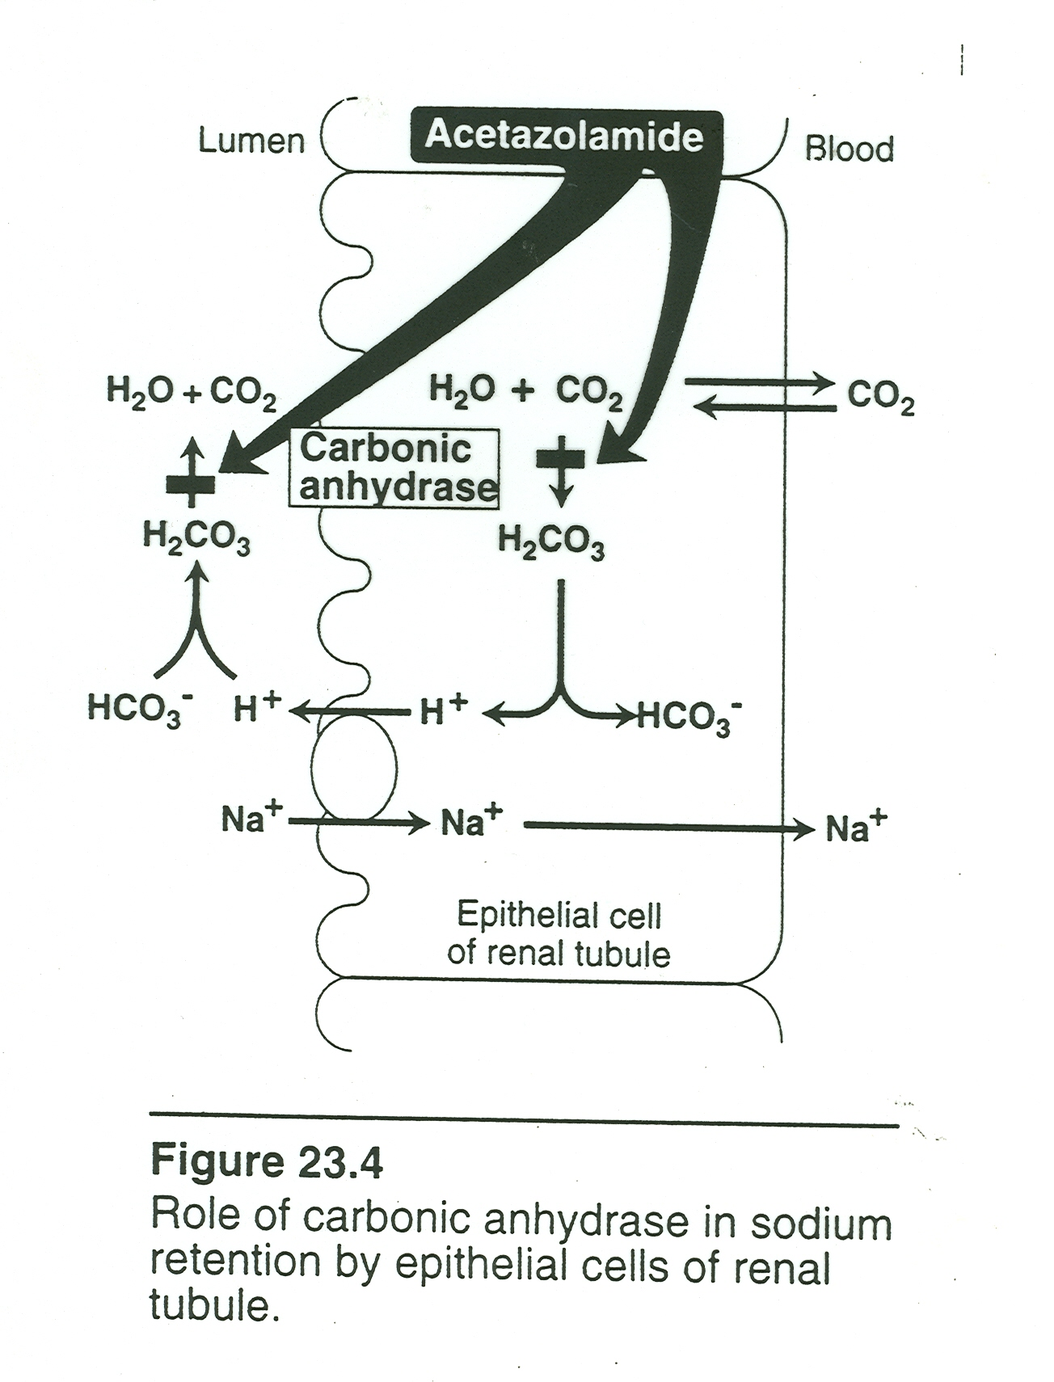

Slide 14
Side Effects of Acetazolamide:
Sedation and drowsness; Hypersensitivity reaction Why?; Renal stone , Acidosis; Hyperchloremia, hyponatremia and hypokalemia

Slide 15
B. Diuretics Acting on the Thick Ascending Loop of Henle (loop diuretics) High ceiling
e.g. Furosemide (Lasix^{R}), Torsemide, Bumetanide (Burex^{R}), Ethacrynic acid.
Phrmacodynamics:
Mechanism of Action : Simply inhibit the coupled NA/K/2Cl transport in the loop of Henle. Also, they have potent pulmonary vasodilating effects (via PGs).
What are the compensatory mechanisms?
Why furosemide is a better diuretic than acetazolamide despite the fact that only 25% of the reabsorption occurs at the ascending loop of Henle?

Slide 16
Side effects:.
Note: most of them are consequenses of the compensotory mechanism
Ototoxicity; Hypokalemic metabolic alkalalosis; hypocalcemia and hypomagnesemia; hypochloremia; Hypovolemia; hyperuricemia (How?); hypersensitivity reactions.
Therapeutic Uses
a) Edema (Like What?)
b) Acute renal failure
c) Hyperkalemia Why?
d) Hypercalcemia

Slide 17
What are the differences between furosemide and torsemide?
Simply oral torsemide considers as i.v of furesemide. Because only 50% of furesemide is absorped in the intestine.
What are the advantages of bumetanide (Bumex) over that of furosemide? Potent (40 times) with very fast onset and short duration.
Dosage of loop diuretics:
Furosemide 20-80 mg
Torsemide 2.5-20 mg
Bumetanide 0.5-2.0 mg
4. Drug interactions: NSAIDs

Slide 18
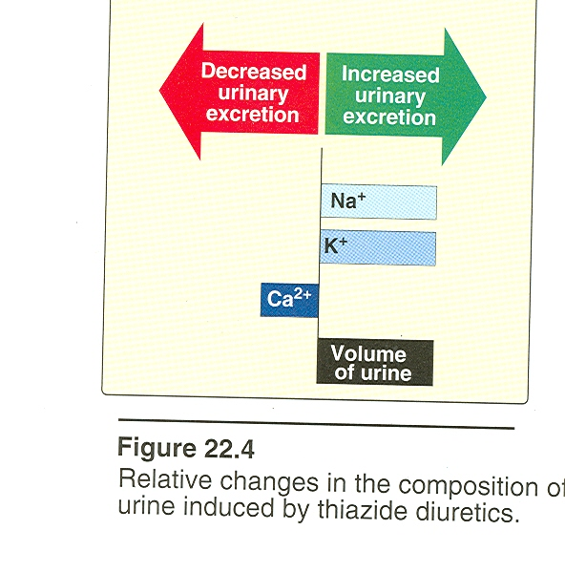
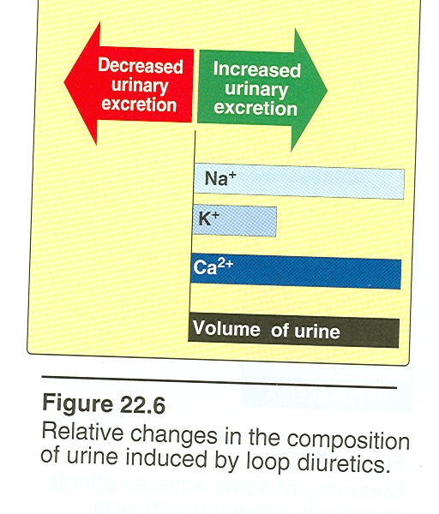

Slide 20
C. Diuretics that Inhibit Transport in the Distal Convoluted Tubule (e.g.: Thiazides and Thiazide-like (Indapamide; Metolazone)
History of Thiazides
Pharmacodynamics:
MOA: Inhibit Na⁺ via inhibition of Na⁺/Cl⁻ cotransporter?
What are the compensatory mechanisms?
Side effects:
How do thiazides differ from furosemide in their side effects?
No ototoxicity; hypercalcemia due to PTH, more hyponatremia; hyperglycemia How? hyperlipidemia and hyperurecemia

Slide 21
Clinical uses:
a) Hypertension Drug of Choice
(Hydrochlorthiazide; Indapamide (Natrilex^{R})
b) Refractory Edema together with the Loop diuretics (e.g. Metolazone).
c) Nephrolitiasis due to idiopathic hypercalciuria (Renal stone) and hypocalcemia.
d) Nephrogenic Diabetes Insipidus. How?
How does indapamide differ from thiazides?
What is metolazone?

Slide 22
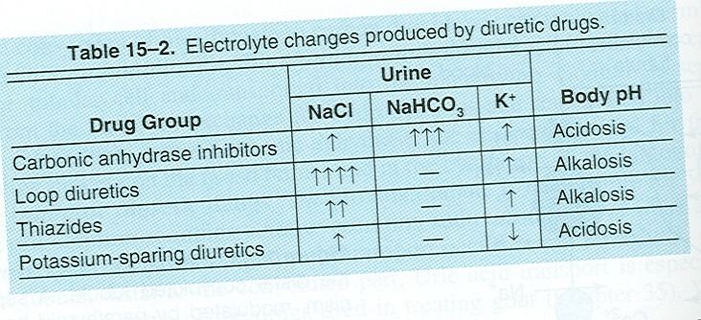

Slide 23
D. Diuretics that inhibit transport in the Cortical Collecting Tubule (e.g. potassium sparing diuretics).
Why does the natriuretic activity of this group has limited range (less than 5%) but d. clinically very important.?

Slide 24
Classification of Potassium Sparing Diuretics:
A) Direct antagonist of mineralocorticoid receptors (Aldosterone Antagonists e.g spironolactone (Aldactone^{R}) or
B) Indirect via inhibition of Na⁺ flux in luminal membrane (e.g. Triametrene, Amiloride)

Slide 25
Spironolactone (Aldactone^{R})
Synthetic steroids acts as competitive antagonist of adlosterone with slow onset of action.
MOA: Aldosterone enhance K⁺ secretion by increasing Na⁺/K⁺ ATPase and the same for H⁺ . Therefore, Spironolactone binds to mineralocorticoid receptors this leads to ???

Slide 26
Clinical Uses of K⁺ sparing Diuretics:
As diuretics in states of primary mineralocorticoid excess (e.g. Conn’s syndrome; Ectopic ACTH production) or to secondary aldosteronism from CHF; Hepatic Cirrhosis , Nephrotic syndrome).
To overcome the hypokalemic action of diuretics
Hirsutism How?

Slide 27
Side effects:
Hyperkalemia (increases ) some times useful?
Hyperchloremic metabolic acidosis
Antiandrognic effects (e.g. gynecomastia, impotence) with spironolactone , kidney stone with Triametrene
Diuretics Combination preparations
Examples:
Dyazide^{R} = Triametrene 50 mg + Hydrochlorothiazide HCT 25 mg
Aldactazide^{R}= Spironolactone 25 mg + HCT 25 mg
Moduretic^{R} = Amiloride 5 mg + HCT 50 mg
Why?
Note : thiazides should always be there
Contraindications: Oral K administration

Slide 29
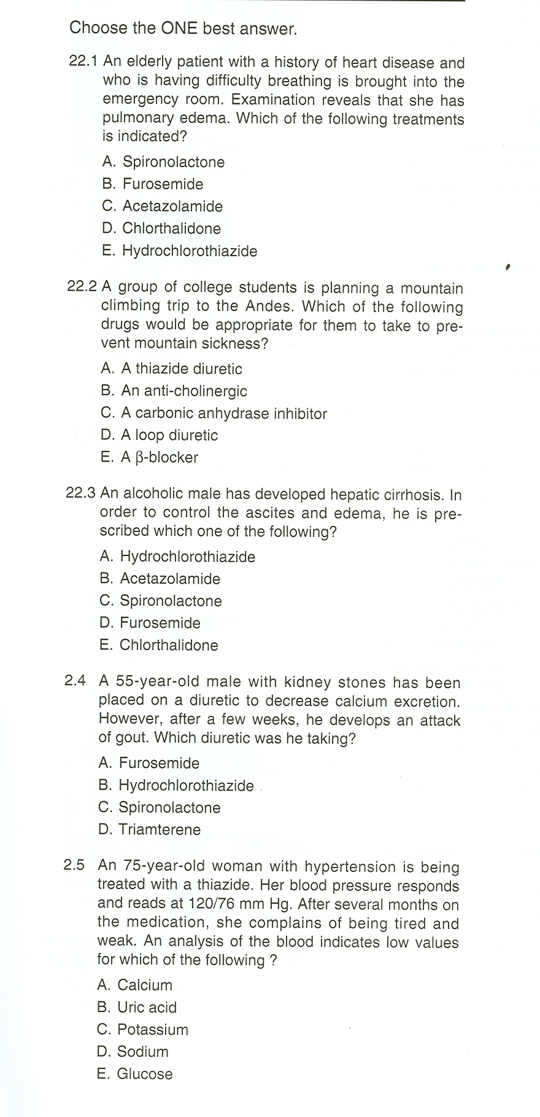

Slide 30
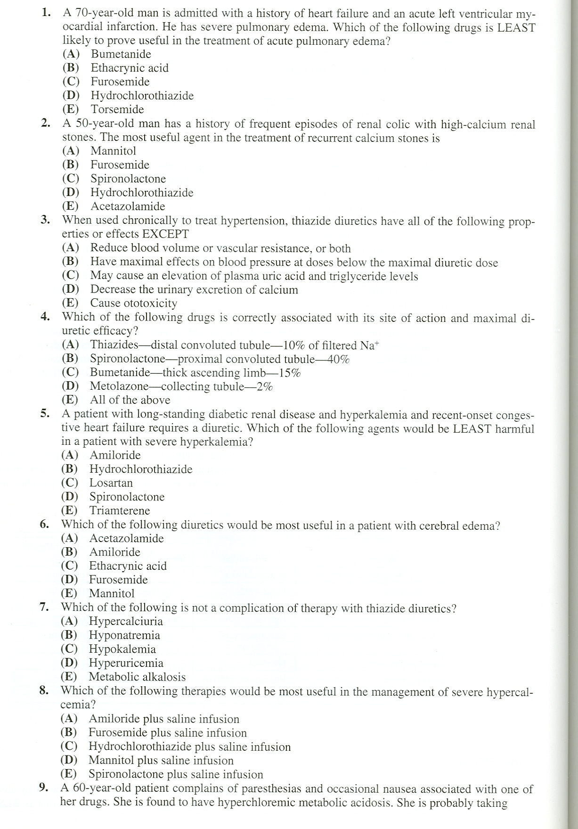

Slide 31
