Slide 1
Renal Functions
Guyton 26,27,28
Dr Sitelbanat Awadalla

Slide 2
Objectives
At the end of this lecture student should be able to describe:
Physiologic anatomy of Urinary system
Functions of the kidney
Structure, Parts and Types of Nephrons
Juxtaglomerular Apparatus
Blood Supply and innervation

Slide 3
Renal System
3

Slide 4
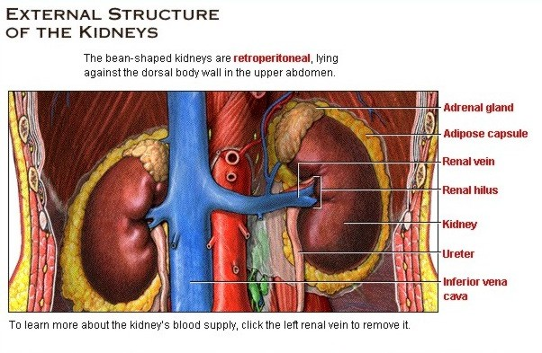
4

Slide 5
Kidney functions
1. Homeostatic function
Regulates:
Osmolality of ECF
Plasma ions concentration
ECF volume
Arterial blood pressure
Acid-base balance
5

Slide 6
Kidney Functions Cont
2.Excretion
Metabolic end products
Urea, creatinine, uric acid, bilrubin
Foreign substances
drugs, toxins
6

Slide 7
Kidney Functions Cont
3. Biosynthesis
Renin
Erythropoietin
Calciferol (1,25 dihydroxy Vit. D)
Glucose (gluconeogenesis) angiotensinogen, ammonia
Prostaglandins, adenosine, endothelin, nitric oxide, bradykinin
7

Slide 8
Macroscopic structure of the kidney
Renal capsule
Cortex
Medulla – pyramid – papilla
Pelvis – major & minor calyxes
Ureter
bladder
8
Notes:
8

Slide 9
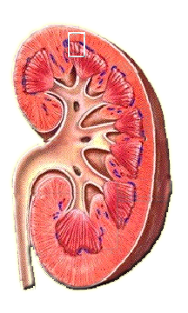
Macroscopic Structure of the Kidney
human kidney is composed of three regions: the renal cortex, medulla, and pelvis.
Renal cortex
Renal pyramid
Renal pelvis
Renal medulla
Ureter
9
Notes:
9

Slide 10
Microscopic structure
Nephron is the basic unit of the kidney
Each kidney consist of 10⁶ nephrons
All kidney functions are performed by nephron
Nephron is a blind tube consist of 5 different regions
10
Notes:
10

Slide 11
Nephron
Glomerulus
Bowman capsule
Tuft of capillary
Proximal convoluted tube (PCT)
Loop of Henle
Descending – thin
Ascending
1/3 thin
2/3 thick
Distal convoluted tubule (DCT)
Collecting duct
11
Notes:
11

Slide 12
Types of nephron
Cortical nephrons
Juxtamedullary nephrons
12
Notes:
12

Slide 13
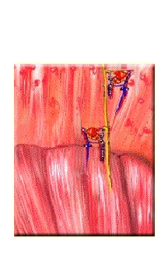
Types of Nephron
cortical nephrons in the cortex
juxtamedullary nephrons in both the cortex and the medulla
Renal cortex
Cortical nephron
Juxtamedullary nephron
Renal medulla
13
Notes:
13

Slide 14
Cortical vs juxtamedullary nephron
1. Cortical
85%
Outer cortex
Larger glomerulus
Short loop
Peritubular capillary blood supply
Juxtamedullary
15%
Deep in the cortex
Small glomerulus
Long loop
Vasa recta
14
Notes:
14

Slide 15
Juxtaglomerular appartus
Junction between thick limb & afferent of its glomerulus
Tall columnar cells in tubule (macula densa)
Granular cells on afferent (renin)
15
Notes:
15

Slide 16
16
Notes:
16

Slide 17
Renal circulation
Renal artery
Segmental branch
Interlobar
Arcuate
Interlobular
Afferent arteriole
Glomerular capillary
Efferent arteriole
Peritubular capillary
17

Slide 18
18
Notes:
18

Slide 19
Renal circulation cont
RBF=
1.2 l/min
(25% of C.O.)
Cortical blood flow > Medallary flow
Cortical blood flow meant for filtraion
19
Notes:
19

Slide 20
Renal innervation
Renal plexus sympathetic
Vasomotor regulate renal blood flow
Parasympathetic
20
Notes:
20

Slide 21
Summary
Function
Component of Renal System
Macroscopic Structure of kidney
Nephron; structure, types
Blood supply & Innervation
Juxta-glomerular apparatus
21
Notes:
21

Slide 22
22
Notes:
22

