Slide 2
MICTURITION REFLEX
Prof. ASHRAF HUSAIN

Slide 3
Micturition or urination is the process of emptying urinary bladder when it is full.

Slide 4
FUNCTIONAL ANATOMY OF THE BLADDER

Slide 5
Main organs involved are;
urinary bladder and urethra.
A--- URINARY BLADDER;
The smooth muscle of the bladder is known as detrusor muscle .when contracts expels urine out which is a major step in micturition reflex.
The ureters enters the bladder oliquely through the detrusor muscle.
In the posterior wall of the bladder there is a small triangular area--- TRIGONE.
Lower most apex of trigone the bladder opens into the urethra and the two ureters enter at the uppermost angles of the trigone.

Slide 6
URETHRA; is 2 to 3centimeters long guarded by two sphincters;
Internal sphincter is composed of detrusor muscle. It is not like other sphincter and not circular but forms loop around urethra. It prevents emptying of bladder and is entirely smooth muscle. This effect is not very strong.
External sphincter; is made up of voluntary skeletal muscle. This voluntary control prevent
Urination even involuntary control is forcing to empty the bladder.

Slide 7
Micturation mechanism involves two main steps
A--- Storage or filling of urine in urinary bladder.
B--- Emptying of bladder; this is a nervous reflex known as micturition reflex
Note; it involves coordination between autonomic ,somatic( motor) and central nervous system

Slide 8
Micturition Reflex

Slide 9
Autonomic innervation

Slide 10
Vesicovesical reflex (Spinal reflex)

Slide 11
Voluntary(motor) control of
external sphincter

Slide 13
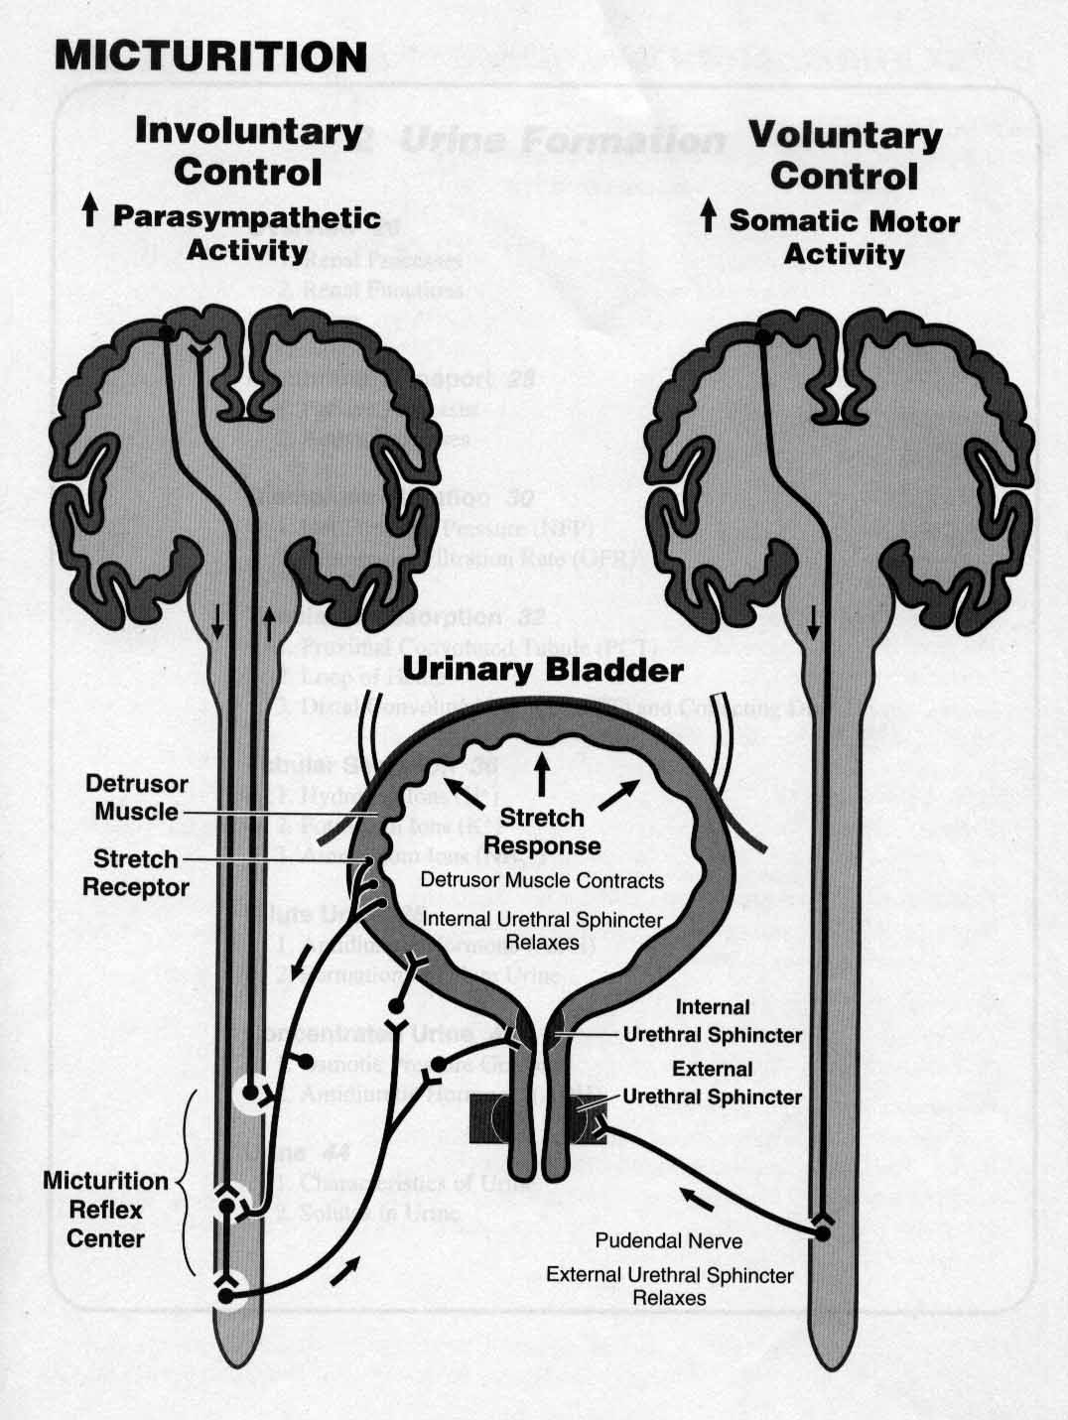

Slide 14
HIGHER CONTROL
The higher centers ordinarily keep the reflex partially inhibited except when micturition is desired.
Higher center can prevent the reflex by tonic contraction of external bladder sphincter through the pudendal nerves until a convenient time.
the cortical centers facilitate the sacral micturition center to initiate the reflex and inhibit external urinary sphincter so that urination can occur.

Slide 15
SUPRA SPINAL CONTROL
Micturition is a vesicovesical reflex which is facilitated and inhibited by higher cortical and pontine micturition center.
1. PONTINE CENTER;
L or lateral center;
Spinoreticular fiber synapse in the L nucleus of pons and then it activates onuf’s nucleus in the sacral spinal cord thereby closing tightly external urinary sphincter. This onuf’s nucleus is situated in the anterior horn of the spinal cord and through the pudendal nerve it supplies the external urinary sphincter.

Slide 16
SUPRA SPINAL CONTROL (cont…)
M: medial pontine center.
It projects to the intermediolateral column of the spinal cord. When stimulated it produces a decrease in urethral pressure and rise in the detrossor muscle pressure causing emptying of the bladder.
Note: pontine centers take 2-3 yrs. to develop hence there is automatic emptying of bladder.
In adult 300-400 ml of urine normally required to initiate this reflex.

Slide 17
Higher cortical control
Cerebral cortex for example paramedian lobule present on the medial surface of frontal lobe.
Hypothalamus it is one of the highest center of autonomic control is also involved.

Slide 18
Role of higher centers in micturition reflex.
Higher centers keep the micturition reflex partially inhibited except when micturition is desired.
It prevents micturition even if micturition reflex is operating by tonic contraction of external sphincter (pudendal nerve) until a convenient time is found.
When it is time to urinate cortical center can facilitate the sacral micturition centers to help and initiate a micturition reflex at the same time it inhibits the external urinary sphincter hence it is relaxed causing urination.

Slide 19
To remember…..
Sympathetic supply to the bladder cause storage of urine.
Parasympathetic supply leads to the Passage of urine.

Slide 21
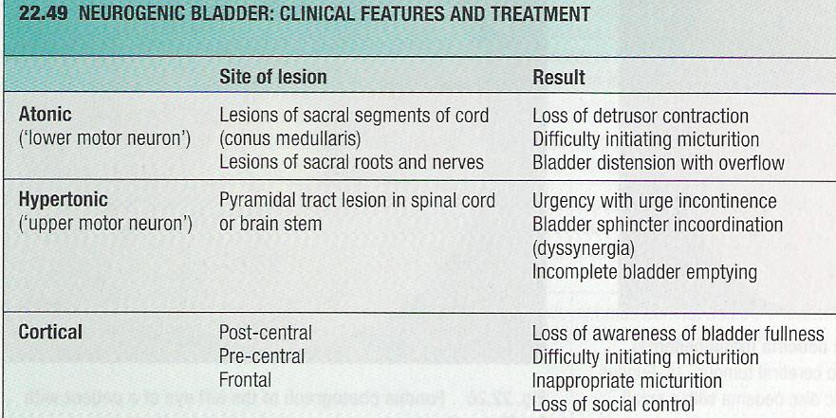

Slide 22
Effects of Deafferentation
Damage Site: When the sacral dorsal roots (Afferents) are interrupted by diseases of the dorsal roots, such as tabes dorsalis and long standing DM
Features: Reflex contractions of the bladder are abolished. The bladder becomes distended, thin-walled, and hypotonic, but some contractions occur because of the intrinsic response of the smooth muscle to stretch.

Slide 23
Effects of Denervation
Damage Site: When the afferent and efferent nerves are both destroyed, as they may be by tumors of the cauda equina or filum terminale,
Feature: the bladder is flaccid and distended for a while. Gradually, however, the muscle of the "decentralized bladder" becomes active, with many contraction waves that expel dribbles of urine out of the urethra. The bladder becomes shrunken and the bladder wall hypertrophied.
Notes:
The reason for the difference between the small, hypertrophic bladder seen in this condition and the distended, hypotonic bladder seen when only the afferent nerves are interrupted is not known. The hyperactive state in the former condition suggests the development of denervation hypersensitization even though the neurons interrupted are preganglionic rather than postganglionic (see Clinical Box 38–4).

Slide 24
Effects of Spinal Cord Transection
Damage Site: Spinal Cord injuries (Paraplegia)
Feature: During spinal shock, the bladder is flaccid and unresponsive. It becomes overfilled, and urine dribbles through the sphincters (overflow incontinence). After spinal shock has passed, the voiding reflex returns, with no voluntary control and no inhibition or facilitation from higher centers. Sometime voiding reflex becomes hyperactive called spastic neurogenic bladder.
Notes:
Some paraplegic patients train themselves to initiate voiding by pinching or stroking their thighs, provoking a mild mass reflex (see Chapter 16).
In some instances, the voiding reflex becomes hyperactive, bladder capacity is reduced, and the wall becomes hypertrophied. This type of bladder is sometimes called the spastic neurogenic bladder. The reflex hyperactivity is made worse by, and may be caused by, infection in the bladder wall.

Slide 25
ABNORMALITIES OF URINE AND ITS CONSTITUENTS

Slide 26
Polyuria= large urinary volume in 24 hrs
Oliguria=diminished urine volume per 24 hrs ( less than 300ml of urine formation per day)
Anuria= negligible urine per day
Nocturia= frequent micturation in night
Haematuria= presence of rbc in urine a few red cells may be found eg mensturation.

Slide 28
Proteinuria=presence of protein in urine(less than 150mg per day is normal)
Over 1.5 to 2g per day is always abnormal
Microalbuminuria=30-300mgper day(early sign of diabetic nephropathy)
Nephrotic syndrome=more than 4.5 g per day results in eg ; Oedema, hypoalbuminaemia

Slide 29
Glycosuria= presence of glucose in urine,always full assessment is needed
Ketonuria= presence of ketone bodies in urine.
Dysuria=Feeling of buring or pain during urination.
Myoglobinuria= due to destruction of muscle

Slide 30
