Slide 1
Renal practical I
Dr Shaesta Naseem

Slide 2
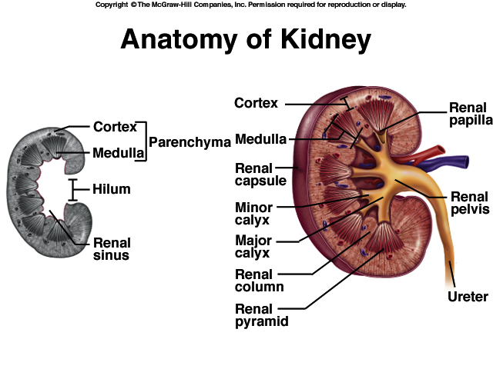

Slide 3
KIDNEY ANATOMY: NEPHRONS
NEPHRONS
FUNCTIONAL UNITS OF KIDNEY
~1.2 MILLION PER KIDNEY
THREE MAIN PARTS
BLOOD VESSELS
RENAL CORPUSCLE
RENAL TUBULE

Slide 4
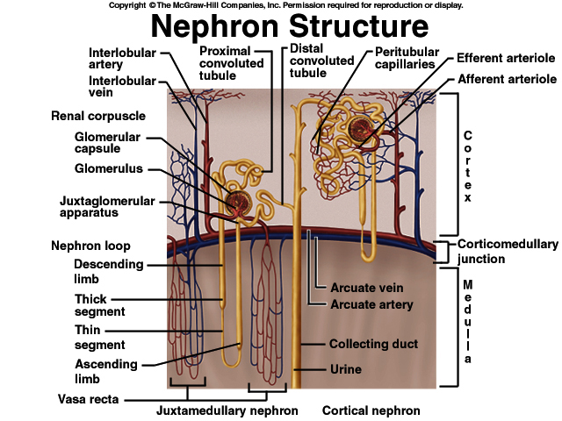

Slide 5
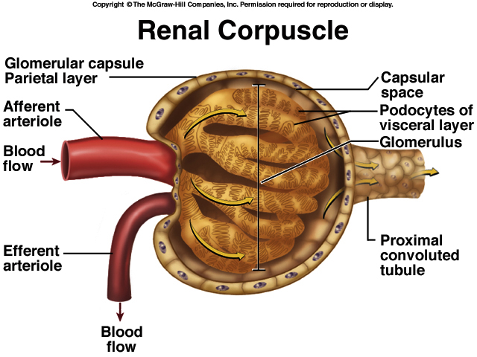

Slide 6
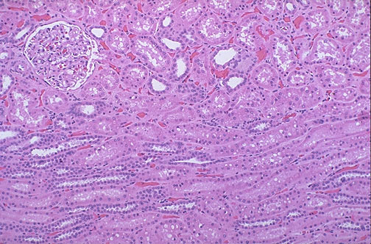

Slide 7
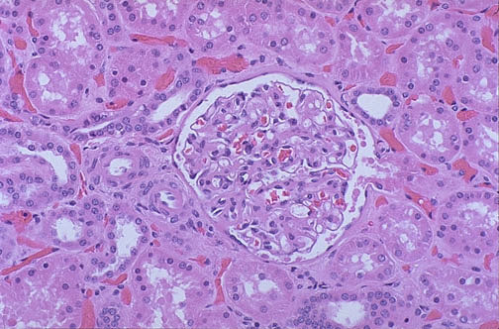
Figure 26.6

Slide 8
Gross and histopathology

Slide 9
1-Polycystic kidney

Slide 10
Adult polycystic kidney disease
The gross picture shows
markedly enlarged kidney
replacement of the renal parenchyma by numerous cysts of variable sizes .
Slide 21.9
Notes:
The pattern of inheritance for adult form is autosomal dominant and for childhood form is autosomal recessive .

Slide 11
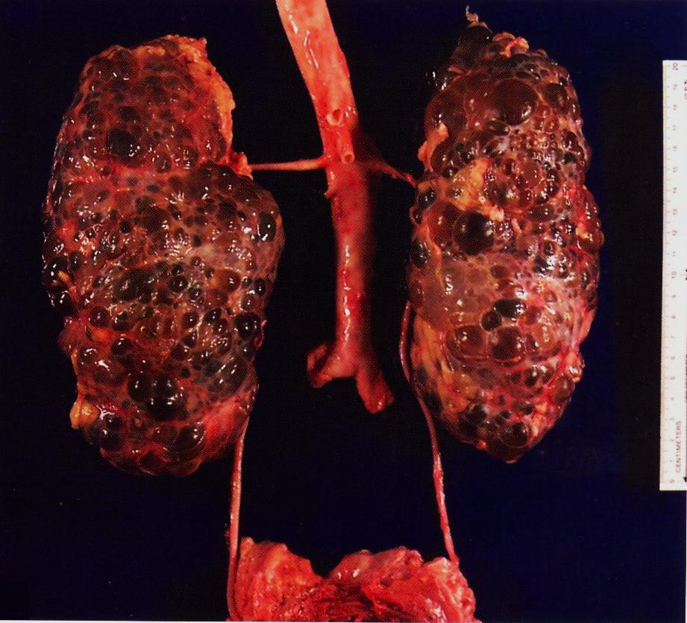

Slide 12
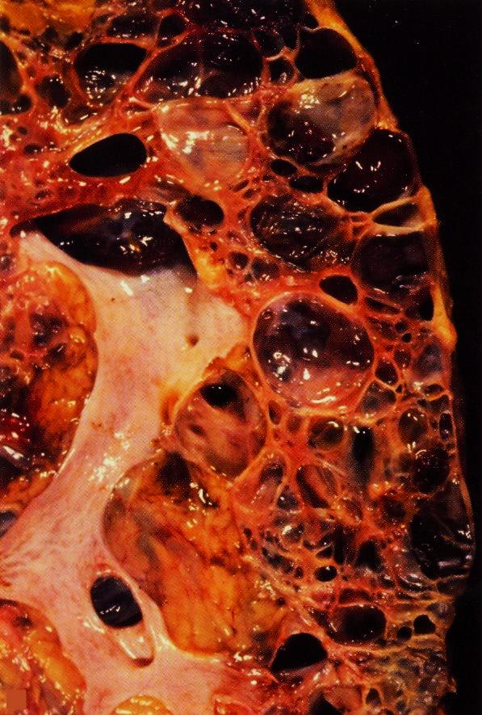

Slide 13
2-Postsreptococcal glomerulonephritis

Slide 14
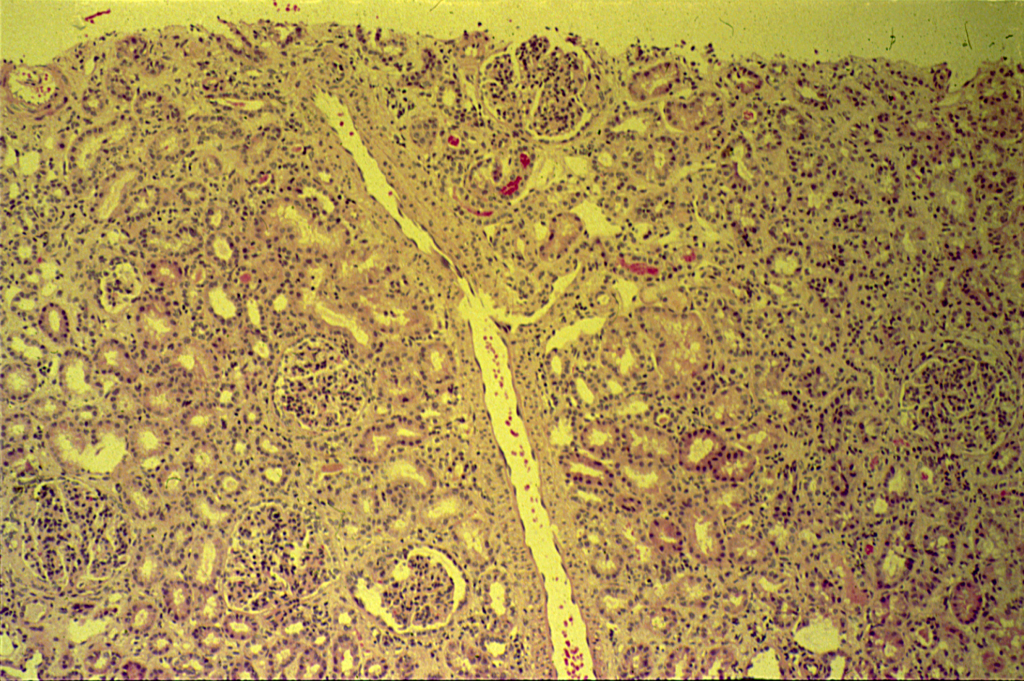
POSTSTREPTOCOCCAL GLOMERULONEPHRITIS

Slide 15
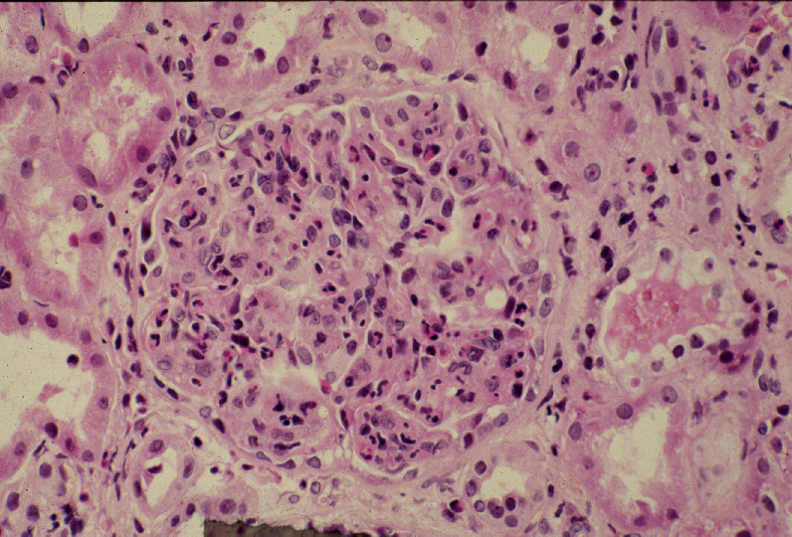
Diffuse proliferative glomerulonephritis:
High power LM of a hypercellular glomerulus; numerous capillaries contain inflammatory cells, mostly neutrophils.
Notes:
Diffuse proliferative glomerulonephritis: High power LM of a hypercellular glomerulus; numerous capillaries contain inflammatory cells, mostly neutrophils. Notice the red blood cells in a distal tubule, to the left of the glomerulus (arrow). H&E

Slide 16
Post streptococcal Glomerulonephritis
Normal glomerulus
Slide 21.22

Slide 17
Post streptococcal glomerulonephritis: Section of kidney shows:
The glomeruli are enlarged, lobulated and hypercellular with obliteration of capsular space.
Cellularity is due to proliferation of endothelial and mesangial cells with some neutrophils.
Many capillaries appear obliterated.
Tubules show degenerative changes.

Slide 18
3- Hydronephrosis

Slide 19
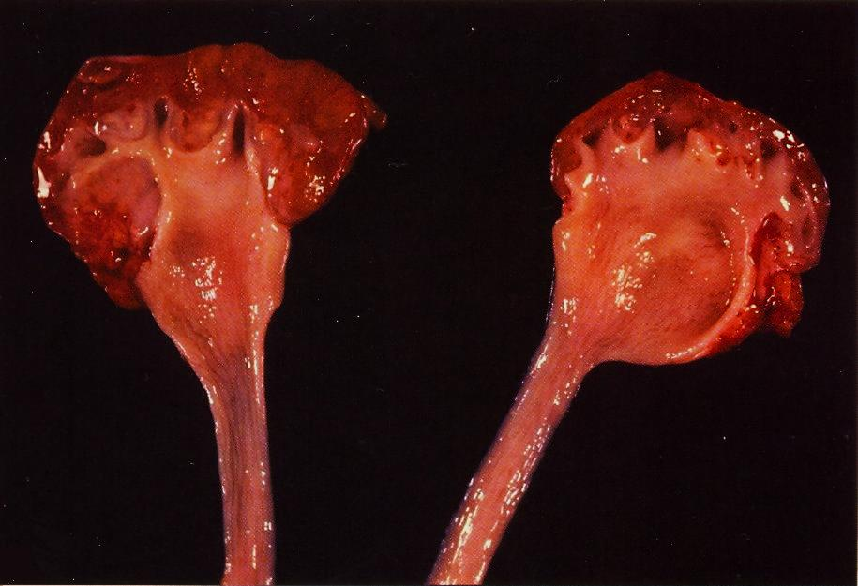
Hydronephrosis is the term used to describe dilation of the renal pelvis and calyces associated with progressive atrophy of the kidney due to obstruction to the outflow of urine
Bisected kidney shows markedly dilated renal pelvis and calyces with atrophic and thin renal cortex /parenchyma

Slide 20
The picture shows markedly dilated renal pelvis and calyces with atrophic and thin renal cortex /parenchyma
Notes:
The most common causes for hydronephrosis are foreign bodies like calculi with obstruction, atresia of the urethra , Benign prostatic hyperplasia ,carcinoma of the prostate and bladder tumours and spinal cord damage with paralysis of the bladder .

Slide 21
4- Pyonephrosis

Slide 22
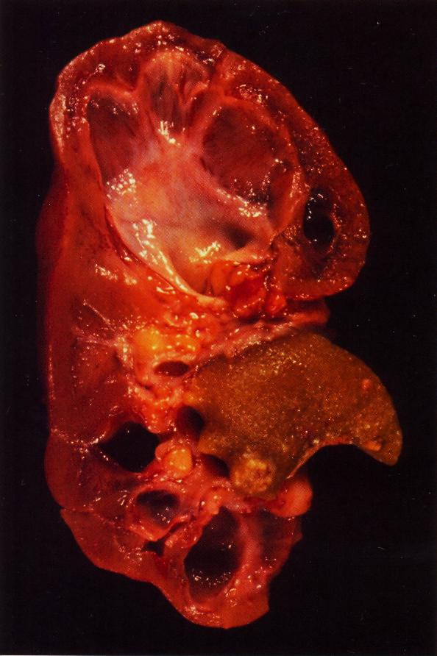
Focal hydronephrosis and pyonephrosis .
Pyonephrosis is seen when there is total or almost complete obstruction, particularly when it is high in the urinary tract.
The suppurative exudate is unable to drain and thus fills the renal pelvis, calyces, and ureter with pus

Slide 23
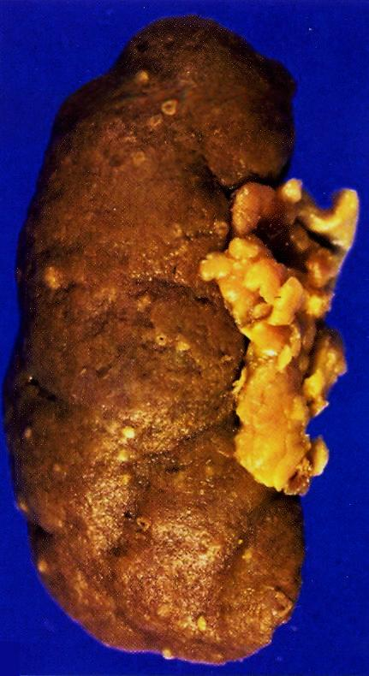
Pyonephrosis with small cortical abscesses

Slide 24
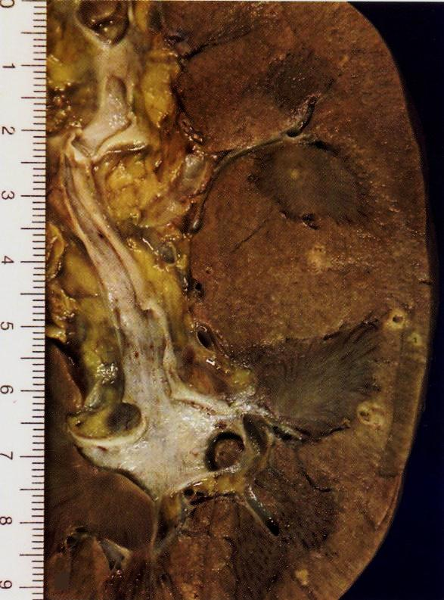
Renal cortical pyonephrosis with renal stone impacted within a calyx

Slide 25
5- Chronic pyelonephritis

Slide 26
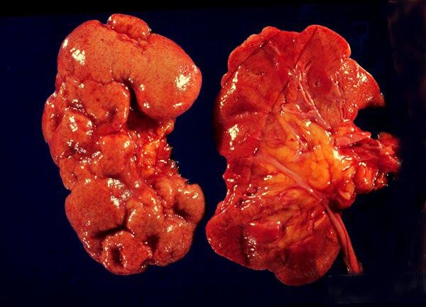
The picture shows slightly atrophic and deformed kidneys with cortical coarse scars .
Chronic pyelonephritis is a disorder in which chronic tubulointerstitial inflammation and renal scarring are associated with pathologic involvement of the calyces and pelvis

Slide 27
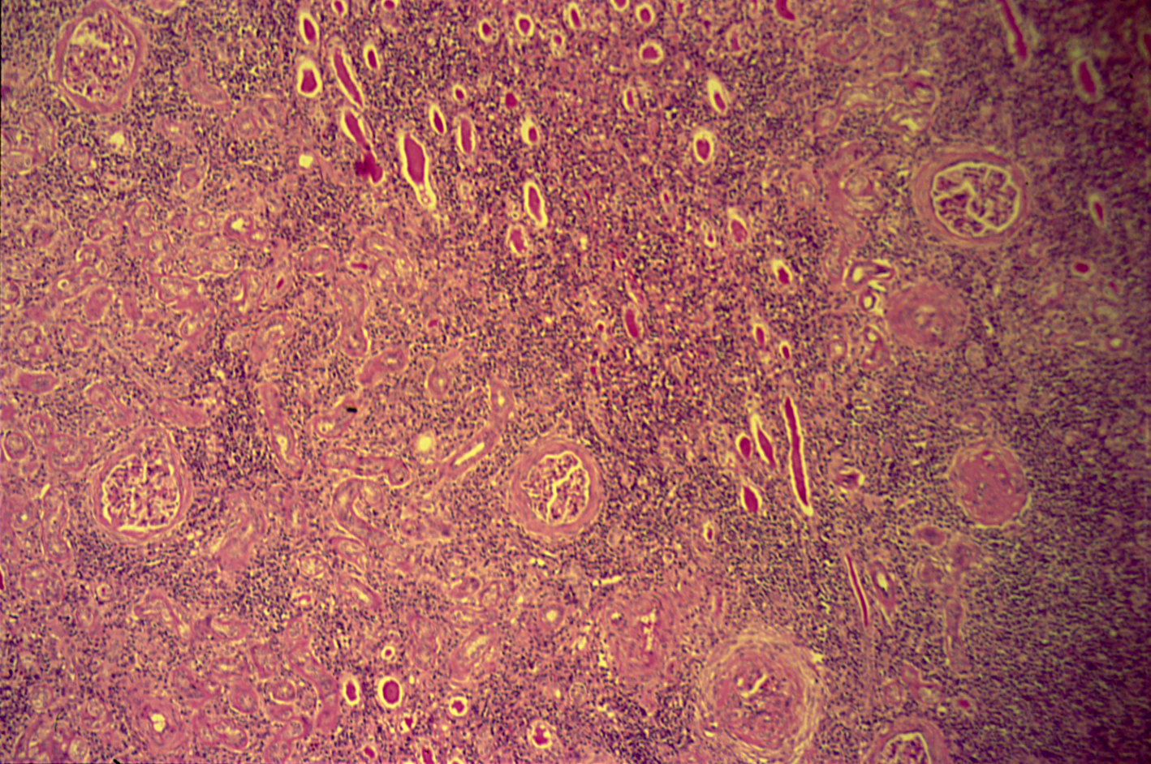
CHRONIC PYELONEPHRITIS

Slide 28
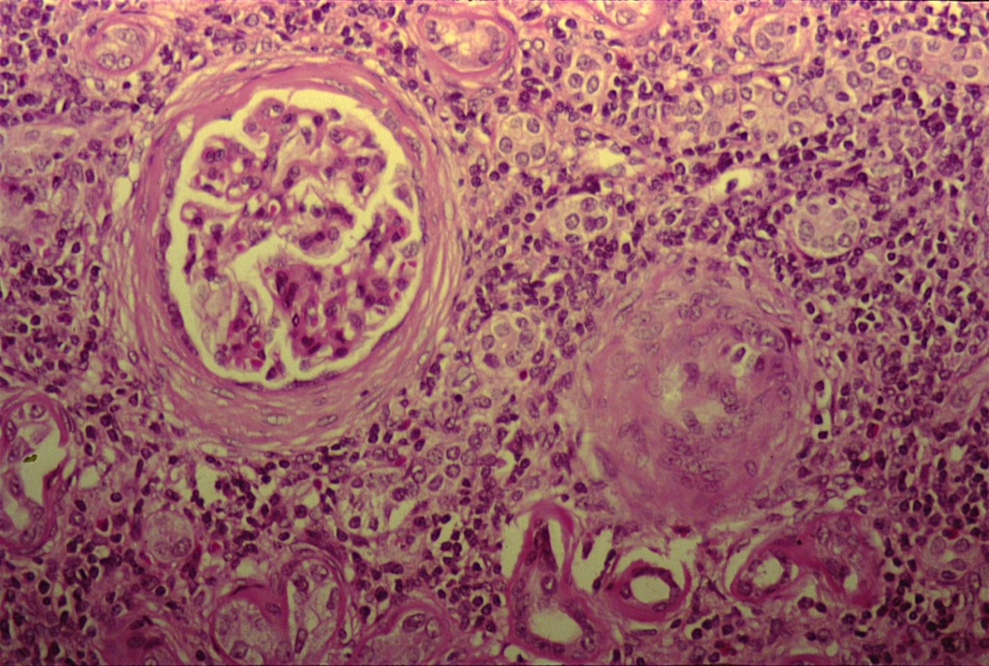
CHRONIC PYELONEPHRITIS
The picture shows periglomerular fibrosis , glomerular sclerosis and hyalinization with marked chronic interstitial inflammation
Notes:
.

Slide 29
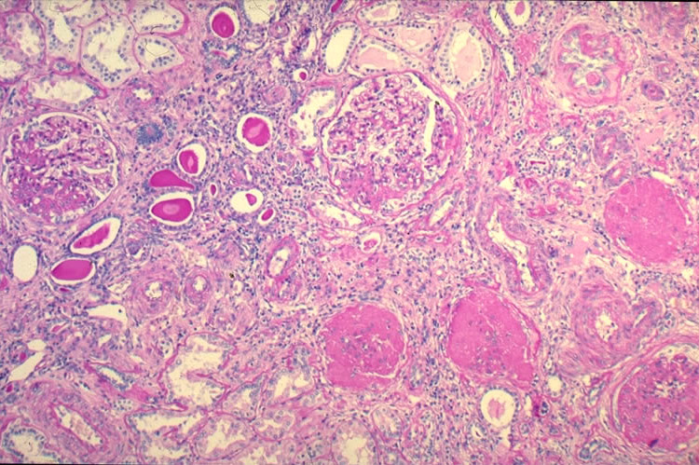

Slide 30
Chronic pyelonephritis: Section of kidney reveals that:
The glomeruli show varying degrees of sclerosis and periglomerular fibrosis.
The tubules show varying degrees of atrophy. Some tubules are dilated and filled with Eosinophilic hyaline casts resembling colloid (thyroidization).
Interstitial tissue shows chronic inflammatory cells infiltrate and fibrosis.

