Slide 1

Diuresis

Slide 2
Deprive of H2O
1
Plasma Osmolarity
2
3
Thirst
Stimulates Osmoreceptors in anterior hypothalamus
3
H2O drinking
ADH secretion from posterior pituitary
4
H2O permeability in late distal tubule and collecting duct
5a
Plsma Osmolarity Toward Normal
H2O reabsorption
5b
Urine osmolarity and urine volume
6

Slide 3
m
1
Drink H2O
Plasma Osmolarity and Volume
2
3
Thirst
Inhibits osmoreceptors in anterior hypothalamus
3
ADH secretion from posterior pituitary
H2O drinking
4
H2O permeability in late distal tubule and collecting duct
5a
H2O reabsorption and excretion
Plasma osmolarity toward Normal
5b
Urine Osmolarity and urine volume
6

Slide 4
Dieresis Experiment
Isotonic Saline (0.9%) 1 liter
Volume of E.C.F. Osmolality same (as isotonic saline) ( total solute amount
Stretch on right atrium (volume receptors in right atrium)
ANP (Atrial Natriuretic peptide
Na excretion by Kidneys

Slide 5
ANP Action
Increase in Blood flow to kidneys (due to relaxation of smooth muscles of blood vessels)
Increase in GFR
In crease in Na loss in urine
Decrease in Aldosterone
Decrease in Na reabsorption in DCT (increase in Na loss in urine)

Slide 6
Dieresis experiment
m
1 tab of Lasix (furosemide) (40mg) with 25ml of water
Action starts 1-2 hours and lasts for 4-6 hours (1/2 life of furosemide is 6hr)
Acts on thick asending limb of loop of Henle and blocks the Na-K-2Cl co-transport (called loop diuretic
Na exrection in urine and water excretion (osmotic drag)

Slide 7
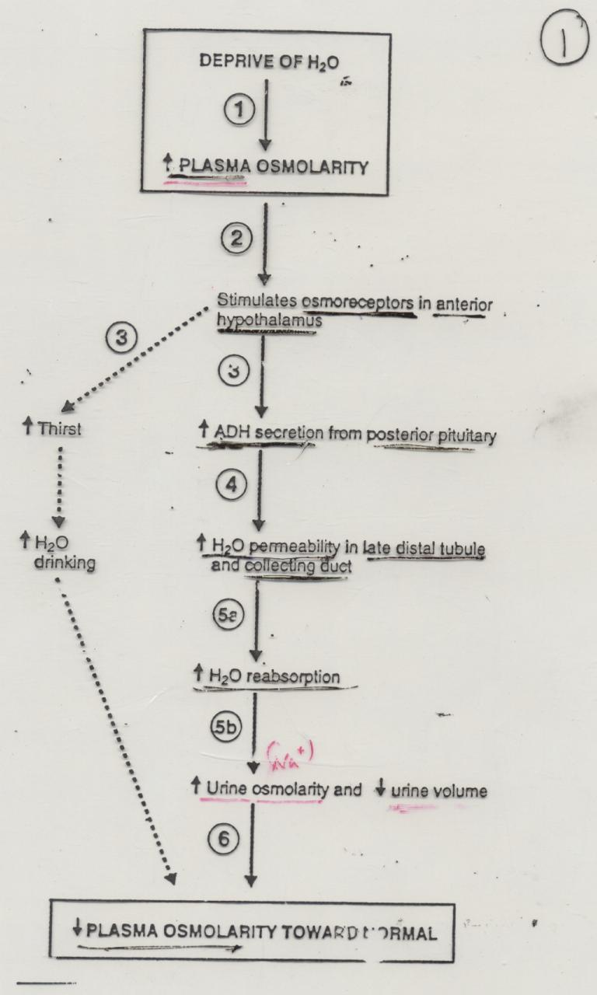

Slide 8
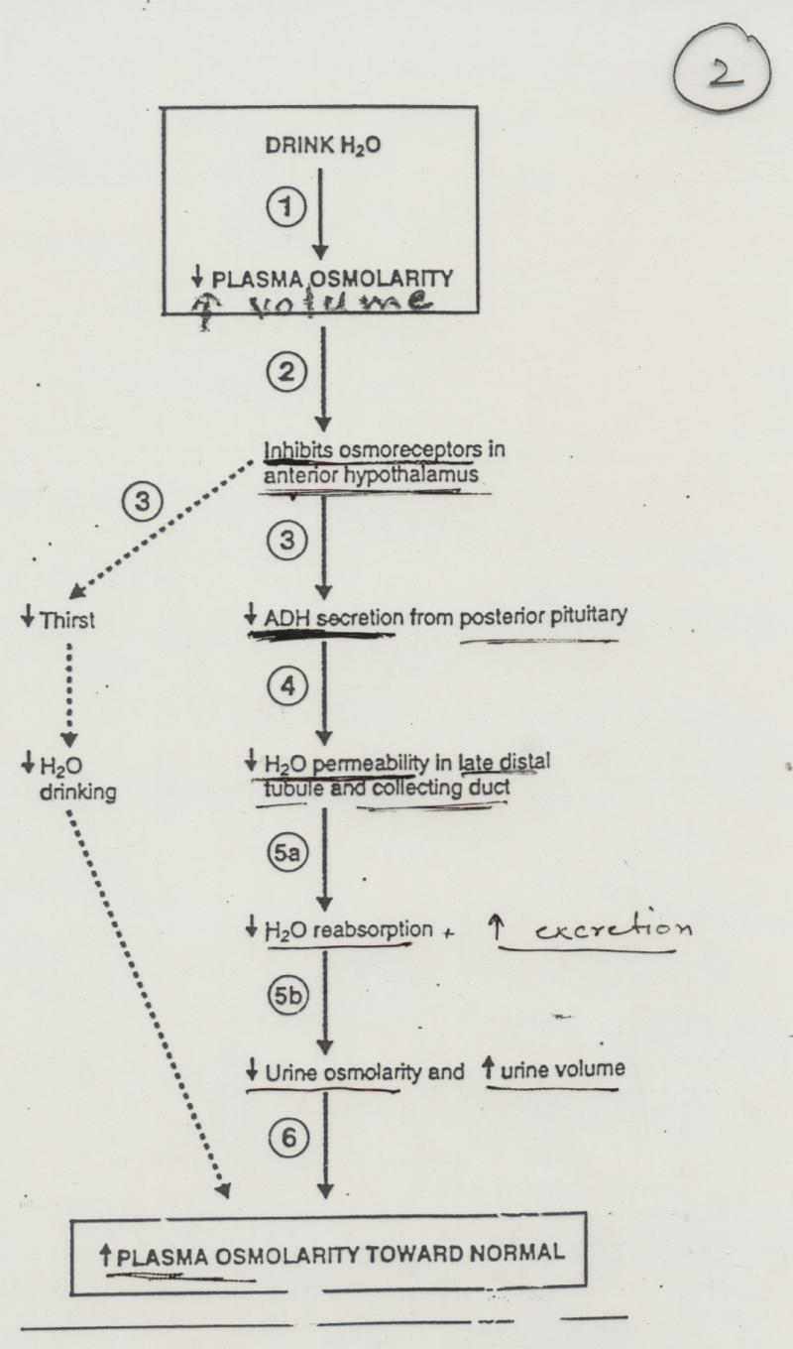

Slide 9
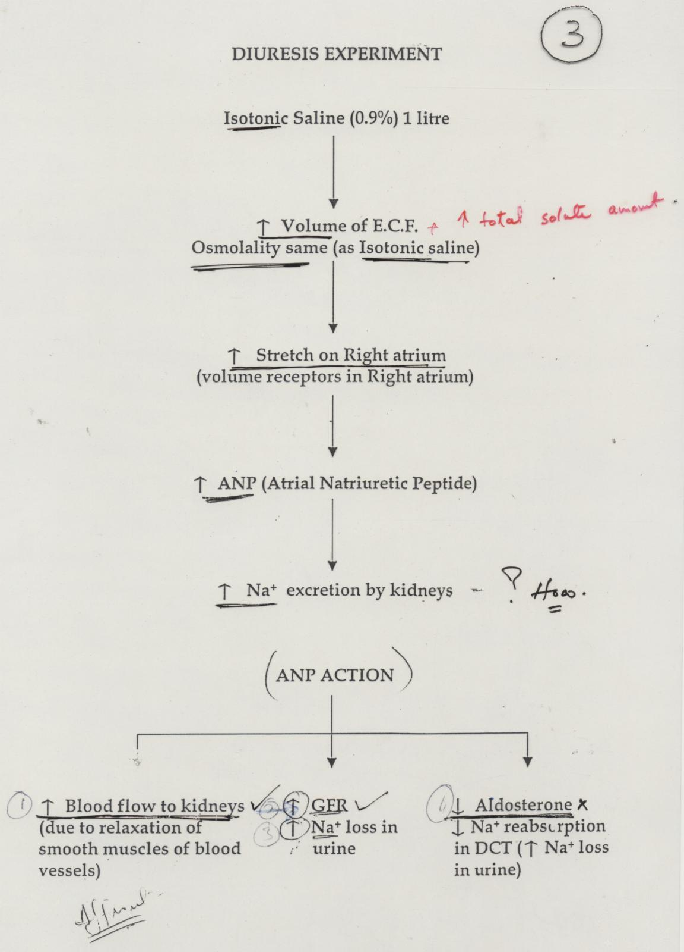

Slide 10
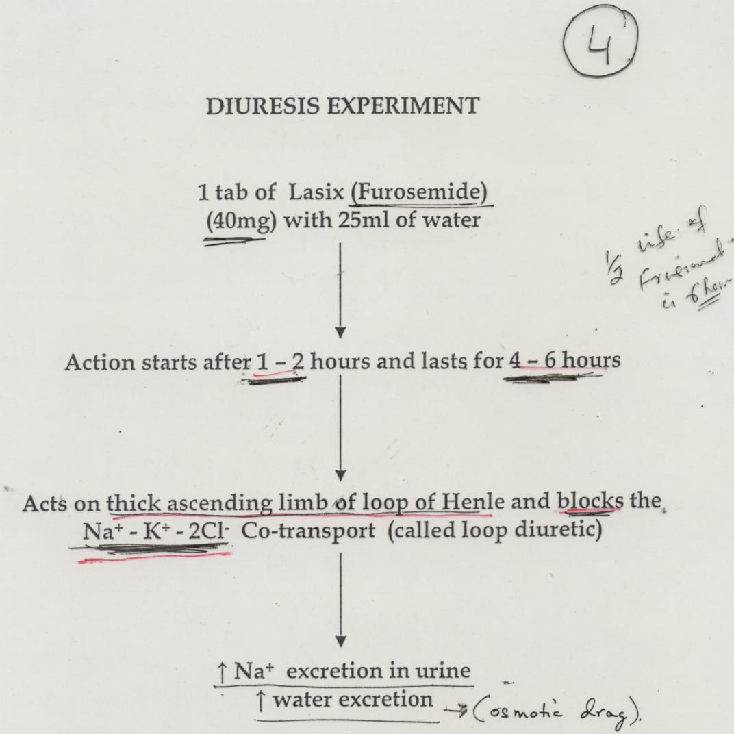

Slide 11
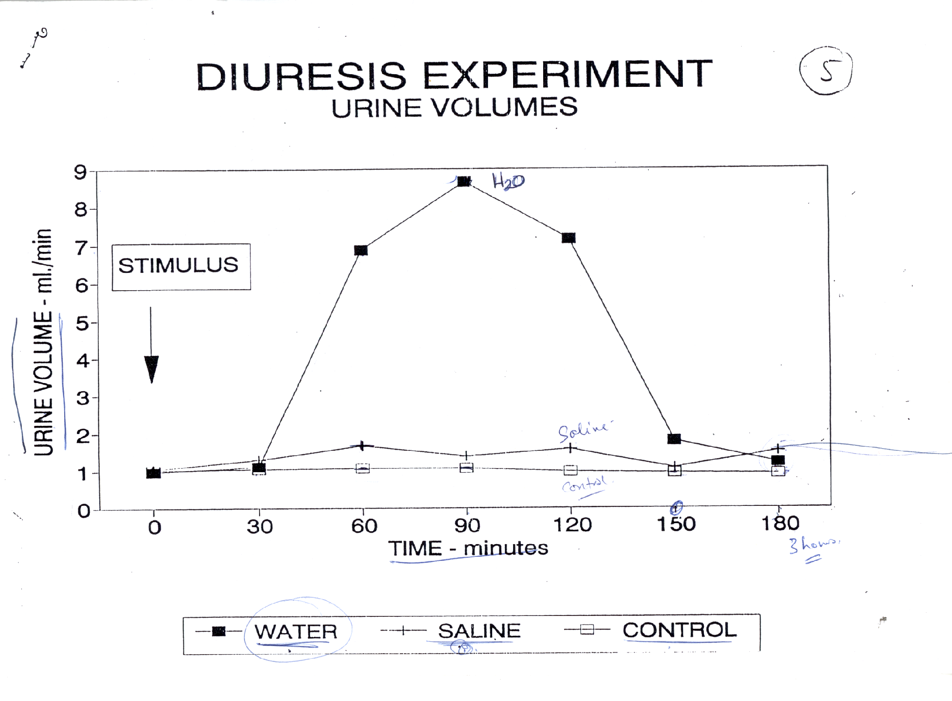

Slide 12
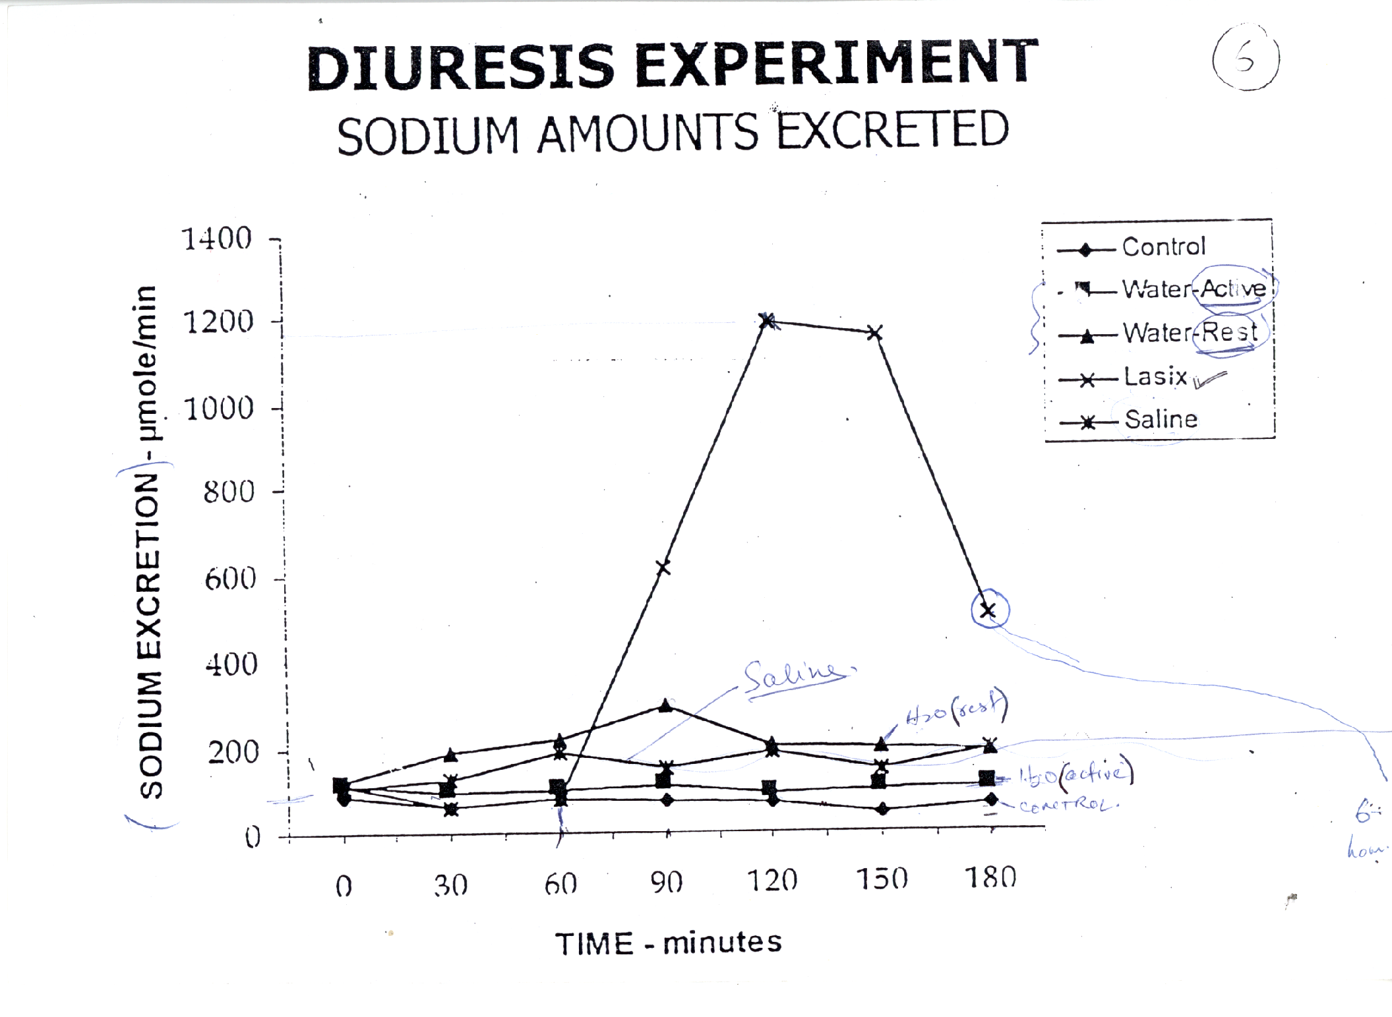

Slide 13
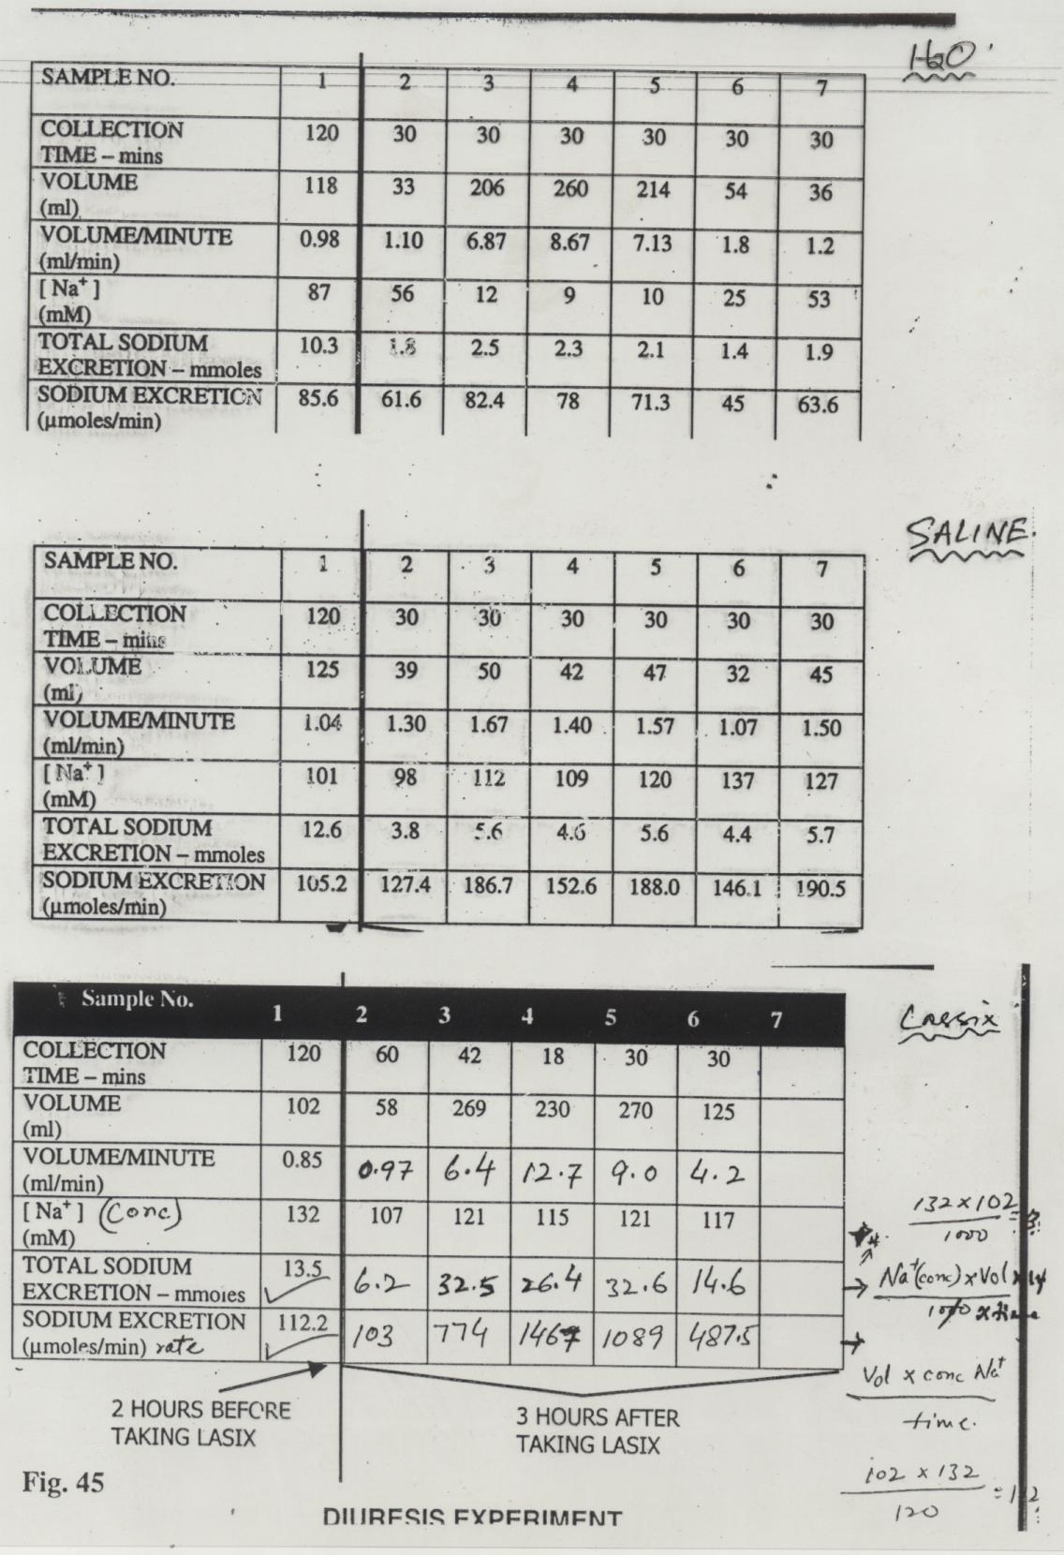
Total Na⁺ Excretion & Na⁺ Excretion Rate

Slide 14
Thank You

