Slide 1
OSPE
Ismail Raslan
&
Musab Almoshiqeh

Slide 2
Objective structured clinical/practical examination (OSCE/OSPE)

Slide 3
What is OSPE?
30 mark exam
Usually 15 stations with 2 points on each
Each station has a 10/10 score
Sometimes on paper
In some blocks its in the anatomy lab on the form of stations with 2 minutes for each station

Slide 4
Its the easiest grade you will ever get during the first 2 years
Study hard and well
Repeat what you finished more than twice
Write down when you study!!

Slide 5
Subjects?
Depends on the block
If you take a practical you will most likely get questions in the exam
If you don't you will most likely no get questions in the exam
Logical?

Slide 6
Subjects?
Anatomy
Physiology
Histology
Pathology
Microbiology
Biochemistry

Slide 7
How will they bring the questions?
Depends on the subject
Depends on your revisions
You must talk to the doctors
By “you “ I mean the leaders

Slide 8
How many questions on each subject?
Ask the medical education.
Usually the subject with more sessions will have more questions

Slide 9
Anatomy
They will provide you with slides
Ask for a revision lecture from the doctor ( professor Saeed abu almakrem preferably* )
During the revision add all his notes to the slides and study that
Its not always perfect but for foundation I’m guessing its enough

Slide 10
Anatomy questions
What pictures will they use?
80% of the time from your practical slides
Sometimes you have to refer to the theoretical slides
Usually :
Identify the organ OR structure
75%of the anatomy questions will be on identifying the organ
Name some of the relations of this structure

Slide 11
Anatomy
The more you repeat it, the better you will memorize it*.
Write down when you study.
Its better to omit answers from the slides then revise your answers after solving them, like a mock exam. ( ask your team to make this for you)
Make sure to be specific when you are answering ( right and left, etc..)

Slide 12
Identify parts of the brain marked A, B, C, D, E & F
Example 1
F
A
B
E
C
D

Slide 13
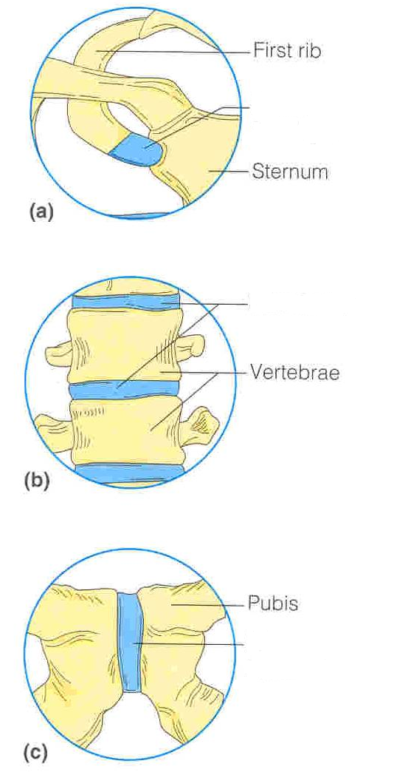
Mention the type of joint A
A
B
Mention the type of joint B
Mention the type of joint C
C
Example 2

Slide 14
Correct answers
A :
Primary cartilaginous joint.
Between sternum and first rib.
B :
Secondary cartilaginous joint.
Between the bodies of vertebae.
C :
Secondary cartilaginous joint
Symphysis pubis.

Slide 15
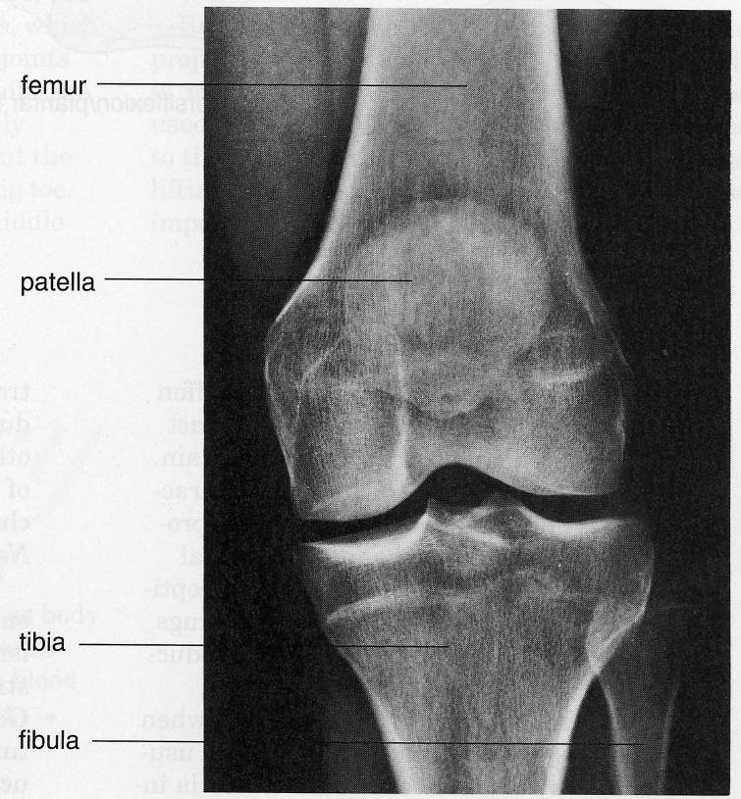
Femur
Patella
Tibia

Slide 16
Histology
They will provide you with slides when you ask for them
Ask for a revision with doctor Mohammed Ali*
He will point out the important and the not so important

Slide 17
Histology questions
Usually
Name the organ ( this section is from?) 100% question!
Name 2-4 identifying features of this slide/picture
Name the type of epithelium or lining tissue
Rarely a theoretical question ( 429 once)
Name different components of this organ/slide
For example the layers of the oesophagus
Name the distribution of this tissue ( where its found)
This is a common question for the epithelium lecture

Slide 18
Histology
Easy
Needs memorizing and repetition
Sometimes you might have to refer to your theory slides
Be VERY precise when answering
What organ – if they ask
What part of the organ

Slide 19
Case scenario
20 year old, first year student was presented with a picture of a slide of the fundus of the gallblader, he answered with fundus alone
Doctor gave him 0 points because there are 4 other funduses in the body
Stomach
urinary Bladder
Eye
uterus

Slide 20
Example

Slide 21
What is the lining epithelium?
Name 2 identifying features?
Where is this epithelium usually found?

Slide 22
Pathology
They will present you with slide
Ask Doctor Amer for a revision ( he is the nicest most polite doctor you will come across )
The slides should be enough

Slide 23
Pathology questions
What is the organ?
What is the pathology?
Name 2-3 features/ findings? ( describe the pathology that you see)
98% they will not ask any other questions
50% they will ask only the first two, but towards the final blocks they will ask all three

Slide 24
pathology
Memorize, revise and repeat as much as you can
Try to make blank slides then check your answers (mock exam yourself)

Slide 25
Example 1
Dx? Or patholgy?
Organ?

Slide 26
Example 2
Organ? Dx?
Organ: Pericardium Dx: Fibrinous Inflammation

Slide 27
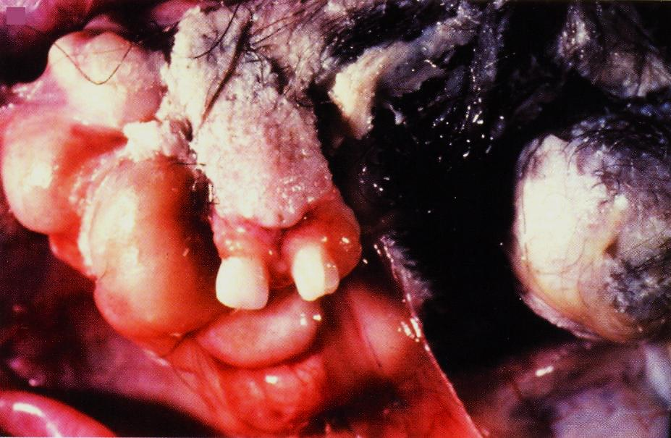
Example 3
Organ? Dx?

Slide 28
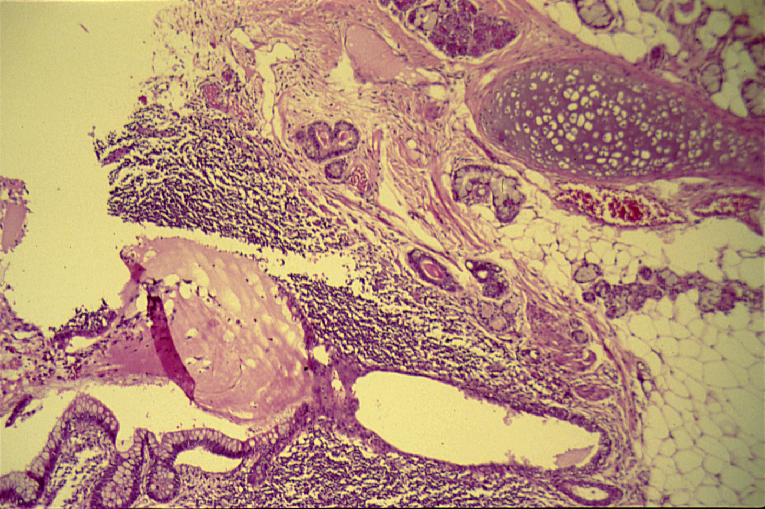
Name 2-3 features/ findings?

Slide 29
Micro
Bacteriology
Parasitology
Virology
Mycology

Slide 30
Bacteriology
Make sure you take slides from Dr Somily
Make sure you get revisions done
Make sure write every single word he says down
Most likely you will be presented with one of 3 questions
Describe what you see ( check next slide)
What is the organism and describe its apperance
A question about diagnoses

Slide 31
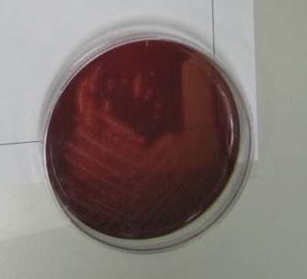

Slide 33
Parasitology
Questions will be probably on the organisms much more likely then on diagnoses and symptoms

Slide 34
Virology and mycology
We had different doctors, so you might want to ask the new doctors
Usually questions on identifying organisms and describing structures

Slide 35
Physiology
Ask for a revision from doctor MUSTAFA! He usually writes the questions, so he will tell you about what's important and what is not
They will almost always provide slides or handouts
You need a team to revise, answer and point out the important stuff.

Slide 36
Physiology questions
It varies from time to time
Usually its theoretical questions about experiments or about interpretation and normal values

Slide 37
For example lets take blood physiology
Types of blood cells?
Types of anaemia?
Interpretation of experiments and results?
Blood films
CT, BT, ESR
PCV, MCHC, MCV, RBC count, Hb, Etc...
Normal values?
Shapes of cells under microscopes

Slide 38
http://www.ksums.net/files/Archive/1st/429/01%20Foundation%20Block/Male/Physiology/Practicals/
This is what we studied

Slide 39
431 list
Anatomy: - Skeletal system. - Skeletal muscles and joints. - Nervous system. Histology: - Microtechnique; cell structure. - Epithelial tissue. - Connective tissue. - Lymphoid tissue. Pathology: - Cell injury and inflammation 1. - Cell injury and inflammation 2. - haemodynamic disorders 1. - haemodynamic disorders 2. - Granulomas. - Neoplasia 1. - Neoplasia 2. - Revision
Physiology: - Tutorial erythropoiesis. - CBS, ESR. - WBC, differential. - Tutorial on WBC. - Tutorial on Mechanisms of Clotting and clotting disorders. - Bleeding, clotting time, and blood group. Biochemistry: - DNA extraction. Microbiology: - Microbiology

Slide 40
Questions?
وفقكم الله
Thank you and the very best of luck

