Slide 1
Foundation Block Revision 1432-1433
Practical

Slide 2
Nucleus

Slide 3
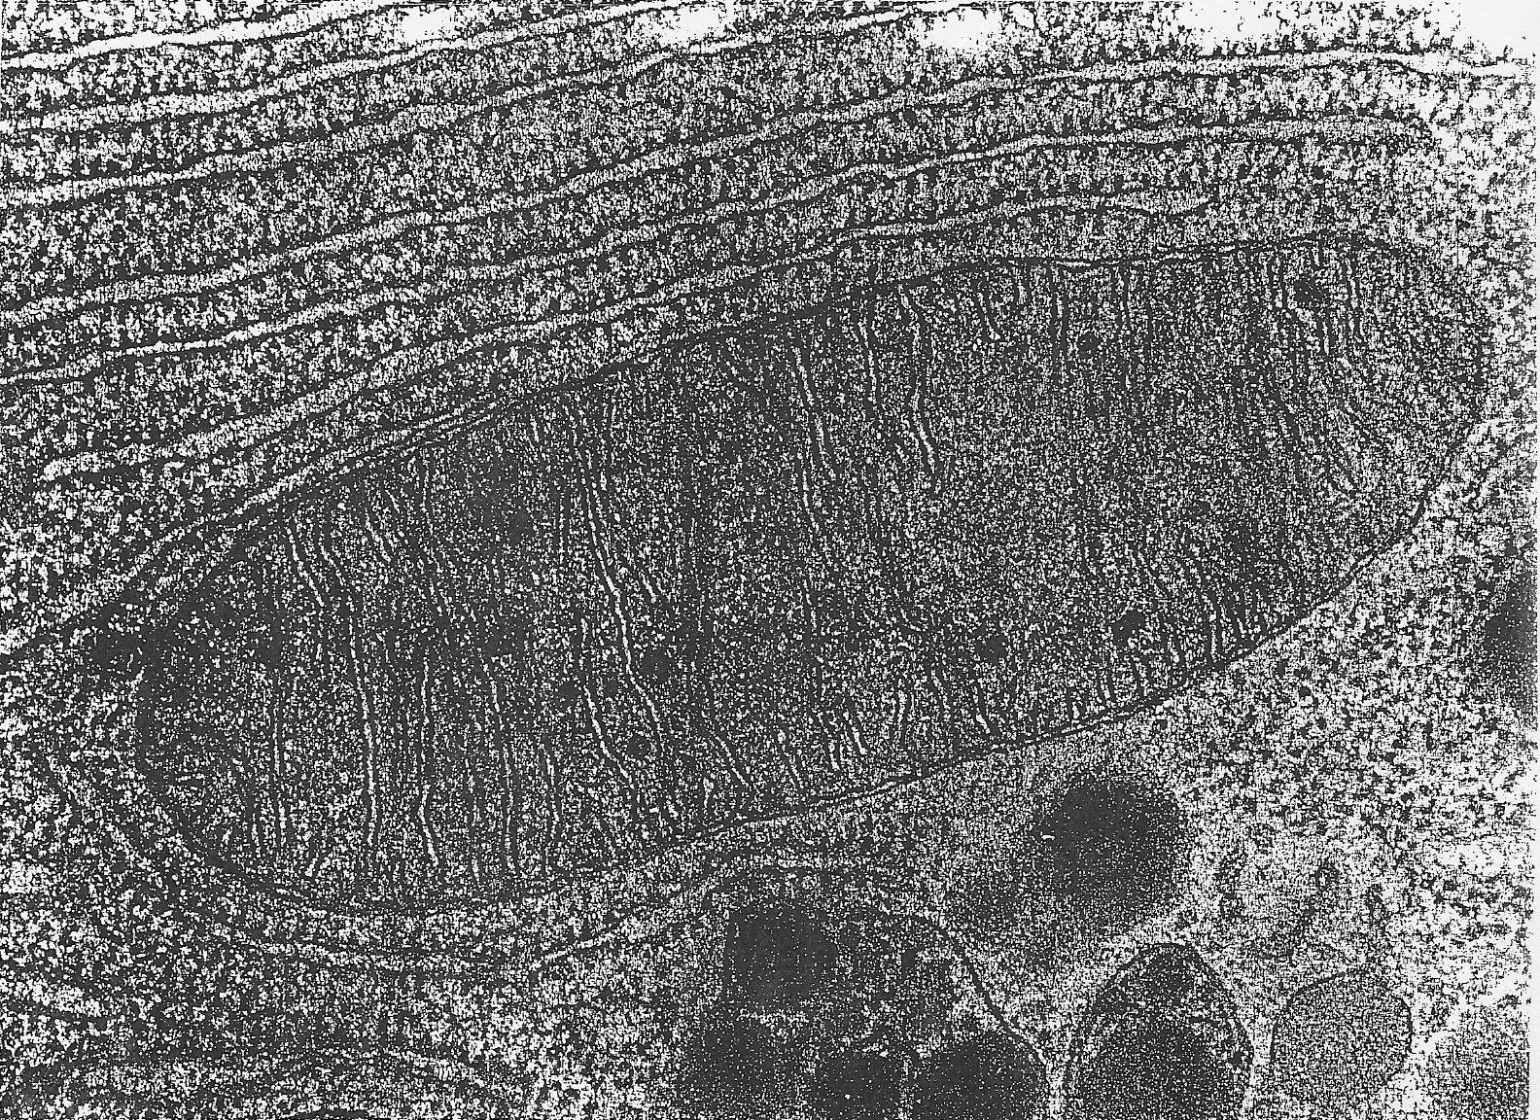
Mitochondria

Slide 4
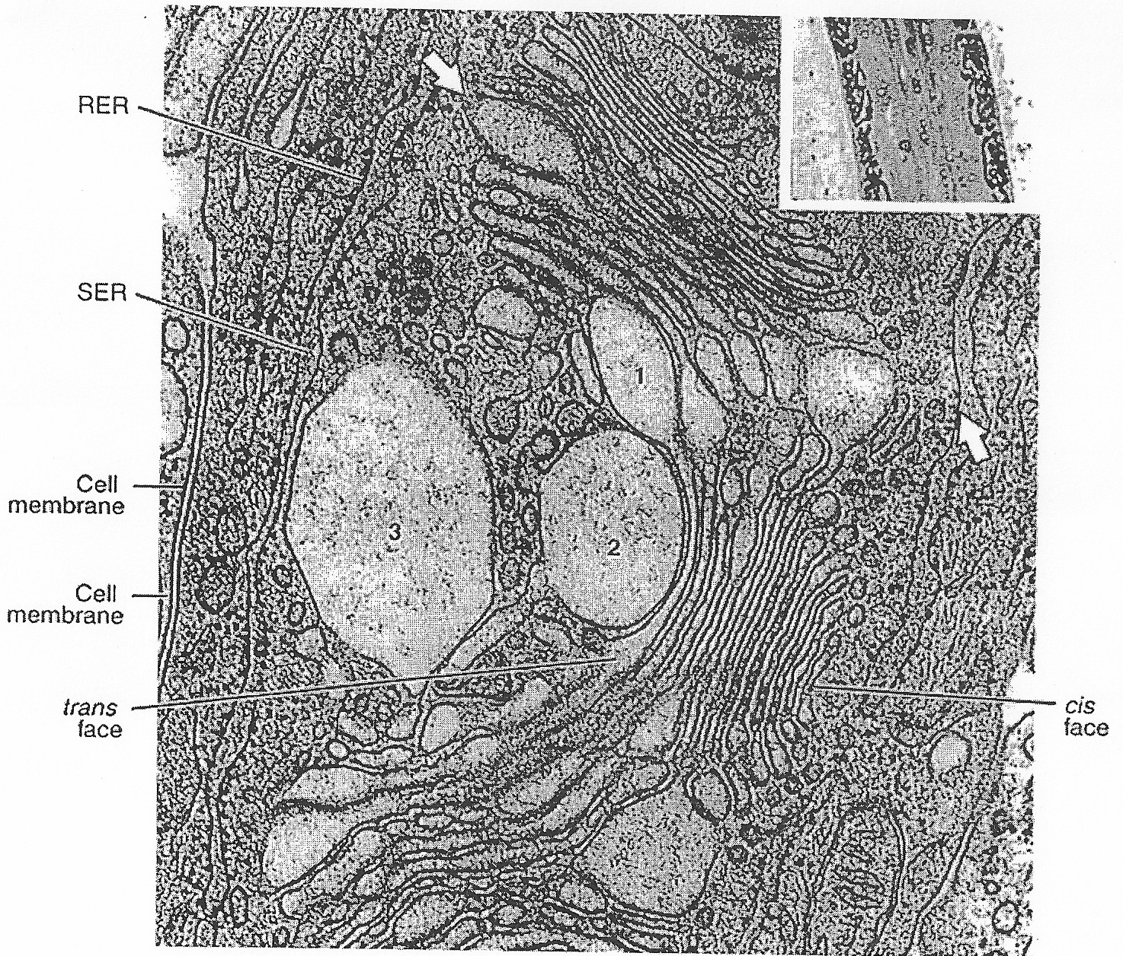
Golgi Apparatus

Slide 5
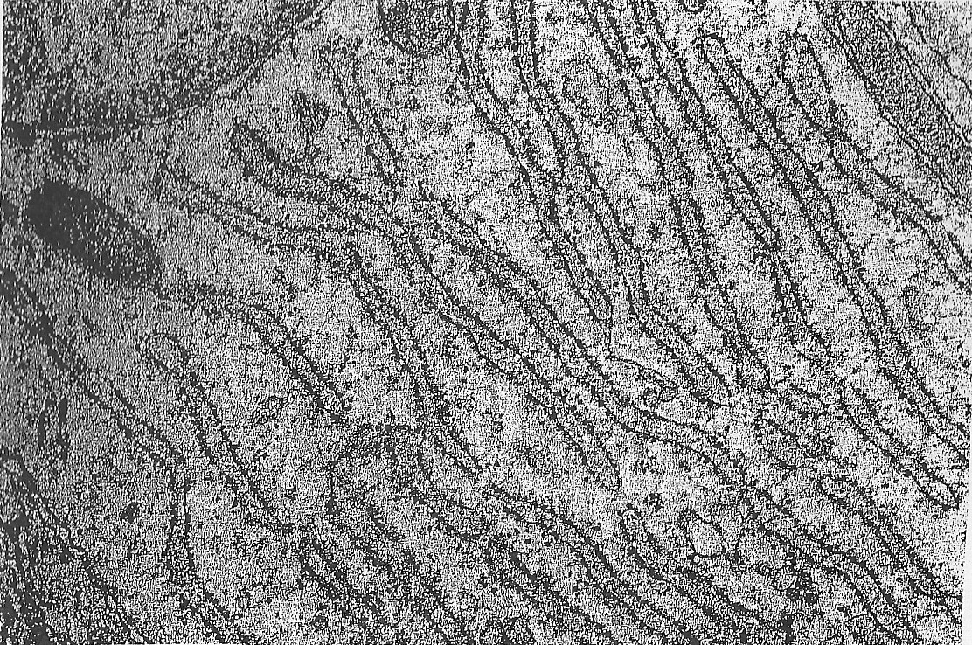
Rough Endoplasmic Reticulum

Slide 6
Centrioles

Slide 7
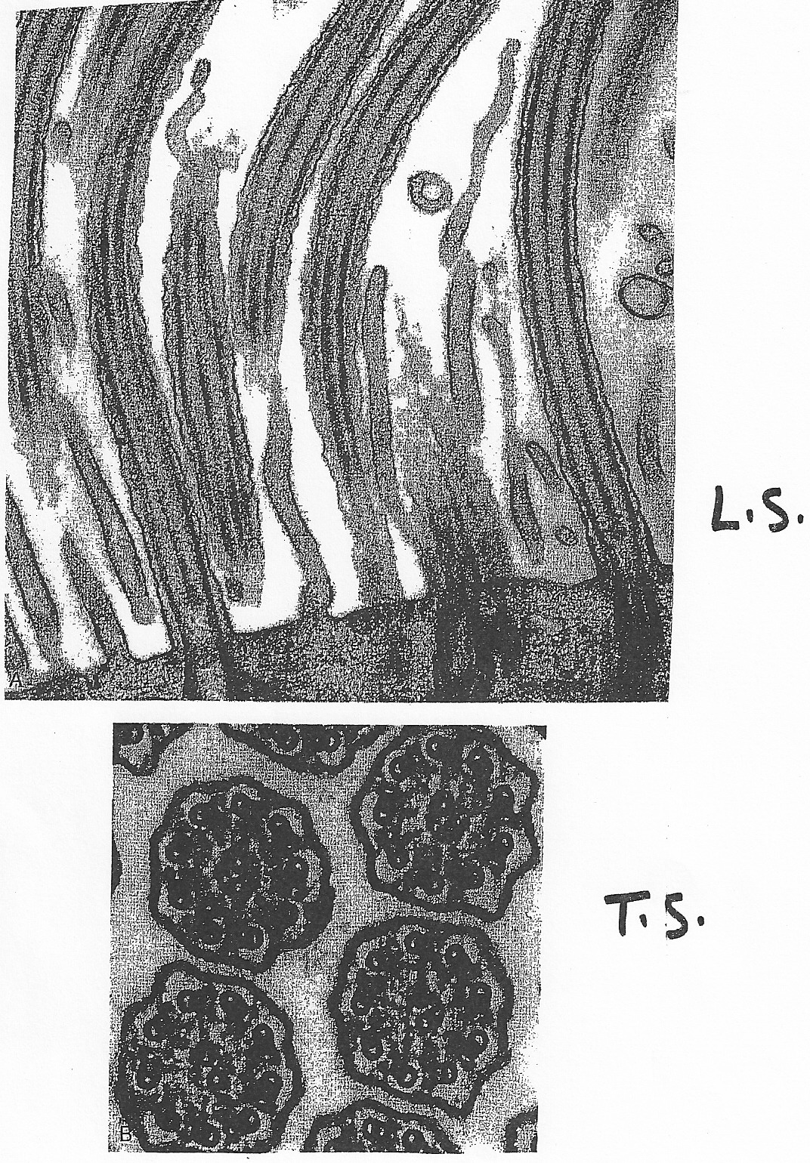
Cilia

Slide 8
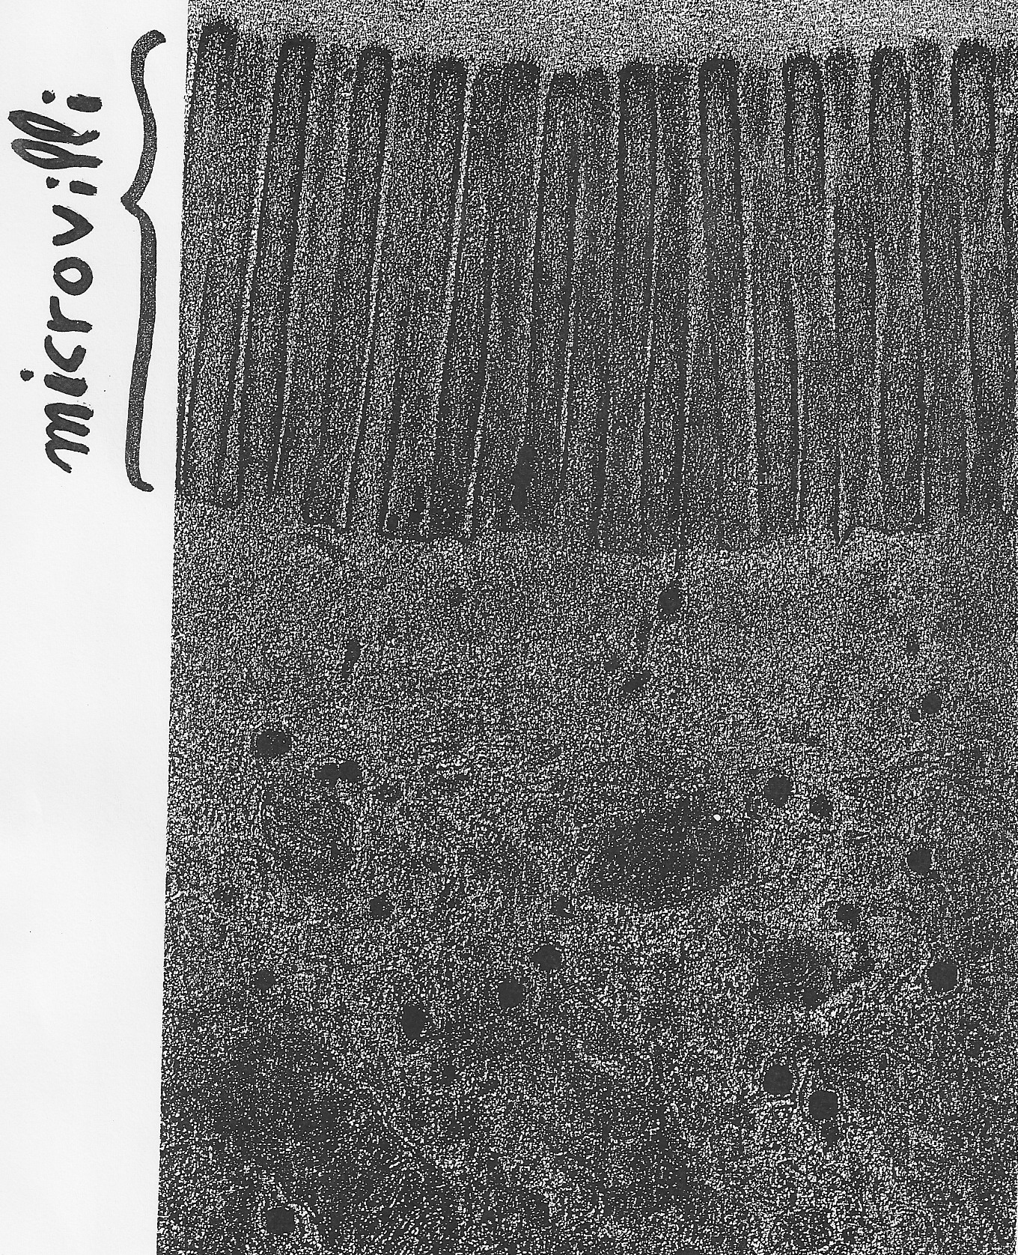
Microvilli

Slide 9
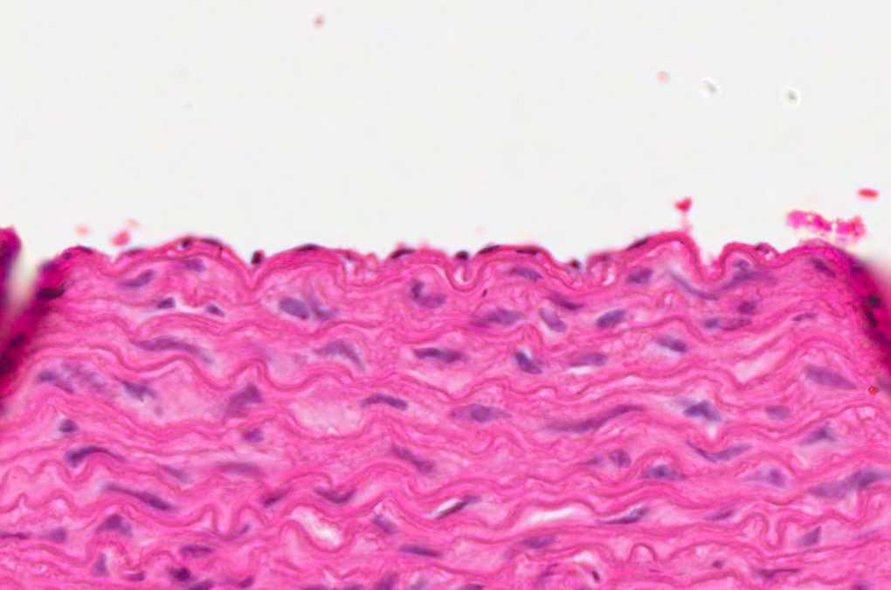
Simple Squamous Epithelium

Slide 10
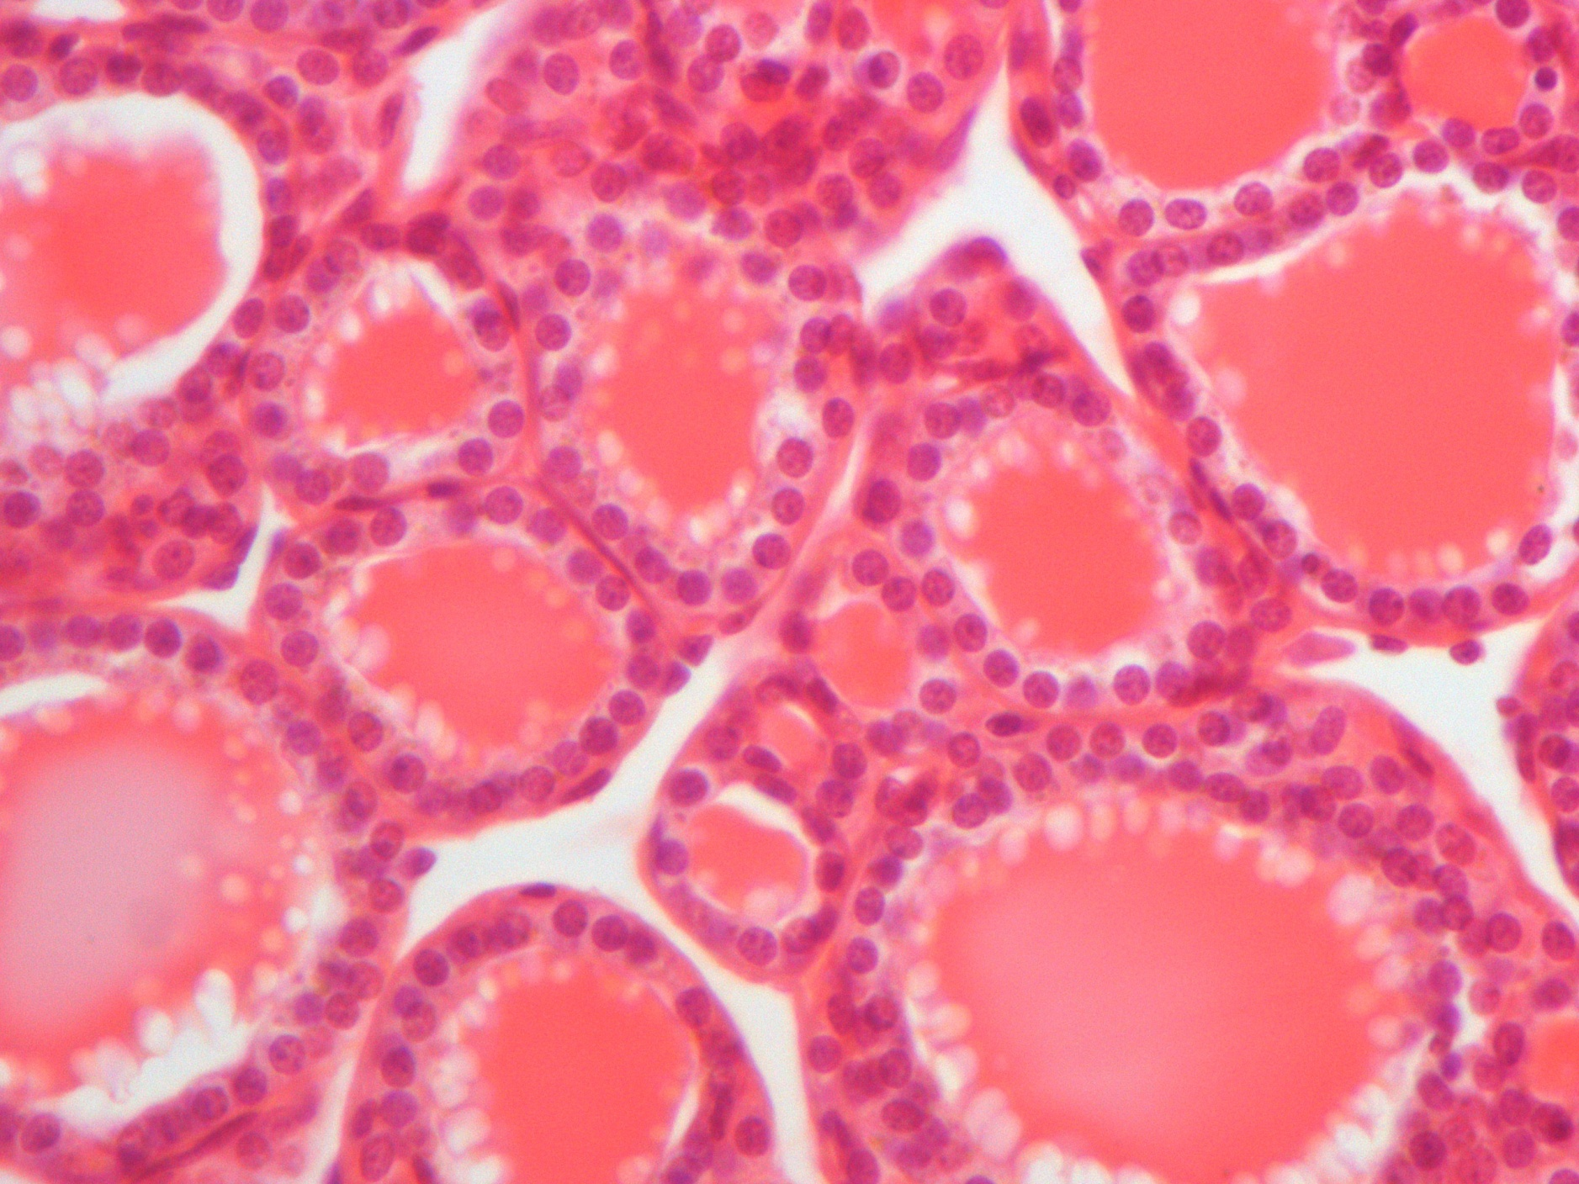
Simple Cuboidal Epithelium

Slide 11
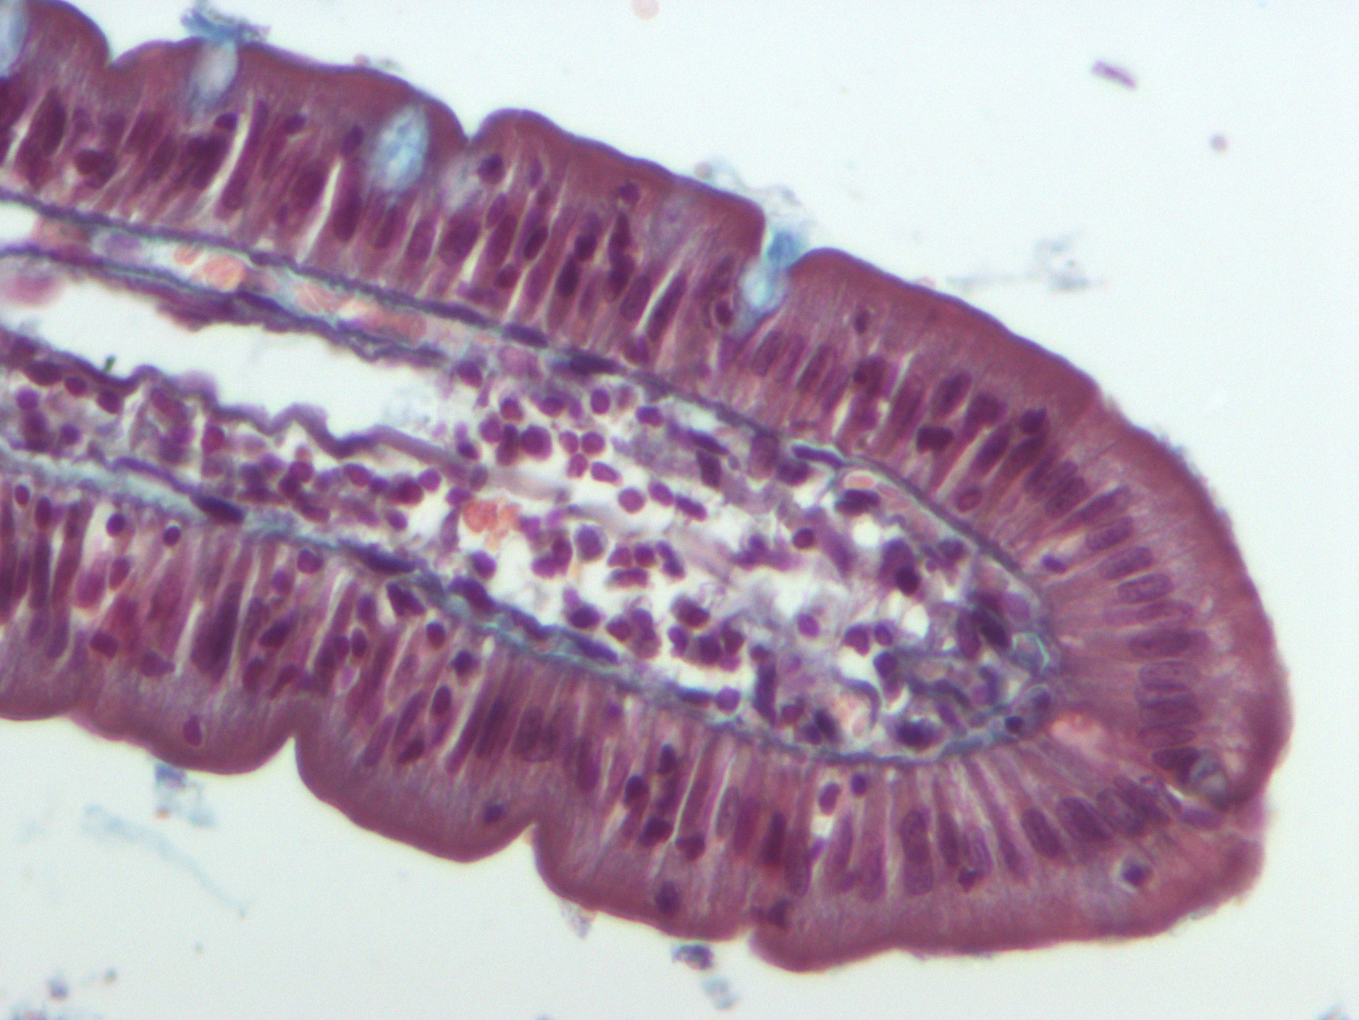
Simple Columnar Epithelium

Slide 12
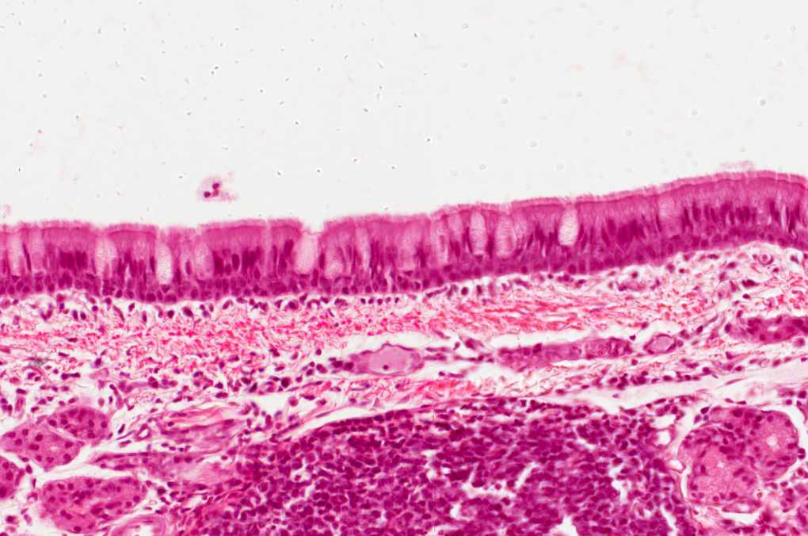
Pseudostratified Columnar Ciliated Epithelium with Goblet Cells

Slide 13
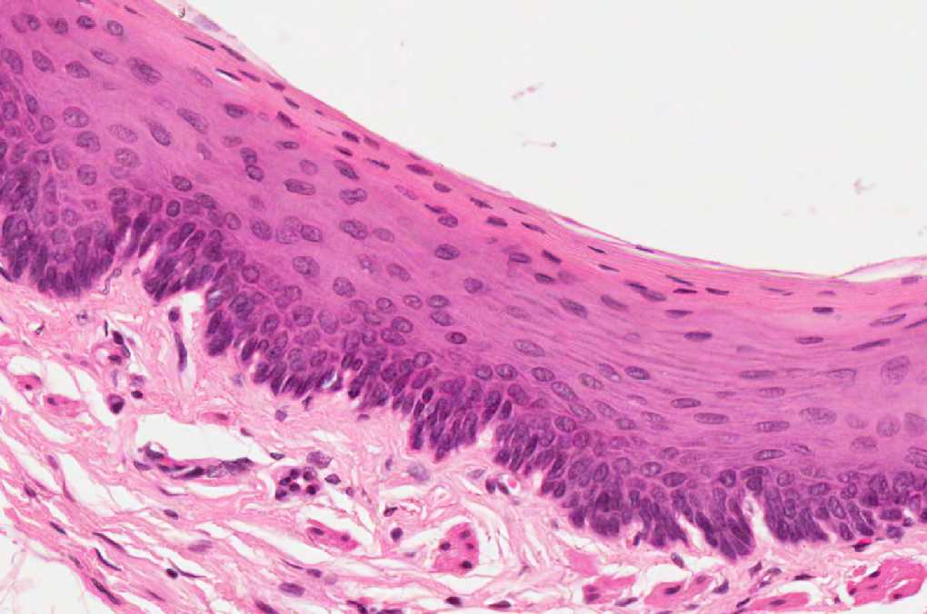
Stratified Squamous Non-Keratinized Epithelium

Slide 14
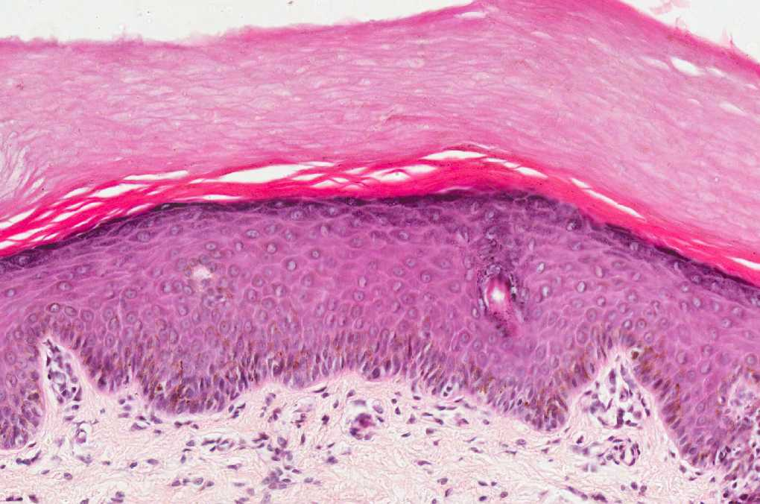
Stratified Squamous Keratinized Epithelium

Slide 15
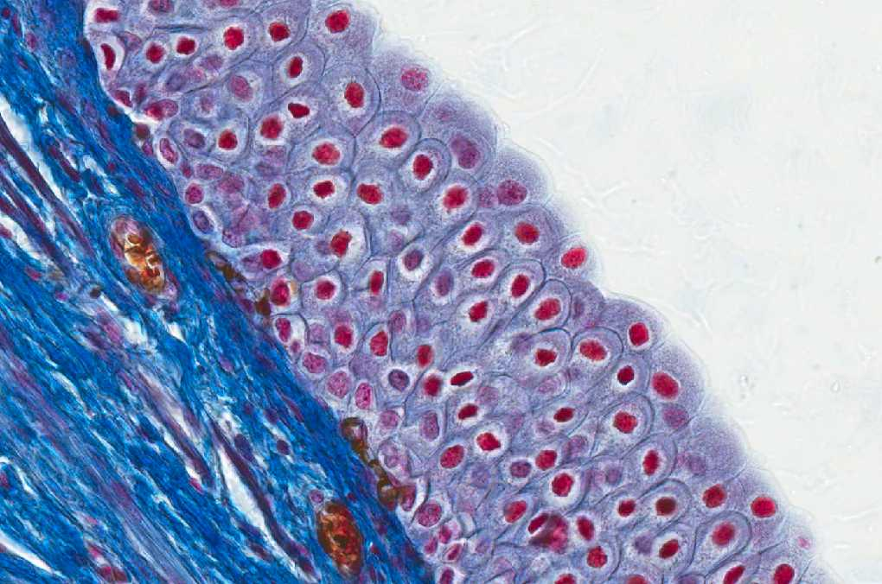
Transitional Epithelium

Slide 16
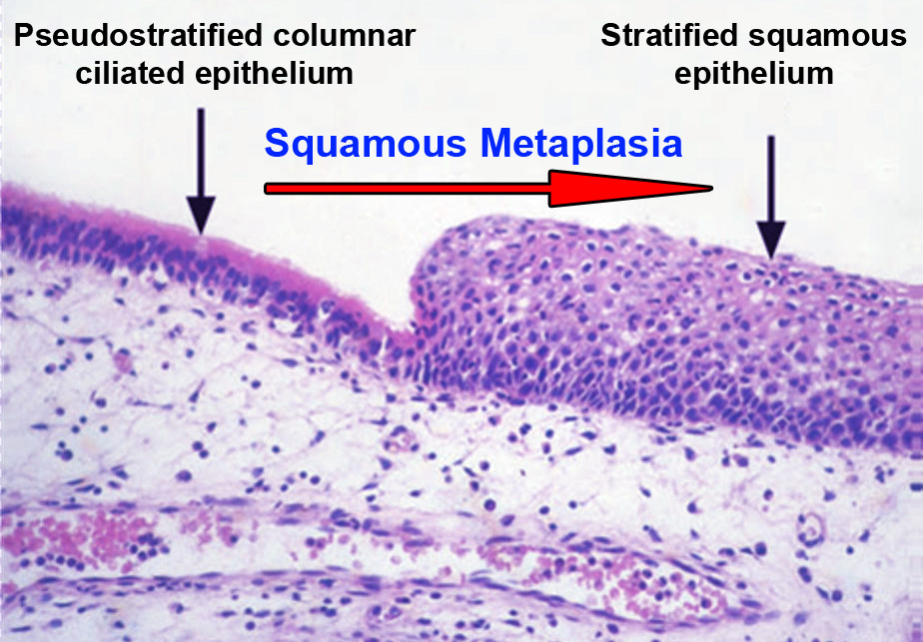
Transitional Epithelium

Slide 17
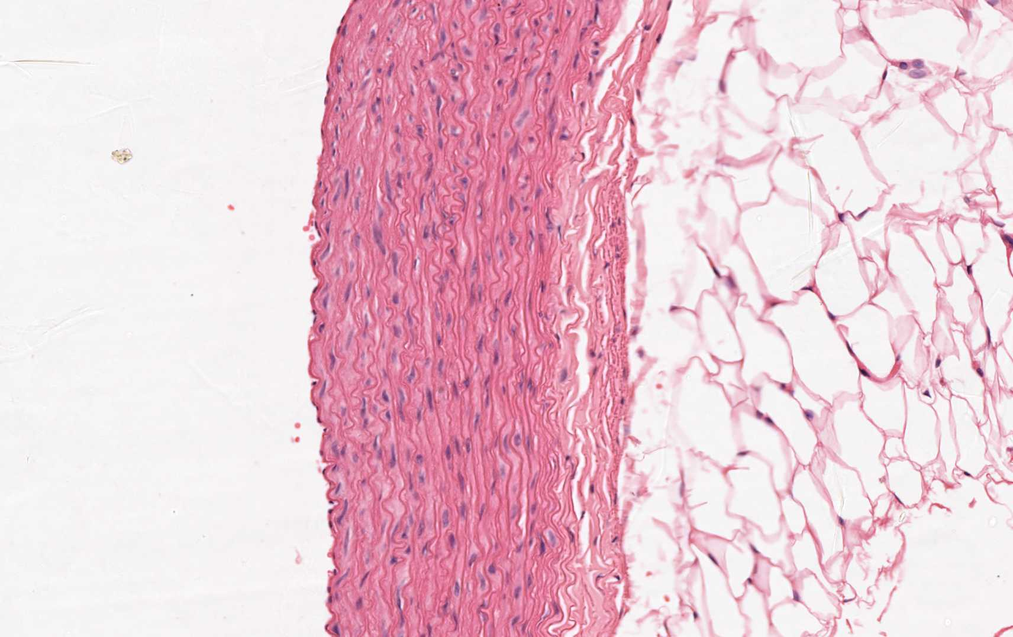
Elastic Connective Tissue

Slide 18
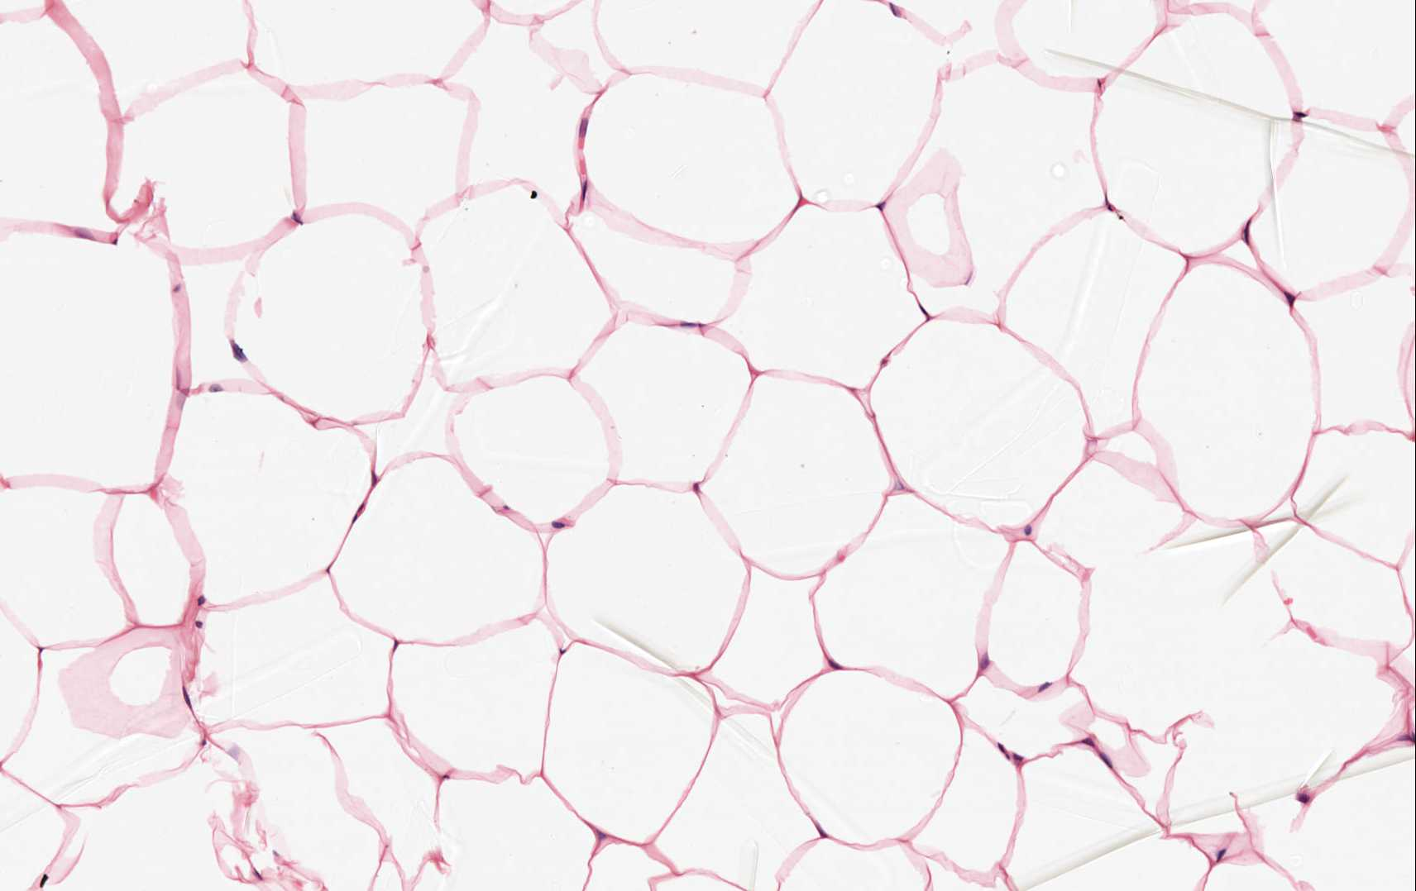
Adipose Connective Tissue

Slide 19
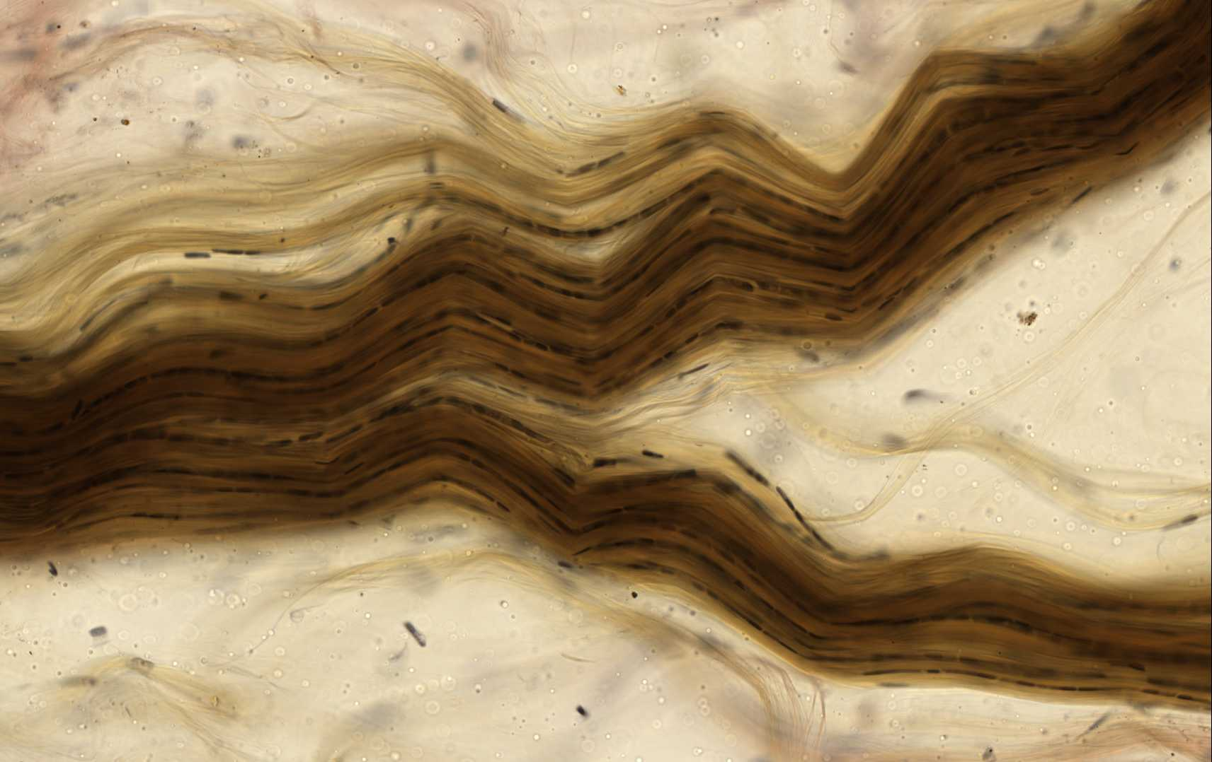
Dense Fibrous Connective Tissue

Slide 20
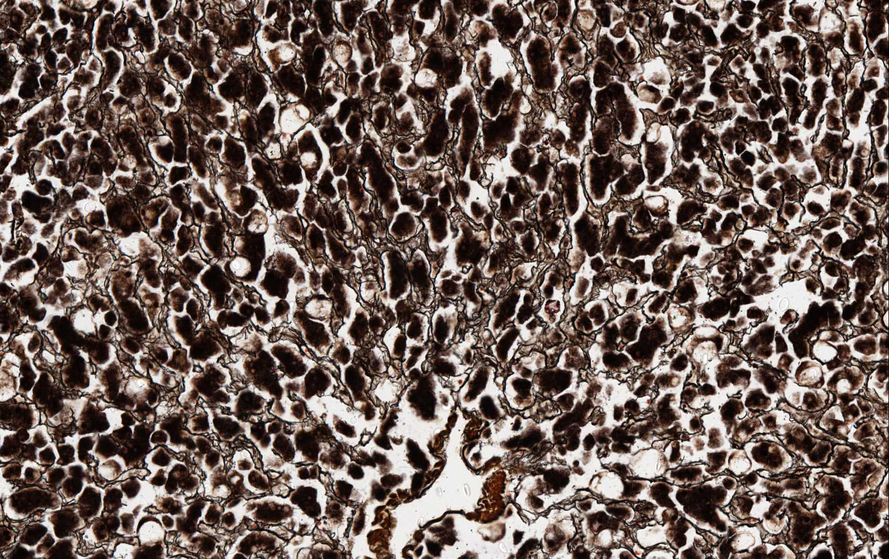
Reticular Connective Tissue

Slide 21
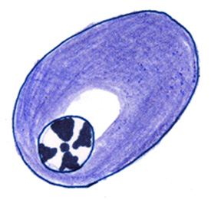
Plasma Cell

Slide 22
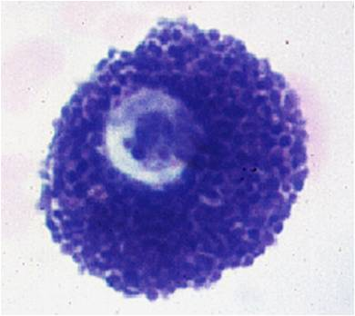
Mast Cell

Slide 23
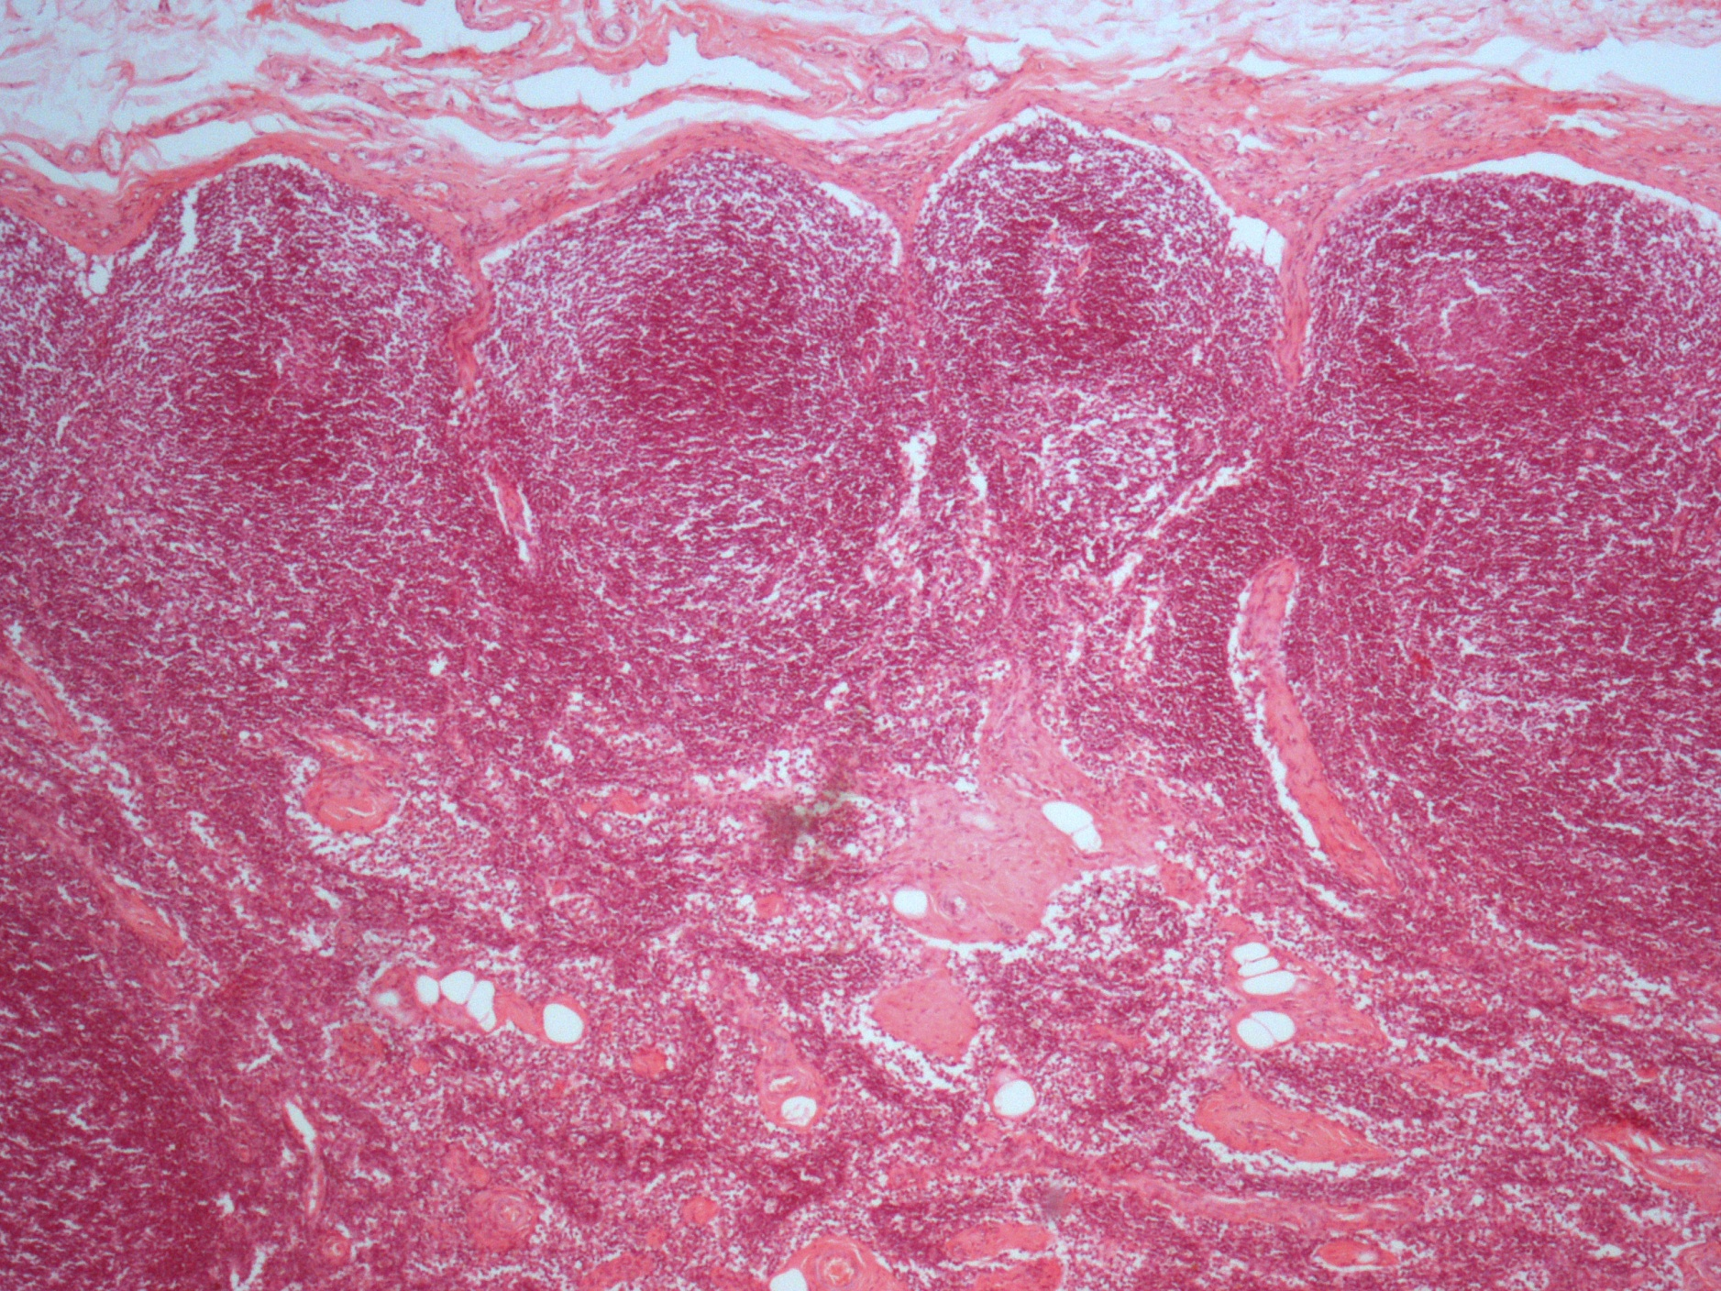
Lymph Node

Slide 24
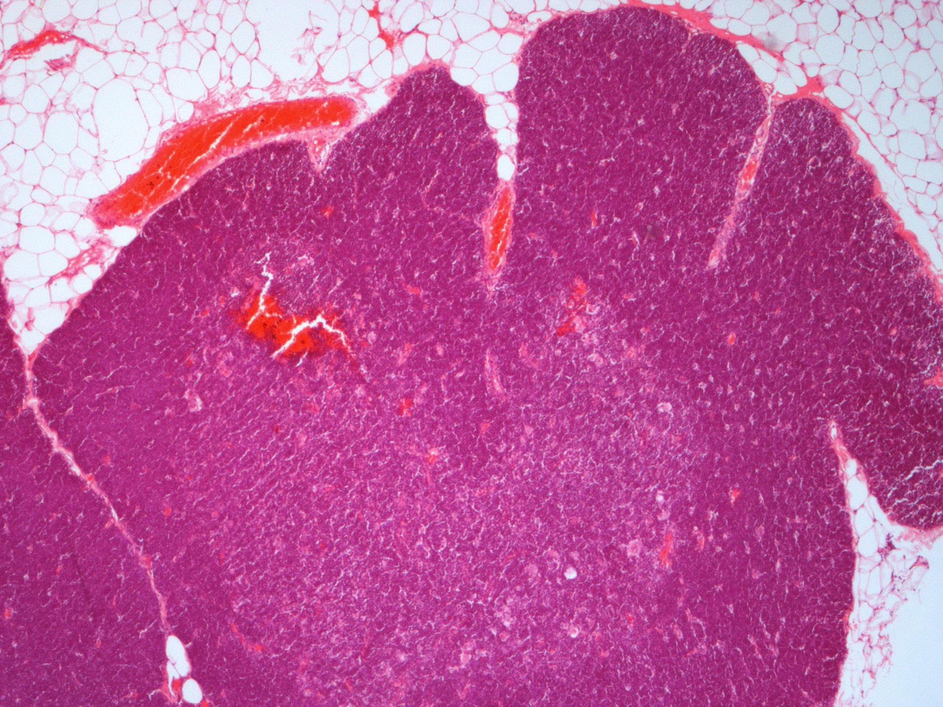
Thymus

