Slide 1
Lymphoid Tissue Prelab

Slide 3
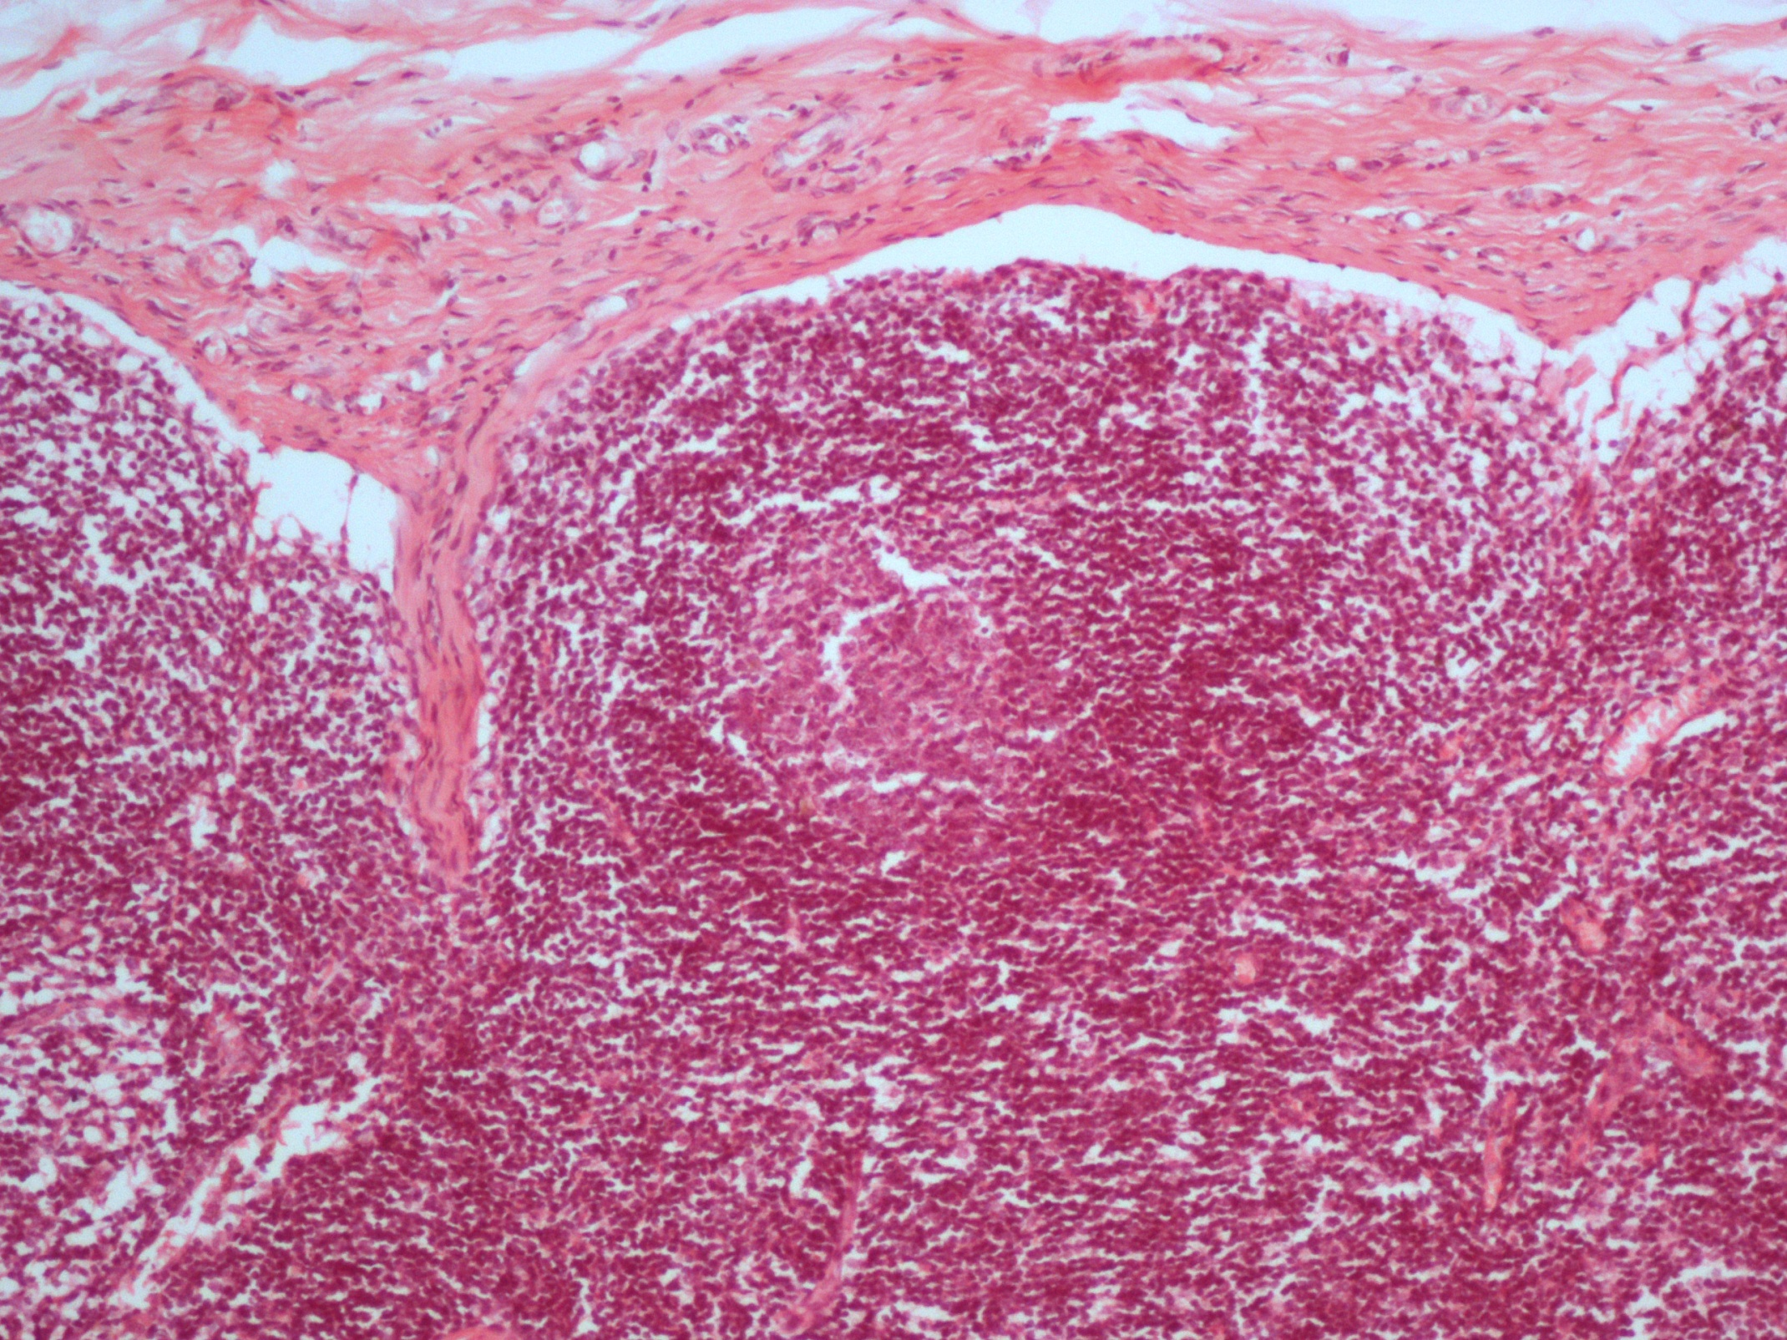

Slide 4
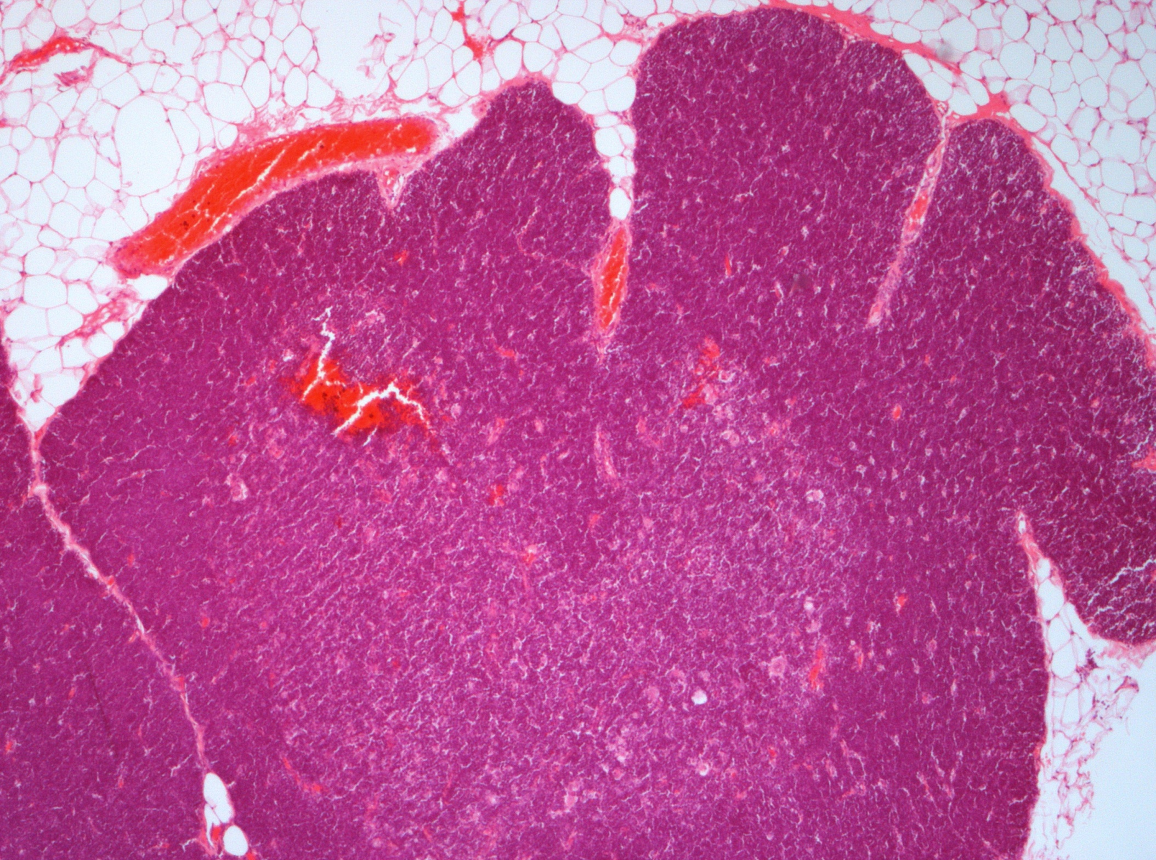

Slide 5
