Slide 1
GRANULOMATOUS INFLAMMATION
Foundation Block, Pathology
Dr. Maha Arafah
2012

Slide 2
OBJECTIVES AND KEY PRINCIPLES TO BE TAUGHT:
Upon completion of this lecture, the student should:
Define Granulomatous inflammation.
Recognize the morphology of granulomas (tubercles) and list the cells found in granuloma along with their appearance.
Understands the pathogenesis of granuloma formation.
Identify the types of granulomas, which differ in their pathogenesis.
Foreign body granulomas
Immune granulomas
List the common causes of Granulomatous Inflammation.

Slide 3
Granulomatous inflammation
Granulomatous inflammation is a distinctive pattern of chronic inflammation characterized by aggregates of activated macrophages with scattered lymphocytes.

Slide 4
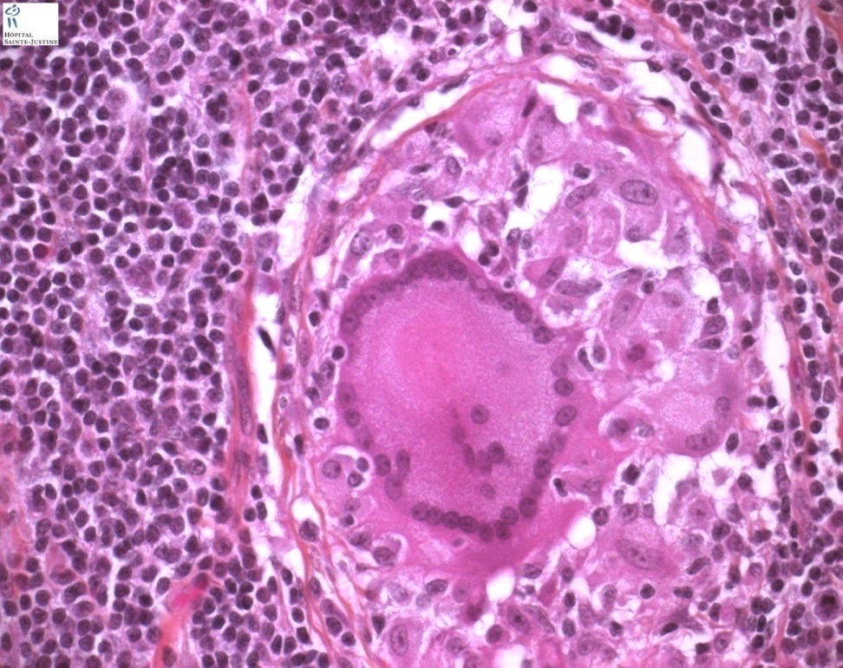
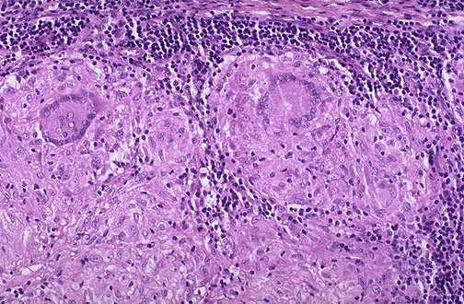
Granulomatous inflammation
Granuloma = Nodular collection of epithelioid macrophages surrounded by a rim of lymphocytes
Epitheloid macrophages: activated macrophages have squamous cell-like appearance

Slide 5
Granulomatous Inflammation
Granulomas are characteristic of certain specific pathologic states
Recognition of the granulomatous pattern is
important because of the limited number of conditions that cause it
(some are life-threatening)

Slide 6
Pathogenesis of granuloma
A granuloma is a cellular attempt to contain an offending agent that is difficult to eradicate.

Slide 7
Granulomas can form under Four settings:
With persistent T-cell responses to certain microbes
In some immune-mediated inflammatory diseases
In response to relatively inert foreign bodies
In a disease of unknown etiology

Slide 8
persistent T-cell responses to certain microbes
Granulomatous Inflammation

Slide 9
Pathogenesis

Slide 10
IL-2, and IFN-γ,

Slide 12
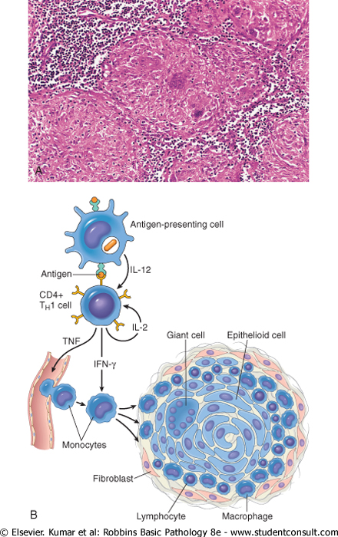
Immune granuloma mechanism
What is the initiating event in granuloma formation?
indigestible antigenic material in macrophages
Antigen presentation on cell membrane
to appropriate CD4+TH1 lymphocytes, causing them to become activated. The responding T cells produce cytokines, such as IL-2, and IFN-γ,
IFN-γ is important in activating macrophages and transforming them into epithelioid cells and multinucleate giant cells

Slide 13
Persistent T-cell responses to certain microbes Causes:
Bacteria
Tuberculosis
Leprosy
Actinomycosis
Cat-scratch disease
Parasites
Schistosomiasis
Leishmaniasis
Fungi
Histoplasmosis
Blastomycosis
Metal/Dust
Berylliosis

Slide 14
Important Disease

Slide 15
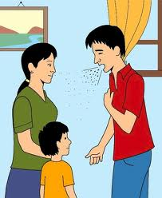
A Disease
Easily transmitted

Slide 16
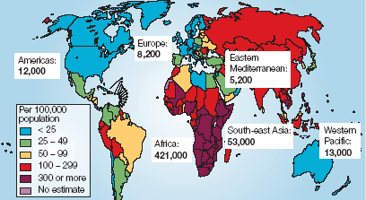
A Disease
Common World Wide
Estimated worldwide TB incidence rates in 2000.

Slide 17
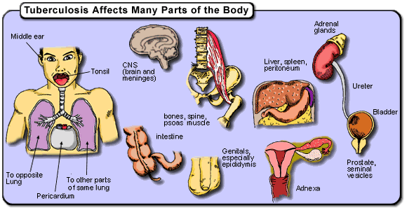
A Disease
Could Affect Any Organ

Slide 18
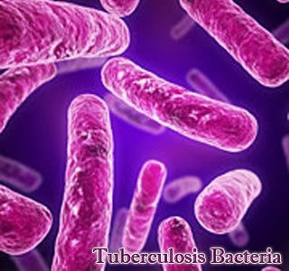
الدرن TB

Slide 20
With persistent T-cell responses to certain microbes
Mycobacterium tuberculosis
Tuberculosis is the prototype of a granulomatous disease caused by infection and should always be excluded as the cause when granulomas are identified.
How?
Acid fast stain
Culture
Molecular

Slide 21
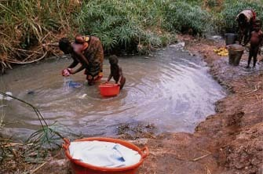
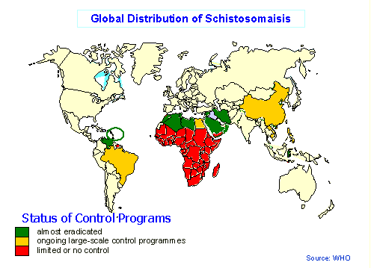
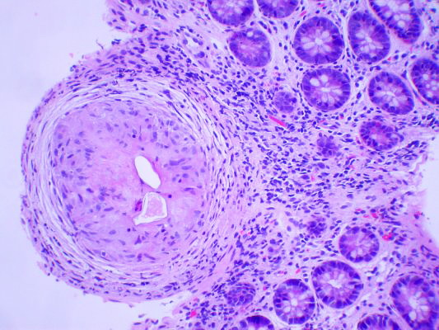
Schistosomiasis

Slide 22
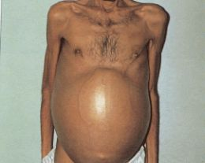
Schistosomiasis

Slide 23
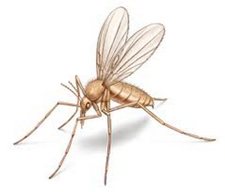
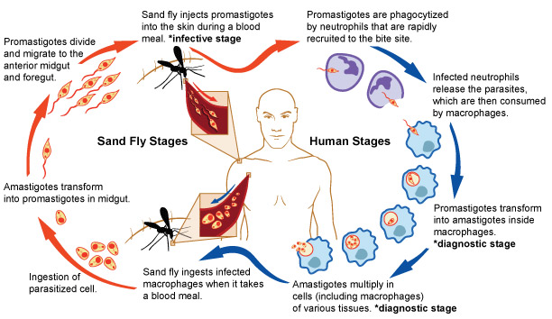
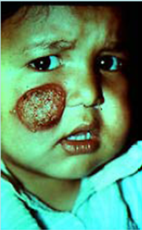
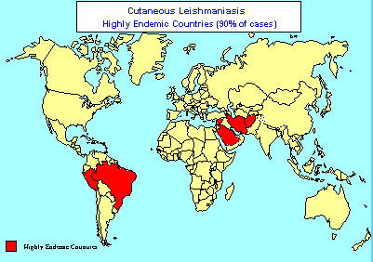
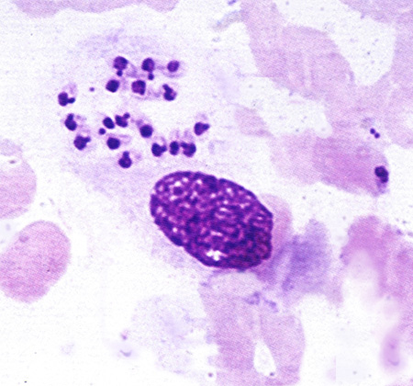
Leishmaniasis
Sand fly

Slide 24
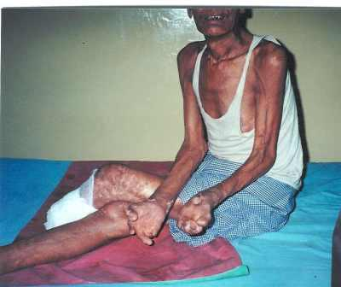
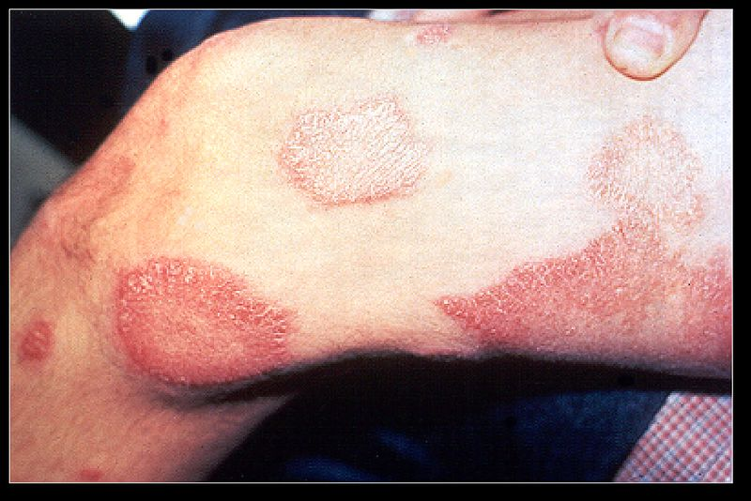
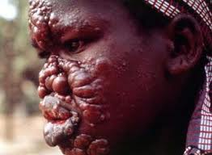
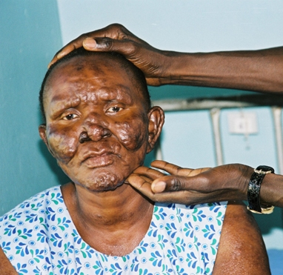
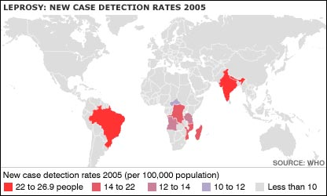
Leprosy

Slide 25
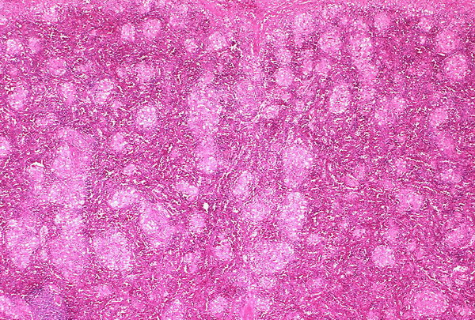
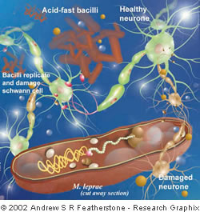
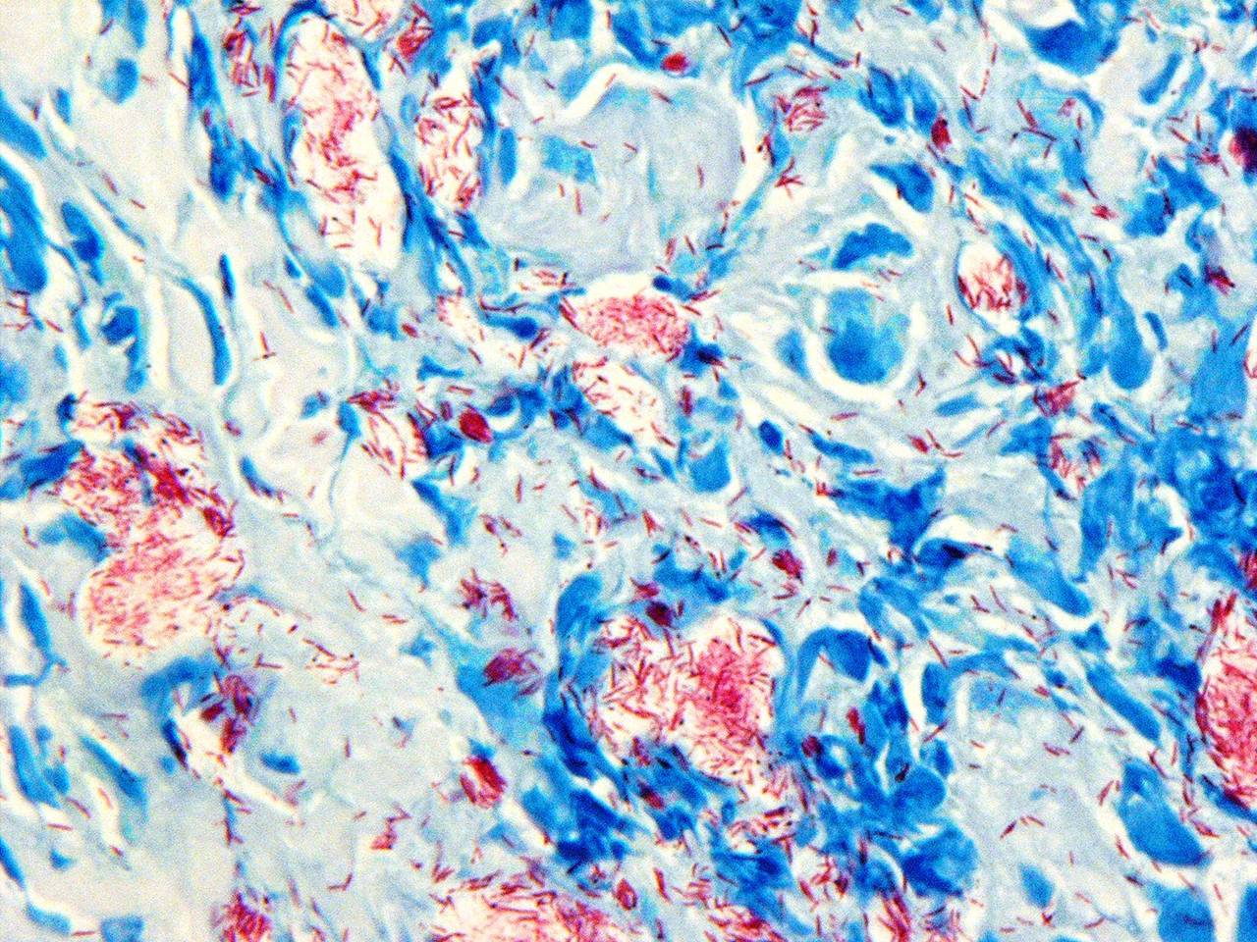
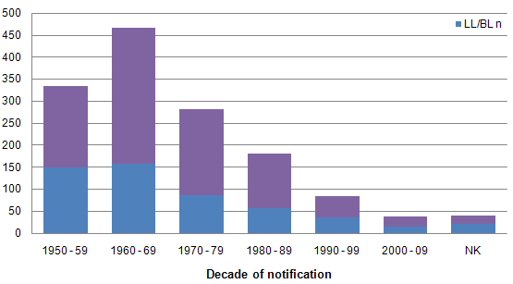
Leprosy

Slide 26
Granulomas can form under Four settings:
With persistent T-cell responses to certain microbes
In some immune-mediated inflammatory diseases
In response to relatively inert foreign bodies
In a disease of unknown etiology

Slide 27
Immune-mediated inflammatory diseases
E.g. Crohn’s disease,
is one type of inflammatory bowel disease and an important cause of granulomatous inflammation
Immune reaction against intestinal bacteria or self antigens
Occasional noncaseating granulomas in the wall of the intestine, with dense chronic inflammatory infiltrate

Slide 28
Granulomas can form under Four settings:
With persistent T-cell responses to certain microbes
In some immune-mediated inflammatory diseases
In response to relatively inert foreign bodies
In a disease of unknown etiology

Slide 29
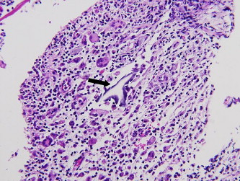
In response to relatively inert foreign bodies
Foreign body
Suture
Graft material
talc (associated with intravenous drug abuse)
The foreign material can usually be identified in the center of the granuloma, by polarized light (appears refractile)

Slide 30
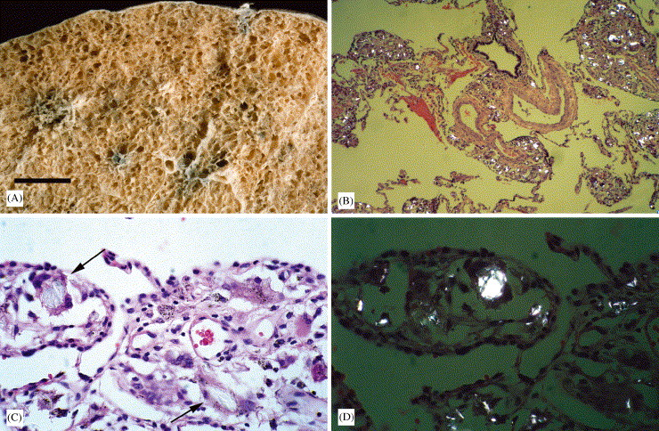
Talc (associated with intravenous drug abuse

Slide 31
Granulomas can form under Four settings:
With persistent T-cell responses to certain microbes
In some immune-mediated inflammatory diseases
In response to relatively inert foreign bodies
In a disease of unknown etiology

Slide 32
In a disease of unknown etiology
E.g. Sarcoidosis
Unknown etiology
Noncaseating granulomas with abundant activated macrophages

Slide 33
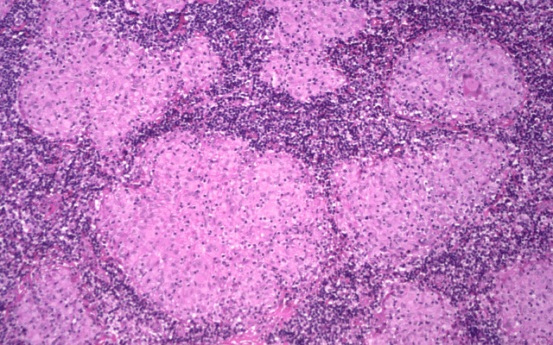
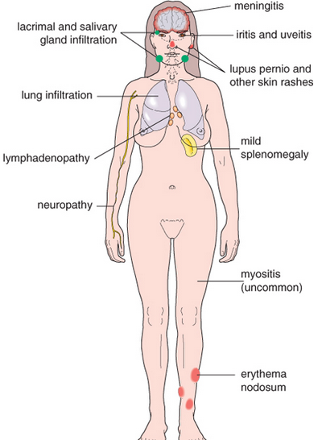
Sarcoidosis
Lymph node: Noncaseating granulomas
Cause: Unknown
Lung: Noncaseating granulomas

Slide 34
Morphology of Granulomatous Inflammation

Slide 35
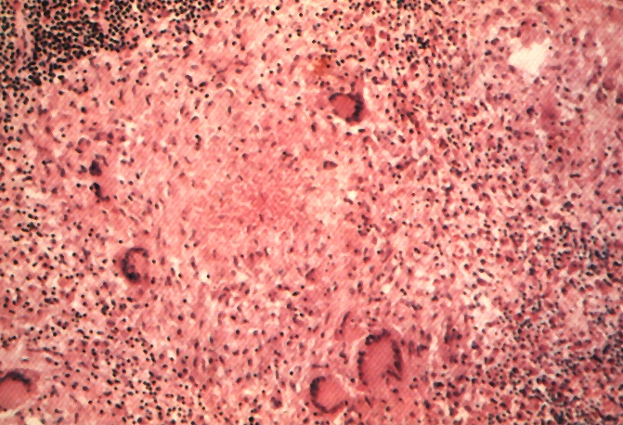
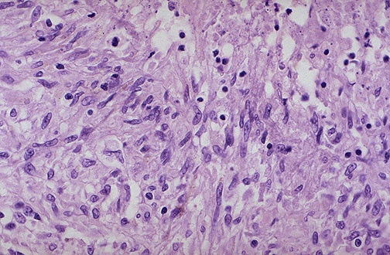
Granuloma
Langhans Giant Cell
Lymphocytic Rim
Caseous Necrosis
Epithelioid Macrophage

Slide 36
Outcome of granulomatous inflammation
If no Rx,
continue tissue destruction and fibrosis
Spread of infection to other part in the body e.g. miliary TB
With adequate Rx, recovery with localized scar formation at site of necrosis

Slide 37
TAKE HOME MESSAGES:
Granulomatous inflammation is a distinctive pattern of chronic inflammation characterized by aggregates of activated macrophages that assume an epithelioid appearance.
Damaging stimuli which provoke a granulomatous inflammatory response include:
Microorganisms which are of low inherent pathogenicity but which excite an immune response.
Granulomata are produced in response to:
Bacterial infection
parasitic infection: e.g. Schistosoma infection
Certain fungi cannot be dealt with adequately by neutrophils, and thus excite granulomatous reactions.
Non-living foreign material deposited in tissues, e.g. keratin from ruptured epidermal cyst.
Unknown factors, e.g. in the disease 'sarcoidosis'
And immunologic reactions e.g. Crohn's diseas

