Slide 1
Lecture Title: Cell injury
(Foundation Block, pathology)
Lecturer name: Dr. Maha Arafah
Lecture Date: 15-9-2012

Slide 2
CONCEPT OF INJURY AND CELLULAR RESPONSE TO INJURY
L1:
Overview of Cell Injury, adaptation to environmental stress and Cell Death
Free radical injury, types of necrosis and apoptosis
L2:
Mechanism of injury, Necrosis and Apoptosis
Cellular accumulation and adaptation to injuries
L3:
Cellular accumulation and Calcification
Pathological calcification

Slide 3
Overview of Cell Injury and ADAPTATION
Upon completion of this lecture, the student should know:
Causes of cell injury
Adaptation to stress
Reversible cell injury ( nonlethal hit)
Irreversible injury and cell death ( lethal hit)
Morphology of cell injury

Slide 4
CONCEPT OF INJURY AND
CELLULAR RESPONSE TO INJURY
Cells are constantly exposed to a variety of stresses.
When too severe, INJURY results.
Injury alters the preceding normal steady state of the cell.

Slide 5
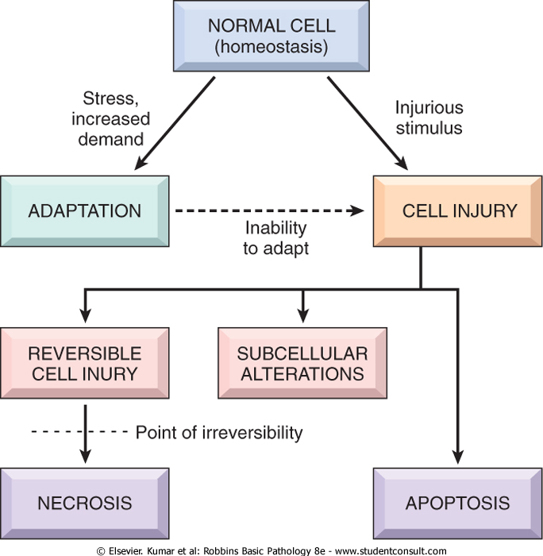

Slide 6
ALL CELLS

Slide 7
ALL ORGANISMS

Slide 8
All medical student

Slide 9
Living in the World

Slide 10
Must cope with…

Slide 11
Stress!!!

Slide 12
Cellular Responses to Injury
Nature and Severity of Injurious Stimulus | Cellular Response
Altered physiologic stimuli: | Cellular adaptations:
Increased demand, increased trophic stimulation (e.g. growth factors, hormones) | Hyperplasia, hypertrophy
Decreased nutrients, stimulation | Atrophy
Chronic irritation (chemical or physical) | Metaplasia

Slide 13
The Four Main Types of Cell Adaptations
Atrophy: shrinkage of an organ as a result of decreased cell size (and cell number).
Hypertrophy: enlargement of an organ as a result of increased cell size.
Hyperplasia: enlargement of an organ through an increase in cell number.
Metaplasia: the replacement of one differentiated cell type by another in a tissue or organ.

Slide 14
Atrophy
Hypoplasia & Aplasia
Developmental failure
Failure in morphogenesis
Signals/injury
Atrophy
Autophagy
Less organells
Reduced metabolic rate
Lipofuscin granules
Reversible
Decrease in size of cell (-s) previously of normal size
Physiologic
shrinkage of testes and ovaries with age
Pathologic
Decreased function
Loss of innervation
Pressure (“bed soars”)
Malnutrition/cahexia
Loss of endocrine stimulation
Aging
Net results: tissue /organ smaller than normal

Slide 15
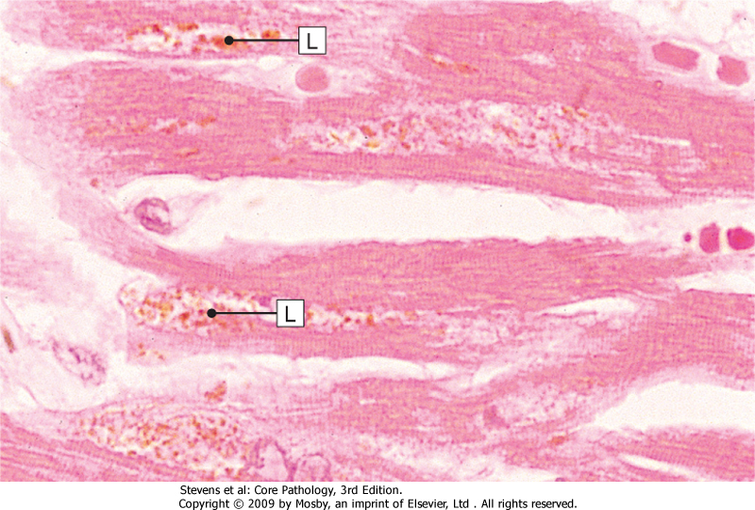
LIPOFUSCIN: wear and tear pigment
Lipofuscin granules are yellow/brown in color and represent non-digestible fragments of lipids and phospholipids combined with protein within autophagic vacuoles.
They are commonly seen in ageing liver and myocardial cells.

Slide 16
Hypertrophy – cell or organ
Signals/injury
Occur in cells which cannot divid
Reversible
Increase in size of cell in response to increased functional demand and/or in response to Hormone/growth factors stimulation
Physiologic
Athletes muscle
Pregnant uterus
Prostatic tissue (elderly)
Pathologic
Cardiac muscle
bladder smooth muscle hypertrophy in outflow obstruction
Net effect: increase in size/volume/weight of tissue / organ

Slide 17
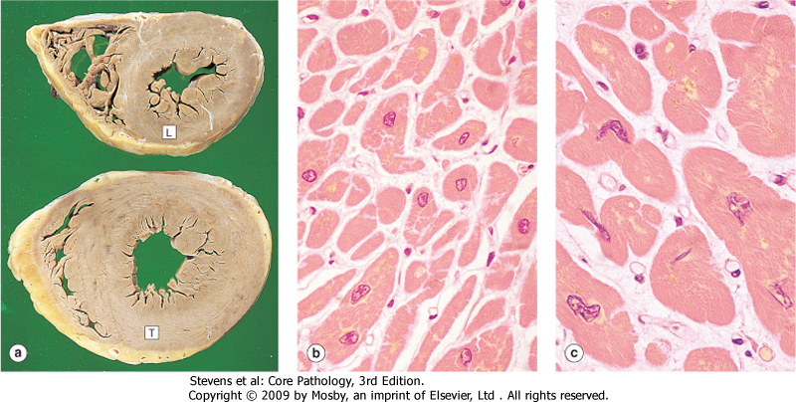
Morphology of hypertrophy
Hypertrophic muscle cells show:
Increased membrane synthesis.
Increased amounts of ATP.
Increased enzyme activity.
Increased myofilaments.
Hypertrophy of smooth endoplasmic reticulum

Slide 18
Hyperplasia – cell or organ
Signals/injury
Reversible
Increase in number of cells in response to increased functional demand and/or in response to Hormone/Growth Factor stimulation
Physiologic
Uterine muscle in pregnancy
Lactating breast
Compensatory after hepatectomy
Pathologic
Endocrine stimulation, e.g. Thyroid
Focal nodular hyperplasia (liver)
Adenomatous hyperplasia of endometrium
Net effect :increase in size/volume/weight of tissue / organ

Slide 19
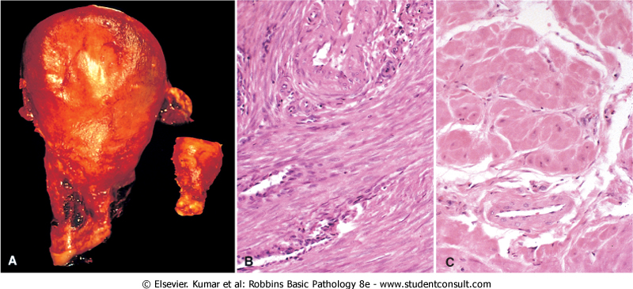

Slide 20
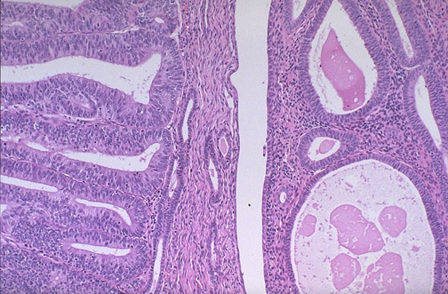
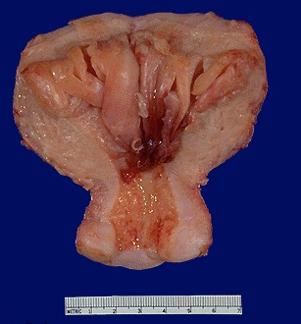
Endometrial hyperplasia
Can be transformed to endometrial carcinoma
Endometrial carcinoma
endometrial hyperplasia

Slide 21
Signals/injury
Metaplasia
Reversible
But not always
genetic "reprogramming" of stem cells
Substitution of mature (differentiated) cell for another mature cell
Physiologic
(metaplastic tissue/organs)
cervical canal
Pathologic
(metaplastic tissue/organs)
Gastric/duodenal metaplasia
Ciliated to squamous in bronchial epith.
Osseous metaplasia
Barret’s oesophagus
Net effect: another cell/tissue - protective – changes in function

Slide 22
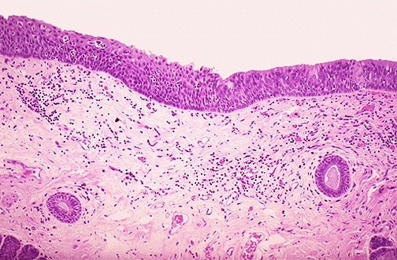
Metaplasia
Ciliated
Squamous

Slide 23
Notice
Metaplasia is often seen next to neoplastic epithelium, indicating that although this adaptive response is potentially reversible, continued insult to the cells may cause uncontrolled growth and the development of cancer.

Slide 25
Etiologic agents

Slide 26
Causes of cell injury
DEFICIENCY OF OXYGEN Ischemia vs. Hypoxia
PHYSICAL AGENTS
CHEMICAL AGENTS
INFECTION
IMUNOLOGICAL REACTIONS
GENETIC DERANGEMENTS
NUTRITIONAL IMBALANCE
AGING

Slide 27
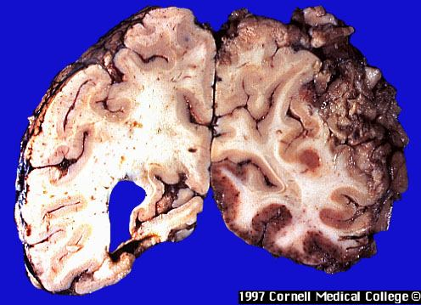
Brain – massive haemorrhagic focus (ischemia) in the cortex
This is a lesion
caused by
DEFICIENCY OF OXYGEN

Slide 28
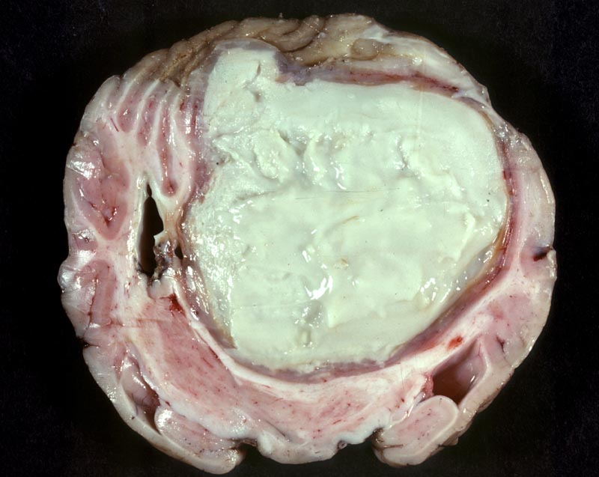
Abscess of the brain (bacterial)
This is a lesion
caused by
infectious agent

Slide 29
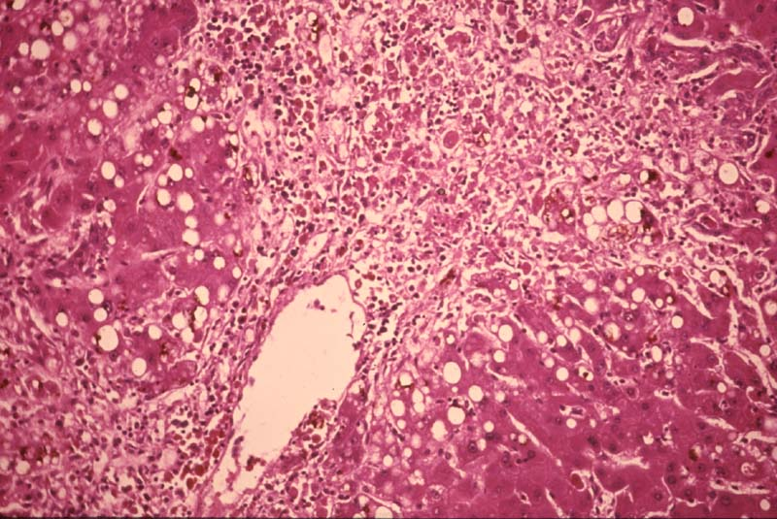
Hepatic necrosis (patient poisoned by carbon tetrachloride)
This is a lesion
caused by
chemical agent

Slide 30
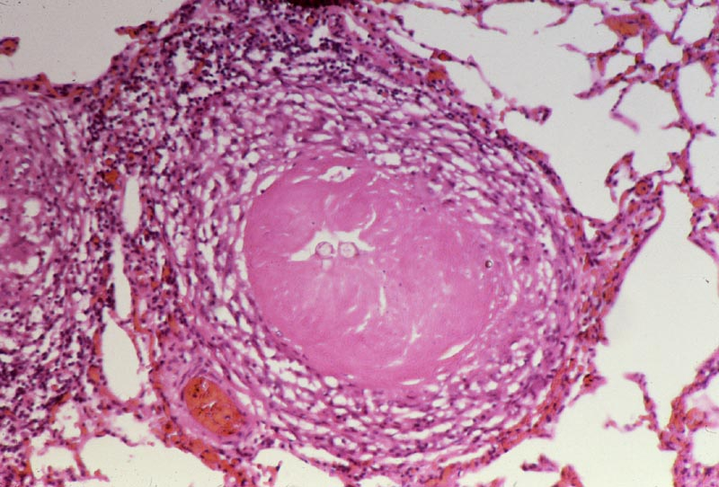
Pulmonary caseous necrosis (coccidioidomycosis)
This is a lesion
caused by
infectious agent

Slide 31
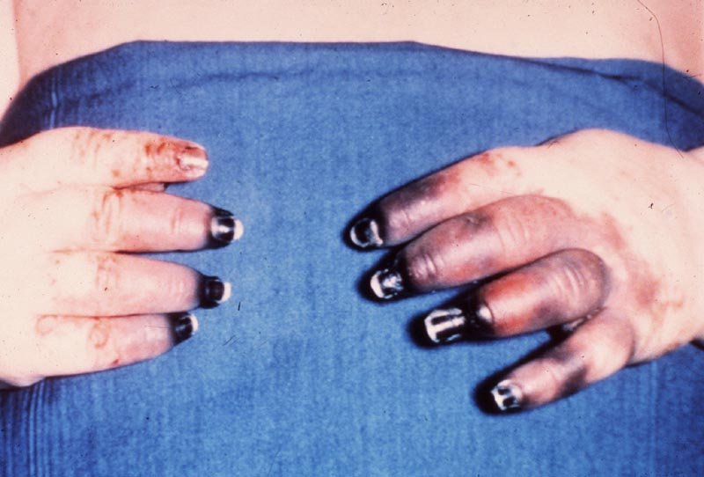
Gangrenous necrosis of fingers secondary to freezing
This is a lesion
caused by
physical agent

Slide 32
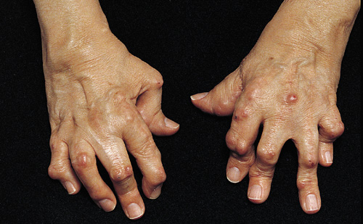
The “boutonnière” (buttonhole) deformity
This is a lesion
caused by
intrinsic factors
(autoimmune disease)

Slide 33
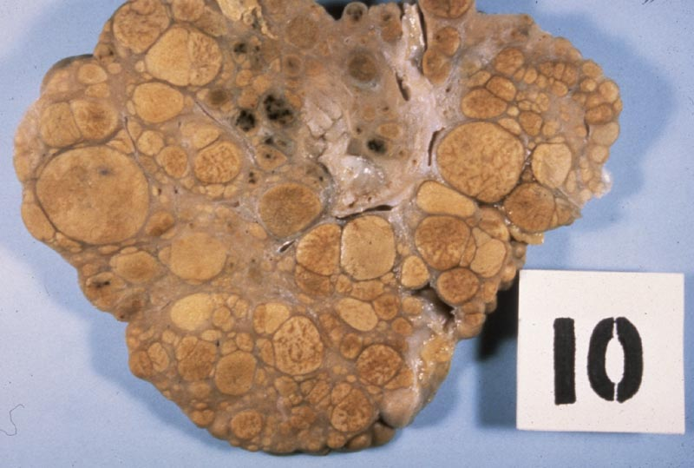
Liver: macronudular cirrhosis (HBV)
This is a lesion
caused by
infectious agent:
Viral hepatitis
(chemical:alcohol, genetic:α1-AT deficiency)

Slide 34
morphology of cells in reversible and irreversible injury

Slide 35
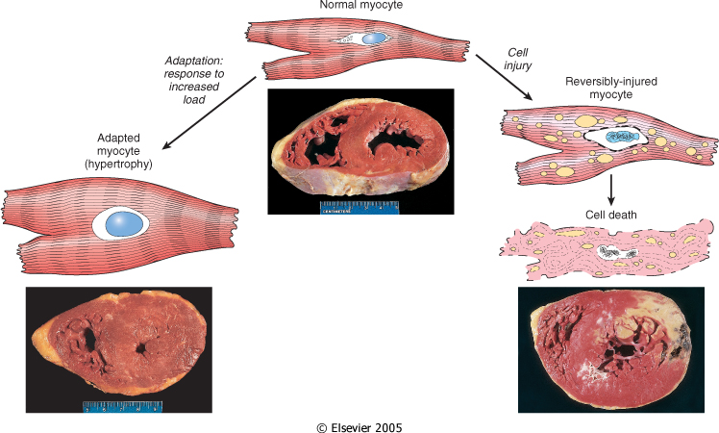
myocadial cells: loss of function after 1-2 min of ischemia
However do not die until 20 to 30 min of ischemia
EM: 2-3 hours, LM 6-12 hours

Slide 36
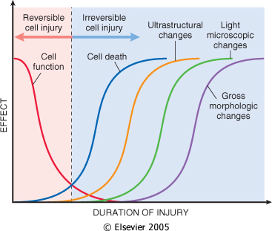

Slide 37
Morphologic changes in Reversible Injury
Early changes:
(1) Cloudy swelling or hydropic changes: Cytoplasmic swelling and vacuolar degeneration due to intracellular accumulation of water and electrolytes secondary to failure of energy-dependent sodium pump.
(2) Mitochondrial and endoplasmic reticulum swelling due to
loss of osmotic regulation.
(3) Clumping of nuclear chromatin.

Slide 39
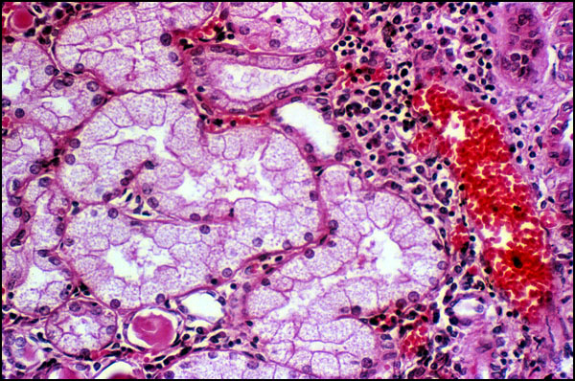
Vacuolar (hydropic) change in cells lining the proximal tubules of the kidney
Reversible
changes

Slide 40
Morphologic changes in irreversible injury:
1. Severe vacuolization of the mitochondria, with
accumulation of calcium-rich densities.
2. Extensive damage to plasma membranes.
3. Massive calcium influx activate phospholipase, proteases, ATPase and endonucleases with break down of cell component.
4. Leak of proteins, ribonucleic acid and metabolite.
5. Breakdown of lysosomes with autolysis.
6. Nuclear changes: Pyknosis, karyolysis, karyorrhexis.

Slide 42
IRREVERSIBLE CELL INJURY- NECROSIS

Slide 43
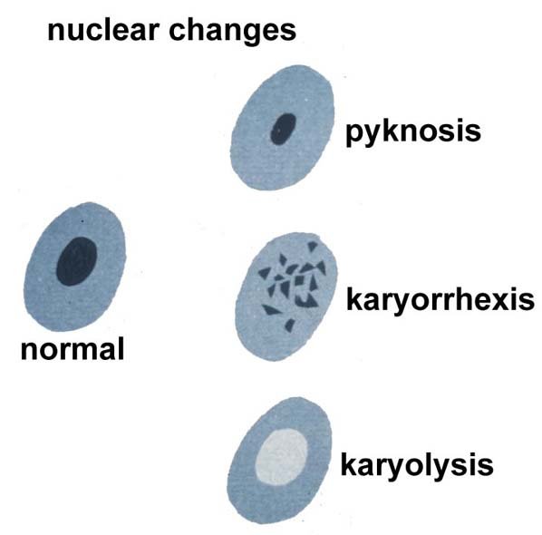

Slide 45
Morphologic changes in irreversible injury
- Dead cell are either collapsed and form a
whorled phospholipid masses or degraded
into fatty acid with calcification.
- Cellular enzymes are released into circula-
tion. This provides important clinical
parameter of cell death
e.g. increased level of creatinin kinase in blood after myocardial infarction

Slide 46
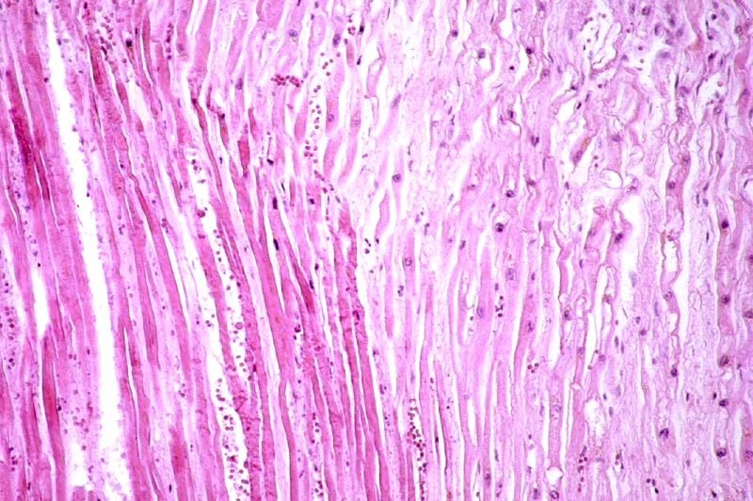
Myocardial infarct
Cell Pathology
This is a lesion
caused by
oxygen
deprivation

Slide 47
MECHANISMS OF CELL INJURY
General principles:
The cellular response to injurious stimuli depends on
1. type of injury
2. Its duration
3. Severity
The consequences depend on
the type, status, adaptability, and genetic makeup of the injured cell.
The structural and biochemical components of a cell are so integrally connected that multiple secondary effects rapidly occur
Cellular function is lost far before cell death occurs

Slide 48
TAKE HOME MESSAGES:
Cell injury is common event and the body respond by adaptation to a certain limit.
Adaptation include atrophy, hypertrophy, hyperplasia and metaplasia.
Cellular injury is caused by various elements include bacterial toxins, hypoxia, alcohol, viruses and radiation.
Cellular injury could be reversible (sublethal) or irreversible (lethal).

Slide 49
Thank You ☺
(Foundation Block, pathology)
Dr. Maha Arafah
15-9-2011

