Slide 1
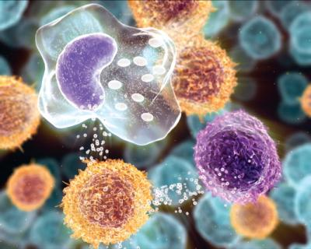
Inflammation and Repair
INFLAMMATION AND REPAIR
Lecture 1
Definition of inflammation; acute inflammation
Vascular Events in Inflammation
(Foundation Block, pathology)
2012
Lecturer: Dr. Maha Arafah
Dr. Maha Arafah

Slide 2
Learning Objectives:
Upon completion of these lectures, the student should:
Define inflammation.
Recognize the cardinal signs of inflammation.
List cells & molecules that play important roles in inflammation
Compare between acute and chronic inflammation
Describe the sequence of vascular changes in acute inflammation (vasodilation, increased permeability) and their purpose.
Know the mechanisms of increased vascular permeability.
Compare normal capillary exchanges with exchange during inflammatory response.
Define the terms edema, transudate, and exudate.

Slide 3
Reference book and the relevant page numbers..
Robbins Basic Pathology 9th edition
Page: 29 - 34

Slide 4
Injury
Tissue damage
Tissue response
Eliminates the effect of injury
Repair

Slide 5
What is Inflammation?
Inflammation, the local response of the vascularized living tissue to injury
A series of events start which leads as far as possible to the healing and reconstitution of the damaged tissue.
➔ Therefore, Inflammation is part of a broader protective response (innate immunity )
Cause : Infection, trauma, physical injury,
chemical injury, immunologic injury, tissue death
Aim: eliminate the initial cause of cell injury as well as the necrotic cells and tissues resulting from the original insult

Slide 6
Can inflammation be harmful ! ?
Inflammation can induce harm:
e.g. anaphylactic reaction
rheumatoid arthritis
atherosclerosis

Slide 7
What happens then?
Inflammation is terminated when the offending agent is eliminated and the secreted mediators are broken down or dissipated.
There are active anti-inflammatory mechanisms that serve to control the response and prevent it from causing excessive damage to the host.

Slide 8
Learning Objectives:
Upon completion of these lectures, the student should:
Define inflammation.
Recognize the cardinal signs of inflammation.
List cells & molecules that play important roles in inflammation
Compare between acute and chronic inflammation
Describe the sequence of vascular changes in acute inflammation (vasodilation, increased permeability) and their purpose.
Know the mechanisms of increased vascular permeability.
Compare normal capillary exchanges with exchange during inflammatory response.
Define the terms edema, transudate, and exudate.

Slide 9
What are the cardinal signs of inflammation?
Local clinical signs of acute inflammation :
Heat
Redness
Swelling
Pain
Loss of function

Slide 10
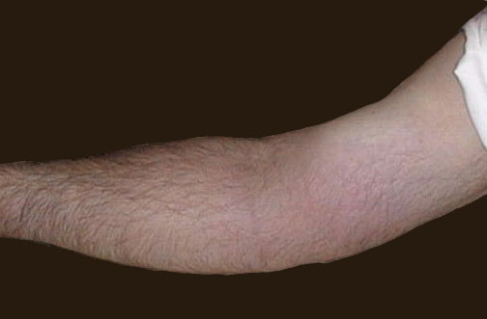
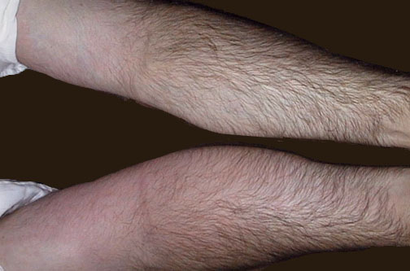
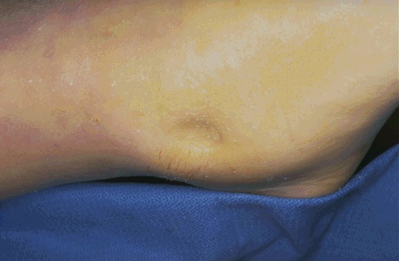
Swelling
Redness
Notes:
The cardinal signs of inflammation are rubor (redness), calor (heat), tumor (swelling), dolor (pain), and loss of function. Seen here is skin with erythema, compared to the more normal skin at the far right.

Slide 11
Learning Objectives:
Upon completion of these lectures, the student should:
Define inflammation.
Recognize the cardinal signs of inflammation.
List cells & molecules that play important roles in inflammation
Compare between acute and chronic inflammation
Describe the sequence of vascular changes in acute inflammation (vasodilation, increased permeability) and their purpose.
Know the mechanisms of increased vascular permeability.
Compare normal capillary exchanges with exchange during inflammatory response.
Define the terms edema, transudate, and exudate.

Slide 12
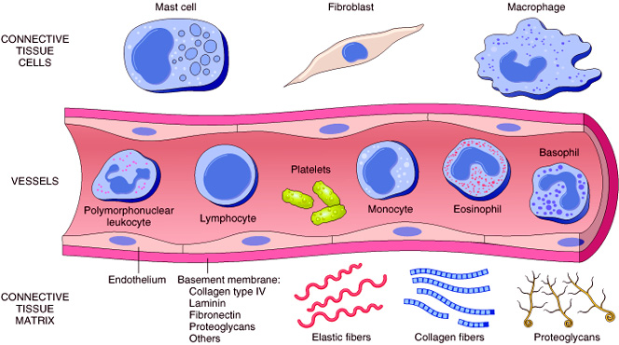
Cells & molecules that play important roles in inflammation
Cells of surrounding C.T.
The circulating cells:
Blood leukocytes
Plasma proteins
Extracellularmatrix of surrounding C.T.
Cells of vascular wall
The extracellular matrix

Slide 13
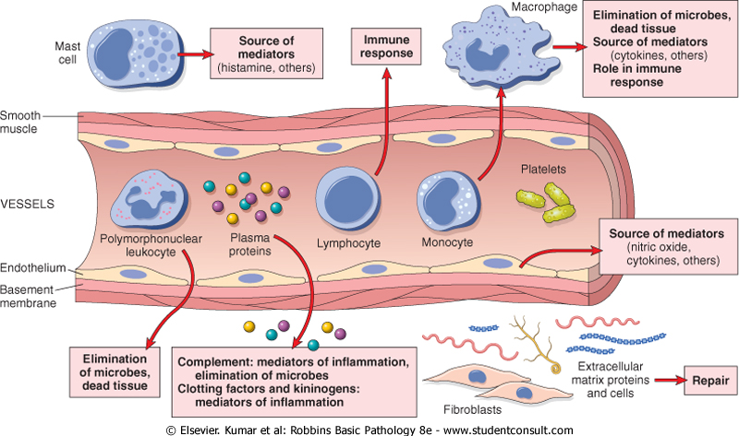

Slide 14
Chemical Mediators
Inflammation is mediated by chemical substances called
What is the source of these chemical mediators?
1. Phagocytes and other host cells
Leukocyte
Endothelium
Mast cell
2. Plasma proteins

Slide 15
Learning Objectives:
Upon completion of these lectures, the student should:
Define inflammation.
Recognize the cardinal signs of inflammation.
List cells & molecules that play important roles in inflammation
Compare between acute and chronic inflammation
Describe the sequence of vascular changes in acute inflammation (vasodilation, increased permeability) and their purpose.
Know the mechanisms of increased vascular permeability.
Compare normal capillary exchanges with exchange during inflammatory response.
Define the terms edema, transudate, and exudate.

Slide 16
TYPES OF Inflammation
Acute inflammation
Chronic Inflammation

Slide 17
Features of acute and chronic inflammation
Chronic | Acute | Feature
Slow : days weeks | Fast : minutes or hours | Onset
lymphocytes and macrophages | neutrophils | Cellular infiltrate
Often sever & progressive | Mild, self limited | Tissue injury, fibrosis
Less prominent, may be subtle | Prominent | Local & systemic signs

Slide 18
Acute inflammation
A rapid response to an injurious agent that serves to deliver mediators of host defense-leukocytes and plasma proteins-to the site of injury.
What are the steps of the inflammatory response?
5Rs
(1) Recognition of the injurious agent
(2) Recruitment of leukocytes
(3) Removal of the agent
(4) Regulation (control) of the response
(5) Resolution

Slide 19
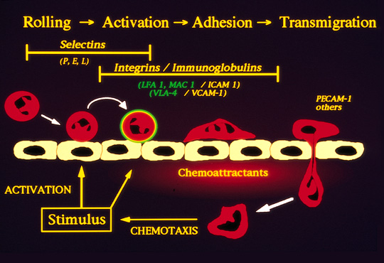

Slide 20
Learning Objectives:
Upon completion of these lectures, the student should:
Define inflammation.
Recognize the cardinal signs of inflammation.
List cells & molecules that play important roles in inflammation
Compare between acute and chronic inflammation
Describe the sequence of vascular changes in acute inflammation (vasodilation, increased permeability) and their purpose.
Know the mechanisms of increased vascular permeability.
Compare normal capillary exchanges with exchange during inflammatory response.
Define the terms edema, transudate, and exudate.

Slide 21
Events of acute Inflammation
Acute inflammation has three main events:
(1) Hemodynamic changes
(alterations in vascular caliber that lead to an increase in blood flow)
(2) Increased vascular permeability
(structural changes in the microvasculature that permit plasma proteins and leukocytes to leave the circulation)
(3) Emigration of the leukocytes from the microcirculation
(their accumulation in the focus of injury, and their activation to eliminate the offending agent)
vascular
cellular
Notes:
9

Slide 22
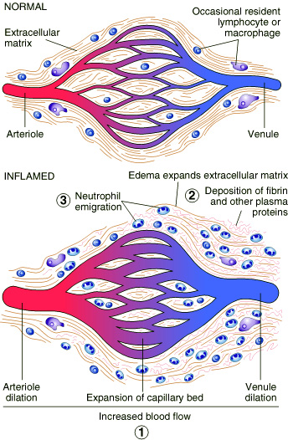
Vascular Events
Vasodilatation
1. Hemodynamic change

Slide 23
Phases of changes in Vascular Caliber and Flow
1. Transient vasoconstriction of arterioles
It disappears within 3-5 seconds in mild injuries
2. Vasodilatation: It involves the arterioles results in opening of new microvasculature beds in the area leading to increasing blood flow
3. Slowing of the circulation due to increased permeability of the microvasculature, this leads to outpouring of protein-rich fluid in the extravascular tissues.
4. stasis: slow circulation due to dilated small vessels packed with red cells

Slide 24
Learning Objectives:
Upon completion of these lectures, the student should:
Define inflammation.
Recognize the cardinal signs of inflammation.
List cells & molecules that play important roles in inflammation
Compare between acute and chronic inflammation
Describe the sequence of vascular changes in acute inflammation (vasodilation, increased permeability) and their purpose.
Know the mechanisms of increased vascular permeability.
Compare normal capillary exchanges with exchange during inflammatory response.
Define the terms edema, transudate, and exudate.

Slide 25
2. Increased Vascular Permeability
A hallmark of acute inflammation (escape of a protein-rich fluid).
It affects small & medium size venules, through gaps between endothelial cells

Slide 26
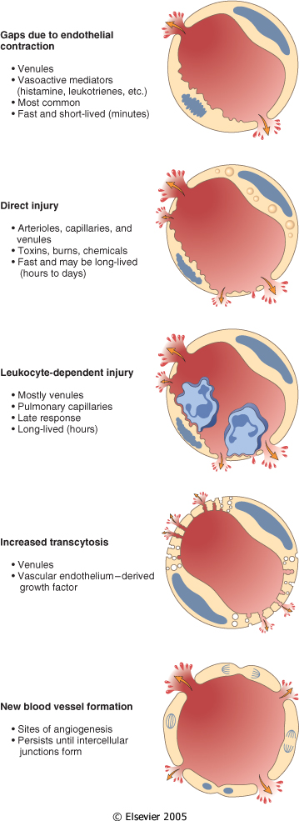
Mechanisms lead to increased vascular permeability
Endothelial cell contraction 15-30 min
Endothelial injury
immediate sustained response 6-24 hours
delayed prolonged leakage 12 hours- days
Leukocyte-mediated endothelial injury
Transcytosis (occurs via channels formed by fusion of intracellular vesicles)
Leakage from new blood vessels

Slide 27
Learning Objectives:
Upon completion of these lectures, the student should:
Define inflammation.
Recognize the cardinal signs of inflammation.
List cells & molecules that play important roles in inflammation
Compare between acute and chronic inflammation
Describe the sequence of vascular changes in acute inflammation (vasodilation, increased permeability) and their purpose.
Know the mechanisms of increased vascular permeability.
Compare normal capillary exchanges with exchange during inflammatory response.
Define the terms edema, transudate, and exudate.

Slide 28
Increased blood volume lead to increased local hydrostatic pressure leading to transudation of protein-poor fluid into the extravascular space.
What is the edema?
denotes an excess of fluid in the interstitial or serous cavities
It can be either an exudate or a transudate

Slide 30
Learning Objectives:
Upon completion of these lectures, the student should:
Define inflammation.
Recognize the cardinal signs of inflammation.
List cells & molecules that play important roles in inflammation
Compare between acute and chronic inflammation
Describe the sequence of vascular changes in acute inflammation (vasodilation, increased permeability) and their purpose.
Know the mechanisms of increased vascular permeability.
Compare normal capillary exchanges with exchange during inflammatory response.
Define the terms edema, transudate, and exudate.

Slide 31
What is the difference between transudates and exudates?
Transudate
is a fluid with low protein content and a specific gravity of less than 1.012
It is essentially an ultrafiltrate of blood plasma that results from osmotic or hydrostatic imbalance across the vessel wall
without an increase in vascular permeability
Exudate
An inflammatory extravascular fluid that has a high protein concentration, cellular debris, and a specific gravity above 1.020
It implies significant alteration in the normal permeability of small blood vessels in the area of injury

Slide 32
TAKE HOME MESSAGES
Inflammation, the local response of the vascularised living tissue to injury.
Could be acute or chronic.
Several cells & molecules that play important roles in inflammation.
Inflammation has vascular and cellular events to eliminate the cause.
Vascular events include vasodilation and increased permeability to deliver a protein rich fluid to site of inflammation.

Slide 33
Thank you

