Slide 1
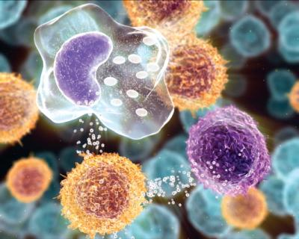
Inflammation and Repair
INFLAMMATION AND REPAIR
Lecture 2
Cellular Events in Inflammation
(Foundation Block, pathology)
Lecturer name:
Maha Arafah
Associate Professor
Department of Pathology
King Khalid University Hospital and King Saud University
Email: marafah@ksu.edu.sa
marafah @hotmail.com
2012
Dr. Maha Arafah

Slide 2
Objectives
Upon completion of this lecture, the student should:
Describe the steps involved in extravasation of leukocytes from the blood to the tissues. Know the steps at which selectins and integrins act.
Describe the meaning and utility of chemotaxis. Understand the role that chemokines play in inflammation.
Describe the steps involved in phagocytosis and the role of IgG and C3b as opsonins and receptors.
Know various defects in leukocyte function.

Slide 3
Reference book and the relevant page numbers..
Robbins Basic Pathology 9th edition, pages 34-41

Slide 4
Acute Inflammation CELLULAR EVENTS: LEUKOCYTE EXTRAVASATION AND PHAGOCYTOSIS
A critical function of inflammation is to deliver leukocytes to the site of injury and to activate the leukocytes to perform their normal functions in host defense.
WHAT ARE THESE FUNCTION?
Leukocytes ingest offending agents, kill bacteria and other microbes, and get rid of necrotic tissue and foreign substances.
They may induce tissue damage and prolong inflammation, since the leukocyte products that destroy microbes and necrotic tissues can also injure normal host tissues.

Slide 5
Recruitment of leukocytes
A multistep process involving attachment of circulating leukocytes to endothelial cells and their migration through the endothelium (extravasation)
3 steps:
In the lumen:
Margination
rolling
adhesion to endothelium
Vascular endothelium normally does not bind circulating cells
Transmigration across the endothelium (also called diapedesis)
Migration in interstitial tissues toward a chemotactic stimulus

Slide 6
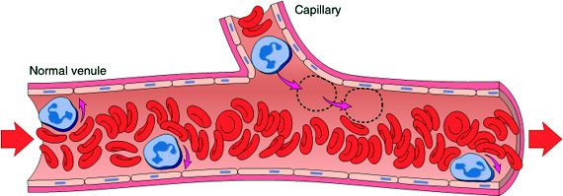
Acute Inflammation CELLULAR EVENTS: LEUKOCYTE EXTRAVASATION AND PHAGOCYTOSIS
Margination

Slide 7
Notes:
2. LEUKOCYTE INFILTRATION AND PHAGOCYTOSIS
The next phase, which we will now examine, is the migration of WBC
from the circulation to the site of injury.
Leukocyte Exudation
The most striking finding in inflammation under the microscope - what
we call a "pathognomonic" feature - is the presence of leukocytes. The sequence
events in leukocyte infiltration (SLIDE) can be divided into (1) margination, (2)
sticking, (3) emigration and (4) phagocytosis.
In a typical course of inflammatory events, vasodilation, transudation,
and then slowing of circulation occurs as the blood viscosity increases. As stasis
develops, one begins to see the peripheral orientation of leukocytes, principally
neutrophils, along the vascular endothelium (margination). Leukocytes first stick
transiently and then more avidly (sticking). Soon after they migrate through the
vascular wall into the interstitial tissue (emigration).

Slide 8
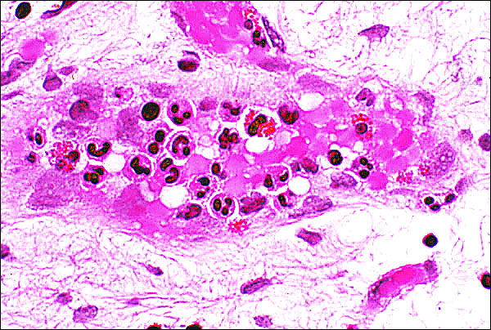
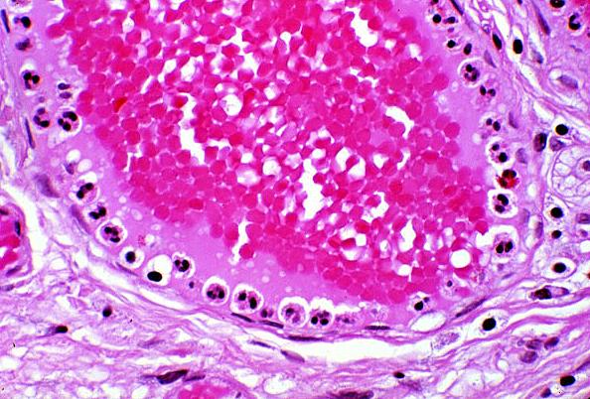
Leukocytes Rolling
Within a Venule
Margination
because blood flow slows early in inflammation (stasis), the endothelium can be lined by white cells
(pavementation)

Slide 9
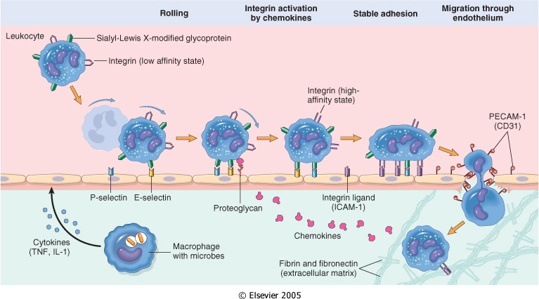
LEUKOCYTE EXTRAVASATION AND PHAGOCYTOSIS
Resident tissue macrophages, mast cells, and endothelial cells respond to injurious agents by secreting the cytokines TNF, IL-1, and chemokines

Slide 10
Leukocyte Adhesion and Transmigration
Mediators such as histamine, thrombin, and platelet activating factor (PAF) stimulate the redistribution of P-selectin from its normal intracellular stores in granules (Weibel-Palade bodies) to the cell surface.

Slide 11
Adhesion Molecules and Receptors
1. Selectins, consist of:
E-selectin , confined to endothelium
P-selectin , present in endothelium and platelets
L-selectin , expressed on most leukocyte and endothelium

Slide 12
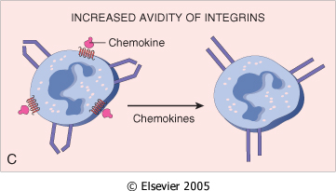
Adhesion Molecules and Receptors
2. Integrins
are transmembrane heterodimeric glycoproteins, made up of α and β chains
expressed on many cell types and bind to ligands on endothelial cells, other leukocytes, and the extracellular matrix
rolling

Slide 13
Adhesion Molecules and Receptors
3. The immunoglobulin family molecules :
ICAM-1 (intercellular adhesion molecule 1)
VCAM-1 (vascular cell adhesion molecule 1)
induced by TNF and IL-1
adhesion to endothelium

Slide 14
Adhesion Molecules and Receptors
4. Mucin-like glycoproteins
- these glycoproteins are found in the extracellular matrix and on cell surfaces.
Neutrophils, monocytes, lymphocytes, eosinophils, and basophils all use the same pathway to migrate from the blood into tissues.

Slide 15
Leukocyte Adhesion and Transmigration
Migration of the leukocytes through the endothelium is called:
Transmigration
or Diapedesis
Diapedesis occurs predominantly in the venules
BV lumen
Extravascular
Chemokines act on the adherent leukocytes and stimulate the cells to migrate toward the site of injury or infection

Slide 16
Leukocyte Adhesion and Transmigration
The type of emigrating leukocyte varies with the age of the inflammatory response
In most forms of acute inflammation: neutrophils predominate in the inflammatory infiltrate during the first 6 to 24 hours, then are replaced by monocytes in 24 to 48 hours
In Chronic inflammation macrophages, lymphocytes and plasma cell are found
WHY?

Slide 17
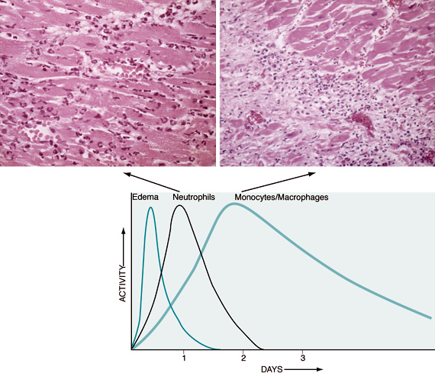
Leukocyte Adhesion and Transmigration
WHY?
neutrophils are more numerous in the blood, they respond more rapidly to chemokines,
but are short-lived; they undergo
apoptosis and disappear after 24 to 48 hours,
whereas monocytes survive longer.

Slide 18
Leukocyte Adhesion and Transmigration
The type of emigrating leukocyte varies with the type of stimulus:
In viral infections, lymphocytes may be the first cells to arrive
In some hypersensitivity reactions and parasitic infection, eosinophil may be the main cell type

Slide 19
Chemotaxis
After extravasation, leukocytes emigrate in tissues toward the site of injury by a process called chemotaxis, defined as locomotion oriented along a chemical gradient !!!!
chemoattractants

Slide 20
Chemotaxis Chemoattractants
Exogenous and endogenous substances
The most common exogenous agents are bacterial products.
Endogenous chemoattractants include several chemical mediators:
components of the complement system, particularly C5a
products of the lipoxygenase pathway, mainly leukotriene B₄ (LTB₄)
cytokines, particularly those of the chemokine family (e.g., IL-8).

Slide 21
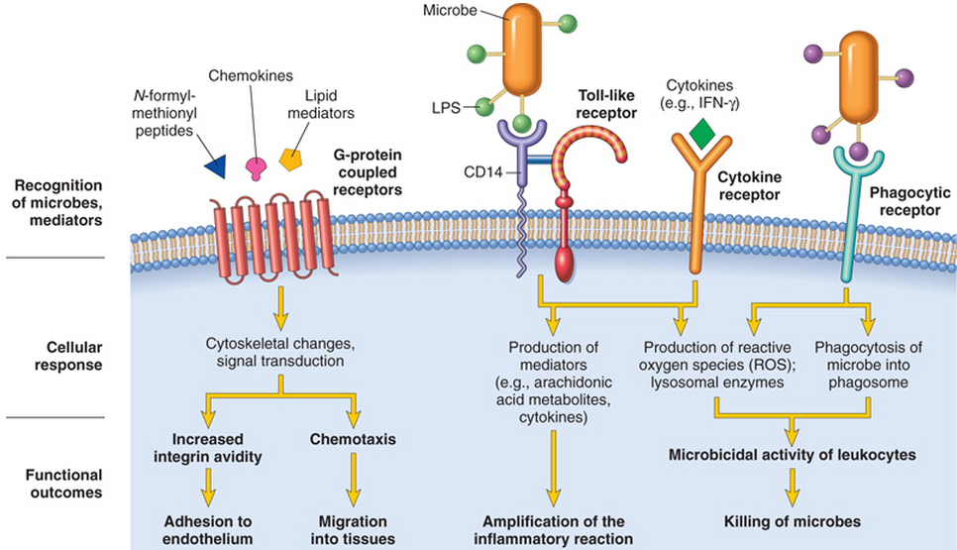
All these chemotactic agents bind to specific seven-transmembrane G-protein-coupled receptors (GPCRs) on the surface of leukocytes.

Slide 22
Phagocytosis

Slide 23
Phagocytosis
Phagocytosis involves three distinct but interrelated steps
Recognition and Attachment of the particle to be ingested by the leukocyte
(2) its Engulfment, with subsequent formation of a phagocytic vacuole
(3) killing or Degradation of the ingested material.

Slide 24
Leukocyte activation (1) recognition and attachment (Opsonization)
Is the process of coating a particle, such as a microbe, to target it for phagocytosis
The substances that do this are opsonins.
These substances include:
antibodies (IgG)
complement proteins (C3)
And others: lectins (mannose-binding lectin (MBL), fibronectin, fibrinogen, and C-reactive protein
These can coat microbes and are recognized by receptors on phagocytes (Fc and C3b receptors).

Slide 25
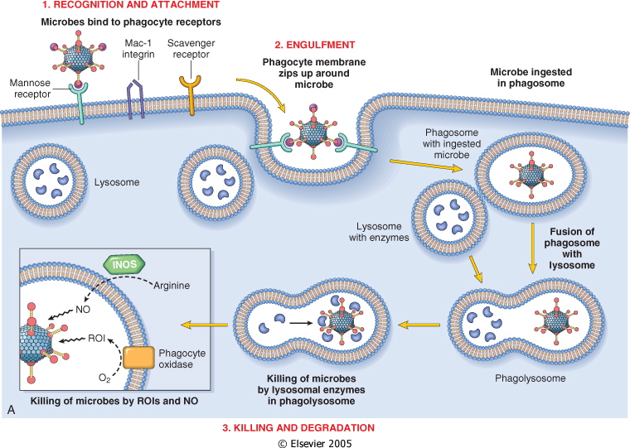

Slide 26
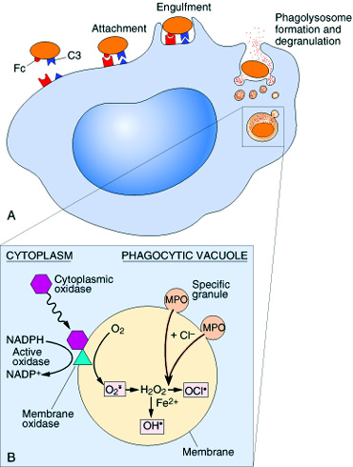
Phagocytosis 2. Engulfment
During engulfment, extensions of the cytoplasm (pseudopods) flow around the particle to be engulfed, eventually resulting in complete enclosure of the particle within a phagosome
The phagocytic vacuole then fuses with a lysosomal granule, resulting in phagolysosome

Slide 27
Phagocytosis Killing and Degradation
2 mechanisms for Microbial killing:
1. Oxygen-dependent mechanisms
2. Oxygen-independent mechanisms

Slide 28
Oxygen-dependent mechanisms
The H₂O₂-MPO-halide system is the most efficient bactericidal system in neutrophils

Slide 29
Phagocytosis 3. Killing and Degradation
Oxygen-independent mechanisms
through the action of substances in leukocyte granules. These include:
bactericidal permeability increasing protein (BPI
lysozyme
lactoferrin
major basic protein
defensins
In addition, neutrophil granules contain many enzymes, such as elastase, that also contribute to microbial killing

Slide 30
Phagocytosis

Slide 31
Defects in Leukocyte Function
Defects in leukocyte function, both genetic and acquired, lead to increased vulnerability to infections:
Defects in leukocyte adhesion
Defects in microbicidal activity
Defects in phagolysosome function.

Slide 32
Defects in Leukocyte Function
Genetic
Leukocyte adhesion deficiency 1and 2
Chronic granulomatous disease
Decreased oxidative burst. 2 types:
X-linked:
NADPH oxidase (membrane component)
Autosomal recessive:
NADPH oxidase (cytoplasmic components)
Myeloperoxidase deficiency
(absent MPO-H2O2 system)
Chédiak-Higashi syndrome
Protein involved in organelle membrane fusion (no phagolysosomes)

Slide 33
Defects in Leukocyte Function
Acquired
Thermal injury, diabetes, malignancy, sepsis, immunodeficiencies
Chemotaxis
Hemodialysis, diabetes mellitus
Adhesion
Leukemia, anemia, sepsis, diabetes, neonates, malnutrition
Phagocytosis and microbicidal activity

Slide 34
TAKE HOME MESSAGES:
Several steps are involved in extravasation of leukocytes from the blood to the tissues.
Phagocytosis is important step to get rid of necrotic material and bacteria.
Various defects in leukocyte function are present. These could be genetic defects or acquired.

