Slide 1
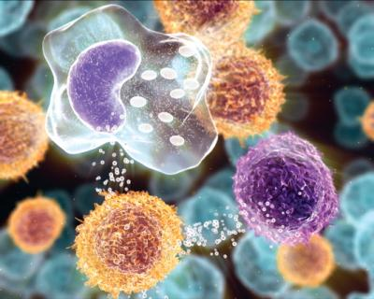
INFLAMMATION AND REPAIR
Lecture 3
Chemical Mediators in Inflammation and
Patterns of Acute Inflammation
Foundation block: pathology
Dr. Maha Arafah
2012

Slide 2
Chemical mediators outcome of acute inflammation

Slide 3
Objectives
Upon completion of this lecture, the student should:
List and describe the outcome of acute inflammation.
Recognize the different pattern of inflammation.
Define the chemical mediators of inflammation.
Know the general principles for chemical mediators.
Know the cellular sources and major effects of the mediators.
List the most likely mediators of each of the steps of inflammation.

Slide 4
Outcomes of Acute Inflammation
Acute inflammation may have one of the four outcomes:
Complete resolution
Healing by connective tissue replacement (fibrosis)
Progression of the tissue response to chronic inflammation
Abcess formation

Slide 5
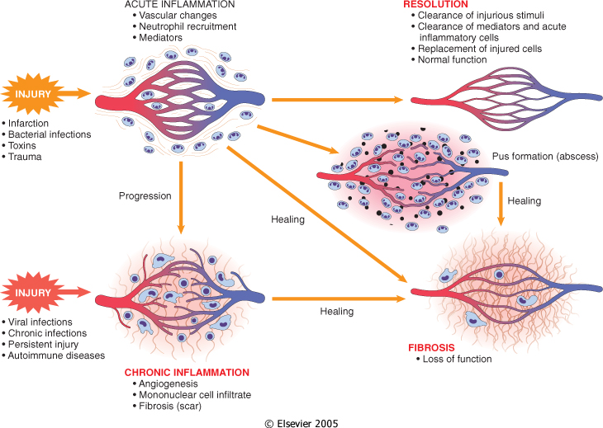

Slide 6
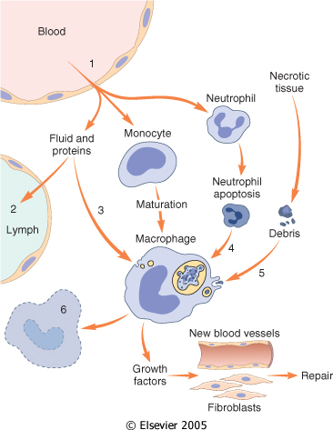
Events in the resolution of inflammation

Slide 7
Objectives
Upon completion of this lecture, the student should:
List and describe the outcome of acute inflammation.
Recognize the different pattern of inflammation.
Define the chemical mediators of inflammation.
Know the general principles for chemical mediators.
Know the cellular sources and major effects of the mediators.
List the most likely mediators of each of the steps of inflammation.

Slide 8
Morphologic Patterns of Acute Inflammation
Several types of inflammation vary in their morphology and clinical correlates. Why?
The severity of the reaction
specific cause
the particular tissue
site involved

Slide 9
Morphologic Patterns of Acute Inflammation
SEROUS INFLAMMATION
FIBRINOUS INFLAMMATION
SUPPURATIVE OR PURULENT INFLAMMATION
ULCERS

Slide 10
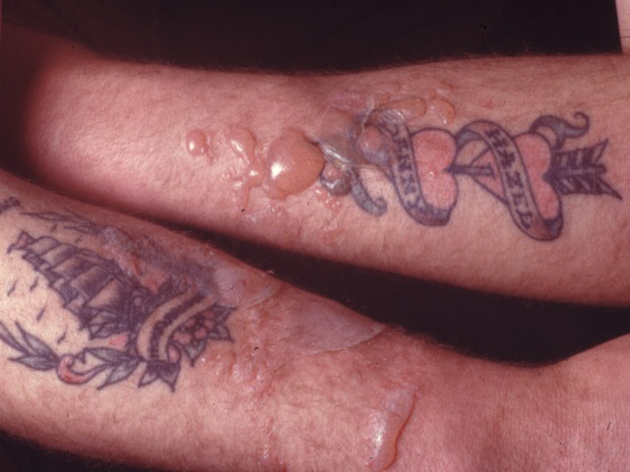
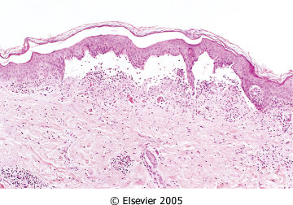
SEROUS INFLAMMATION: marked by the outpouring of a thin fluid

Slide 11
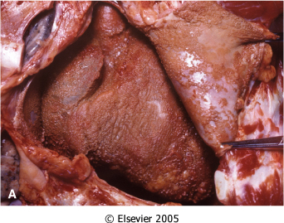
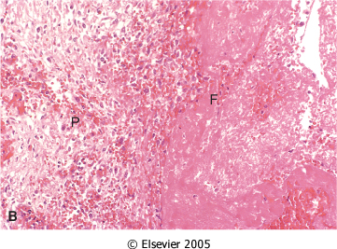
FIBRINOUS INFLAMMATION
A fibrinous exudate is characteristic of inflammation in the lining of body cavities, such as the meninges, pericardium and pleura (larger molecules such as fibrinogen pass the vascular barrier)
Fibrinous exudates may be removed by fibrinolysis, if not: it may stimulate the ingrowth of granulation tissue (organization)

Slide 12
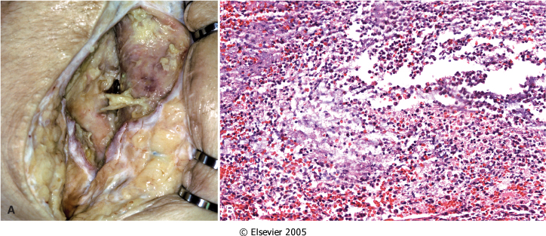
Morphologic Patterns of Acute Inflammation SUPPURATIVE OR PURULENT INFLAMMATION
characterized by the production of large amounts of pus or purulent exudate consisting of neutrophils, necrotic cells, and edema fluid caused by as pyogenic (pus-producing) bacteria

Slide 13
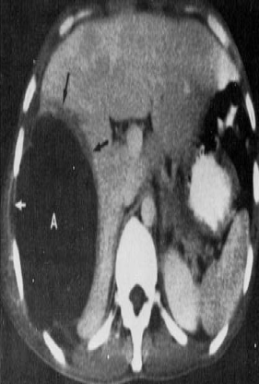
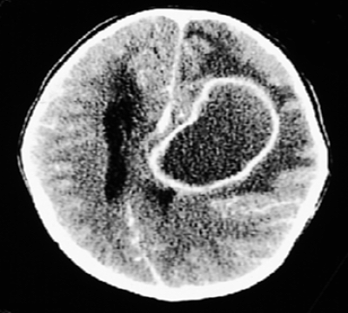
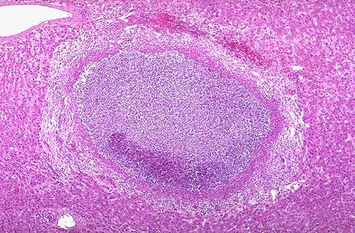
Morphologic Patterns of Acute Inflammation SUPPURATIVE OR PURULENT INFLAMMATION
Abscesses : localized collections of purulent inflammatory tissue caused by suppuration buried in a tissue, an organ, or a confined space

Slide 14
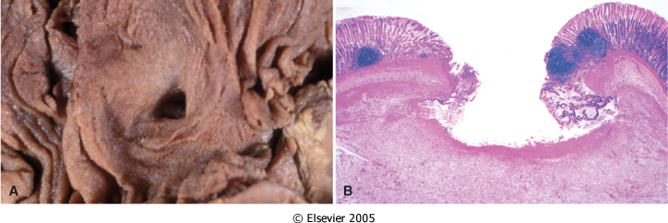
ULCERS
An ulcer is a local defect of the surface of an organ or tissue that is produced by the sloughing (shedding) of inflammatory necrotic tissue
Epithelial Defect
Necrotic base
Fibrinopurulent exudates
Granulation tissue
Fibrosis

Slide 15
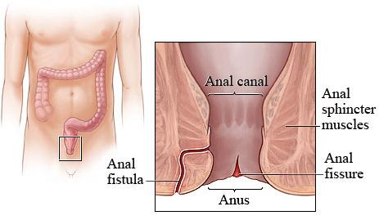
Fistula
A tract between two surfaces.

Slide 16
Objectives
Upon completion of this lecture, the student should:
List and describe the outcome of acute inflammation.
Recognize the different pattern of inflammation.
Define the chemical mediators of inflammation.
Know the general principles for chemical mediators.
Know the cellular sources and major effects of the mediators.
List the most likely mediators of each of the steps of inflammation.

Slide 17
What are mediators?
Chemical mediators of inflammation are substances produced during inflammation inducing a specific events in acute inflammation.

Slide 18
General principles for chemical mediators
The production of active mediators is triggered by:
microbial products
host proteins, such as the proteins of the complement, kinin and coagulation systems
( these are themselves activated by microbes and damaged tissues)

Slide 19
General principles for chemical mediators
Most mediators have the potential to cause harmful effects.
Therefore, there should be a mechanism to checks and balances their action.
Mediator function is tightly regulated by:
decay (e.g. AA metabolites)
inactivated by enzymes (kininase inactivates bradykinin)
eliminated ( antioxidants scavenge toxic oxygen metabolites)

Slide 20
Source of Chemical mediators
Plasma-derived:
Complement
kinins
coagulation factors
Many in “pro-form” requiring activation (enzymatic cleavage)
Cell-derived:
Synthesized as needed (prostaglandin)
Preformed, sequestered and released (mast cell histamine)

Slide 21
Notes:
.

Slide 23
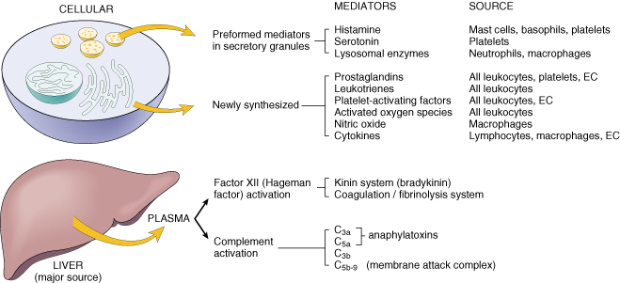
Cell-Derived Mediators
Producing cells:
Tissue macrophages
Mast cells
Endothelial cells
Leukocytes
Notes:
Endothelial cells at the site of inflammation
Leukocytes recruited to the site form the blood

Slide 24
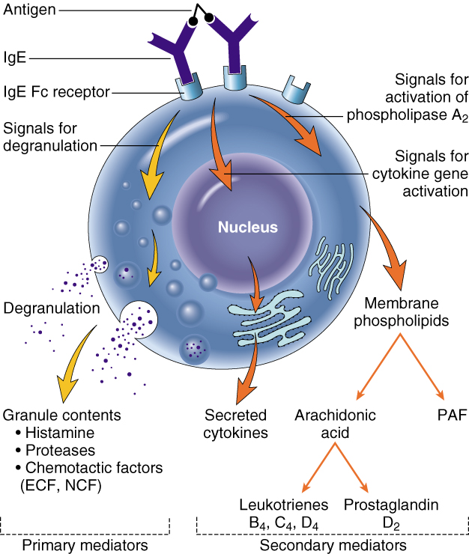
Vasoactive Amines Histamine & Serotonin
Among first mediators in acute inflammatory reactions
Preformed mediators in secretory granules

Slide 25
Histamine
Source:
many cell types, esp. mast cells, circulating basophils, and platelets
Stimuli of Release:
Physical injury
Immune reactions
C3a and C5a fragments
Leukocyte-derived histamine-
releasing proteins
Neuropeptides
Cytokines (e.g. IL-1 and IL-8)
Actions:
ARTERIOLAR DILATION
INCREASED VASCULAR PERMEABILITY (venular gaps)
ENDOTHELIAL ACTIVATION
Inactivated by:
Histaminase
Notes:
Histamine is the principal mediator of the immediate phase of increased vascular permeability, inducing venular endothelial contraction and interendothelial gaps.

Slide 26
Serotonin (5-HT)
Source:
Platelets
Action:
Similar to histamine
Stimulus:
Platelet aggregation

Slide 27
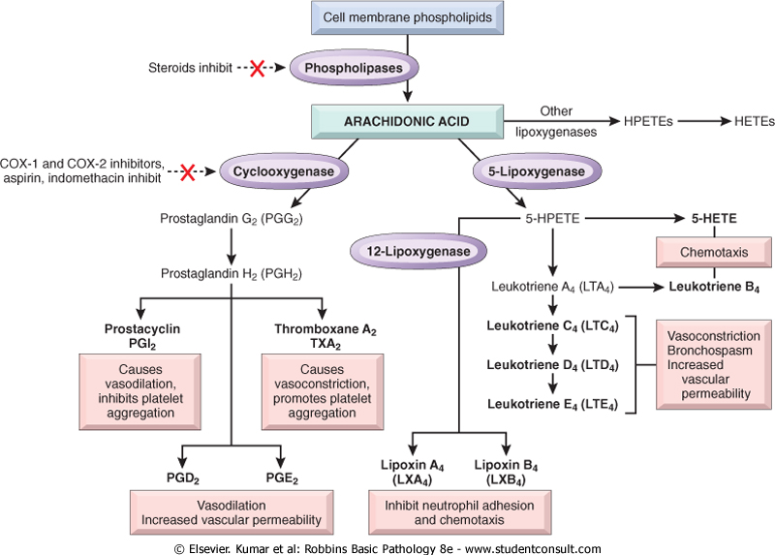
Source:
Leukocytes
Mast cells
Endothelial cells
Platelets
Notes:
.

Slide 28
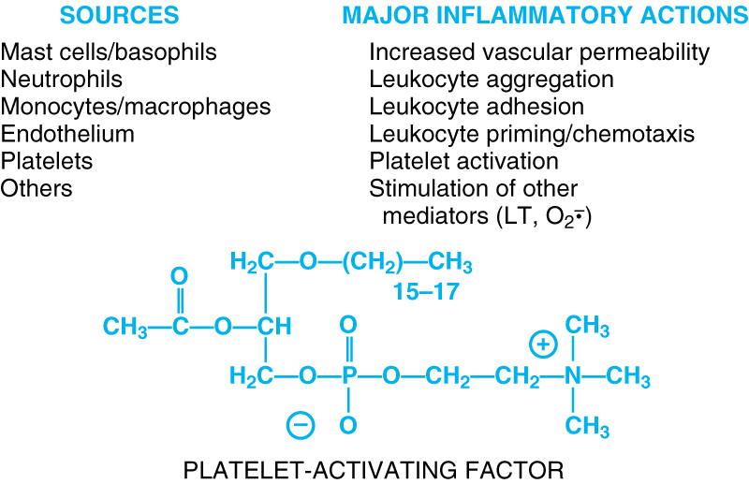
Notes:
.

Slide 29
Cytokines
Polypeptides
Actions:
Involved in early immune and inflammatory reactions
Some stimulate bone marrow precursors to produce more leukocytes
Notes:
.

Slide 30
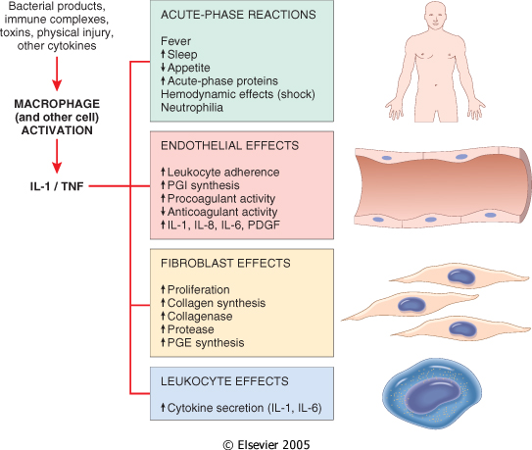
Cytokine of
Acute inflammation:
Interleukin (IL-1) & TNF

Slide 31
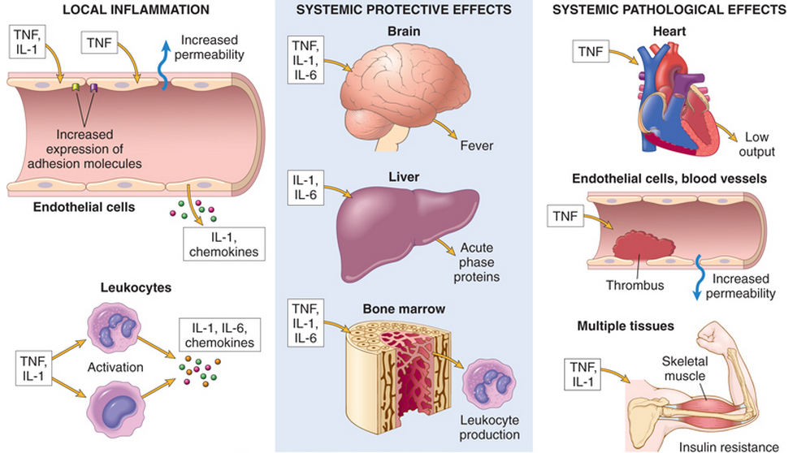

Slide 32
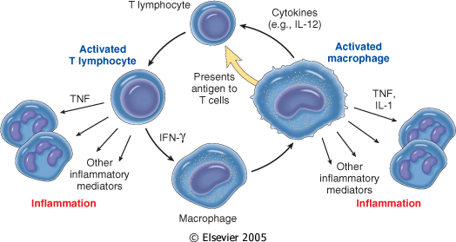
Chronic Inflammation:
Interferon-γ INF- γ & Interleukin ( IL-12)
Activated lymphocytes and macrophages influence each other and also release inflammatory mediators that affect other cells.

Slide 33
Chemokines
Small proteins
They are chemoattractants for leukocytes
Main functions:
Leukocyte recruitment & activation in inflammation
Normal anatomic organization of cells in lymphoid and other tissues
Notes:
.

Slide 34
Reactive Oxygen Species
Synthesized via
NADPH oxidase pathway
Source:
Neutrophils and Macrophages
Stimuli of release:
Microbes
Immune complexes
Cytokines
Action:
Microbicidial (cytotoxic) agent
Notes:
.

Slide 35
Nitric Oxide ( NO)
Short-lived
Soluble free-radical gas
Functions:
Vasodilation
Antagonism of platelet activation (adhesion, aggregation, & degranulation)
Reduction of leukocyte recruitment
Microbicidial (cytotoxic) agent (with or without ROS) in activated macrophages
Notes:
.

Slide 36
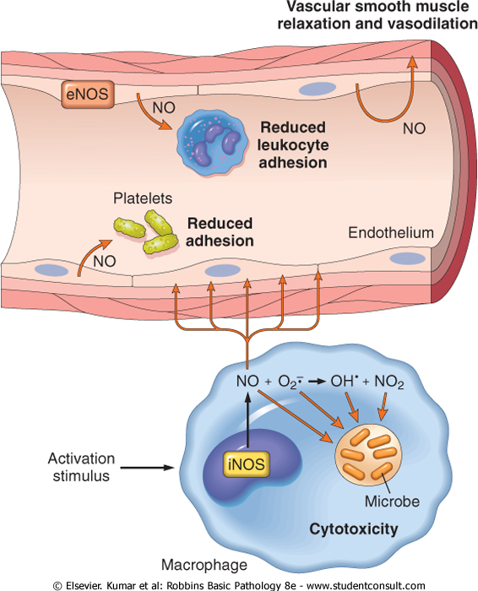

Slide 37
Lysosomal Enzymes of Leukocytes
Neutrophils & Monocytes
Enzymes:
Acid proteases
Neutral proteases (e.g. elastase, collagenase, & cathepsin)
Their action is checked by:
Serum antiproteases (e.g. α1-antitrypsin)
Notes:
.

Slide 38
Neuropeptides
Small proteins
Secreted by nerve fibers mainly in lung & GIT
Initiate inflammatory response
e.g. Substance P :
Transmits pain signals
Regulates vessel tone
Modulates vascular permeability
Notes:
.

Slide 40
PLASMA PROTEASES
A variety of phenomena in the inflammatory response are mediated by plasma proteins that belong to three interrelated systems
1. Kinin
2. the complement
3. clotting systems

Slide 41
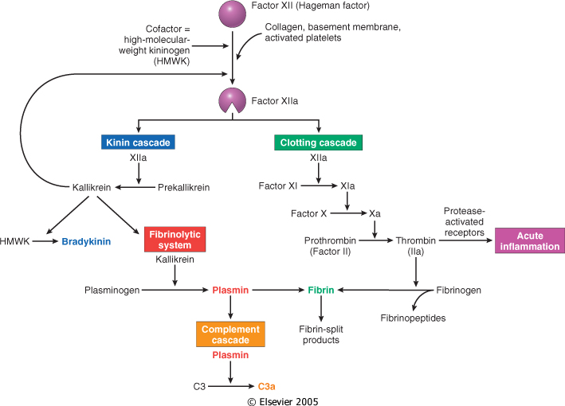
Kinin & clotting systems
enhanced leukocyte adhesion & activation
increases vascular permeability, pain
increases vascular permeability, Chemotaxis

Slide 42
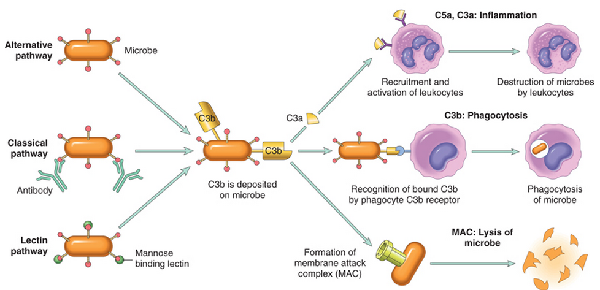
Complement System

Slide 43
Complement protein
C3a & C5a ➔ Increase vascular permeability (^ histamine)
anaphylatoxins
C5a ➔ Chemotaxis
C3b ➔ Opsonization
C5-9 ➔ membrane attack complex

Slide 44
Objectives
Upon completion of this lecture, the student should:
List and describe the outcome of acute inflammation.
Recognize the different pattern of inflammation.
Define the chemical mediators of inflammation.
Know the general principles for chemical mediators.
Know the cellular sources and major effects of the mediators.
List the most likely mediators of each of the steps of inflammation.

Slide 45
Vasodilation | Prostaglandins Histamine Nitric oxide
Increased vascular permeability | Vasoactive amines Bradykinin Leukotrienes C4, D4, E4 PAF Substance P
Chemotaxis, leukocyte recruitment and activation | C5a Leukotriene B4 Chemokines IL-1, TNF Bacterial products
Fever | IL-1, TNF Prostaglandins
Pain | Prostaglandins Bradykinin
Tissue damage | Neutrophil and macrophage lysosomal enzymes Oxygen metabolites Nitric oxide
Role of Mediators in Different Reactions of Inflammation

Slide 47
