Slide 1
Granulomatous diseases
Dr Shaesta Naseem
13-10-12

Slide 2
Gross and histopathology

Slide 3
1- Tuberculosis of the lung

Slide 4
Ghon’s Complex

Slide 5
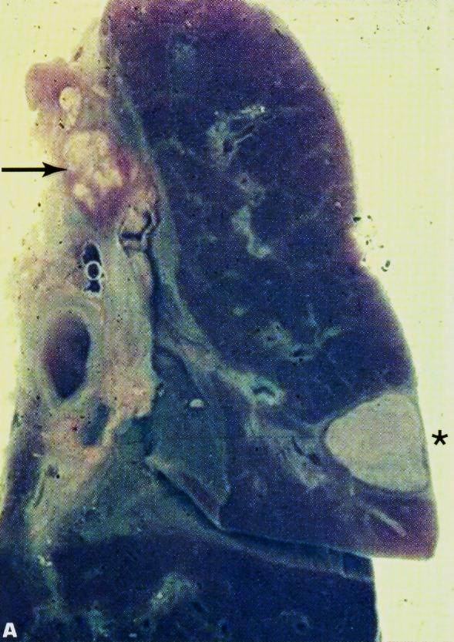

Slide 6
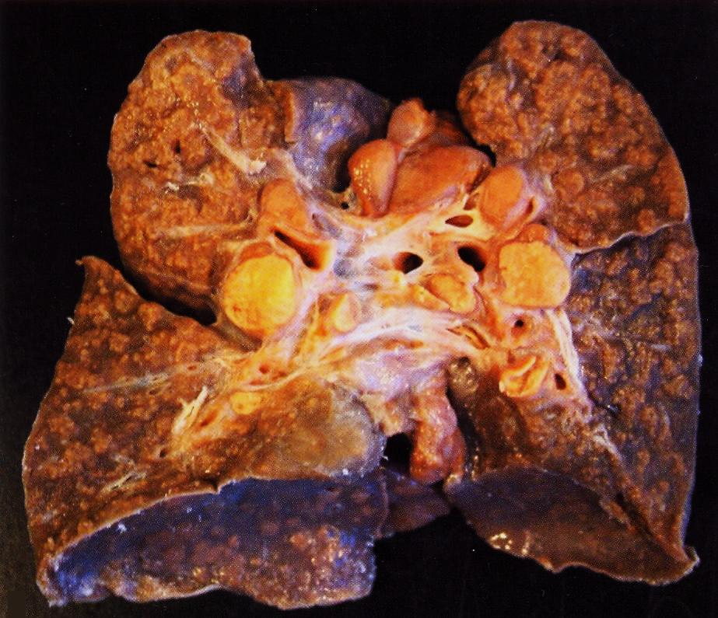

Slide 7
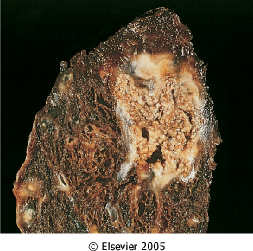
Organ: lung Dx : Caseous necrosis (tuberculosis)

Slide 8
Tuberculous Granulomas

Slide 9
Caseation Necrosis

Slide 10
Epitheloid cells in Granuloma

Slide 11
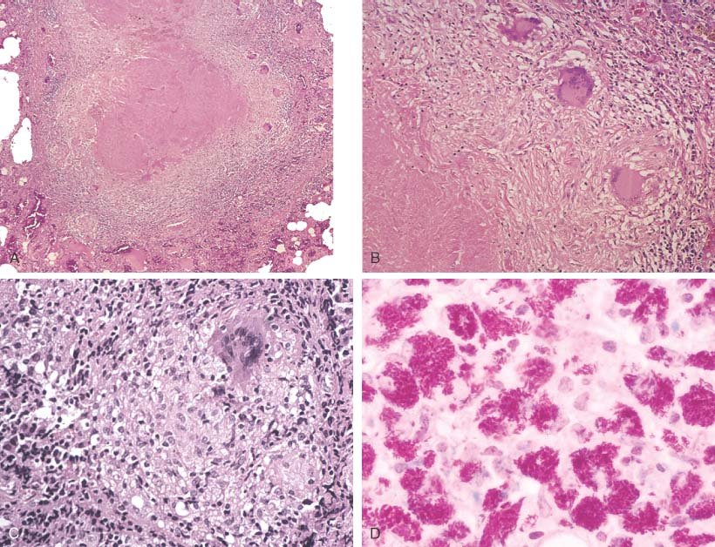
Notes:
Necrotizing (i.e., caseating) granulomas filled with acid fast bacilli. This is CLASSIC for TB.

Slide 12
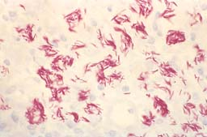
MORE ACID-FAST BACILLI, AFB
Notes:
The acid fast stain for acid fast bacteria is also called the Ziel-Neilseon stain, or simply AFB stain

Slide 13
Miliary tuberculosis of the lung :
Section of the lung shows : The alveolar septae contain many tubercles which consist of epithelioid cells , few langhan’s giant cells and peripheral rim of lymphocytes with or without caseation

Slide 14
2- Tuberculous lymphadenitis

Slide 15
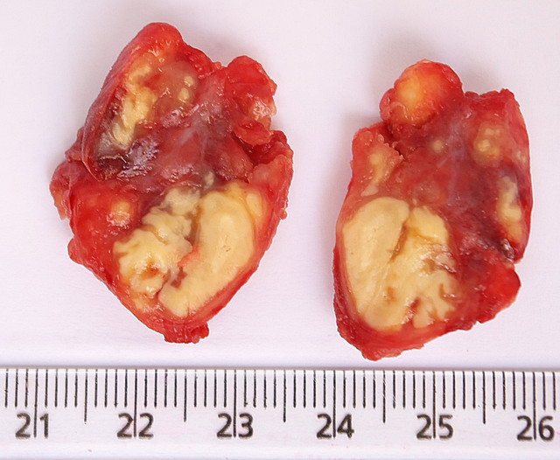

Slide 16
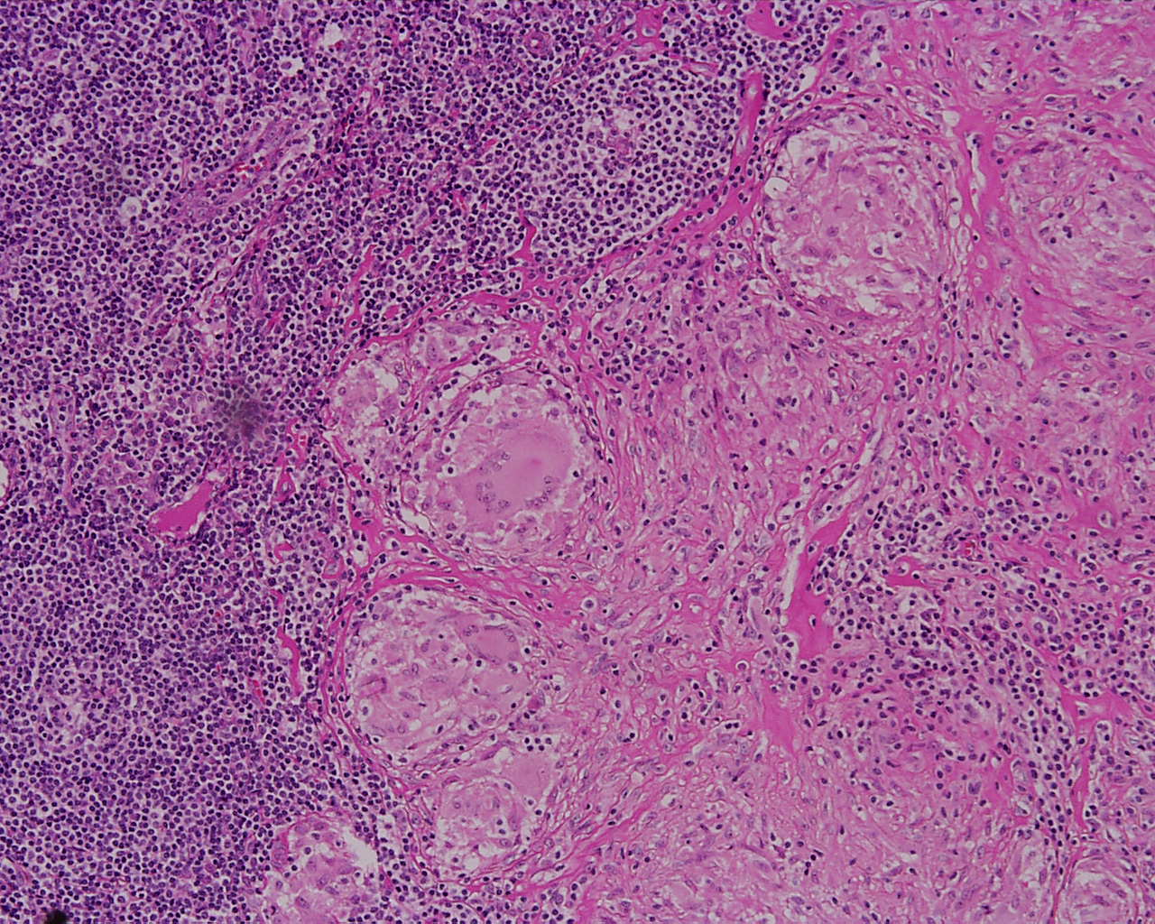

Slide 17
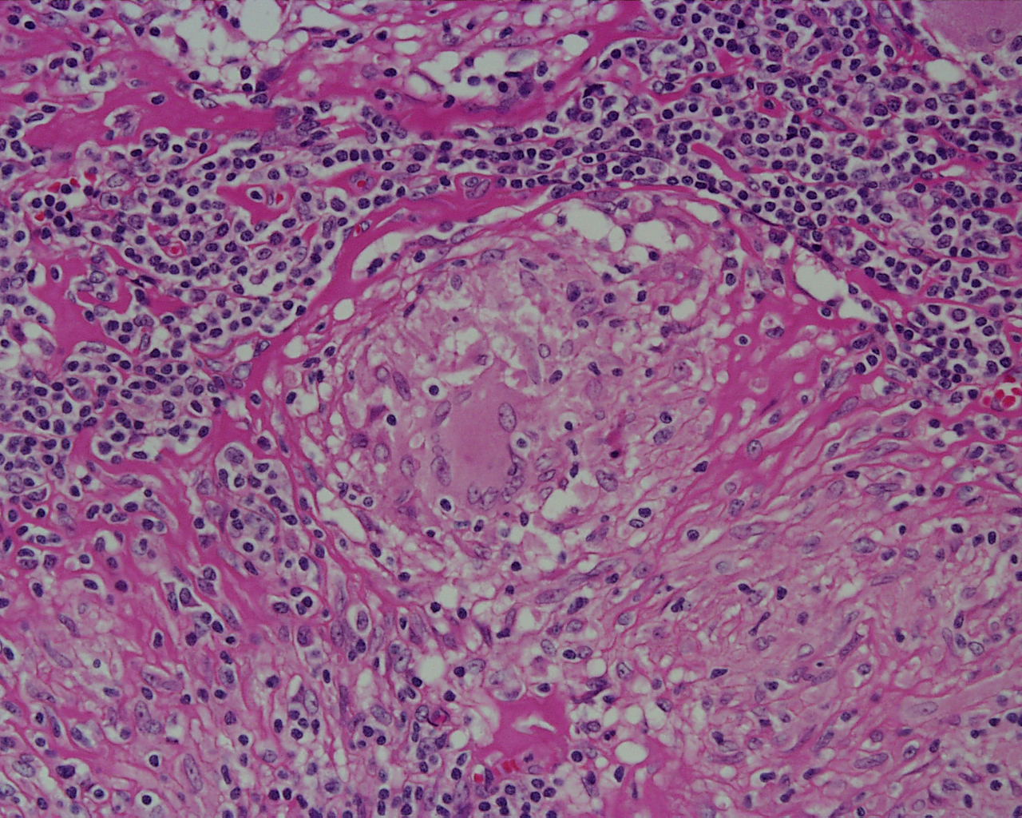

Slide 18
Tuberculous lymphadenitis : Section of a lymph node with connective tissue capsule and lymphoid tissue shows:
Many round and oval tubercles/ granulomas with or without central caseation that appears structureless, homogenous and pink in colour.
The granulomas consists of epithelioid cells, few langhan’s giant cells (large cell with multiple peripheral nuclei) and peripheral rim of lymphocytes.

Slide 19
3- Bilharziasis of the colon

Slide 20
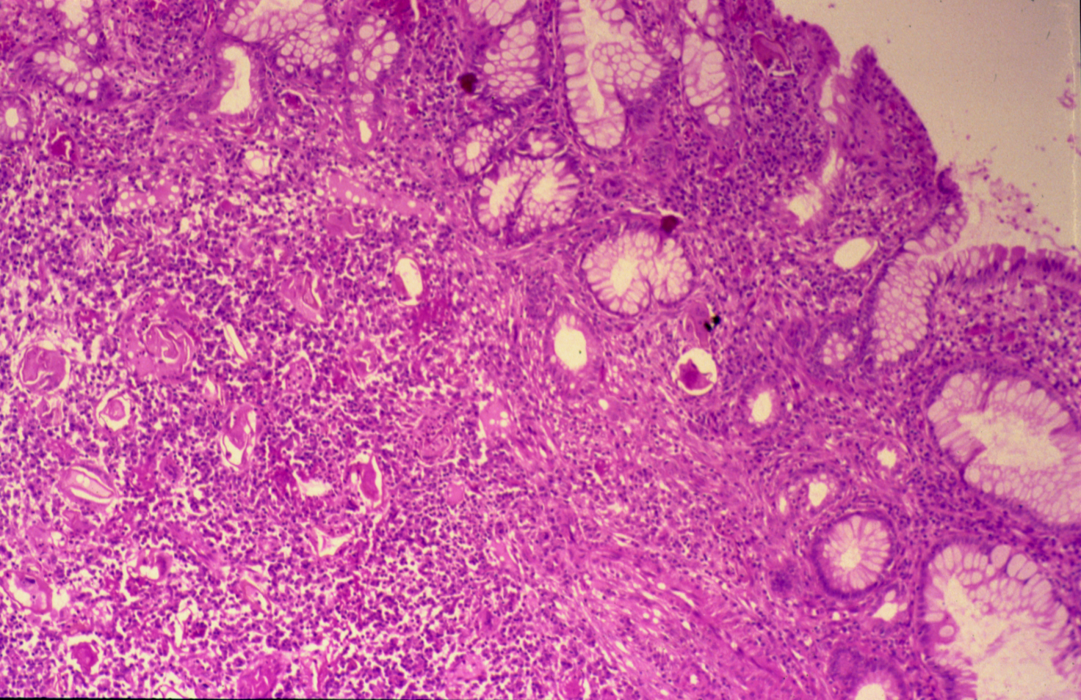
COLONIC BILHARZIASIS

Slide 21
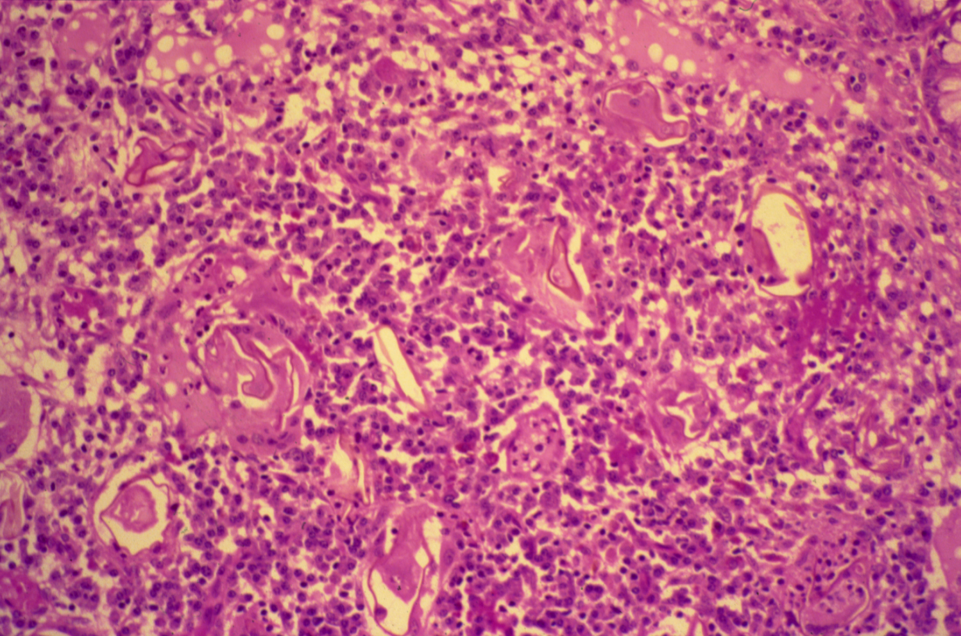
BILHARZIASIS (COLON)

Slide 22
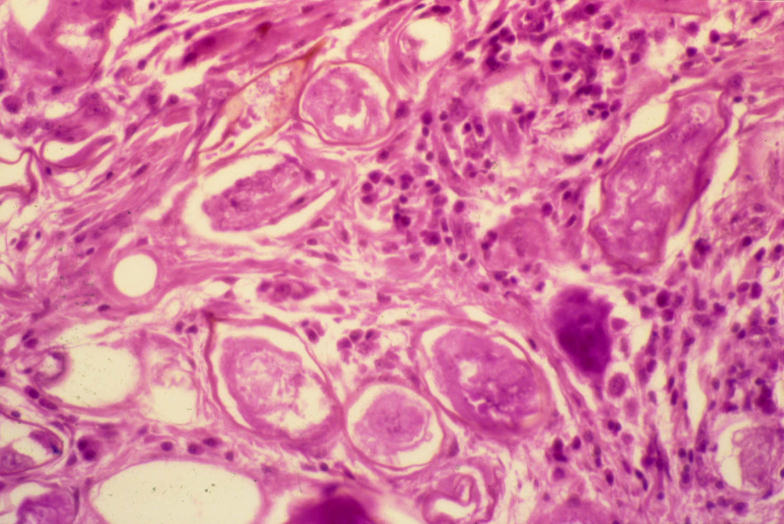
SCHISTOSOMIASIS OF THE URINARY BLADDER

Slide 23
Bilharziasis of the rectum\urinary bladder: Section of fragments of rectal\urinary bladder mucosa shows:
Many Bilharzial ova with yellow brown shells in mucosa and submucosa surrounded by fibrosis and chronic inflammatory cells consisting of lymphocytes, plasma cells and many eosinophils.
Few granulomas are seen around the ova.

Slide 24
5- Cutaneous leishmaniasis

Slide 25
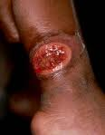
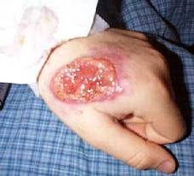

Slide 26
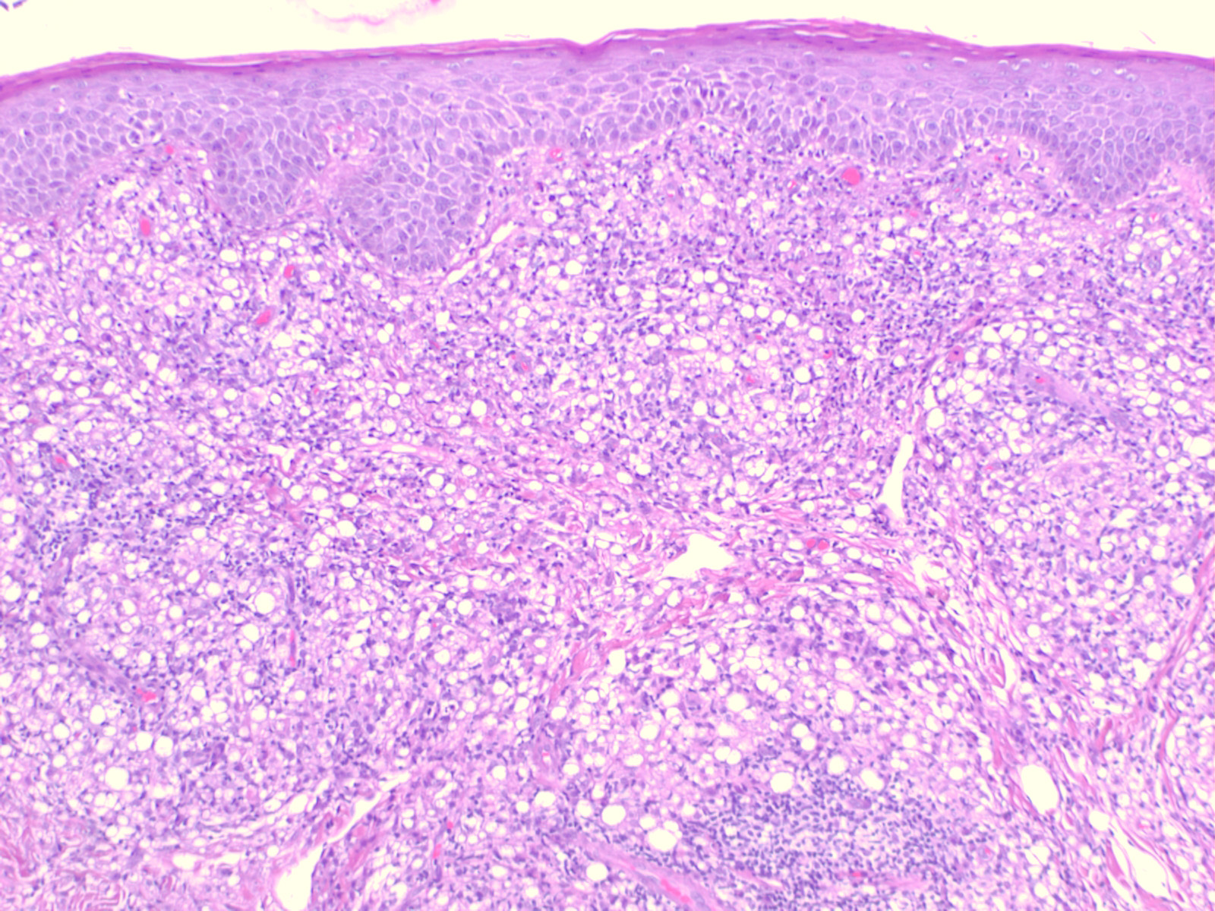

Slide 27
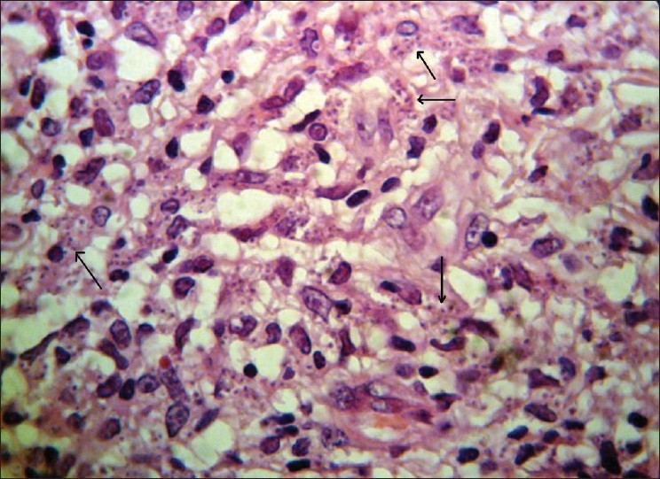
Histological view shows marked cellular infiltration and parasites (Leishman bodies) within macrophages

Slide 28
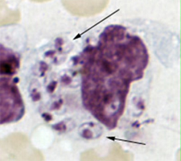
Picture shows a macrophage containing Leishmania amastigotes with characteristic features (round nucleus, rod-shaped kinetoplast; arrows) .

