Slide 1
Neoplasia –malignant tumours

Slide 2
1- Squamous cell carcinoma of the skin

Slide 3
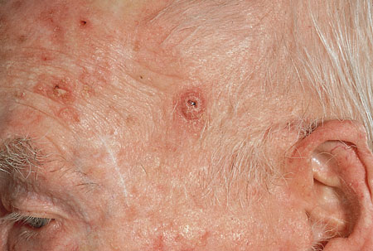
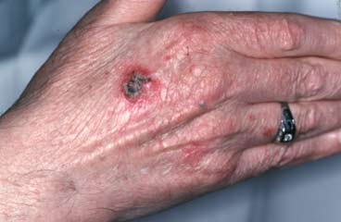
1- SQUAMOUS CELL CARCINOMA (SKIN)

Slide 5
SCC

Slide 6
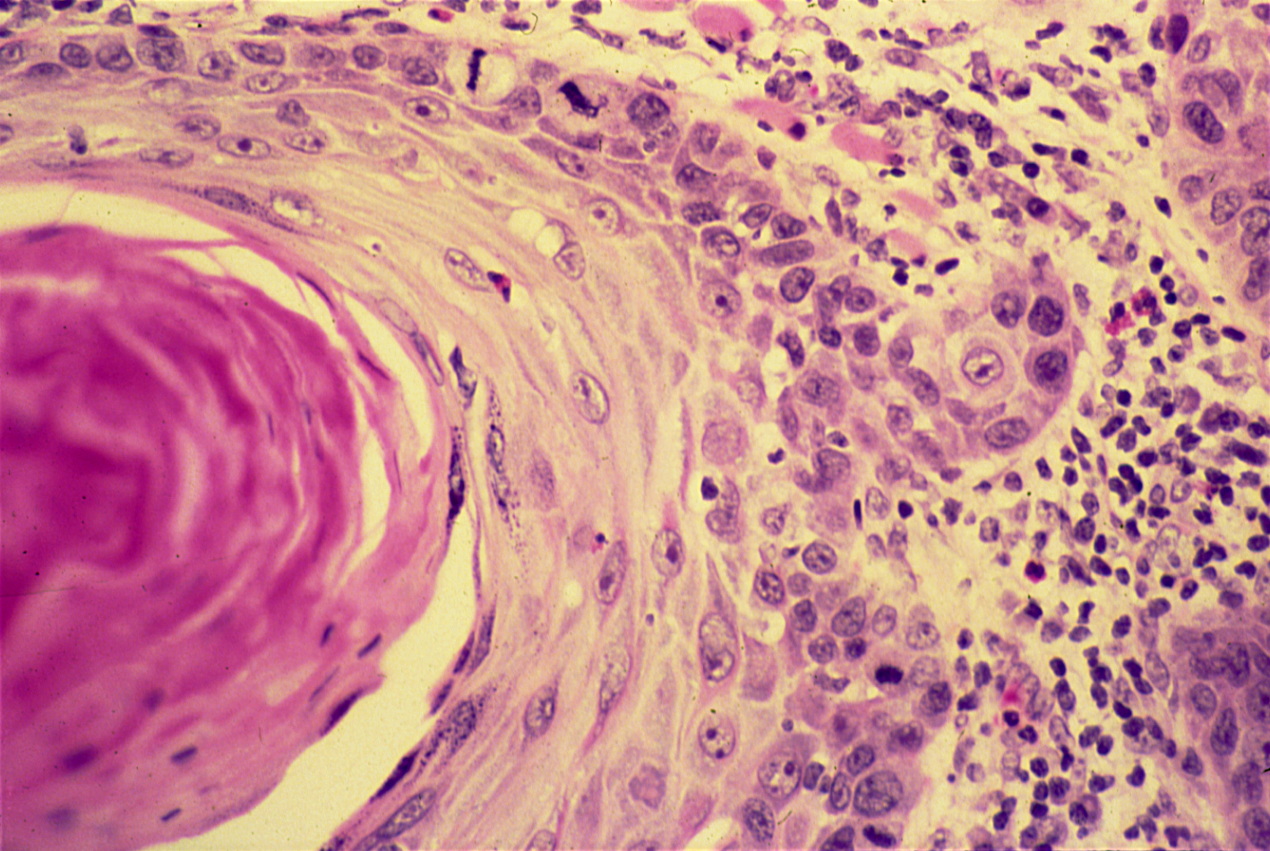
SQUAMOUS CELL CARCINOMA

Slide 7
Squamous cell carcinoma of the skin : Section of the skin shows an ulcer covered by inflammatory exudate .
The dermis is infiltrated by masses of well differentiated neoplastic squamous cells which are separated by fibrous tissue stroma with chronic inflammatory cells .
Tumour cells show pleomorphism, hyperchromatism and many mitotic figures .
Pinkish laminated keratin pearls (epithelial cell nests) are present in the center of some cell masses .

Slide 8
2- Adenocarcinoma of the large intestine

Slide 9
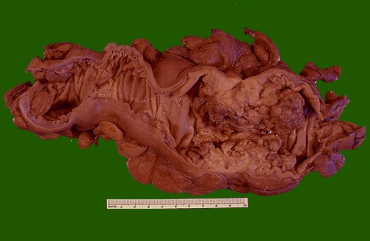
Organ: Colon Dx: adenocarcinoma

Slide 11
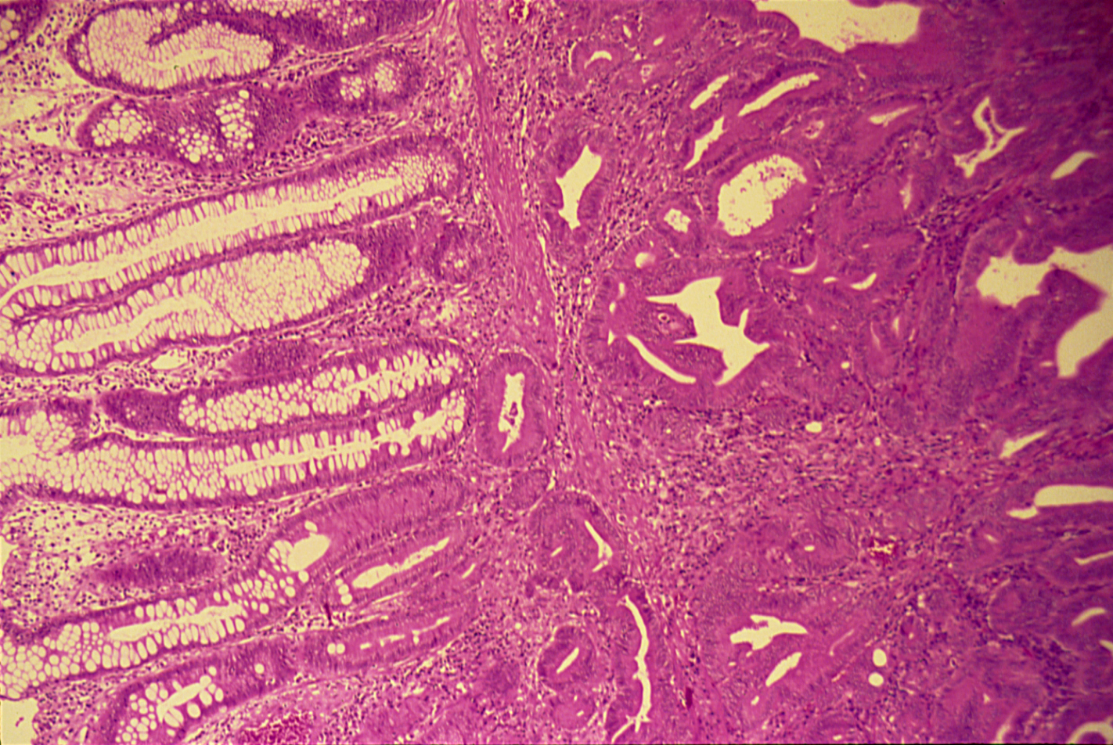

Slide 12
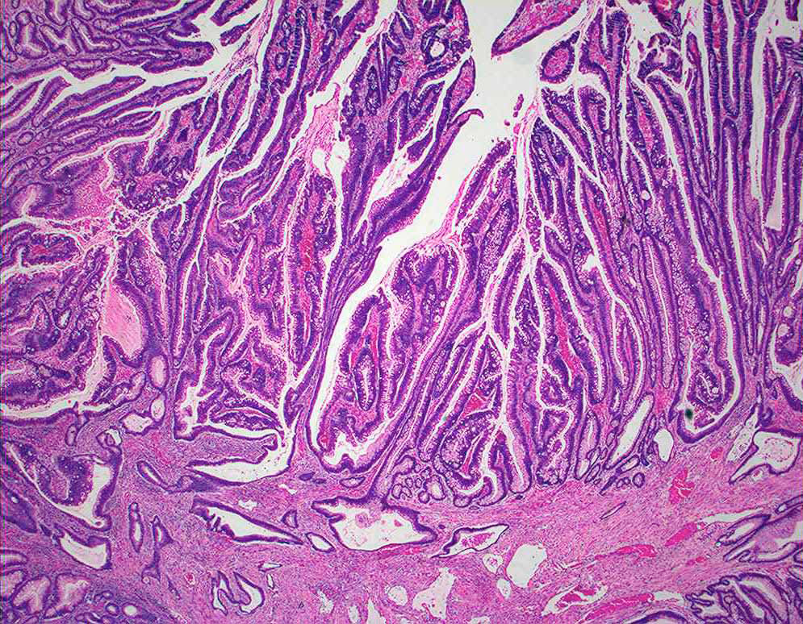

Slide 13
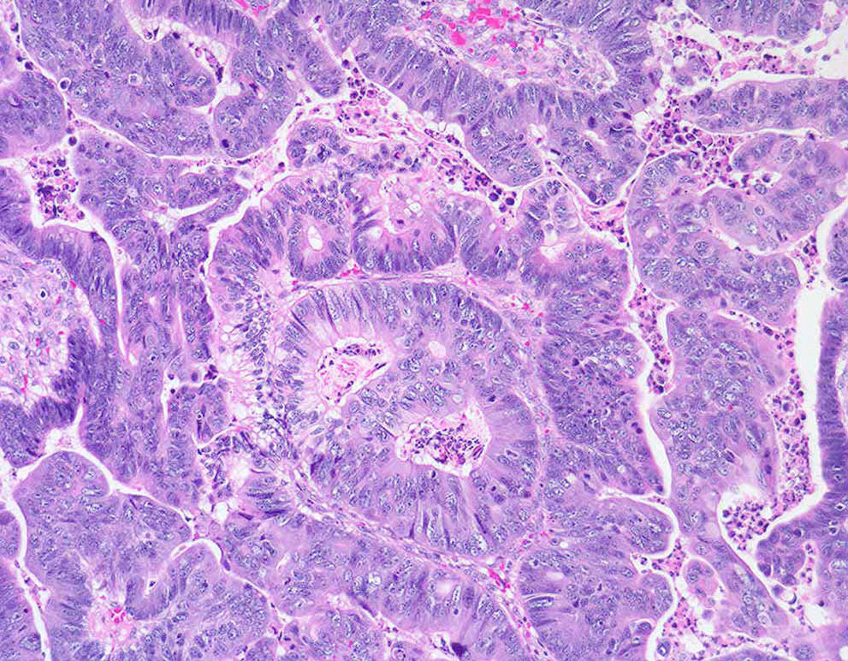

Slide 14
Adenocarcinoma of the large intestine: Section of large intestine shows:
Tumor consists of crowded irregular malignant acini separated by thin fibro-vascular stroma.
The acini are lined by one or several layers of neoplastic cells with papillary projection showing pleomorphism, hyperchromatism and few mitoses.
Muscle coat is invaded by neoplastic glands.

Slide 15
3- Leiomyosarcoma

Slide 16
Cut surface of this leiomyosarcoma showing ill defined pale and soft large fleshy mass with hemorrhage and necrosis.

Slide 17
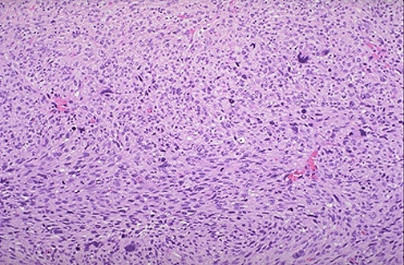
Sarcomas tend to have a spindle cell pattern. Note that some of these neoplastic cells are much larger than others, and thus very pleomorphic

Slide 18
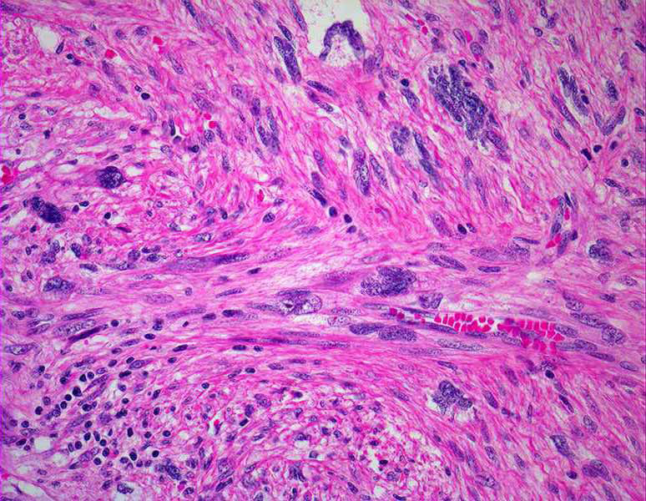
High power shows pleomorphic cells that vary markedly in size and shape.
The cell of origin of sarcomas is often difficult to determine because of their tendency to be poorly differentiated or even anaplastic.

Slide 19
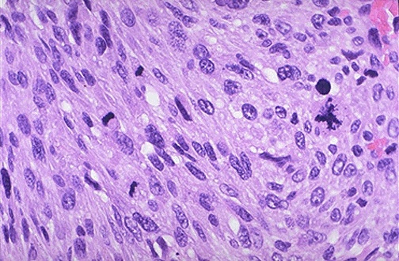
This sarcoma has many mitoses. A very large abnormal mitotic figure is seen at the right.

Slide 20
Leiomyosarcoma
Cut surface of this leiomyosarcoma showing ill defined pale and soft large fleshy mass with hemorrhage and necrosis.
Microscopic examination- cells show marked variation in size and shape, nuclear hyperchromatism with tumour giant cells formation and many mitoses.

