Slide 2
Inflammation and repair
Dr Shaesta Naseem
24-09-12

Slide 3
Inflammation and repair

Slide 4
Gross and histopathology

Slide 5
1- Fibrinous pericarditis

Slide 6
Organ: Pericardium Dx: Fibrinous Inflammation

Slide 7
ACUTE FIBRINOUS PERICARDITIS

Slide 8
ACUTE FIBRINOUS PERICARDITIS

Slide 9
Fibrinous Pericarditis: Section of Heart shows:
The pericardium is distorted by thick irregular layer of pinkish fibrinous exudate with some red cells and inflammatory cells.
The subpericardial layer is thickened by edema and shows dilated blood vessels, chronic inflammatory cells and areas of calcification.

Slide 10
2- Acute appendicitis

Slide 11
ACUTE APPENDICITIS
Notes:
What is the white junk coating the surface?

Slide 12
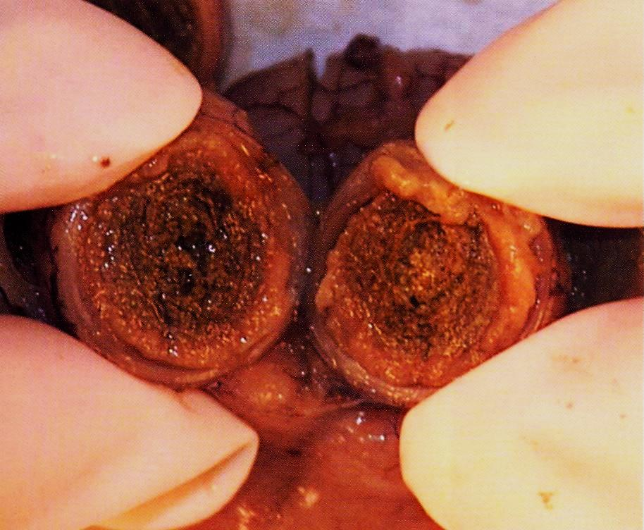

Slide 13
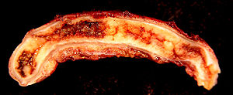
Acute appendicitis

Slide 14
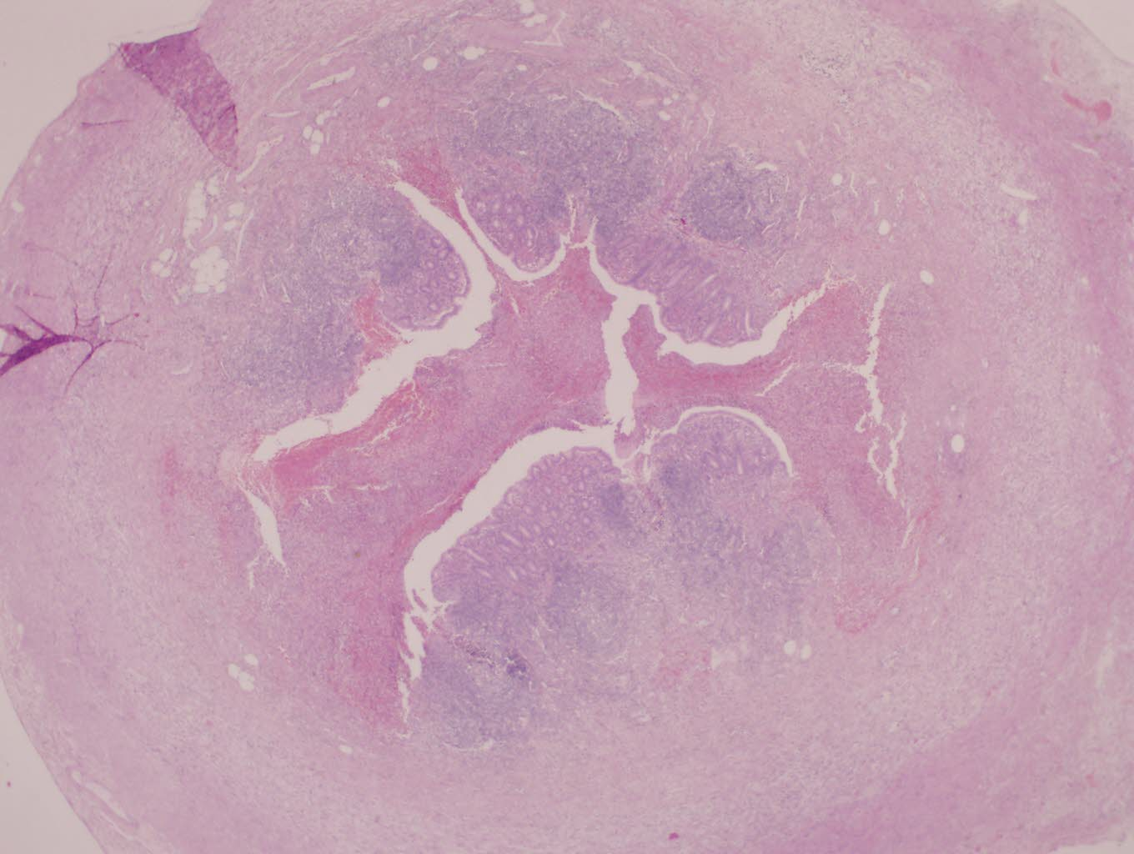
ACUTE APPENDICITIS

Slide 15
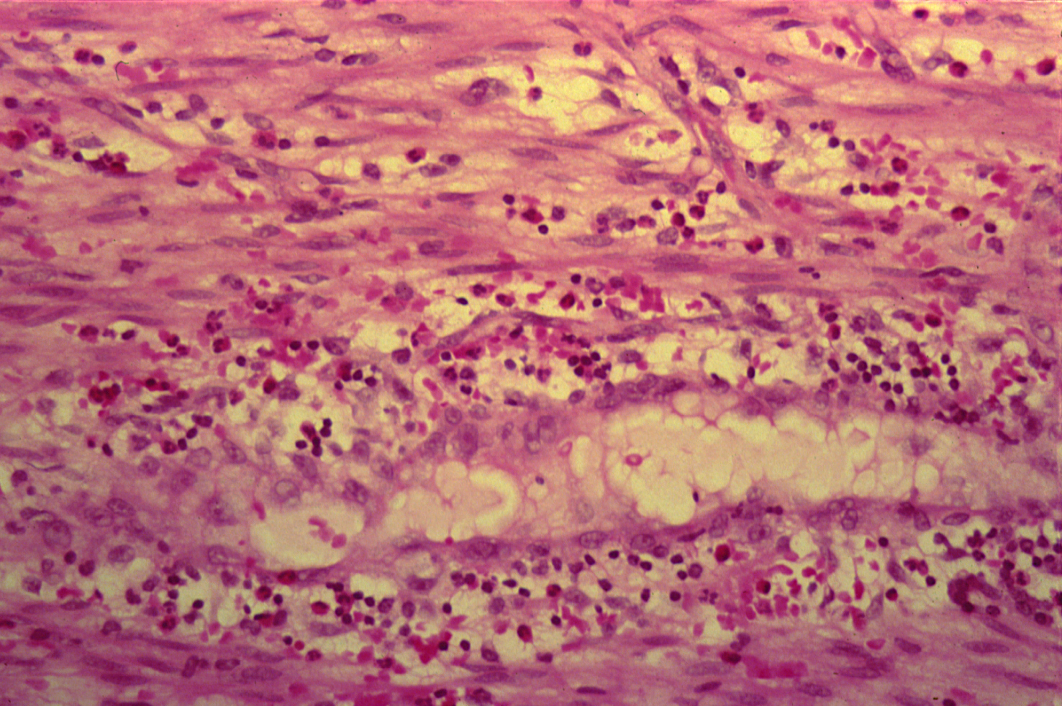
ACUTE APPENDICITIS

Slide 16
Acute Suppurative appendicitis: Cross Section of Appendix shows:
On gross, fibrino-purulent exudate is present on the serosal surface.
Accumulation of inflammatory exudate and pus cells in the lumen and the mucosa is ulcerated.
All layers of the appendix wall show edema, dilated and congested blood vessels and infiltration by many neutrophils.

Slide 17
3-Skin pilonidal sinus

Slide 18
3- FOREIGN BODY REACTION (PILONIDAL SINUS)

Slide 19
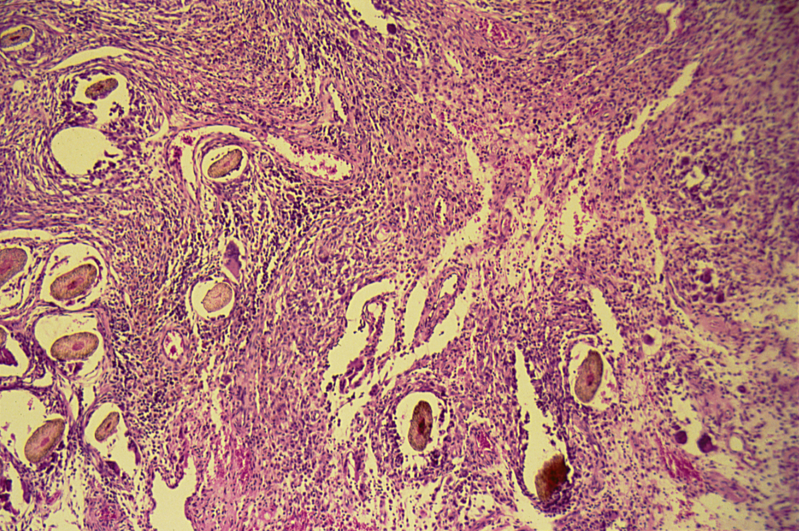
FOREIGN BODY REACTION (PILONIDAL SINUS)

Slide 20
Foreign Body reaction (Pilonidal sinus): Section of Skin Shows:
A sinus tract lined by an inflammatory granulation tissue in the dermis .
The lumen of sinus and wall contain large number of hair shafts with foreign body giant cells, lymphocytes , macrophages & neutrophils .

Slide 21
4-Chronic cholecystitis with stones

Slide 22
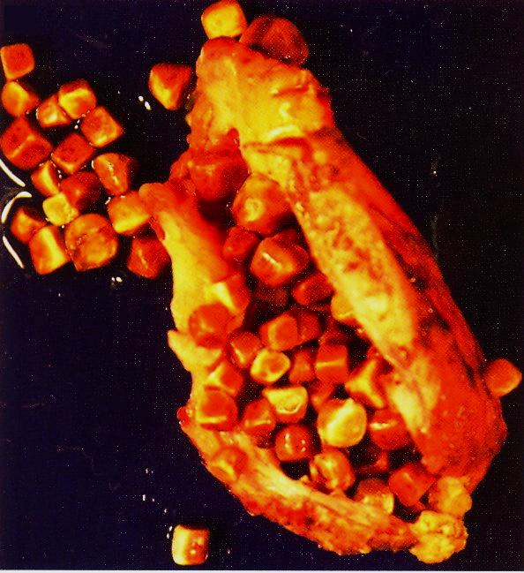

Slide 23
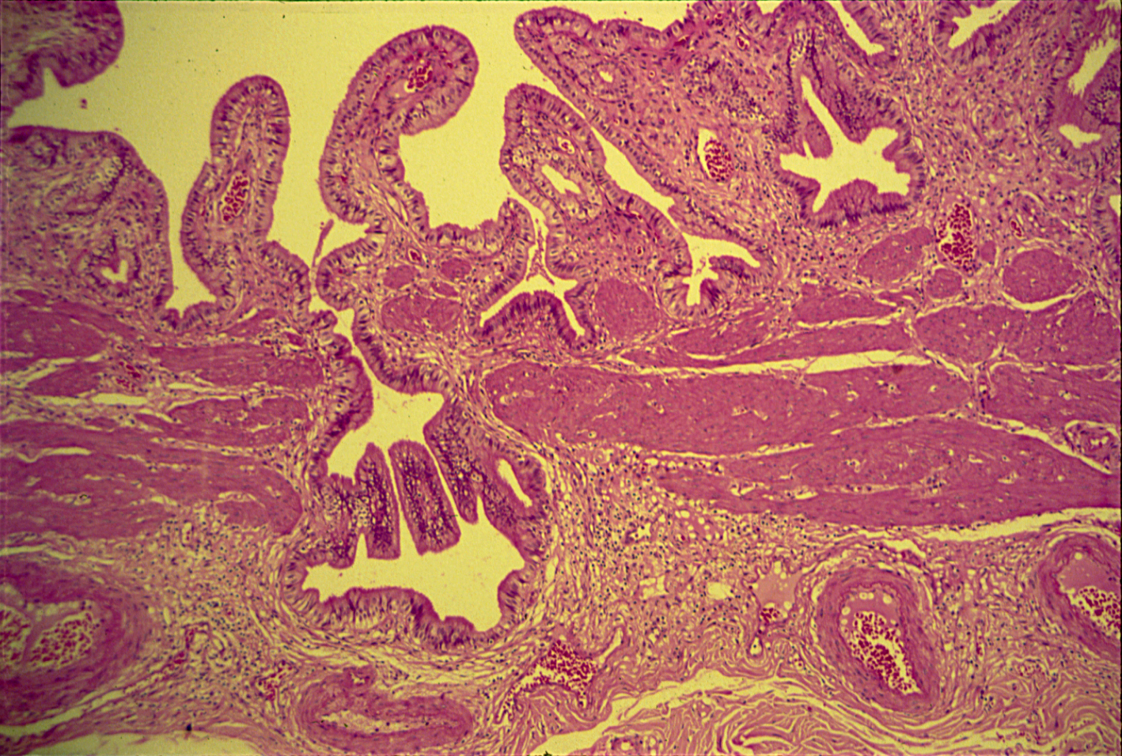
CHRONIC CHOLECYSTITIS

Slide 24
Chronic cholecystitis: Section of gallbladder wall shows:
Irregular mucosal folds and foci of ulceration in mucosa.
Wall is penetrated by mucosal glands which are present in muscle coat ( Rokitansky- Aschoff sinuses).
All layers show chronic inflammatory cells infiltration and fibrosis.

Slide 25
5- Brain abscess

Slide 26
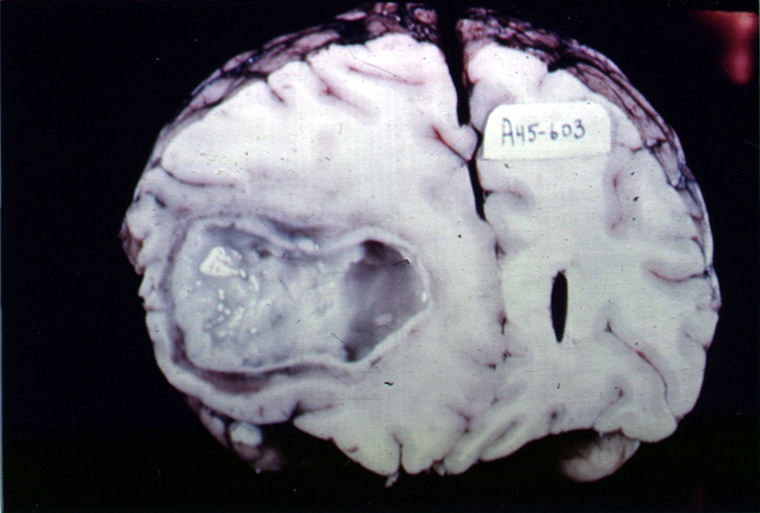

Slide 27
6- Granulation tissue

Slide 28
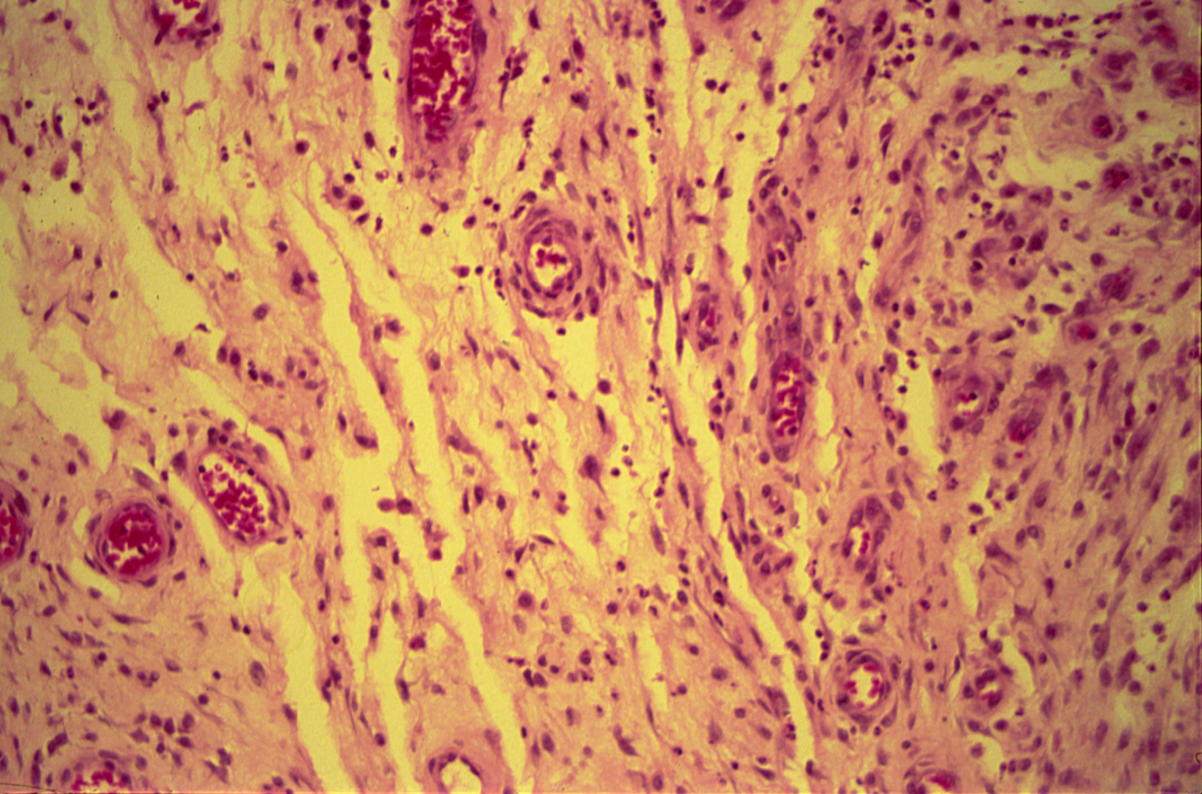
GRANULATION TISSUE

Slide 29
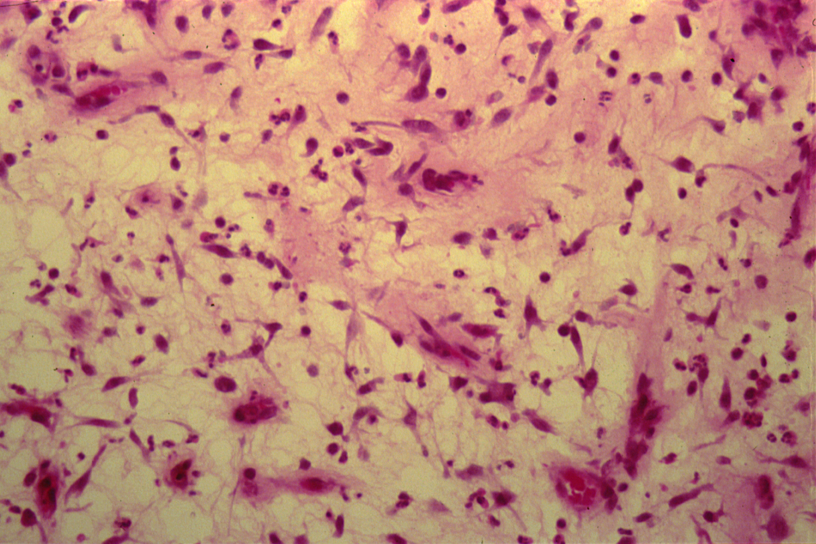
GRANULATION TISSUE

Slide 30
Granulation Tissue: Section of fragments of edematous, loose connective tissue shows:
Many small newly formed capillaries lined by plump endothelial cells.
Proliferation of fibroblasts is seen.
Inflammatory cells including macrophages, lymphocytes, plasma cells and neutrophils in the oedematous stroma.
Pink homogenous collagen fibres may be identified.

