Slide 1
Neoplasia-I
Pathology practical
Dr Shaesta Naseem

Slide 2
Benign tumors Gross and histopathology

Slide 3
1- Adenomatous polyp of rectum / colon

Slide 4
Organ: Colon Dx: adenoma

Slide 5

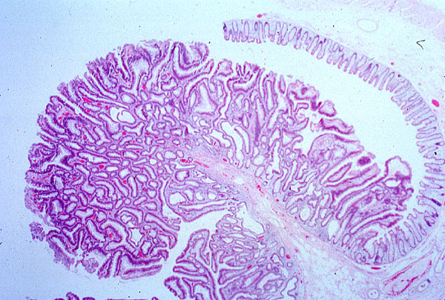
Tubular adenoma, colon

Slide 6
2- Lipoma

Slide 7
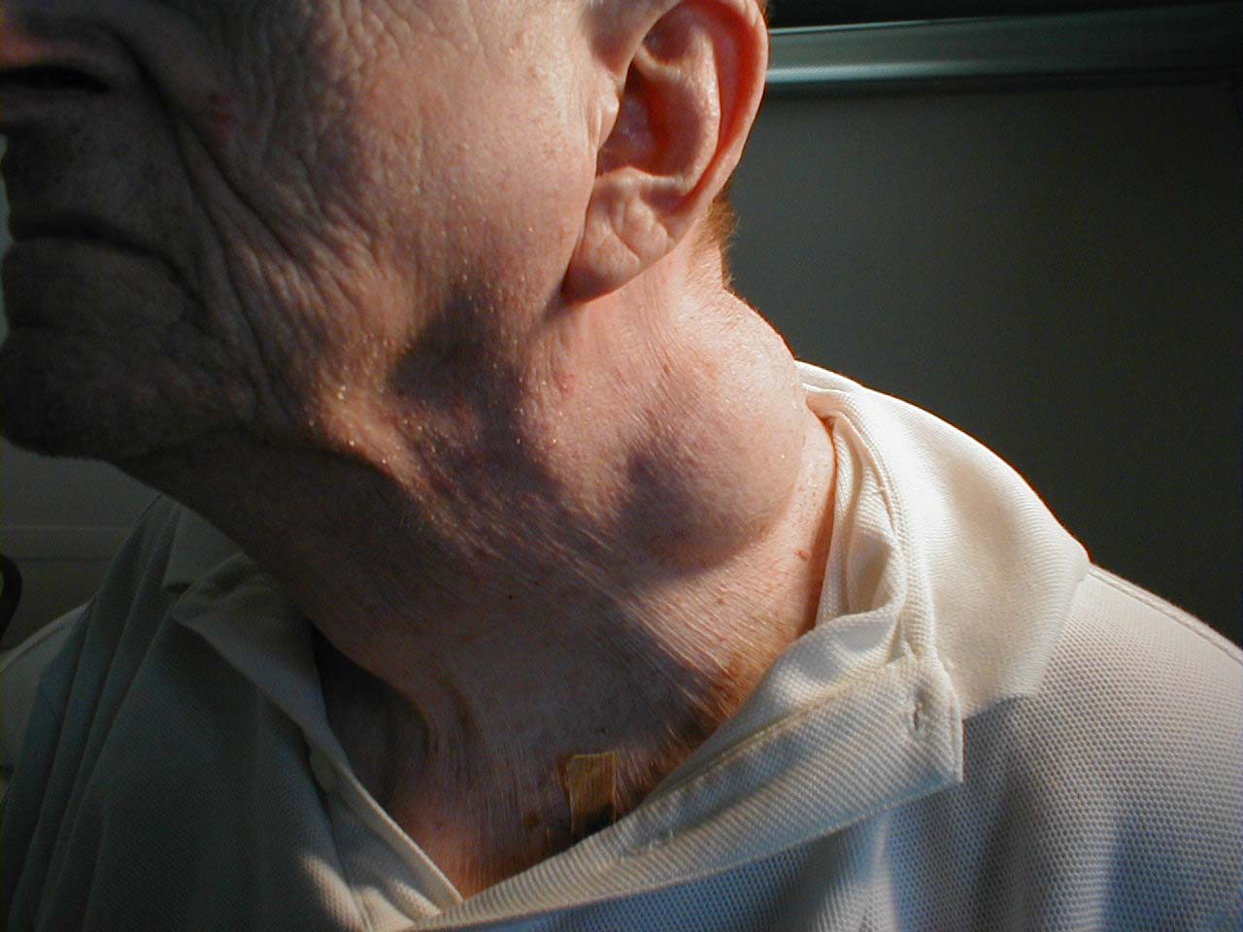
2-Lipoma of the neck
Benign, slow growing, subcutaneous skin growth. In this case, the lipoma is rather large and located in the neck region. On palpation, these are soft, nontender, and freely mobile.

Slide 8
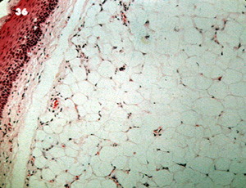
Subcutaneous lipoma
Lipoma

Slide 9
Lipoma
Benign, well-circumscribed tumor of
well-differentiated adipocytes
In adult, upper back, neck, shoulder
Usually subcutaneous, any site of
adipose tissue
Most common type of benign soft
tissue tumor
Resemble normal adipose tissue
Subtypes :angiolipoma, spindle cell lipoma

Slide 10
3- Intradermal nevus

Slide 11
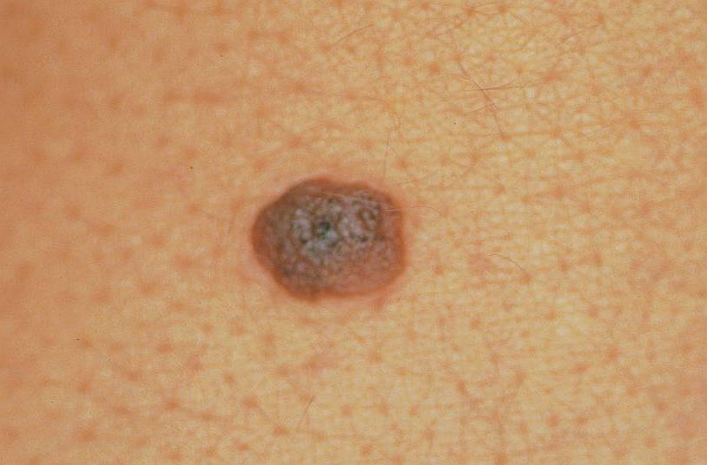
Notes:
Intradermal nevus

Slide 12
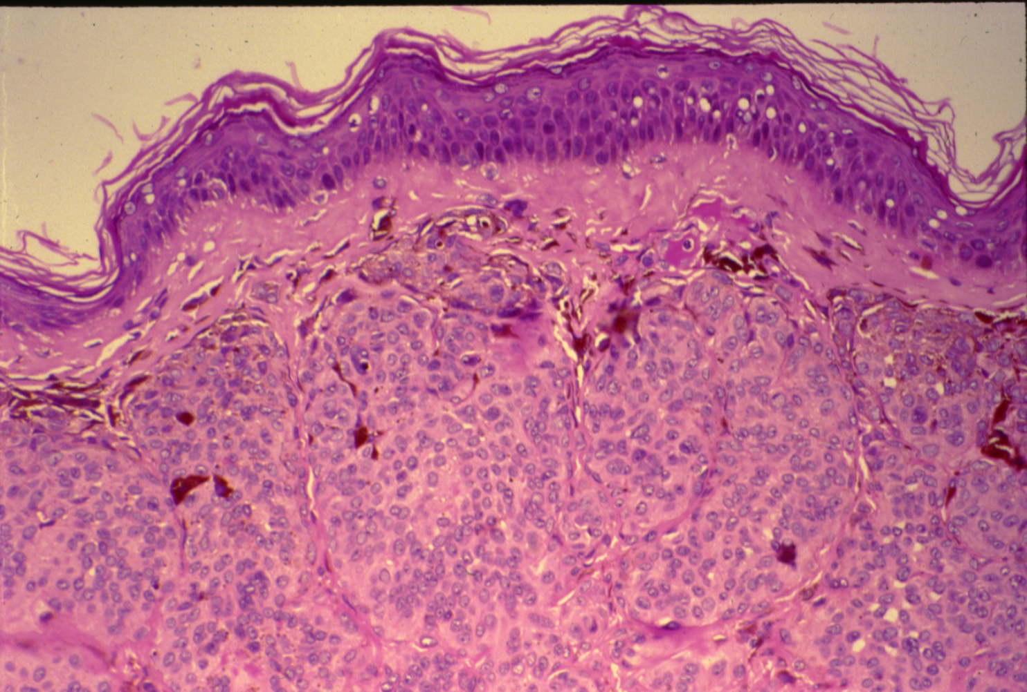
NEVUS (SKIN)

Slide 13
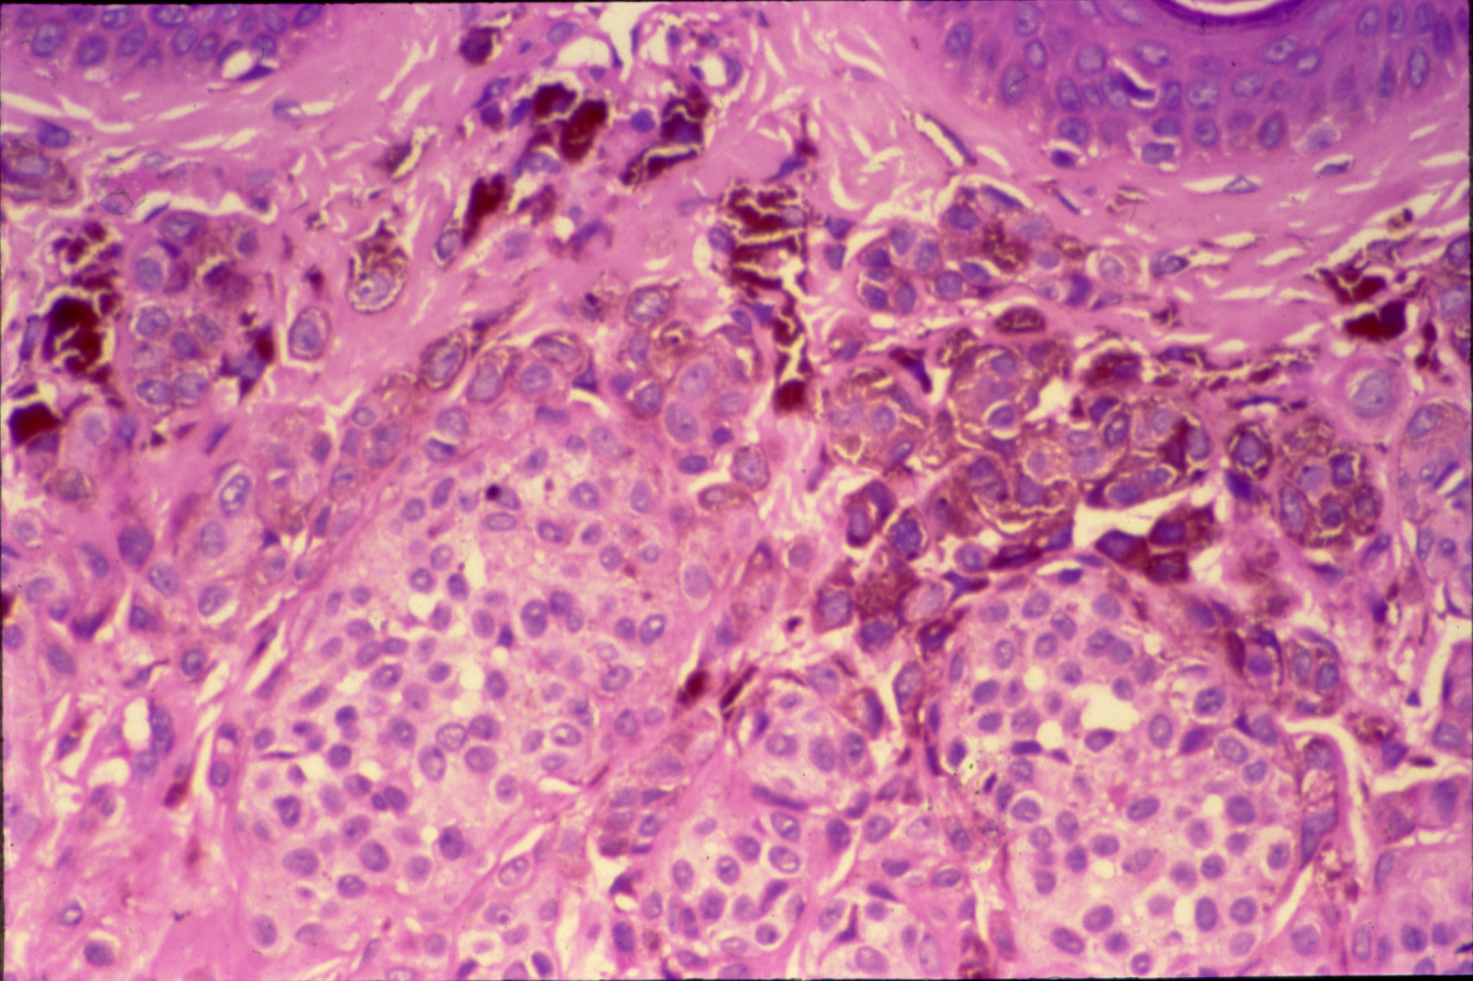
NEVUS (SKIN)

Slide 14
Nevus:
Section of Skin shows:
Nests and clusters of small round or spindle shaped nevus cells with few melanophages in the upper dermis.
The cells contain varying amount of brown melanin pigment.
No junctional activity.

Slide 15
4- Multiple uterine leiomyomata

Slide 16
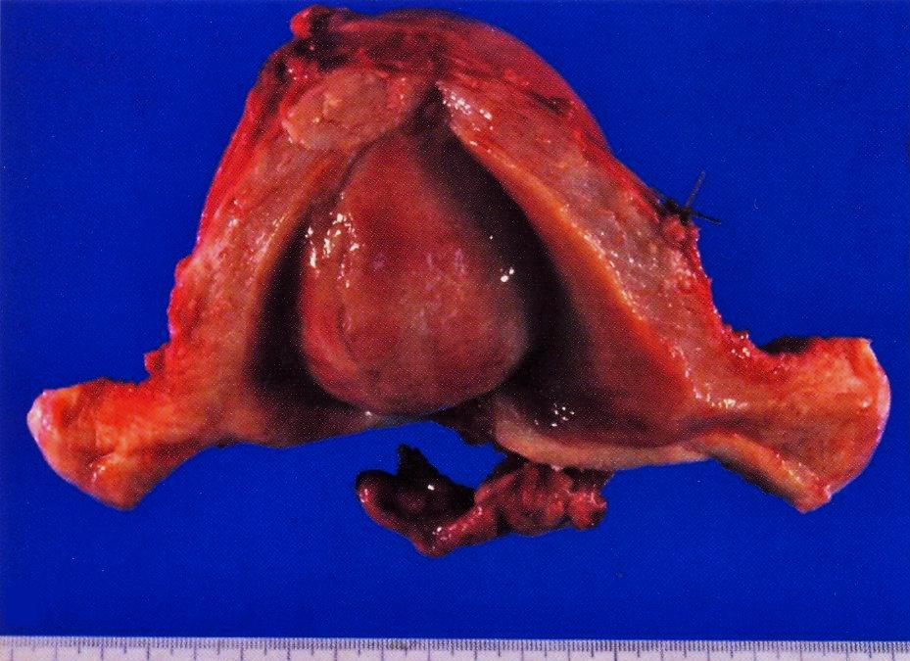

Slide 17


Slide 18
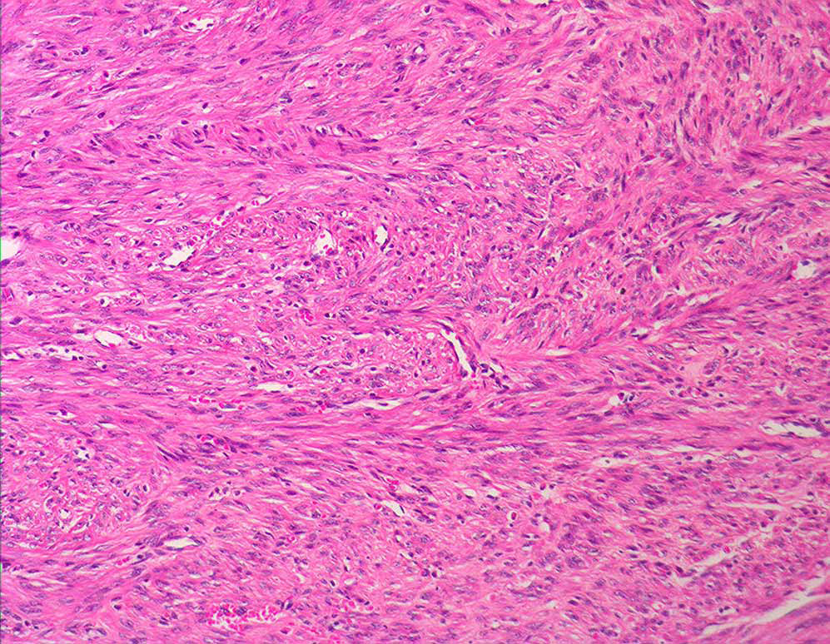

Slide 19
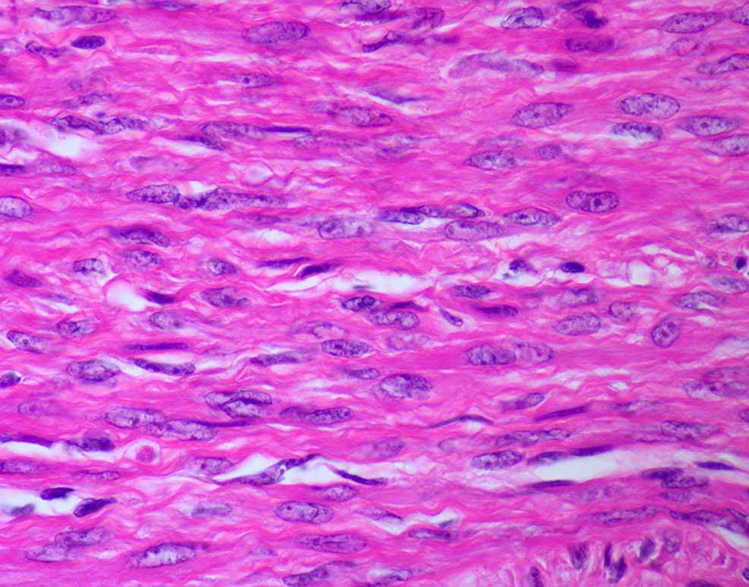

Slide 20
Leiomyoma:
Section of tumour shows:
A well demarcated tumour mass in the muscle coat of uterus without a definite capsule.
Tumour consists of interlacing bundles of smooth muscle and fibrous tissue.
The muscle cells are spindle shaped with elongated nuclei and eosinophilic cytoplasm.

Slide 21
5- Chondroma

Slide 22
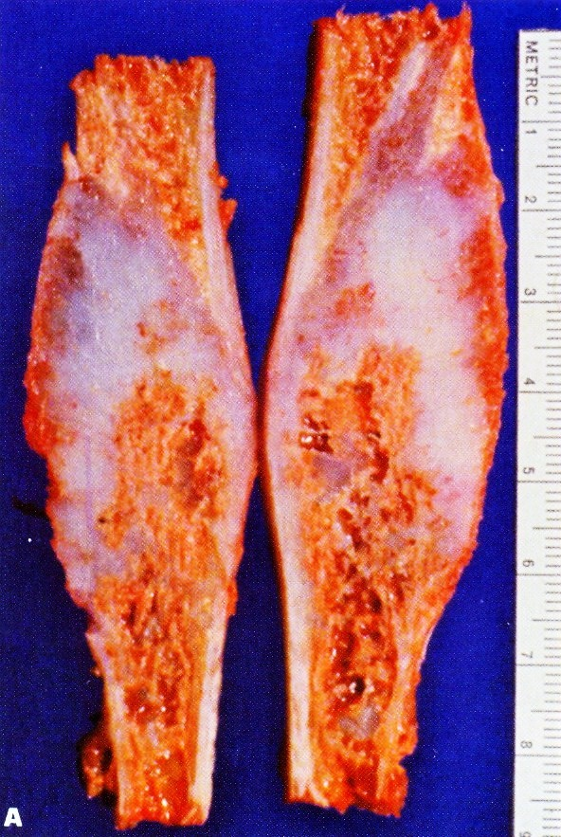
Enchondroma of the fibula
Notes:
Intramedullary bone expansion, chondromyxoid material, thin bone cortex.

Slide 23
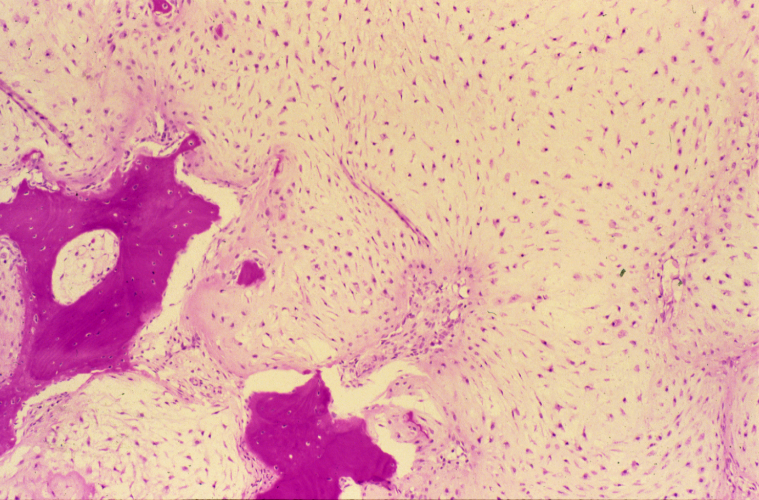
CHONDROMA OF BONE

Slide 24
Chondroma:
Section of tumour shows:
Lobules of mature cartilage separated by thin trabeculae of fibrous tissue with blood vessels.
Lobules consists of mature cartilage cells irregularly distributed through pale blue homogenous matrix and are contained within the lacunar spaces singly, in pairs or in tetrads.
Few bony trabeculae are included in the tumour.

Slide 25
6- Hemangioma

Slide 26
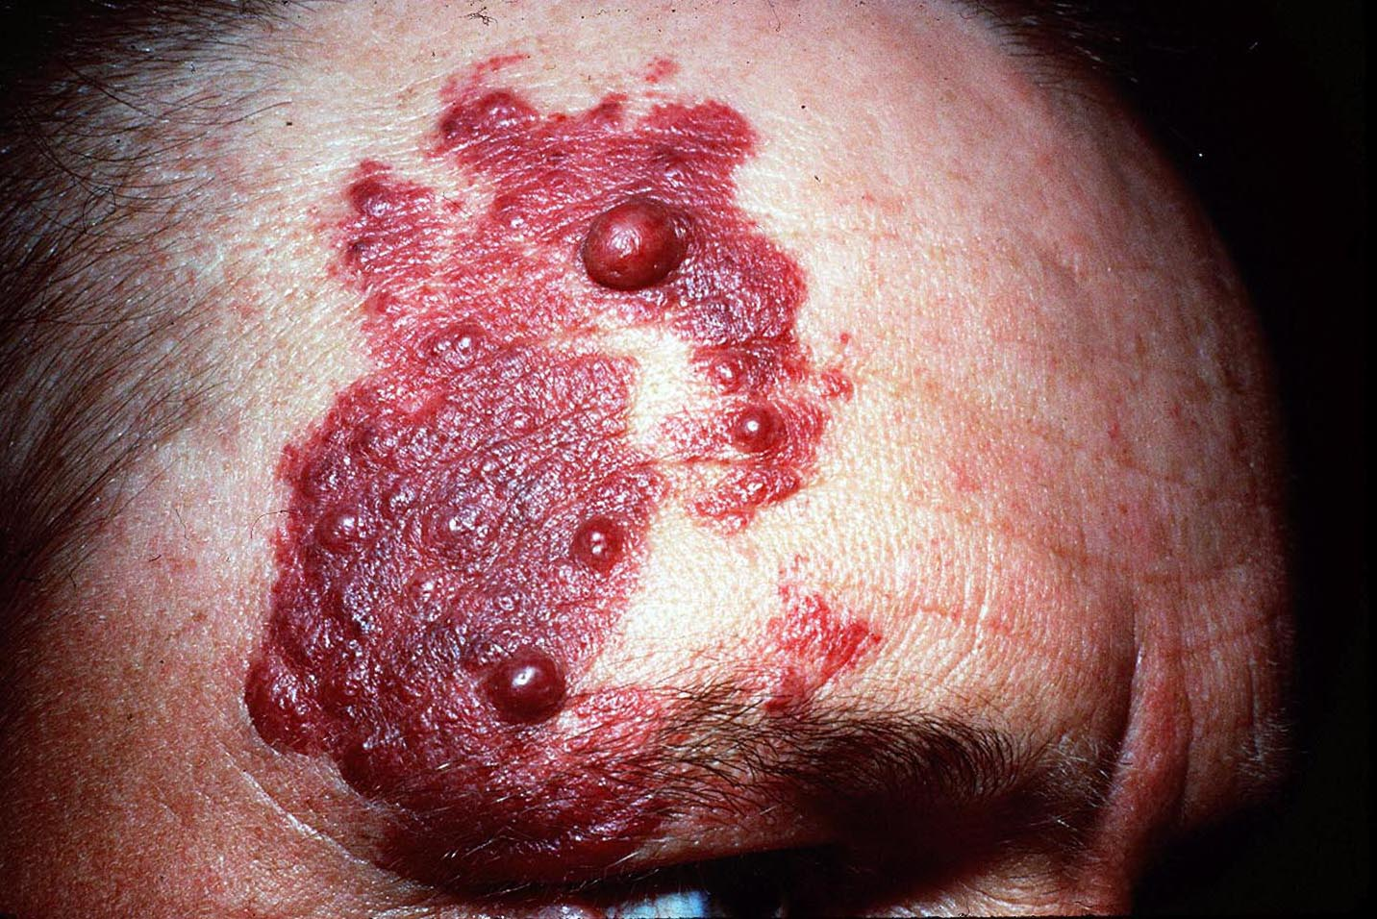

Slide 27
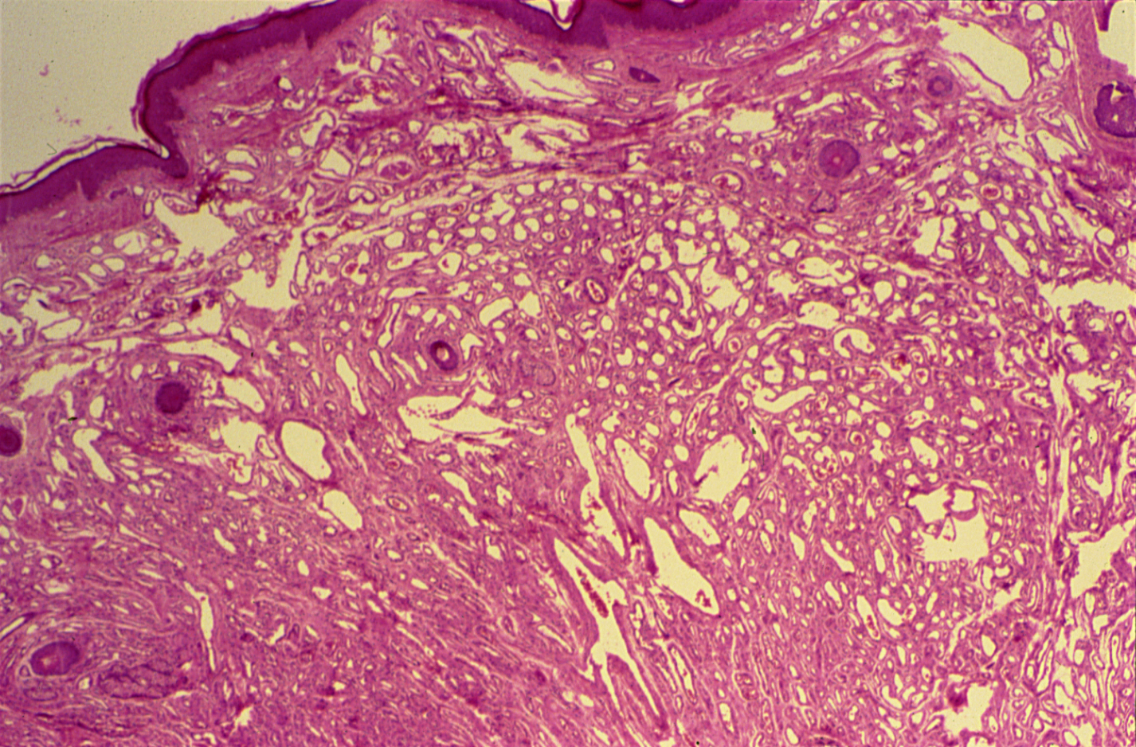
HAEMANGIOMA (SKIN)

Slide 28
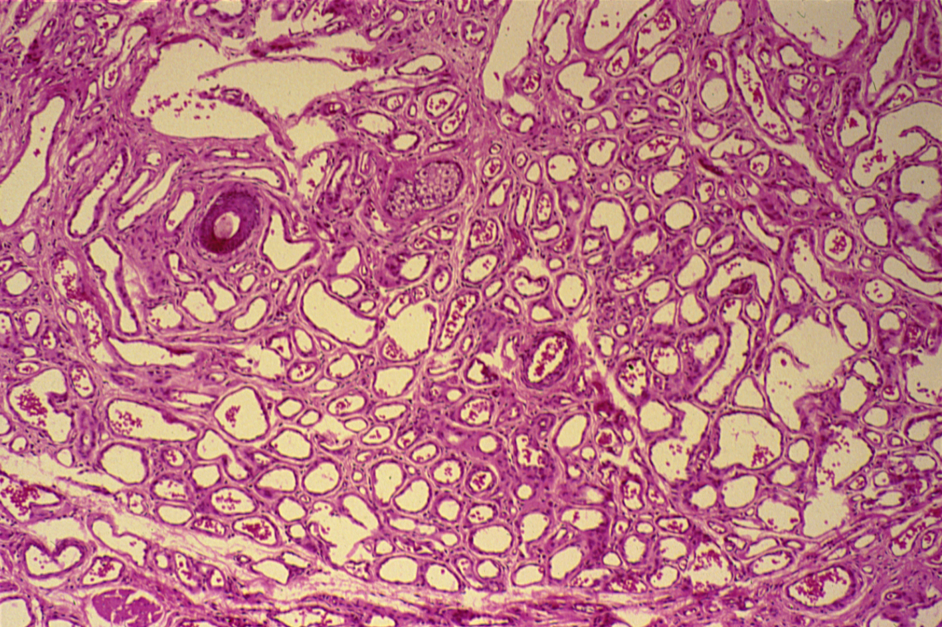
HAEMANGIOMA

Slide 29
Haemangioma:
Section of skin shows:
A tumour mass in the dermis which consists of large number of vascular spaces of varying shapes and sizes separated by connective tissue stroma.
Vascular spaces are lined by the flattened endothelial cells and some contain blood.
Delicate connective tissue stroma separated the capillary vascular spaces.

Slide 30
7- Teratoma , dermoid cyst of the ovary

Slide 31
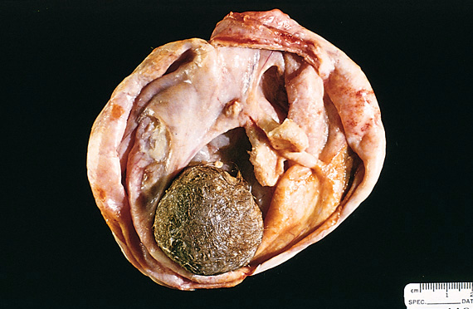
Slide 24.52
Notes:
Opened mature cystic teratoma ( dermoid cyst ) shows hair (bottom ) and a mixture of tissues .

Slide 32


Slide 33
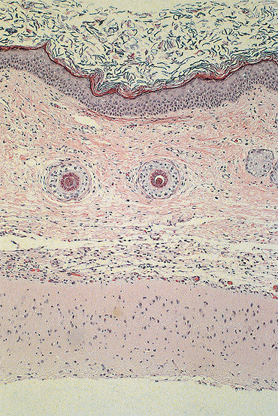
Slide 24.53
Notes:
Picture shows skin tissue ( upper part ) beneath which there this brain tissue .

Slide 34

DERMOID CYST OF THE OVARY
(BENIGN CYSTIC TERATOMA OF THE OVARY)

Slide 35
Dermoid cyst of the ovary: section of the cyst wall shows:
Stratified Squamous epithelium with underlying appendages (sweat glands, sebaceous glands, hair follicles) columnar ciliated epithelium, mucous and serous glands and structures from other germ layers such as bone and cartilage, lymphoid tissue, smooth muscle and large area of brain tissue containing neurons and glial cells.

