Slide 1
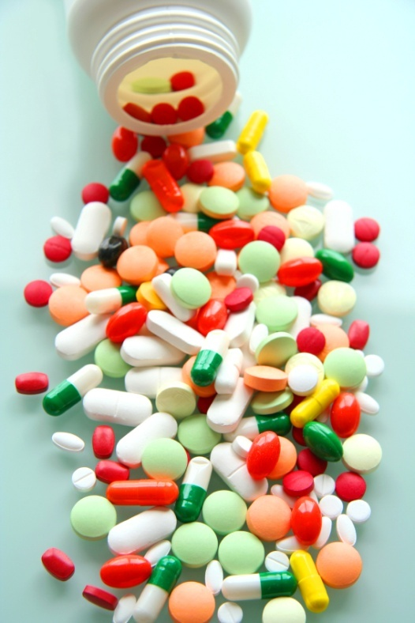
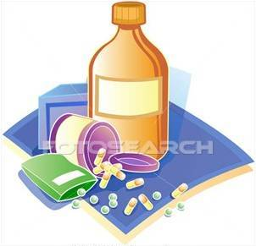
PHARMACOLOGY
PHARMACOLOGY

Slide 2
PHARMACOKINETICS
Exceptions
Absorb
Distribute
Metabolize
Excrete
Osmotic Diuretics
Purgatives
Antacids
The body
Interacts with body’s biological molecules
TARGETS Of Drug Action
To alter their biochemical &/or biophysical activity
Depress
Activate
Replace
Irritate
Destroy
The DRUG
RESPONSE
PHARMACODYNAMICS

Slide 3
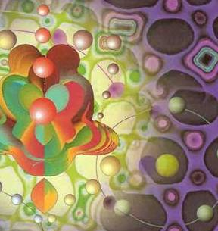
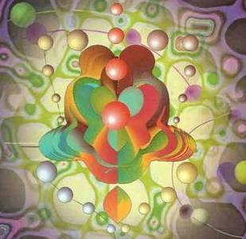
ilos
By the end of this lecture you will be able to :
Identify different targets of drug action
Differentiate between their patterns of action; agonism versus antagonism
Elaborate on drug binding to receptors
MOLECULAR MECHANISMS OF DRUG ACTION
By
Prof. Omnia Nayel
Assoc. Prof. Osama Yousif

Slide 4
PHARMACODYNAMICS
TARGETS
> Proteins
STRUCTURAL
REGULATORY
ENZYME
CARRIER MOLECULE
ION CHANNEL
RECEPTOR

Slide 5
TARGETS
STRUCTURAL PROTEIN
Tubulin is target for:
Vincristine
Colchicine
Tubulin
Structure

Slide 6
TARGETS
REGULATORY PROTEIN
ENZYME
The drug competes with the natural substrate
for the enzyme
REVERSIBLE
Neostigmine reversibly compete with ACH for cholinestrase at MEP
IRREVERSIBLE
Organophosphates irreversibly competes with ACH for cholinestrase

Slide 7
REVERSIBLE
Neostigmine
Organophosphorsphates
IRREVERSIBLE

Slide 8
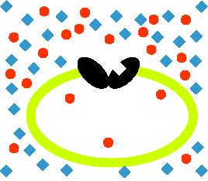
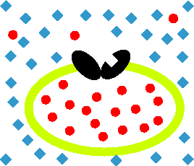
TARGETS
REGULATORY PROTEIN
Responsible for transport of ions and small organic molecules between intracellular compartments, through cell membranes or in extracellular fluids.
CARRIER MOLECULE
Passive Transporter
The drug binds to such molecules altering their transport ability
Antiporter
Symporter
Cocaine blocks transport of catecholamines at synaptic cleft in CNS

Slide 9
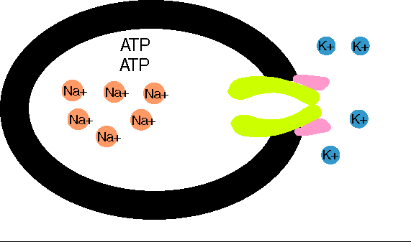
TARGETS
REGULATORY PROTEIN
CARRIER MOLECULE
Digitalis blocks efflux of Na by Na pump
Active
Transporter
Digitalis
Notes:
9

Slide 10
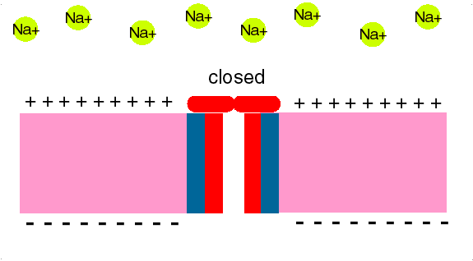
ION CHANNEL
TARGETS
REGULATORY PROTEIN
Responsible for influx or out-flux of ions through cell membranes along their concentration gradients.
They are activated by alteration in action potential and are controlled by gating machinery.
Drugs bind to alter channel function by block or modulation
Local Anesthetics block Na influx through Na channel in nerve fibers.
They are Na channel Blockers.
.Anaesthesia

Slide 11
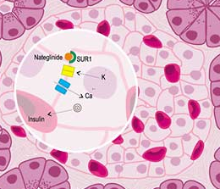
ION CHANNEL
TARGETS
REGULATORY PROTEIN
Sulfonylurea drugs block K⁺ out flux via the K channels in pancreatic cells .
They are K Channel Modulator

Slide 12
TARGETS
REGULATORY PROTEIN
RECEPTOR
Responsible for selectively sensing & binding of a stimulus (ligand) & its coupling to a response via a set of signal transduction machinery
Drugs bind and alter R signal transduction machinery.
Bind
Occupy
Initiate
Activate
L
Physiological
RESPONSE
L
R
LR*
ENDOGENOUS
LIGAND
AFFINITY
EFFICACY
Agonist
R
Pharmacological
RESPONSE
A
A
R
AR*
ACh
A drug that possesses both affinity and efficacy
Antagonist
NO RESPONSE
B
B
R
Tubocurarine
A drug that possesses an affinity but no efficacy

Slide 13
The tendency of a drug to bind to the receptors is governed by its affinity.
AFFINITY
The ability for it, once bound, to activate the receptor is denoted by its efficacy.
EFFICACY
Agonist
A drug that possesses both affinity and efficacy
Is that inherent property intrinsic to the agonist that determines how "good" an agonist is.
high intrinsic efficacy
↓
a full agonist
low intrinsic efficacy ↓
a partial agonist.
Antagonist
A drug that possesses an affinity but no efficacy
Notes:
13

Slide 14
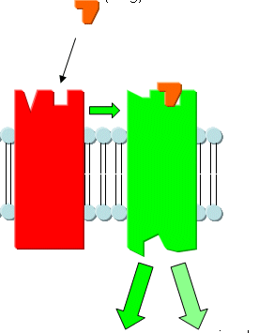
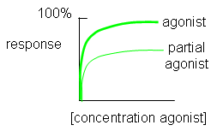
Ligand
Agonist
Ligand
High intrinsic efficacy
↓
Max response
low intrinsic efficacy
↓
Submax response agonist.
A Full Agonist
A Partial
Agonist
Agonistic-Antagonistic
Potentials
Pindolol, a beta blocker which is a partial agonist, produces less decrease in heart rate than pure antagonists such as propranolol.
Notes:
14

Slide 15
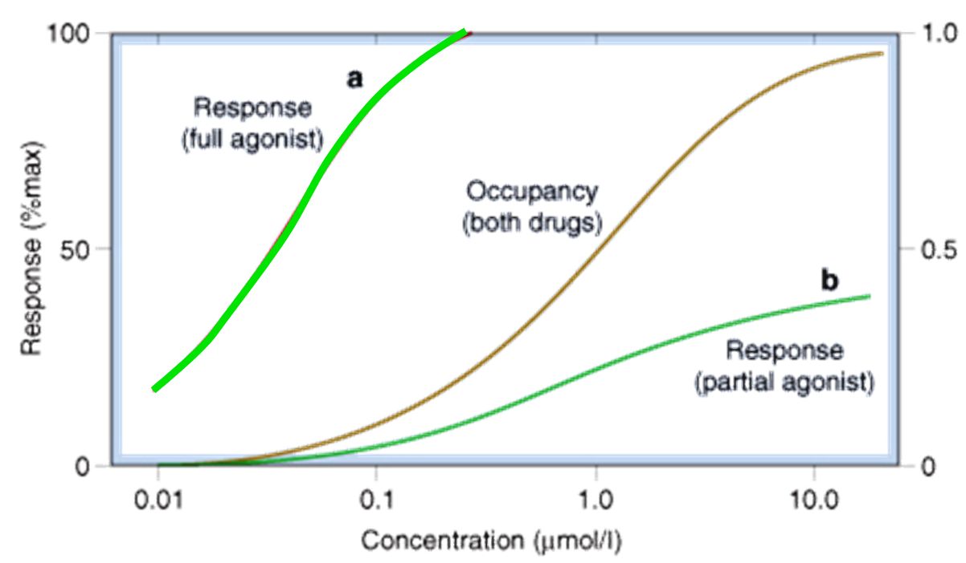

Slide 16
Quiz?
Vincristine binds to:
A) a structural protein B) an ion channel C) an enzyme D) a carrier molecule

Slide 17
Quiz?
Local anaesthetics are:
A) Reversible enzyme inhibitors B) Irreversible enzyme inhibitors C) Channel blockers D) Channel modulators

Slide 18
Quiz?
An agent that can bind and maximally activate the receptor .
A) Reversible antagonist B) Full agonist C) Partial agonist D) Irreversible antagonist

Slide 19
Quiz?
Tubocurarine is a drug that possesses
A) Affinity and efficacy B) Affinity but no efficacy C) No affinity but efficacy D) No affinity and efficacy

