Slide 1
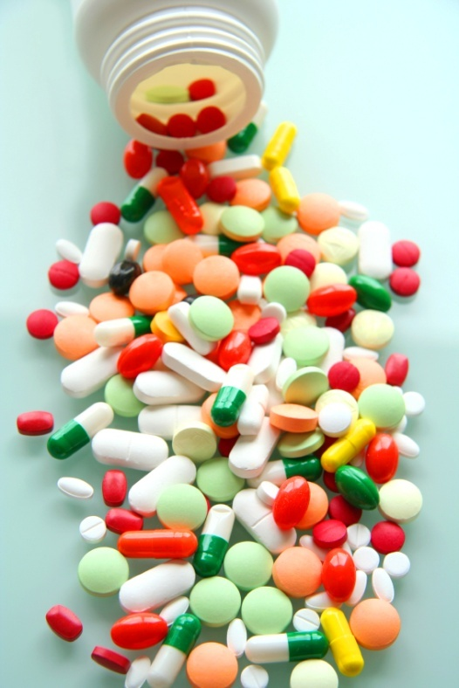
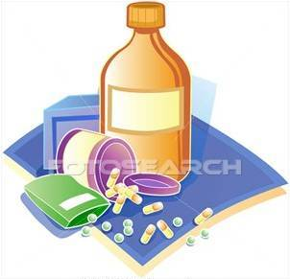
PHARMACOLOGY
PHARMACOLOGY

Slide 2
PHARMACOKINETICS
Absorb
Distribute
Metabolize
Excrete
The body
Interacts with body’s biological molecules
TARGETS Of Drug Action
To alter their biochemical &/or biophysical activity
Depress
Activate
Replace
Irritate
Destroy
The DRUG
RESPONSE
PHARMACODYNAMICS

Slide 3
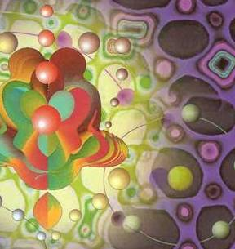
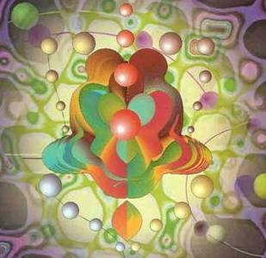
ilos
By the end of this lecture you will be able to :
Identify different targets of drug action
Differentiate between their patterns of action; agonism versus antagonism
Elaborate on drug binding to receptors
MOLECULAR MECHANISMS OF DRUG ACTION
By
Prof. Omnia Nayel
Assoc. Prof. Osama Yousif

Slide 4
PHARMACODYNAMICS
TARGETS
> Proteins
STRUCTURAL
REGULATORY
ENZYME
CARRIER MOLECULE
ION CHANNEL
RECEPTOR

Slide 5
TARGETS
STRUCTURAL PROTEIN
Examples of drugs acting on:
Tubulin are
Vincristine
Colchicine
Tubulin
Structure

Slide 6
TARGETS
REGULATORY PROTEIN
ENZYME
The drug competes with the natural substrate
for the enzyme
Examples of drugs acting:
REVERSIBLE
Neostigmine reversibly compete with ACH for cholinestrase at MEP
IRREVERSIBLE
Organophosphates irreversibly competes with ACH for cholinestrase

Slide 7
TARGETS
REGULATORY PROTEIN
Responsible for transport of ions and small organic molecules between intracellular compartments, through cell membranes or in extracellular fluids.
CARRIER MOLECULE
The drug binds to such molecules altering their transport ability
Examples of drugs acting:
On a Passive Transporter
Cocaine blocks transport of catecholamines at synaptic cleft in CNS
On an Active Transporter
Digitalis blocks efflux of Na by Na pump

Slide 8
ION CHANNEL
TARGETS
REGULATORY PROTEIN
Responsible for influx or out-flux of ions through cell membranes along their concentration gradients.
They are activated by alteration in action potential and are controlled by gating machinery.
Drugs can act as a:
*Channel blocker
or
*Channel modulator
Local Anesthetics block Na influx through Na channel in nerve fibers.
They are Na channel Blockers.
Sulfonylurea drugs block K⁺ out flux via the K channels in pancreatic cells . They are K Channel Modulator

Slide 9
TARGETS
REGULATORY PROTEIN
RECEPTOR
Responsible for selectively sensing & binding of a stimulus (ligand) & its coupling to a response via a set of signal transduction machinery
Drugs bind and alter R signal transduction machinery.
Bind
Occupy
Initiate
Activate
L
Physiological
RESPONSE
L
R
LR*
ENDOGENOUS
LIGAND
AFFINITY
EFFICACY
Agonist
R
Pharmacological
RESPONSE
A
A
R
AR*
ACh
A drug that possesses both affinity and efficacy
Antagonist
NO RESPONSE
B
B
R
Tubocurarine
A drug that possesses an affinity but no efficacy

Slide 10
The tendency of a drug to bind to the receptors is governed by its affinity.
AFFINITY
The ability for it, once bound, to activate the receptor is denoted by its efficacy.
EFFICACY
Agonist
A drug that possesses both affinity and efficacy
Is that inherent property intrinsic to the agonist that determines how "good" an agonist is.
high intrinsic efficacy
↓
a full agonist
low intrinsic efficacy ↓
a partial agonist.
Antagonist
A drug that possesses an affinity but no efficacy
Notes:
10

Slide 11
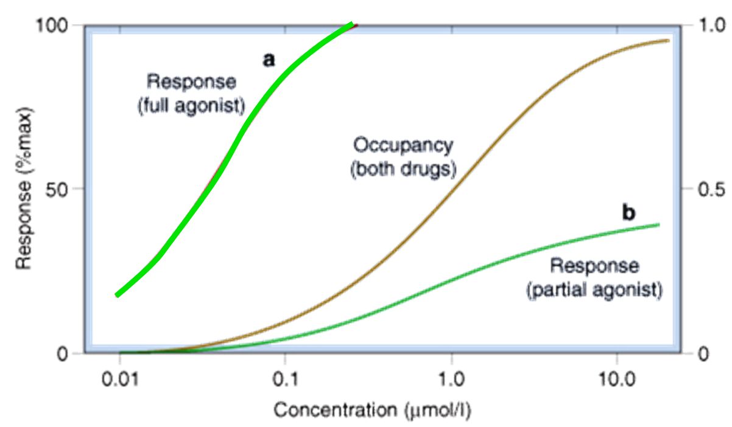
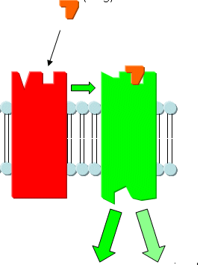
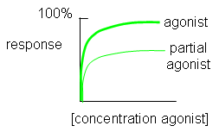
Ligand
Agonist
High intrinsic efficacy
↓
Max response
Low intrinsic efficacy
↓
Submax response
Ligand
A Full Agonist
A Partial
Agonist
Has Agonistic-Antagonistic Potentials
Pindolol, is a partial agonist, produces less decrease in heart rate than pure antagonists such as propranolol.
Notes:
11

Slide 12
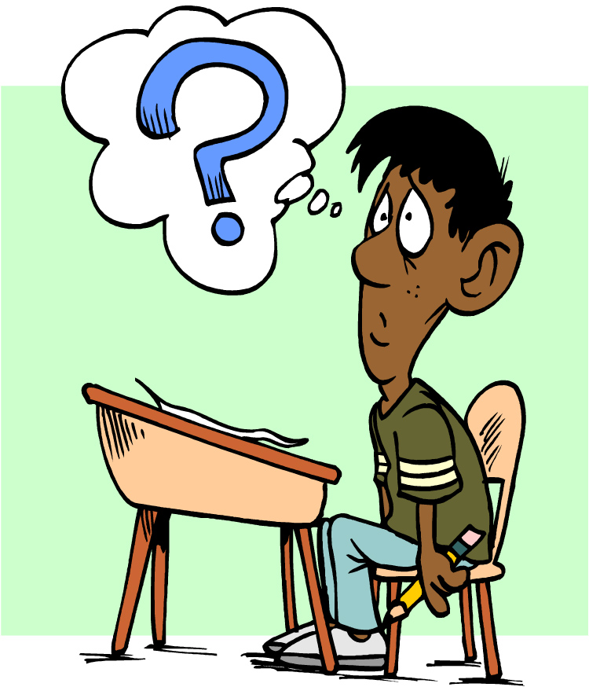
Quiz?
Vincristine binds to:
A) a structural protein B) an ion channel C) an enzyme D) a carrier molecule

Slide 13
Quiz?
Local anaesthetics are:
A) Reversible enzyme inhibitors B) Irreversible enzyme inhibitors C) Channel blockers D) Channel modulators

Slide 14
Quiz?
An agent that can bind and maximally activate the receptor .
A) Reversible antagonist B) Full agonist C) Partial agonist D) Irreversible antagonist

Slide 15
Quiz?
Tubocurarine is a drug that possesses
A) Affinity and efficacy B) Affinity but no efficacy C) No affinity but efficacy D) No affinity and efficacy

