Slide 1
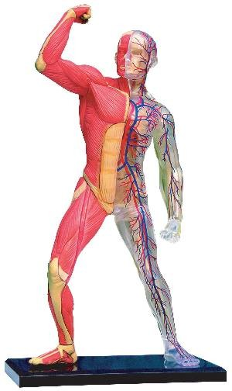
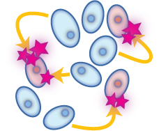
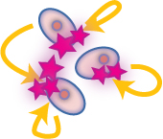
Cell-toCell COMMUNICATION
Distance
Via general routes  Blood
Local
Via  ECF, Gap junctions, ECM...
Along specified path Nerves

Slide 2
LOCAL COMMUNICATION
PARACRINE MEDIATORS
Secreted by one cell & acts upon adjacent cells or surrounding extracellular matrix [ECM]
AUTOCRINE MEDIATORS
Secreted from a cell and acts on the same cell

Slide 3
Paracrine Autocrine Mediators
Chemically they are classified into


EICOSANOIDS
Prostaglandins
Prostacyclines
Thromboxane A₂
Leukotrienes …etc
OTHERS
Cytokines
Chemokine
Growth Factors
….etc.
NO
PEPTIDES
Contractants Angiotensin Endothelin
NPY
Vasopressin
Relaxants Kinines
ANP
Tachykinins [SP]
VIP ….etc

PURINES
ATP / ADP
Adenosine

MONOAMINES
Histamine
Serotonin …etc


Slide 4
Paracrine Autocrine Mediators
General Features
Act mostly on:
smooth muscles (SMC) [vascular (VSMC) or non vascular (NVSMC)]
nerve endings [> nonadrenergic non-cholinergic (NANC) co-transmission] + heart + exocrine glands + CNS …etc
Exist either:
Preformed & stored in tissues & released by a stimulus
[Monamines (histamine), most peptides ]
Formed de novo in response to a stimulus
[NO, eicosanoids, some peptides, cytokines] ]
Their presence is either:
Constitutive: present all times, to share in normal basic functional regulation within the cells (eNOS / COXI )
Inducible: only present upon demand i.e. gets expressed [gene transcription, mRNA formation and ribosomal translation into protein]
(iNOS / COXII)

Slide 5
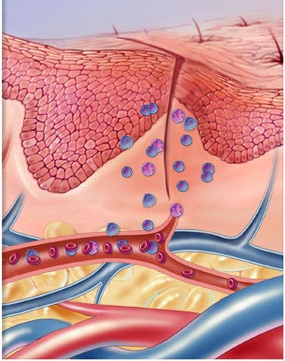
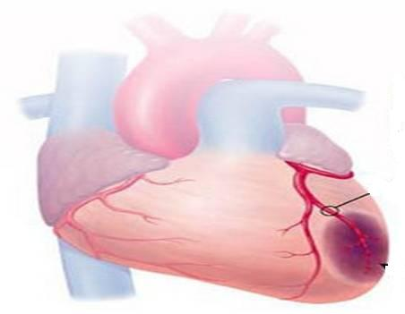
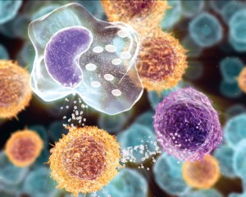
DRUGS Acting On
Paracrine Autocrine Mediators
Nitric Oxide
Angiotensin & Bradykinin
Eicosanoids
Histamines
I
II

Slide 6
DRUGS Acting OnParacrine Autocrine Mediators
Part I
ILOs
By the end of this lecture you will be able to:
Recognize the role of NO in cellular communication.
Classify the different NOS available
Expand on its formation, actions termination and pharmacological modulation.
Identify role of angiotensin in body homeostasis and local regulation.
Explain its formation, target receptors, feedback regulatory actions, breakdown, intersection with the kinin system and pharmacological modulation.

Slide 7
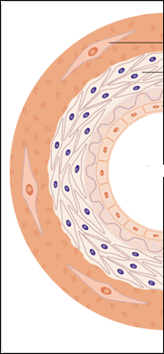
Nitric Oxide

Slide 8
Nitric Oxide
Is a highly diffusible stable gas
L-arginine + O₂ NO + Citrulline + H₂O
Synthesis
NADPH, FAD, CaCAM
Nitric oxide synthase (NOS)
NOS Isoforms
Type I [n-NOS] Neuronal NOS | Type III [E-NOS] Endothelial NOS | Type II [I-NOS] Inducible NOS
Cytosol of Neuronal cells | Bound to membrane of endothelial cell [EC], platelets …etc. | Cytosol of macrophage, neutrophil, kupffer cells … etc
Constitutive | Constitutive | Inducible
Neuronal messenger Cytoprotective | Relaxation of VSMC Cytoprotective | Immunocytotoxicity
Shear Stress or Agonists as; Ach, histamine, bradykinin, …..when bind to receptors  intracellular Ca activate eNOS NO formation

Slide 9
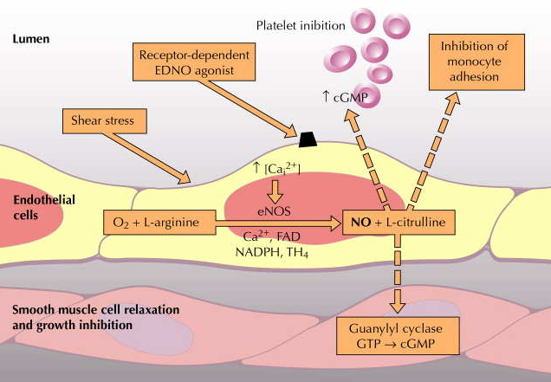
Nitric Oxide
PARACRINE
PARACRINE
AUTOCRINE
PARACRINE
Role of NO in blood vessels
Relaxation of VSMC (Vasodilatation) + Cytoprotection on ECs

Slide 10
Nitric Oxide
Action
Diffusion
1.Vasodilatation
Diffuse to VSMC
Binds soluble GC
Change GTP to cGMP
PARACRINE
Endothelial Cell [EC]
Vascular Smooth Muscle [ VSMC]
Site of formation
Activate PKG &
Ca
Inactivate MLCK
Prevent actin myosin cross link
No contraction
RELAXATION
-
MLCK
2. Cytoprotection
platelet aggregation
inflammatory cell recruitment
Cholesterol deposition…etc.
PARACRINE
AUTOCRINE

Slide 11
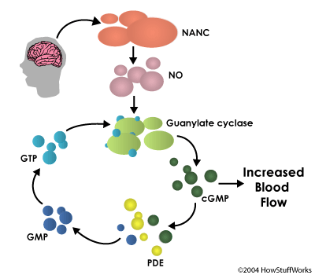
Nitric Oxide
Termination of action
By formation of
1. Stable analogues  with
proteins containing SH ….
2. Free radical Peroxynitrite  in oxidative stress
By break down of its downstream signal [cGMP]
by
PDE
to form GMP
BV

Slide 12
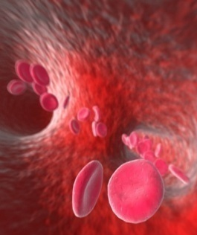
Nitric Oxide
Drugs modulating
1. Express eNOS:
Statins, Estrogen CVS Cytoprotection
2. Act as NO donners:
a. Nitrates  >Venulodilators in angina
b. Na Nitroprusside  Arteriolar dilator in hypertension
3. Prevent breakdown of PDE:
Selective PDE₅ Inhibitors; Sildenafil  Erectile dysfunction

Slide 13
Angiotensin

Slide 14
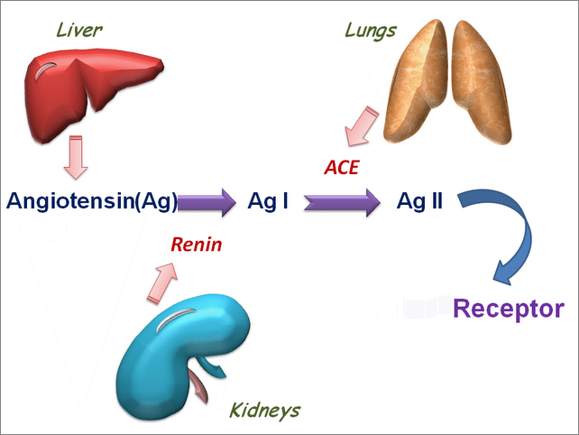
Angiotensin [Ag]
A vasoconstrictor peptide
Synthesis
Precursor is Angiotensinogen; a plasma α-globulin synthesized in the liver.
Endothelium, brain &
Angiotensinogen (Ag)
Other Proteolytic Enzymes
Chymase
Endoperoxidase
AT₂
AT₁
IIIIII
IIIIII
IIIIII
Secreted by renal juxtaglomerular apparatus
Blood Pressure
Renal Blood flow

Slide 15
ENDOCRINE
RAAS
PARACRINE
ALDOSTERONE
PARACRINE
Suprarenal Gland

Slide 16
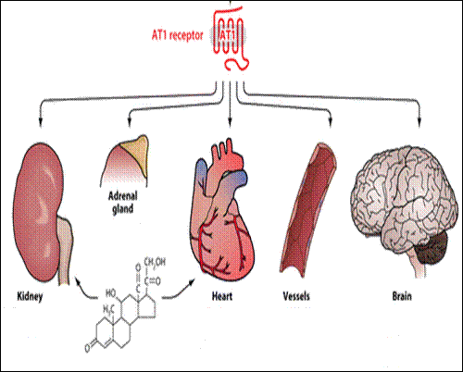
Angiotensin
Ag II
Ag II
Ag II
Ag II
Action
Thirst
SNS activation
Ag II
ALDOSTERONE
ADH
Fibrosis
Hypertrophy
Fibrosis
Remodeling
=Hypertrophy
Na retention
Inotropy
Chronotropy
Vasoconstriction
Blood Pressure

Slide 17
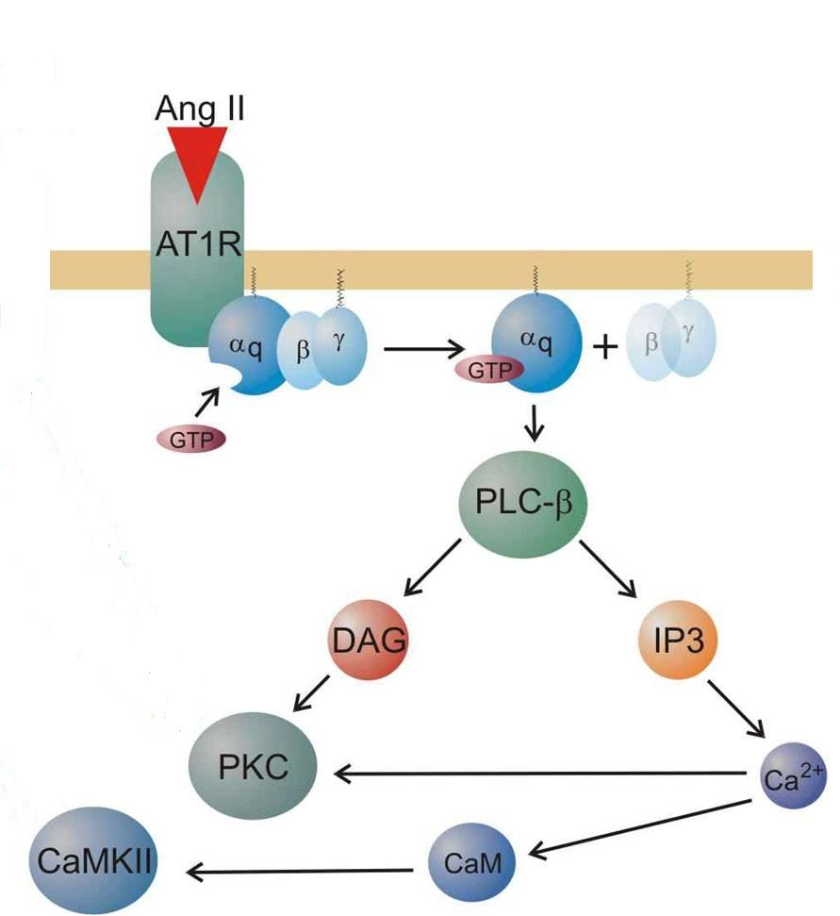
Angiotensin
Ag II
Termination of action
AgII acted upon by peptidases
aminopeptidases (angiotensinase)
to Ag III
[a less active] & then to fragmentation products

Slide 18
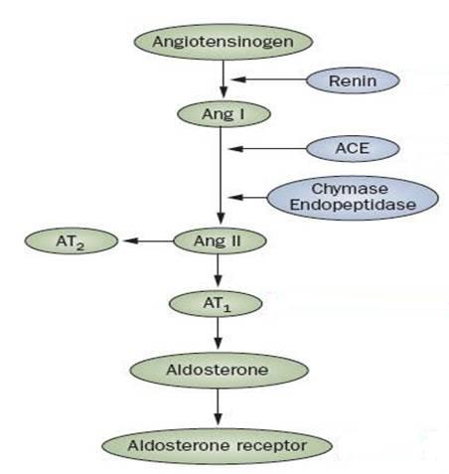
Angiotensin
Clonidine
Propranolol
◉ BP
BF [β₂ ]
Drugs modulating
INHIBITION OF RAAS SYSTEM
is beneficial in treatment of:
Hypertension (hypertrophy)
Heart Failure (hypertrophy & fibrosis)
Diabetics (Protect the kidney)
RENIN Inhibitors
Aliskiren
ACE Inhibitors
Lisinopril
VASOPEPTIDASE Is
Omapatrilat
ARBs
Candisartan
Inactive metabolites
ADOSTERONE Antagonists
Spirinolactone Eplerenone

Slide 19
Kinins
Bradykinin is a vasodilator peptides
Synthesis
Kininogen
From liver
Plasma Kallikrin
TissueKallikrin
Aminopeptidase
Action
Bradykinin
Kallidin
Vasodilatation
Inflammation & Exudation
Pain (sensory nerves)
Exocrine gland secretion
ACE & Neutral Endopeptidase (NEP)
Termination of action
Inactive metabolites

Slide 20
Kinins
◉ Action bradykinin mediated pain → NSAIDs
Drugs modulating .
ACE Inhibitors

Bradykinin
ACE

Inactive metabolites
BK R
L-arginine + O₂ NO + Citrulline + H₂O
(eNOS)
Vasodilatation
Breakdowntheir concentration  ACE Inhibitors VASOPEPTIDASE Is
Antihypertensive drugs

Slide 21
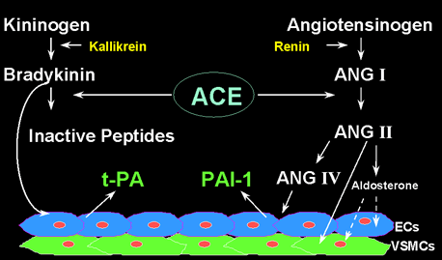
Difference between ACE Is & ARBs action
Inhibit activation of AgI to AGII + decrease degradation of bradykinin
ACE Inhibitors
Ramipril



AT₂

ARBs
Candisartan
AT₁
Block action of AgII on AT1 in VSMCs that is causing vasoconstriction
The AgII act on non-blocked AT2 on endothelial cells causing vasodilatation

Slide 22
DRUGS Acting OnParacrine Autocrine Mediators
GOOD LUCK

