Slide 1
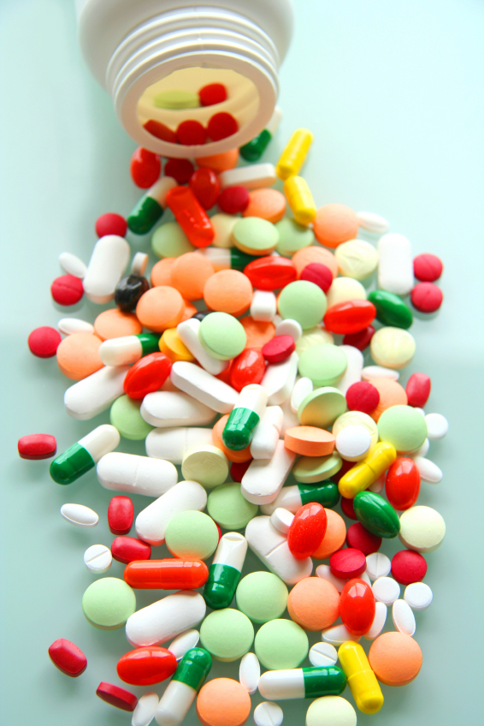
ilos
By the end of this lecture you will be able to :
Recognize different dose response curves
Distinguish the therapeutic utility of each of these curves
Classify different types of antagonism
QUANTITATIVE ASPECTS OF DRUG ACTION
By
Prof. Omnia Nayel
Assoc. Prof. Osama Yousif

Slide 2
DOSE RESPONSE CURVE
How does response vary with C?
A continuous response
BP, HR, FBG, Cholesterol,…
GRADED DOSE RESPONSE CURVE
An all-or-non response prevention of convulsion, arrhythmias or death…..
Relate C to % of patients eliciting the :
* specified therapeutic response
* adverse response
* lethal outcome
QUANTAL DOSE RESPONSE CURVE

Slide 3
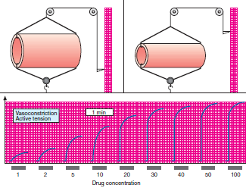
GRADED DOSE RESPONSE CURVE
A continuous response
BP, HR, FBG, Cholesterol,…

Slide 4
100
Max effect = E_{max}
Effect when all the receptors are occupied by D
80
As C ↑ response increment ↓
100
60
% of Maximal Effect
80
40
% of Maximal Effect
60
20
40
[C]
0
20
0
200
400
600
800
EC₅₀
EC₅₀
C that gives the half-maximal effect
[C]
0
1
10
100
1000
Graded dose-response curves are used to determine:
The max efficacy (E_{max}) → highest limit of dose-response relationship on response axis.
The potency = The concentration of drug required to produce a specified response
The smaller the EC₅₀ , the greater the potency of the agonist i.e. the lower C needed to elicit the maximum biological response.
3. Compare the relative potency and efficacy of drugs that produce the same effect.

Slide 5
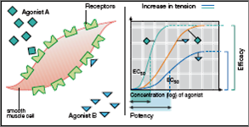
GRADED DOSE RESPONSE CURVE
EFFICACY
B Partial Agonist
A > efficacy than B
POTENCY
A > potent B

Slide 6
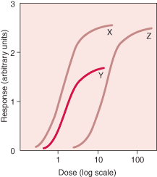
GRADED DOSE RESPONSE CURVE
X & Z are equal efficacy
X & Z > efficacy than Y
Y > potent but
< efficacious than Z
X > potent than Y & Z
Y> potent than Z

Slide 7
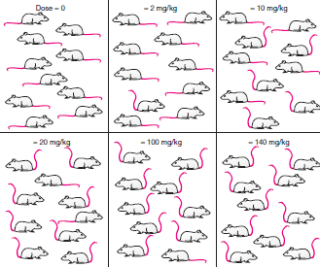
QANTAL DOSE RESPONSE CURVE
All-non responses
% subjects responding
Dose-frequency relationship

Slide 8
QANTAL DOSE RESPONSE CURVE: used to determine
100
Lethal Effect
80
Toxic Effect
Therapeutic Effect
60
Predict the safety profile
% subjects responding
40
20
ED₅₀
LD₅₀
TD₅₀
[Dose]
0
1
10
100
1000
1. Median Effective Dose
2.Median toxic dose
3. Median lethal dose
1. 50% of individuals exhibit the specified therapeutic response
2. “ “ “ toxic effects
3. “ “ “ death
TD₅₀
The relation between dose to induce a desired effect versus that producing the unwanted effect.
Therapeutic Index
ED₅₀
When low → the drug has a narrow margin of safety →digoxin
When high → the drug has a safe profile → diazepam

Slide 9
ANTAGONISM
It is the diminution or the complete abolishment of the effect of one drug in the presence of another.
Types
1. Chemical
Two drugs react chemically resulting in loss of activity of active drug.
Dimercaprol reduces heavy metal toxicity [ lead]
2.Physiological
Two drugs possess opposing actions in body, so tend to cancel each other’s effect.
Omeprozole & histamine
3. Pharmacokinetic
The antagonist effectively reduces the concentration of the active drug at the site of action
Phenobarbitone accelerates hepatic metabolism warfarin
4. Receptor Blockade (Competitive )
Reversible
Irreversible
5. Non-Competitive

Slide 10
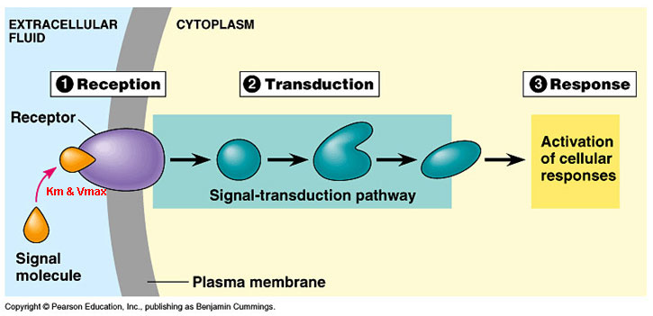
ANTAGONISM
Non-Competitive
Antagonist block at some point the chain of events that ignite the response of agonist
Receptor Blockade
(Competitive)
Agonist and Antagonist can be bound simultaneously
Antagonist prevents binding of agonist to the receptor at the same binding site ( = competes with it at same occupancy site )
Agonist and Antagonist compete ( only one is bound)
Reversible
Irreversible

Slide 11
COMPETATIVE ANTAGONISM
Antagonist readily dissociate from binding site of agonist to the receptor
Reversible
Antagonism can be overcomed by increasing concentration of agonist = Surmountable
Atropine vs Ach
Irreversible
Antagonist form stable, permanent / near permanent chemical bond with receptor.
Inactivation lasts for duration of receptor turnover or its de- novo synthesis → explains its longevity of action
Phenoxybenzamine & Noradrenaline

Slide 12
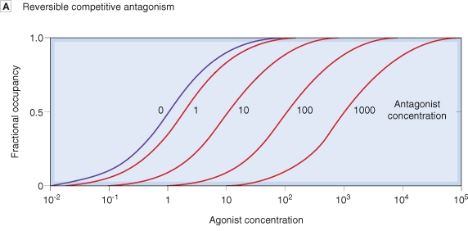
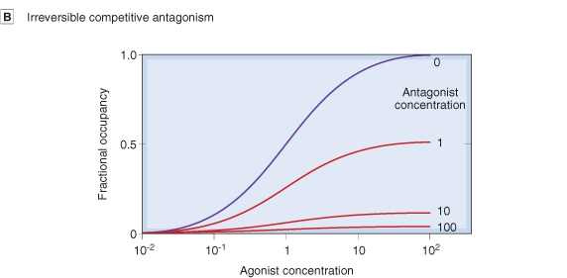
Competitive Antagonism
Reversible
Parallel shift to the right, without any change in slope or maximum
Irreversible
No parallel shift
But both a decrease in slope and a reduced maximum are obtained.

Slide 13
Competitive vs Noncompetative Antagonism
Antagonism can be overcomed by increasing concentration of agonist = SURMOUNTABLE
% of Maximal Effect
Agonist + reversible competitive antagonist
100
Agonist
80
Agonist + irreversible competitive antagonist
60
Agonist + non-competitive antagonist
Depression of maximal response +/- rightward shifts ( if some R are spare )
40
20
Verapamil vs noradrenaline
0
[C]
1
10
100
1000
Antagonism cannot be overcomed by increasing concentration of agonist = NON-SURMOUNTABLE

Slide 14
Quiz?
Concentration-binding-curves are used to detect:
A) highest limit of dose-response relationship B) concentration of drug required to produce a specified response C) affinity of a drug for its receptor D) therapeutic index of a drug
Notes:
C

Slide 15
Quiz?
Drug A has a smaller EC₅₀ than drug B. This means that drug B is:
A) more potent than A B) less potent than A C) more efficacious than A D) less efficacious than A
Notes:
B

Slide 16
Quiz?
An example of a reversible competitive antagonist is:
A) phenoxybenzamine to noradrenaline. B) omeprazole to histamine C) dimercaprol to lead D) atropine to acetylcholine
Notes:
d

Slide 17
Quiz?
Antagonism can be overcomed by increasing concentration of agonist in:
A) irreversible competitive antagonism. B) non-competitive antagonism C) reversible competitive antagonism D) pharmacokinetic antagonism
Notes:
c

