Slide 1
Hypersensitivity Reactions
Immunology Unit
Department of Pathology
College of Medicine
King Saud University

Slide 2
Objectives
To know that hypersensitivity reactions are over and excessive immune responses that can be harmful to body in four different ways
To be familiar with inflammatory processes in Type I hypersensitivity reaction that mediate allergic inflammation
Recognize that Type II hypersensitivity deals with immune responses against antigens that are integral part of cell membrane and are usually associated with autoimmune disorders
To know that Type III hypersensitivity reactions are mediated by immune complexes and cause vasculitis
Describe Type IV hypersensitivity is a purely cell mediated immune response associated with chronic inflammation

Slide 3
What is hypersensitivity?
Protective immunity: desirable reaction
Hypersensitivity: undesirable reaction
Undesirable responses can be mediated by
Antibody binding to antigens (Types I-III)
Cell mediated reaction to chemicals or proteins
(Type IV)

Slide 4
Gel and Coombs Classification
Type I: IgE Ab
Type IV: Cell Mediated Immunity
Type II: IgG Ab to tissue antigens
Type III: IgG Immune Complexes

Slide 5
Type I: Immediate Hypersensitivity
Most people will not react to these allergens but some individuals “atopic” respond by producing large amounts of IgE
Non-allergic individuals respond to these allergens by producing IgG antibodies

Slide 6
Type I Hypersensitivity
Also termed as:
Immediate Hypersensitivity
Anaphylactic reactions
Allergic reactions
(Occurs within minutes to hours)

Slide 7
Features
Antibody type: IgE
- Cellular components:
Mast cells, basophiles & eosinophils
- Antigens:
Also known as allergens
(antigens with low molecular weight & highly soluble)

Slide 8
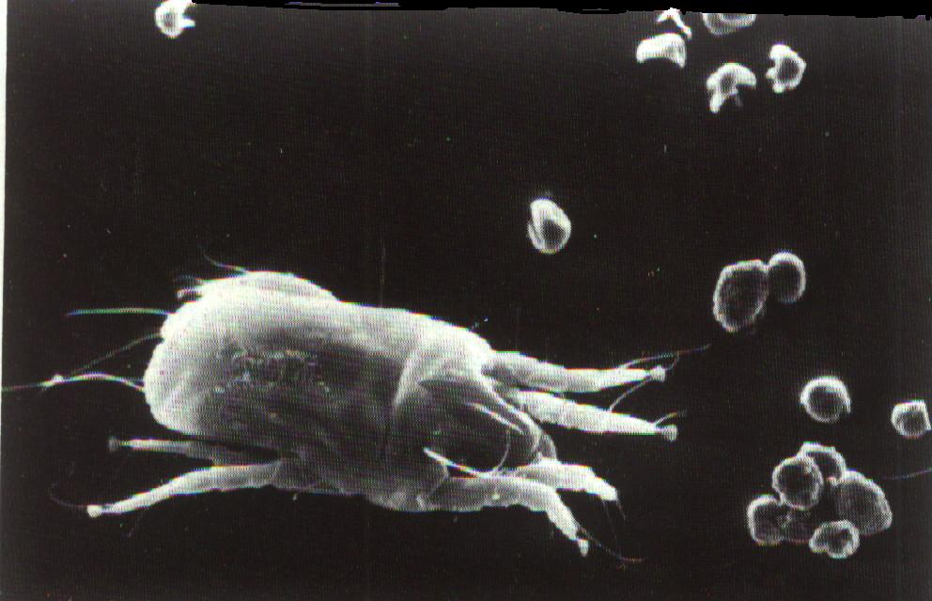
Allergens
Some of the allergens involved in type I hypersensitivity are: pollens, dust mite allergens, animal dander, nuts, shellfish, various drugs etc

Slide 9
Type I Reaction occur in 2 phases:
Type I reactions occur in two phases
- Sensitization phase
First contact with allergens
- Challenge phase
Subsequent contact with allergens
Phase I :
- Sensitization phase .
Allergen enter tissues , induce an
immune response . B – cells transform
to plasma cells & produce IgE.
- IgE bind to receptors on Mast cells and
basophiles ( F c ЄRI - high affinity receptors).
individuals become :
“ Sensitized . “
Phase I :
- Sensitization phase .
Allergen enter tissues , induce an
immune response . B – cells transform
to plasma cells & produce IgE.
- IgE bind to receptors on Mast cells and
basophiles ( F c ЄRI - high affinity receptors).
individuals become :
“ Sensitized . “

Slide 10
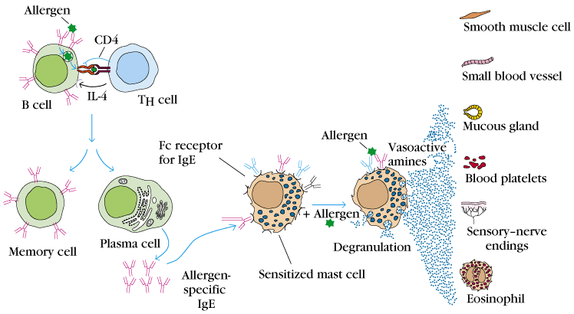
Type I Hypersensitivity (Immediate)
Sensitization
Challenge

Slide 11
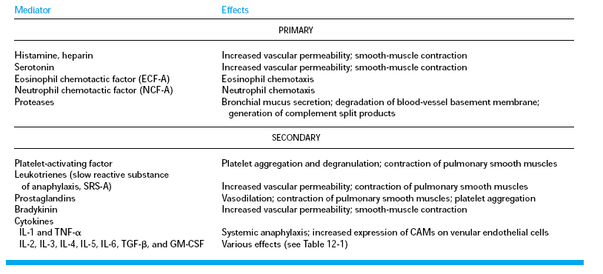
Primary and Secondary Mediators

Slide 12
Allergy is a systemic disorder
Nose
Pharynx
Allergic rhinitis
Asthma
Lungs
Esophagus
Food allergy
Stomach
Skin
Eczema
Urticaria
Allergic dermatitis

Slide 13
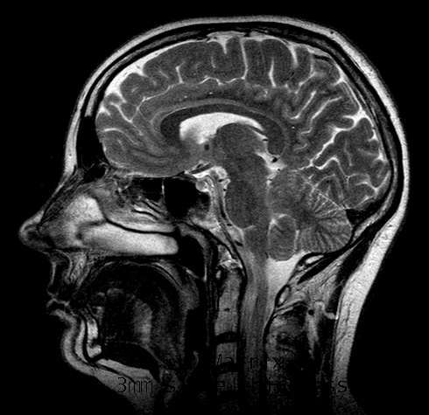
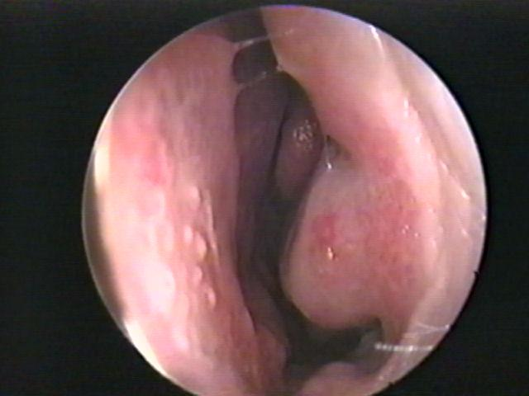
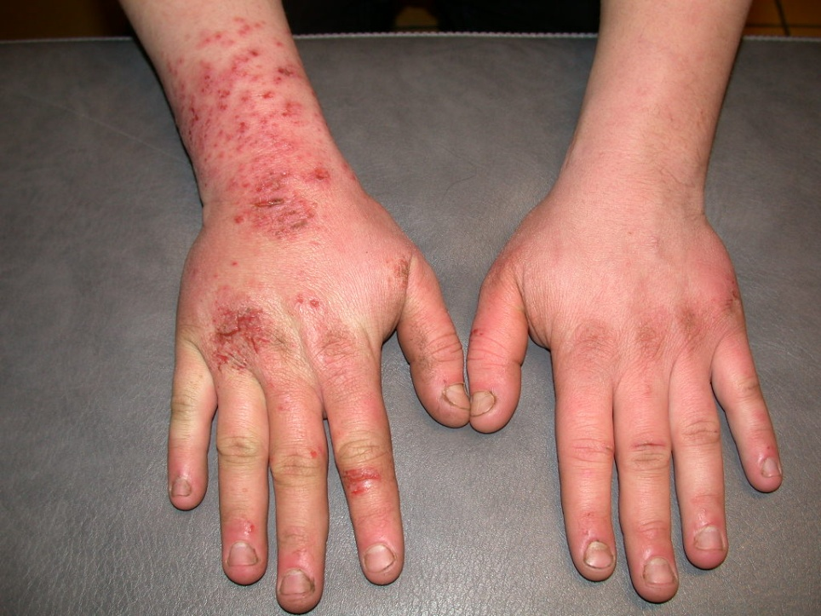
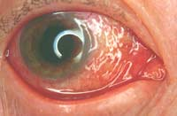
Allergy: Rhinitis, Eczema & Conjunctivitis
Normal nose

Slide 14
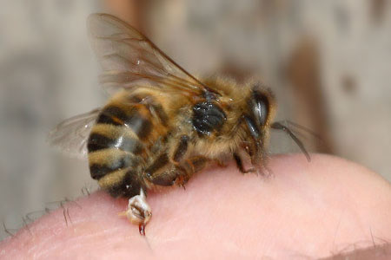
* Injected allergens:
Bee sting venom enters
the blood stream
→ Systemic inflammation
→ Anaphylactic shock
(life - threatening)
Anaphylactoid reactions:-
Are non - IgE mediated
may result from contrast media or
local anesthetics

Slide 15
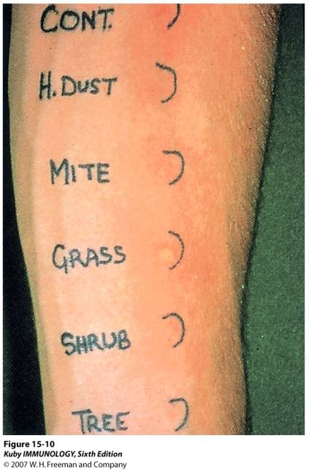
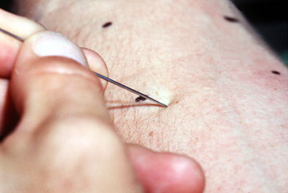
Diagnosis of Allergy
Skin Prick test
1. Skin prick test (SPT)
2. Intradermal test
3. Specific IgE measurement (RAST)
4. Elimination / Provocation test (Food allergy)

Slide 16
Type II Hypersensitivity Reactions
Features:-
- IgG (or IgM)
- Antigens: bound to cell membranes
(Self antigens) - Exogenous antigens
(microbial)
- Complement activation (Invariable)

Slide 17
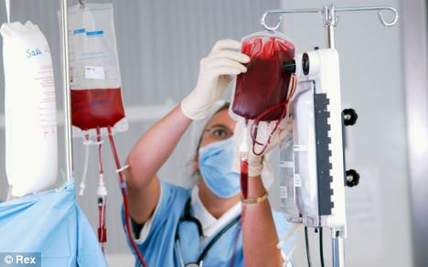
Clinical examples:
Glomerulonephritis (anti-glomerular basement membrane)
Mis-matched blood transfusion

Slide 18
Diagnosis
- Detection of antibodies and antigens by Immunofluoresence in tissue biopsy specimens e.g. kidney, skin etc.

Slide 19
Type III: Immune complex hypersensitivity
When an antigen reacts with an antibody the product they form is called an immune complex which is capable of inducing an inflammatory response
Immune complexes are deposited in tissues like kidneys (nephritis), joints (arthritis) or blood vessels (vasculitis)

Slide 20
Type III Hypersensitivity (immune–complex mediated)
Features
Antibody (IgG/ or IgM) + Antigen (soluble)
- Immune – Complex formation
- Complement activation
- Attraction of inflammatory cells

Slide 21
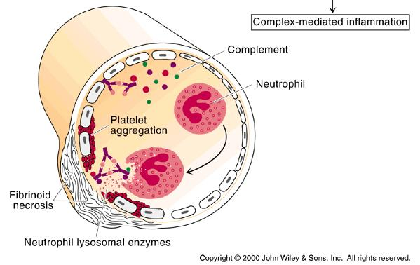
Type III Reactions

Slide 22
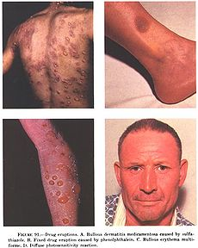
Type III H/S: Clinical examples
Glomerulonephritis
Drug eruptions

Slide 23
Diagnosis (Type III H/S)
Demonstration of specific immune complexes in the blood or tissues by:
Immunofluoresence

Slide 24
Type IV hypersensitivity reactions (Delayed Hypersensitivity)
Features
Cell mediated immune response
Antigen dependent T cell (CD4 generally and CD8 occasionally) activation via MHC Class I or II
Activated macrophages
Delayed onset (2-4 days)
Abnormal cellular response
(Granuloma formation)

Slide 25
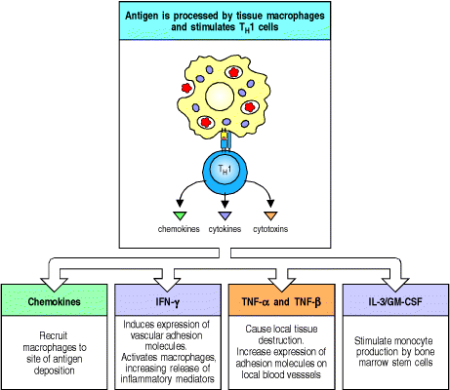
Mediators released by T_{DTH} cells

Slide 26
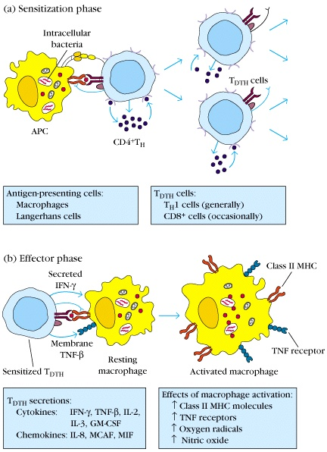
Development of DTH Response
Sensitization phase:
1-2 week period
Effector phase:
24-72 hours
Effector cells
(activated macs)
act non-specifically

Slide 27
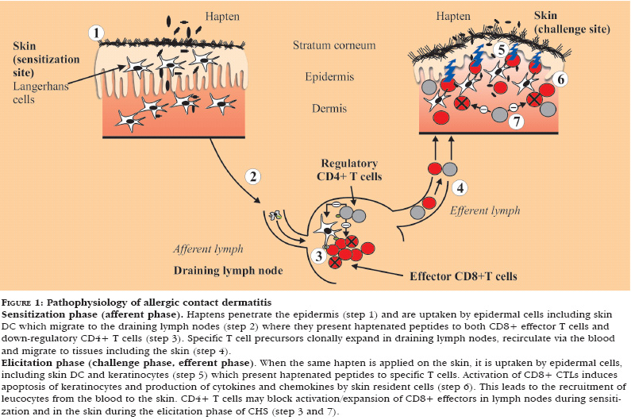
Pathophysiology of allergic contact dermatitis.

Slide 28
Type IV clinical examples:
Allergic contact dermatitis
TB granuloma
(persistent antigen)

Slide 29
Diagnosis (Type IV)
1. Delayed skin test (Mantoux test)
2. Patch test (Contact dermatitis)
3. Lymphocyte transformation test

Slide 30
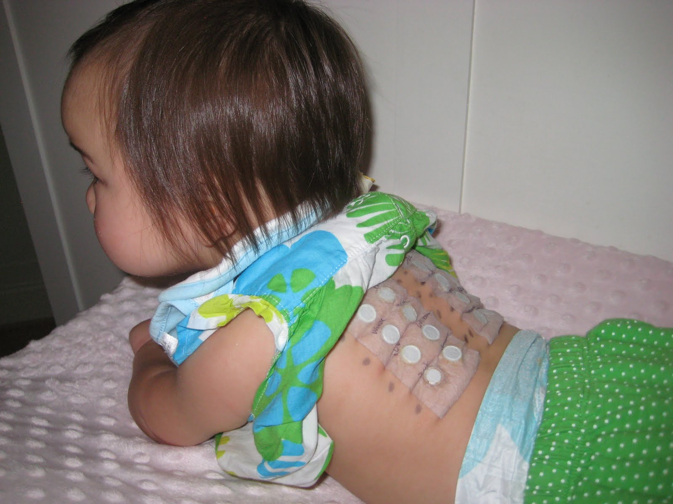
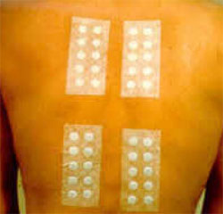
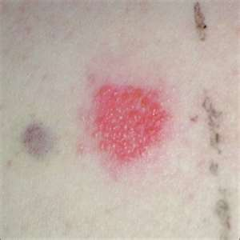
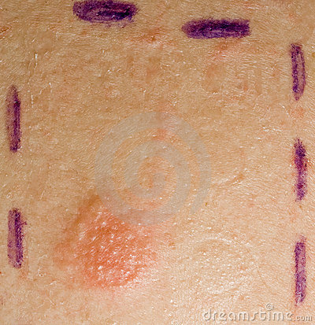
Allergy Skin Patch Test

Slide 31
Take Home Message
1. Type I (IgE), II (IgG) and III (IgG) hypersensitivity reactions are mediated by antibodies whereas Type IV hypersensitivity reaction is a cell mediated immune response.
2. Hypersensitivity reactions are undesirable, excessive, and aberrant immune responses associated with disorders such as allergy, autoimmunity and chronic inflammation.

Slide 32
Thank you

