Slide 1
Lecture Title:
Diversity of Fungi and Fungal Infections
(Foundation Block, Microbiology)
Lecturer name:
Dr. Ahmed M. Albarrag
Lecture Date: Oct-2012

Slide 2
Mycotic Diseases
Hypersensitivity (Allergy)
Mycotoxicoses
Infections
Notes:
2

Slide 3
Mycotic Diseases
How the infection is acquired?
Colonization (normal flora)
Inhalation (Airborne)
Contact
Ingestion
Trauma
Notes:
3

Slide 4
Mycotic Diseases
Healthy host?
OR
Immunocompromised host?
(When, which type of infection)
Notes:
4

Slide 5
Types of fungal infections ( Mycoses)
Superficial mycoses
Cutaneous mycosis
Subcutaneous mycoses
Systemic mycoses
Opportunistic mycoses
Notes:
5
5

Slide 6
Types of fungal infections ( Mycoses)
Healthy Host
Superficial mycoses
Cutaneous mycosis
Subcutaneous mycoses
Systemic mycoses
Immunocompromised Host
Superficial mycoses
Cutaneous mycosis
Subcutaneous mycoses
Systemic mycoses
Opportunistic mycoses
Notes:
6
6

Slide 7
Types of fungal infections - Mycoses
Superficial Mycoses
Affect the outer layer of the skin or hair shaft
No immune response
Cutaneous Mycoses
Dermatophytosis
Infection of the skin, hair or nails caused by a group of keratinophilic fungi, called dermatophytes
Notes:
7
7

Slide 8
Types of fungal infections - Mycoses
Cutaneous Mycoses
Dermatophytosis
Infection of the skin, hair or nails caused by a group of keratinophilic fungi, called dermatophytes
Notes:
8
8

Slide 9
Types of fungal infections - Mycoses
Subcutaneous Mycoses
Fungal infections involving the dermis, subcutaneous
tissues, muscle and may extend to bone.
Usually they are initiated by trauma to the skin.
Notes:
9
9

Slide 10
Types of fungal infections - Mycoses
Opportunistic fungal infections
Diseases in immunocompromised host
Risk factors
HIV/AIDS
Malignancies
Organs transplantation
Diabetes
Many others
Notes:
10
10

Slide 11
The Fungi
Primary Pathogens
Dermatophytes
Opportunistic Fungi
Normal flora
Candida spp.
Other yeast
• Endemic geographically restricted fungi
Ubiquitous in our environment
Aspergillus spp.
Zygomycetes spp.
Cryptococcus spp.
Many others
Notes:
11
11

Slide 12
Diagnosis of fungal infection
Clinical features (history, risk factors, etc)
Imaging
Good value in diagnosis and therapy monitoring
Lab Investigations
Histopathology
Microbiology
Notes:
12

Slide 13
Lab Diagnosis
Direct Microscopy
1. Potassium Hydroxide (10-20% KOH)
2. Fungal stains:
Giemsa Stain
Grocott’s Methenamine Silver stain (GMS)
India ink
Culture
Fungal media: Sabouraud Dextrose Agar (SDA), other media if needed.
Serology: (Detection of Antigen and/or Antibody)
PCR: (Detection of Fungal DNA)
Notes:
13

Slide 14
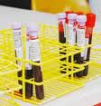
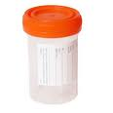
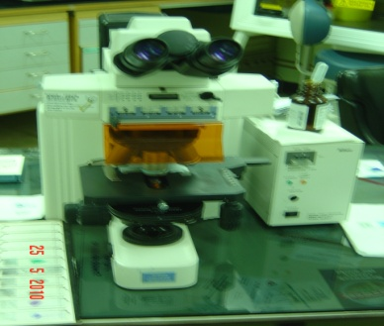
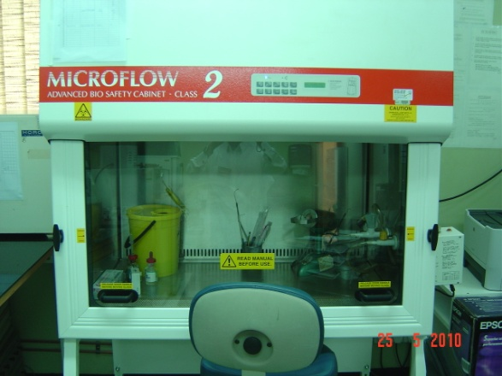
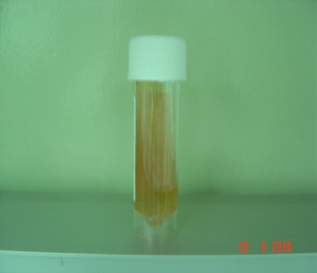
Microscopy
Clinical samples
Culture
Yeast
+/-
pseudohyphae
Fungal hyphae or other fungal element
Yeast
Mold
No growth
Negative
Notes:
14

Slide 15
Antifungal agents
Notes:
15
15

Slide 16
Comments | Spectrum of activity | Antifungal Agents | Mechanism of action | Group | Target
Serious toxic side effects (nephrotoxicity) | Broad antifungal spectrum which includes most fungi | Amphotericin B, Nystatin | Binds to ergosterol within cell membrane, formation of pores which lead to cell death | Polyenes | Cell membrane
Not effective against zygomycosis (except posaconazole) Adverse Effects Drug Interactions | Variable antimycotic activity* Fluconazole has a limited or no activity against mould fungi Voriconazol is the drug of choice for Aspergillosis Posaconazole has a broader spectrum of activity than other azoles | Ketoconazole Itraconazole Fluconazole Voriconazole Posaconazole Miconazole clotrimazole | Inhibit the synthesis of ergosterol | Azoles
Has less toxicity and side effects compared to amphotericin B and azoles | Good activity against Candida spp ,Aspergillus spp Limited or no activity against other fungi | Caspofungin Micafungin Anidulafungin | Inhibits glucan synthesis, (glucan polymers in the fungal cell wall) | Echinocandins | Cell wall
Monotherapy now limited (Resistance) | Restricted spectrum of activity Candida species Cryptococcus neoformans | Flucytosine | Fungal RNA miscoding Interfering with DNA synthesis | Pyrimidine analogues | DNA/RNA synthesis
Notes:
16

Slide 17
Thank You ☺
(Foundation Block, Microbiology)
Dr. Ahmed M. Albarrag
Oct-2012

