Slide 1
Lecture Title:
Host-Parasite Relationship
(Foundation Block,microbiology )
Lecturer name: Prof .Hanan Habib & Prof A.M. Kambal
Department of Pathology, Microbiology Unit

Slide 2
Lecture Objectives.
By the end of this lecture, the student should able to:
1-Define core terms important in understanding host-parasite relationship: parasite, pathogen, pathogenicity, disease, infection.
2-Know host response to parasite invasion that include; nonspecific and specific defense mechanisms.

Slide 3
Lecture Objectives..
3-Name the important examples of primary pathogens and opportunistic pathogens.
4- Recognize the differences between virulence and pathogenicity and know how virulence is measured.
5- Recognize the transmissibility of pathogens.

Slide 4
Lecture Objectives..
6- Describe the attributes of pathogenicity and recalls examples, including:
a- Adherence
b- Survival of host natural defence mechanisms
C-Invasion (capsulated and non capsulated organisms)
d- Multiplication
e- Tissue destruction by toxins (the differences between endotoxins and exotoxins)
7- States Koch's postulates.

Slide 5
Host - Parasite Relationship
Human host is in contact with many microorganisms (normal flora) only a small number of these (primary and opportunistic pathogens) can cause disease.
Host-parasite relationships:
Is characterized by fighting of the organism to invade the body and the body defending itself by protective measures.

Slide 6
It can be discussed under:
A) Pathogenecity
B) Normal flora

Slide 7
Host Resistance to Parasite Invasion is divided into:
A- Pathogenecity
Non specific resistance – part of natural constitution of the host.e.g.
Skin mechanical barrier
ciliated epithelium of respiratory tract
Competition by normal flora
Low pH in the stomach
Cough
peristalsis
Lysozymes
Neutrophils
b) Specific / Acquired resistance – to certain organism: e.g. Antibodies

Slide 8
the ability of a microorganism to cause disease.
A microorganism having capacity to cause disease in a particular host.
Is the end product of an infectious process.
Pathogenecity
Pathogen
Disease

Slide 9
Pathogens
Can be divided according to degree of Pathogenecity into:
a) Primary pathogens:
causing disease in non immune host to that diseases.
e.g. - Bordetella species
- Mycobacterium tuberculosis
b) Opportunistic pathogens:
having low pathogenecity and infect people with low immunity.
e.g. Pseudomonas

Slide 10
Resistance:
The ability of the host to prevent establishment of infection by using its defense mechanisms.
Susceptibility:
Lack of this resistance and establishment of disease.

Slide 11
Note:
Infection is simply invasion of cells and multiplication by microorganisms without tissue destruction.
b) Virulence is an ability to invade and destroy tissue to produce disease.
Virulence is measured by the Lethal dose 50 (LD50) which is the number of organisms or mg. of toxins that will kill 50% of susceptible lab. animal – usually mice – when injected into such animal. When the LD 50 is small, the microorganism is considered highly virulent and when it is high the organism is said to be of low virulence.

Slide 12
c) When the organism is able to produce disease even in an apparently healthy host it is referred to as primary pathogen but when it causes disease only when the host’s defenses are impaired, it is called secondary pathogen (opportunistic pathogen).

Slide 13
Transmissibility
The ability to spread from one host to another. This enables microorganism to maintain continuity of its species in the event of death of original host.

Slide 14
Determinants of Pathogenecity
Before causing disease a microorganism should have the ability to:
a) Adherence: ability to attach firmly to host epithelial surface.
b) Survive host natural defense mechanisms.
c) To multiply to large numbers.
d) Tissue Destruction:
Ability to overcome host defense and invade tissue and cause destruction to produce clinical disease.

Slide 15
a) Adherence:
By means of adhesins (attachment apparatus) on bacterial surfaces.
e.g. a) Pili
b) Other protein surface structures
b) Structures on host cells include:
a) Fibronectin
b) Proteins and glycopeptide parts

Slide 16
c) Tissue destruction is produced by:
a) Toxin production either
- Exotoxin
- Endotoxin
b) Invasion by
- Capsulated ,or
- Non-capsulated
Organisms

Slide 17
Capsulated organisms bacterial capsules are all made of polysaccharide except that of B. anthracis (made of polypeptide).
Capsule prevent phagocytosis:
But such organisms are readily killed once they are phagocytosed. So called extracellular organisms
e.g. Pneumococcus

Slide 18
Non capsulated organisms resist intracellular killing so called intracellular organisms.
e.g. M. tuberculosis, Salmonella typhi, Brucella species, etc.
Exotoxin can be:
a) A - B -exotoxins
e.g. Cholera toxins
A = Active Unit
B = Binding Unit for attachment
b) Membrane active exotoxin
e.g. Haemolysin of group A Streptococci

Slide 19
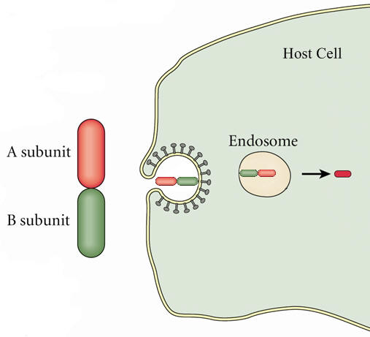

Slide 20
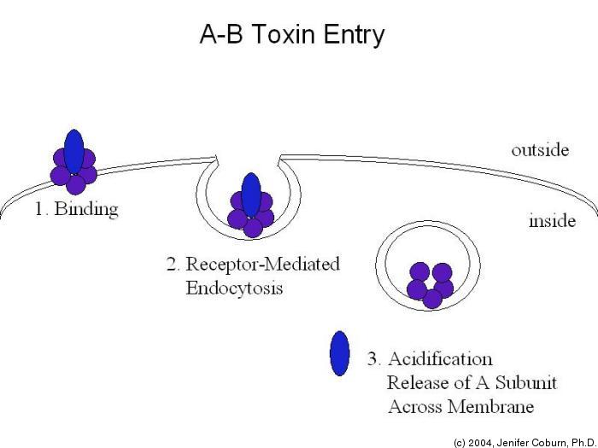

Slide 21
Exotoxin verus Endotoxin
Exotoxin
Endotoxin
1- Protein
Lipopolysaccharide
2- Soluble & Diffusible
Part of cell wall
3- Heat Labile
Heat stable
4- Pharmacologically specific action
Non-Specific
Low Immunognicity
5- High Immunogenicity
6- Inactivated by chemicals
to
Do not form toxoids
7- form toxoids
7- No Fever
Induce Fever

Slide 22
Koch’s Postulates
For a microorganism to be accepted as the cause of an infectious disease it must satisfy all or most of these criteria:
1) The organism must be found in all cases of the disease and its distribution in the body must Correspond to that of the lesions observed in the host.

Slide 23
Koch’s Postulates (continued)
2) The organism should be cultured in pure culture from all cases of the disease.
N.B. Some organisms are yet to be cultured in the lab.
e.g.. Treponema pallidum, M. leprae.
3) The organisms should reproduce the disease in other susceptible animal hosts.
4) Antibodies to the disease usually develop in the course of the disease.

Slide 24
Reference book and the relevant page numbers..
Sherries page 149-172SHERRIS MEDICAL MICROBIOLOGY, AN INTRODUCTION TO INFECTIOUS DISEASES.
KENNETH RYAN /GEORGE RAY. LATEST EDITION.
PUBLISHER MC GRW HILL
CHAPTER 10, PAGE 149- 172

Slide 25
Thank You ☺
(Foundation Block, Microbiology)
Prof .Hanan Habib &
Prof A.M. Kambal

