Slide 1
BLOOD PRACTICAL
CBC & ESR

Slide 2
Aims of the Practical
Counting Red blood cells.
Counting White blood cells.
Determination of hemoglobin concentration.
Determination of packed cell volume (PCV) hematocriet.
Calculation of red blood cell indices.
Determination of ESR.

Slide 3
Objectives (CBC)
At the end of this lesson the student should be able to:
Recognize the method used to measure the different hemato-logical values, and compare it with the normal values.
Do the calculation of indices, their normal values and their importance in diagnosis of different types of anemia.

Slide 4
Objectives (ESR)
At the end of this lesson the student should be able to:
To know how to measure the erythrocyte sedimentation rate.
To recognize what is the clinical value of taking these measurements.

Slide 5
Complete Blood Count (CBC)
It is a test panel requested by a doctor or other medical professional that gives information about the cells in a patient's blood.

Slide 6
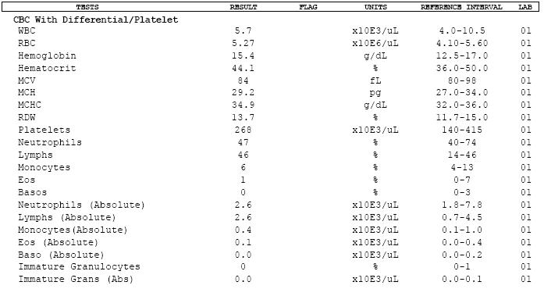

Slide 7
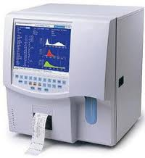
Coulter Counter

Slide 8
Coulter Counter Principle
It count and measure the size of the cells by detecting and measuring electrical resistance when a liquid pass through aperture.
While passing the aperture, the cells impedes the current and causes a measurable pulse.
Number of pulses --> number of particles.
Height of pulses --> volume of particles.

Slide 9
Materials and methods
Coulter analyzer
Diluent reagents
Lytic reagent
Calibrator kit
EDTA anticoagulant blood

Slide 10
RBC, WBC cell count & HB
5ml of venous blood will be drawn in EDTA anticoagulant tube.
Diluted by the reagent I and used to count RBC.
Lysing RBC using reagent II and used for counting WBC and Hb.

Slide 11
Normal values
 | Male | Female | Average
RBC | 4.5-6.5 x10⁶/μl | 3.8-5.8 x10⁶/μl | 4.7–6.5 x10⁶/μl
WBC | 4 – 11 x10³ /μl | 4 – 11 x10³ /μl | 4 – 11 x10³ /μl
HB | 13-18 g/dl | 11.5-16.5 g/dl | 13 –18 g/dl
Platelet | 150-400x10³ /μl | 150-400x10³ /μl | 150-400x10³ /μl

Slide 12
Clinical application
↓ RBC = aneamia
↑ RBC = polycythemia
↓ WBC = leucopenia
↑ WBC = leucocytosis
↓ Platelets = thrombocytopenia
↑ Platelets = thrombocytosis

Slide 13
Clinical application
Low numbers of RBCs may indicate:
Blood loss:
Anemia (various types).
Hemorrhage.
Bone marrow failure (for example, from radiation, toxin, fibrosis, tumor).
Erythropoietin deficiency (secondary to renal disease).
Hemolysis (RBC destruction).

Slide 14
Clinical application
High numbers of RBCs may indicate:
Low oxygen tension in the blood
Congenital heart disease
Cor pulmonale
Pulmonary fibrosis
Polycythemia vera.
Dehydration (such as from severe diarrhea).
Renal (kidney) disease with high erythropoietin production.

Slide 15
Clinical application
High numbers of WBCs (leukocytosis) may indicate:
Infectious diseases.
Inflammatory disease (such as rheumatoid arthritis or allergy).
Leukemia.
Severe emotional or physical stress.
Tissue damage (burns).

Slide 16
Clinical application
Low numbers of WBCs (leukopenia) may indicate:
Bone marrow failure (for example, due to infection, tumor or fibrosis).
Presence of cytotoxic substance.
Autoimmune/collagen-vascular diseases (such as lupus erythematosus).
Disease of the liver or spleen.
Radiation exposure.

Slide 17
WBCs Differential
Cells | shape | Number of cells | %
Neutrophils |  | 59 | 40-60%
Eosinophils |  | 3 | 1-4%
Basophils |  | 1 | 0.5-1%
Monocytes |  | 5 | 2-8%
Lymphocytes |  | 32 | 20-40%
Total |  | 100 | 100%

Slide 18
Clinical Application
Leucocytosis: High WBC count, in infection, allergy, systemic illness, inflammation, tissue injury.
Differential count provides clues about certain illnesses -->
Neutrophilia: pyogenic illness.
Eosinophilia: Allergy.
Lymphocytosis: infectious mononucleosis.

Slide 19
Clinical application
Platelet count:
Thrombocytosis →
Chronic myeloid leukaemia.
Thrombocytopenia →
A plastic anemia.
Chemotherapy.

Slide 20
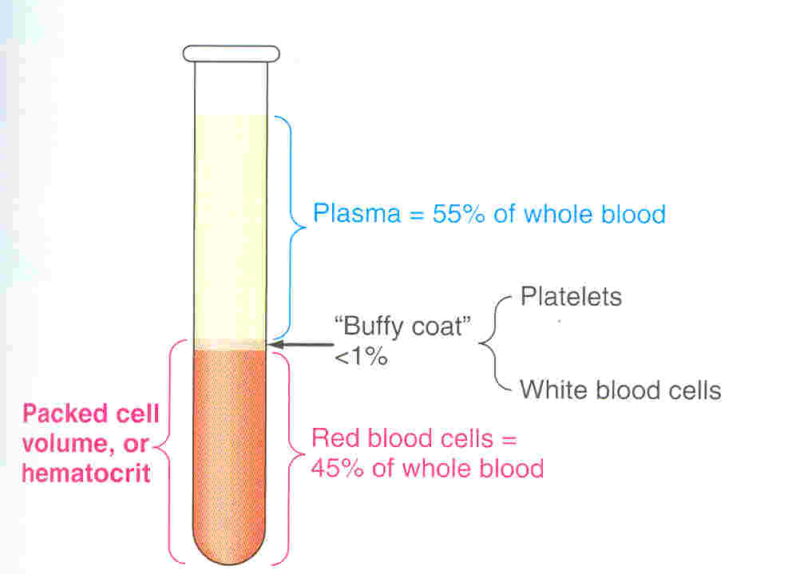
The packed cell volume (PCV) hematocrit
The ratio of packed blood cells volume to plasma.

Slide 21
The packed cell volume (PCV) hematocrit
Capillary blood obtained from pricking finger tip after cleaning it with alcohol
Fill a heparinised capillary tube, then seal one end by plasticine.
Centrifuge for 15 minutes to packed the cells at one end of the tube leaving a clear plasma on top.
Use the hematocrit reader to find the packed cell volume.

Slide 22
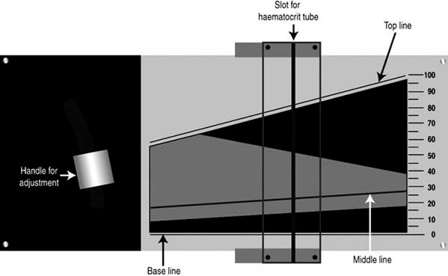
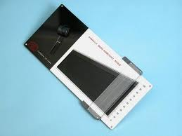
Haematocrit Reader

Slide 23
Normal value PCV
 | Male | Female | Average
PCV % | 40-54 | 35-47 | 35-54

Slide 24
Clinical application
High hematocrit may indicate:
Dehydration
Burns
Diarrhea
Polycythemia vera.
Low oxygen tension (smoking, congenital heart disease, living at high altitudes).

Slide 25
Clinical application
Low hematocrit may indicate:
Anemia (various types).
Blood loss (hemorrhage).
Bone marrow failure (for example, due to radiation, toxin, fibrosis, tumor).
Hemolysis (RBC destruction) related to transfusion reaction.
Leukemia.

Slide 26
The calculation of Red Blood Indices
Mean cell volume (MCV)
The average volume of red blood cell
MCV = PCV x 10 = 85 + 8 μm³
RBC count
Mean cell hemoglobin (MCH)
The average weight of Hb in red cells
MCH = Hb x 10 = 29.5 + 2.5 pg
RBC count.

Slide 27
The calculation of Red Blood Indices
Mean cell Hb concentration (MCHC)
Concentration of Hb per 100 ml of RBC
MCHC = Hb x 100 = 33 + 3 g/dl
PCV

Slide 28
Normal values
 | Average
MCV | 78-98 μm3
MCH | 27-32 pg
MCHC | 30-35 g/dl

Slide 29
Types of Anemia
 | Case A | Case B
RBC | Low | Low
HB | Low | Low
PCV | Low | Low
MCV | Low | high
MCH | Low | N/ high
MCHC | Low | N/low
Type of anemia | Microcytic Hypochromic | Macrocytic megaloblastic
cause | Iron deficiency | Vit B12 or Folic deficiency

Slide 30
Erythrocyte Sedimentation Rate (ESR)
Is the rate at which red blood cells sediment in a period of 1 hour.
non-specific measure of inflammation.

Slide 31
RBC Sedimentation
Is controlled by the balance between plasma protein fibrinogen, and the negative charge of the erythrocytes.
In inflammatory, the high fibrinogen level causes RBCs to stick to each other to form stacks (rouleaux), which settle faster.

Slide 32
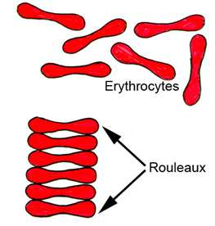
Rouleaux formation

Slide 33
Material and methods
Westergren’s sedimentation apparatus.
Anticoagulant (EDTA).
Disposable sterile syringes and needles.

Slide 34
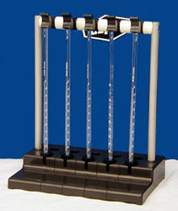
Westergren apparatus

Slide 35
Procedure
Using a sterile syringe remove 1.6ml of blood from a suitable vein. Transfer it to a test tube containing EDTA and then draw up blood into a Westergren tube exactly to the zero mark.
Place the tube upright in the stand and leave undisturbed. The height of the column of clear plasma at the top of the tube is noted at the end of an hour and again at the end of 2nd hours.

Slide 36
ESR Results
Normal ESR in male = 3-5 mm/ 1st hour and 7-15mm/2nd hour. In females values are slightly higher.
Moderately elevated ESR occurs: inflammation, anemia, pregnancy, and old age.
A very high ESR associated with multiple myeloma, polymyalagia Rheumatic, temporal arteritis.

Slide 37
Clinical application of ESR
Nonspecific test.
Prognostic not diagnostic.
Monitor disease activity and response to therapy.
ESR is a nonspecific marker of inflammation and is affected by other factors, ESR results must be used along with other clinical findings.

Slide 38
C-reactive protein & ESR
C-reactive protein is an acute phase protein produced by the liver during an inflammatory reaction.
Since C-reactive protein levels in the blood rise more quickly after the inflammatory or infective process begins, ESR is often replaced with C-reactive protein measurement.

Slide 39
Thank you

