Slide 1
White (Leukocyte) blood cell differential
Dr. Asma M. Al yahya
Physiology department
College of Medicine
KSU

Slide 2
Objectives
To be able to identify the different types of leukocytes under the microscope.
Practice the procedure for differential leukocyte counting.
Know the normal values for differential WBC count.
Interpretation of WBC count.

Slide 3
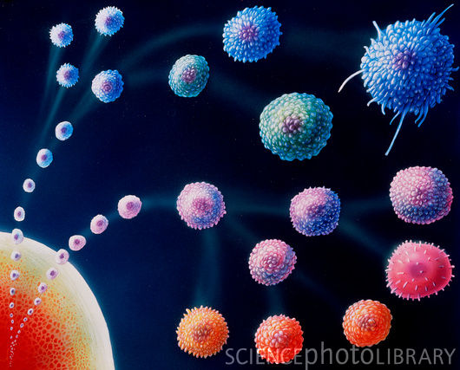
White Blood cells
White blood cells comprise the orchestra of the human immune system; the body's defence mechanism

Slide 4
White Blood cells
White Blood cells are also known as Leukocytes (from the Greek word leuko- meaning "white“).
There are about 4.5-10.5 X10³ WBC / µl.

Slide 5
Formation of WBC’s
Leukocytes are formed in the red marrow of bones.
They can also be formed in lymphatic tissue.

Slide 6
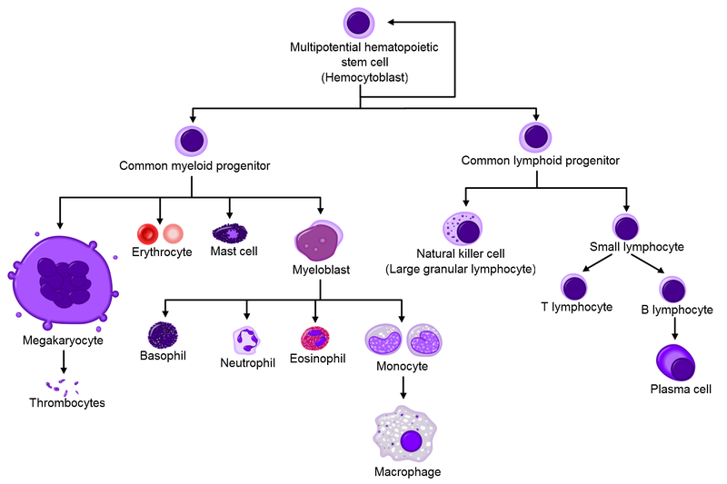
Formation of WBC’s

Slide 7
White Blood cells
Five Types
Classified according to the presence or absence of granules and the staining characteristics of their cytoplasm.
Leukocytes appear brightly colored in stained preparations, they have a nuclei and are generally larger in size than RBC’s.

Slide 8
White Blood cells

Slide 9
White Blood cells

Slide 10
Type of WBC’s
Granulocytes—have large granules in their cytoplasm
Neutrophils
Eosinophils
Basophils

Slide 11
Granulocytes

Slide 12
Granuloctyes
Neutrophils
Stain light purple with neutral dyes
Granules are small and numerous
Several lobes in nucleus
62% of WBC count
Highly mobile/very active
Diapedesis—Can leave blood vessels and enter tissue space
Phagocytosis
Life span: 6 hours–few days

Slide 13
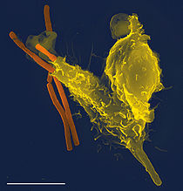
Neutrophil engulfing bacteria

Slide 14
Granuloctyes
Eosinophils or Acidophils:
Large, numerous granules
Nuclei with two lobes
2-5% of WBC count
Important functions involve protection against infections by parasitic worms and involvement in allergic reactions
Secrete anti-inflammatory substances in allergic reactions
Life span: 8–12 days

Slide 15
Granuloctyes
Basophil
Least numerous 0.5-1%
Diapedesis—Can leave blood vessels and enter tissue space
Contain histamine, serotonin, heparin—inflammatory chemical
Life span: a few hours to a few days

Slide 16
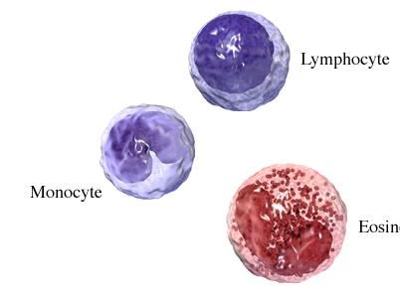
Agranulocytes
Agranulocytes—do not have granules in their cytoplasm
Lymphocytes
Monocytes

Slide 17
Agranulocytes
Lymphocytes
Smallest WBC
Large nuclei/small amount of cytoplasm
Account for 30% of WBC count
Life span: years for memory cells, weeks for all else.
Two types:
-T lymphocytes: attack an infected or cancerous cell,
-B lymphocytes: produce antibodies against specific antigens (foreign body)

Slide 18
Agranulocytes
Monocytes
Largest of WBCs
Account for 5% of WBC count
Dark kidney bean shaped nuclei
Highly phagocytic become macrophages in tissues
Life span: hours to days

Slide 19
Blood smear
smallest
Largest

Slide 20
To Summarize

Slide 21
Normal blood smear

Slide 22
Blood smear
White Blood Cells
Check for even distribution and estimate the number present (also, look for any gross abnormalities present on the smear).
Perform the differential count.
Examine for morphologic abnormalities.

Slide 23
Observing direction
Observe one field and record the number of WBC according to the different type then turn to another field in the snake-liked direction

Slide 24
white blood cell differential count
A manual white blood cell differential count consists of looking at 100 white cells and enumerating them in categories.
An automated white blood cell differential count is done by a laboratory instrument.

Slide 25
Automated white blood cell differential count

Slide 26
WBC Estimates
WBC Estimates
• Find the appropriate viewing area of the blood film
• Add the total number of WBC including smudge cells in four or more low power (10X objective) fields (LPF)
• Divide the total number of cells by the number of fields viewed to determine the average number
• Divide the average/LPF by the field factor to determine the WBC estimate

Slide 27
Leukopenia & leukocytosis
A decrease in the number of white blood cells is leukopenia
An increase in the number of white blood cells is leukocytosis.

Slide 28
Leukocytosis
Leukocytosis, a WBC above 11,000, is usually due to an increase in one of the five types of white blood cells
Neutrophilic leukocytosis neutrophilia
Lymphocytic leukocytosis lymphocytosis
Eosinophilic leukocytosis eosinophilia
Monocytic leukocytosis monocytosis
Basophilic leukocytosis basophilia

Slide 29
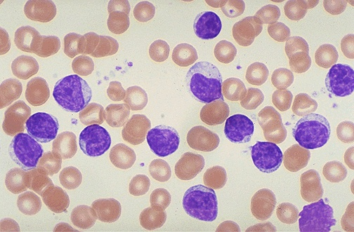
Case study
Case:
This 65 year old male was in good health except for mild hypertension. At his last check-up, a CBC showed a markedly elevated white blood cell count and physical examination revealed several slightly enlarged lymph nodes in the neck and the axillae, and the spleen was palpable.
What is the differential diagnosis?
Chronic lymphocytic leukemia (CLL).
This peripheral smear demonstrates increased numbers of small mature lymphocytes.
Notes:
Clinical History:
This 65 year old male was in good health except for mild hypertension. At his last check-up, a CBC showed a markedly elevated white blood cell count and physical examination revealed several slightly enlarged lymph nodes in the neck and the axillae, and the spleen was palpable.Laboratory studies:
CBC showed Hgb 12.8 g/dl, WBC 130 X 109/L, and platelet count 330 X 109/LWhat is the predominant white blood cell type present?
Most of the white blood cells are small to medium-sized lymphocytes. There are also many smudged lymphocytes present. In addition, one sees some larger lymphocytes with abundant cytoplasm and a prominent nucleolus which are prolymphocytes.
What is the differential diagnosis?
The only real diagnostic consideration in this case is chronic lymphocytic leukemia (CLL).

Slide 30
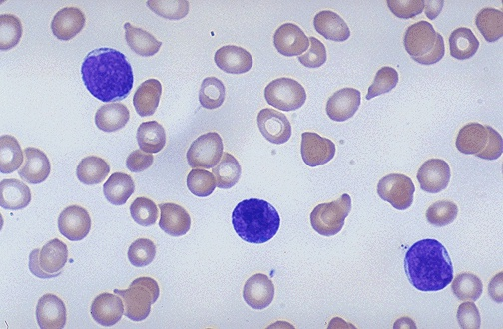
Case study
Case:
A 5 year old boy has been too tired to play with his friends for two months. His mother is also worried that, whenever he falls or bumps into anything, a big bruise forms. For the past two days he has had a high fever.
What type of white blood cells are present?
The white blood cells present are predominantly lymphoblasts.
What is the most likely diagnosis?
The most likely diagnosis is acute lymphocytic leukemia (ALL).
This peripheral smear demonstrates increased numbers of immature lymphocytes.
Notes:
Clinical History:
A 5 year old boy has been too tired to play with his friends for two months. His mother is also worried that, whenever he falls or bumps into anything, a big bruise forms. For the past two days he has had a high fever.Laboratory studies:
CBC shows Hgb 9.8, Hct 28.2, MCV 95, platelet count 74,000, and WBC count 2,300 with differential count 23 segs, 15 bands, 12 monos, 44 lymphs, 5 eos, and 1 baso. A bone marrow biopsy shows replacement by primitive cells that have large nuclei with delicate chromatin and indistinct nucleoli. There is scanty cytoplasm with no granules and no Auer rods. These cells mark for CD10 (CALLA) antigen.What type of white blood cells are present?
The white blood cells present are predominantly lymphoblasts.
What is the most likely diagnosis?
The most likely diagnosis is acute lymphocytic leukemia (ALL).
What is the most likely outcome of this child's disease with standard therapy?
The most likely outcome of this child's disease with standard therapy is good--a >90% chance for complete remission following chemotherapy.
What other test could be helpful in distinguishing the nature of the cells in this case?
A TDT (terminal deoxyribonucleotidyl transferase) test is positive in cases of lymphoid leukemias.

Slide 31
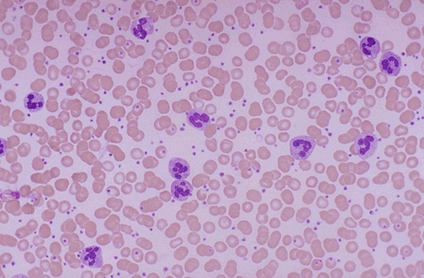
Case study
Case:
This 16 year old male came to the emergency room complaining of severe abdominal pain in the right lower quandrant. He had a fever. On physical examination, he had a rigid, board-like abdomen and rebound tenderness in the right lower quandrant.There were no other abnormalities.
What is the predominant white blood cell present?
The majority of white blood cells present here are polymorphonuclear leukocytes
What is the name for this type of leukocyte reaction?
The name of this reaction is known as a neutrophilia
What do you think is the diagnosis in this case?
The diagnosis in this case is acute appendicitis
This peripheral smear demonstrates increased neutrophils.
Notes:
Clinical History:
This 16 year old male came to the emergency room complaining of severe abdominal pain in the right lower quandrant. He had a fever of 101 F. On physical examination, he had a rigid, board-like abdomen and rebound tenderness in the right lower quandrant. There were no other abnormalities.Laboratory studies:
Urinalysis was within normal limits. A CBC showed Hgb 14.8 g/dl, WBC 20 X 109/L, and platelet count 240 X 109/L.What is the predominant white blood cell present?
The majority of white blood cells present here are polymorphonuclear leukocytes, and notice that, at low power, the white blood cell count is higher than in a normal smear. In addition to the PMN's, a small but increased number of band forms are seen. Other cells present are lymphocytes and monocytes, but these are not increased. However, the platelets are moderately increased in number.
What is the name for this type of leukocyte reaction?
The name of this reaction is known as a neutrophilic leukemoid reaction.
What do you think is the diagnosis in this case?
The diagnosis in this case is acute appendicitis (most, but not all, cases of acute appendicitis are accompanied by peripheral neutrophilia).

Slide 32
Further practice
The Internet Pathology Laboratory For Medical Education-WBC tutorial
http://courses.path.utah.edu/classes/webpath/labs/wbclab/wbclab.htm

Slide 33
Thank you

