Slide 1

Protein Structure
(Foundation Block)
Dr. Usman Ghani
What are proteins?
Four levels of structure (primary, secondary, tertiary, quaternary)
Protein folding and stability
Protein denaturation
Protein misfolding and diseases

Slide 2
What are proteins?
Proteins are polymers of amino acids joined together by peptide bonds

Slide 3
Primary Structure
It is the linear sequence of amino acids

Slide 4
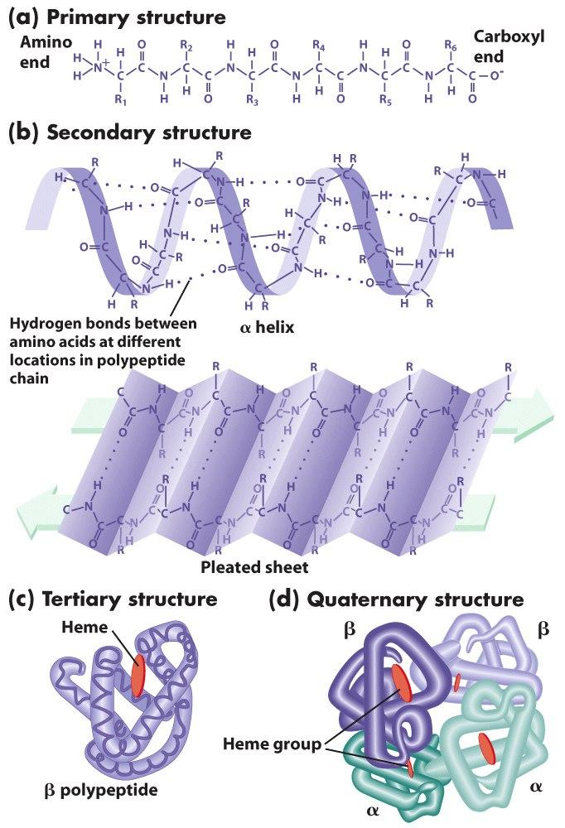
Page 65

Slide 5
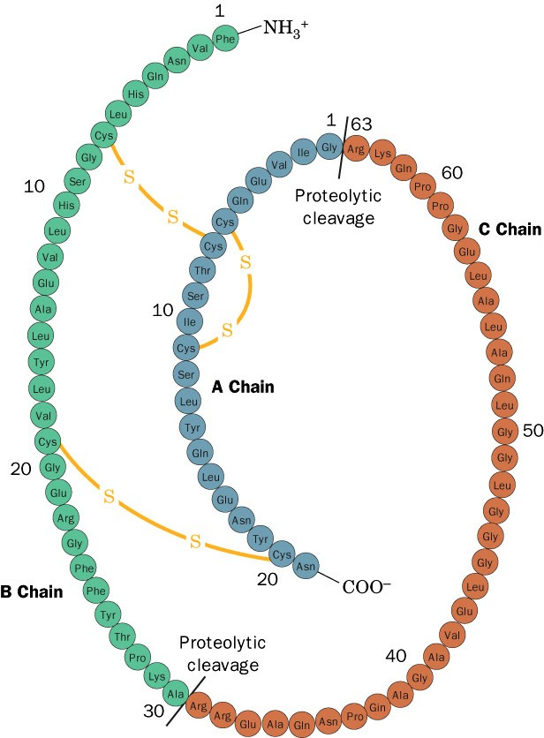
Primary structure of proinsulin
Page 278

Slide 6
Secondary Structure
It is the local three-dimensional arrangement of a polypeptide backbone
Excluding the conformations (3D arrangements) of its side chains

Slide 7
α Helix
α helix is right-handed
It has 3.6 residues (amino acids) per turn
The helix is stabilized by hydrogen bonding
  Between carboxylic group and 4th N–H group
The amino acid side chains point outward and downward from the helix
The core of the helix is tightly packed; its atoms are in van der Waals contact

Slide 8
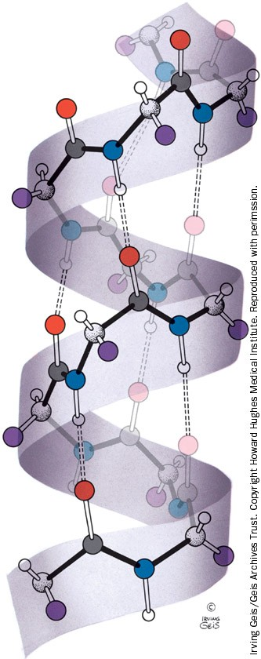
The right-handed α helix
Page 224

Slide 9
Page 65

Slide 10
β Sheets
Two or more polypeptide chains form hydrogen bonding with each other
Also called pleated sheets
They appear as folded structures with edges

Slide 11
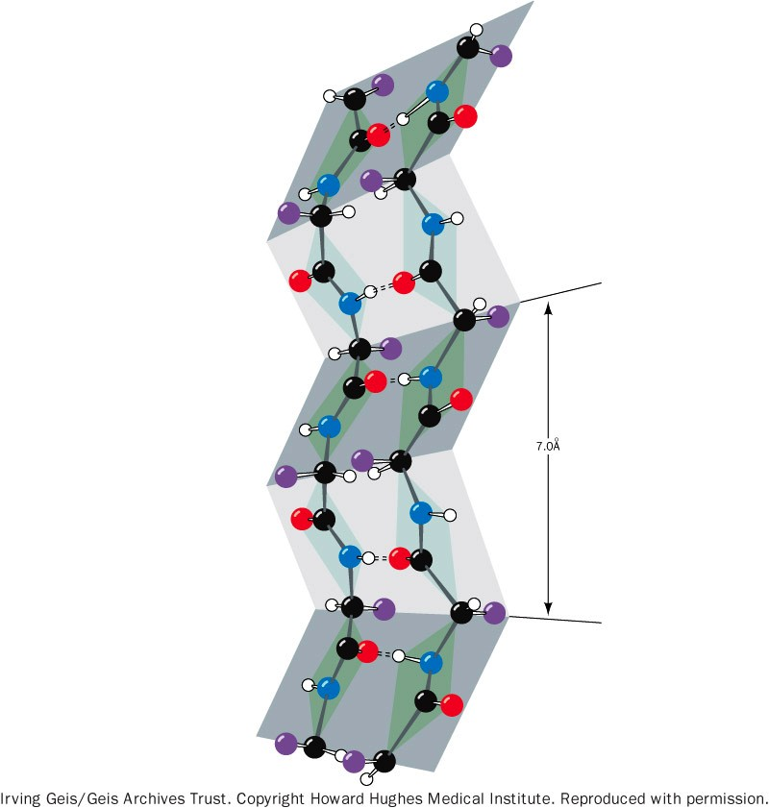
A two-stranded β antiparallel pleated sheet
Page 228

Slide 12
Page 65

Slide 13
Antiparallel β sheets
Two or more hydrogen-bonded polypeptide chains run in opposite direction
Hydrogen bonding is more stable

Slide 14
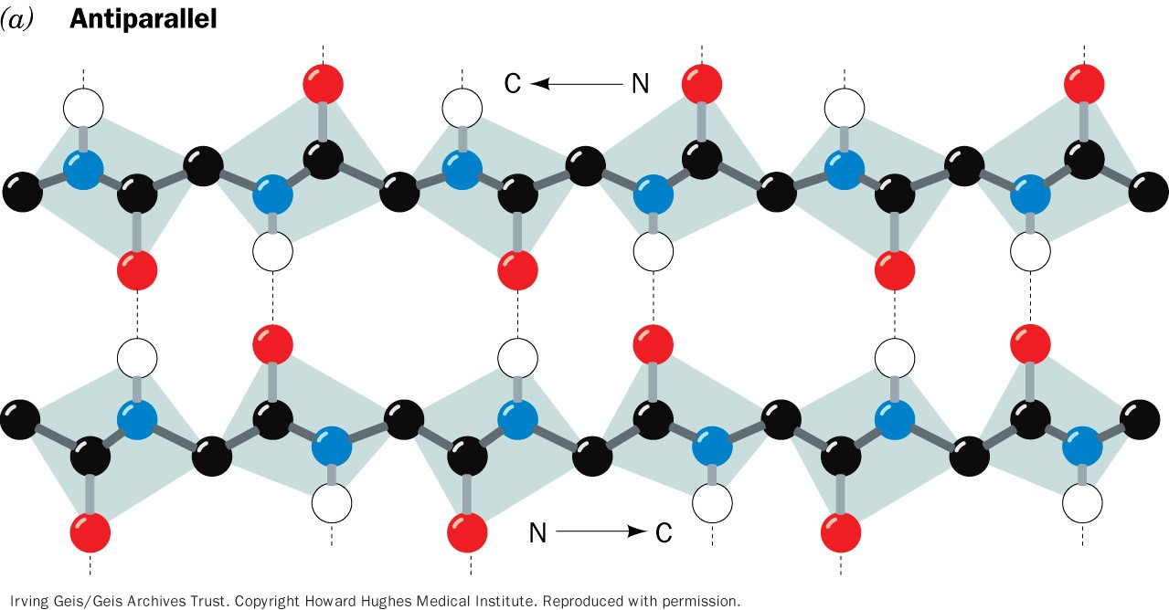
β pleated sheets. (a) The antiparallel β pleated sheets
Page 227

Slide 15
Parallel β sheets
Two or more hydrogen-bonded polypeptide chains run in the same direction
Hydrogen bonding is less stable (distorted)

Slide 16
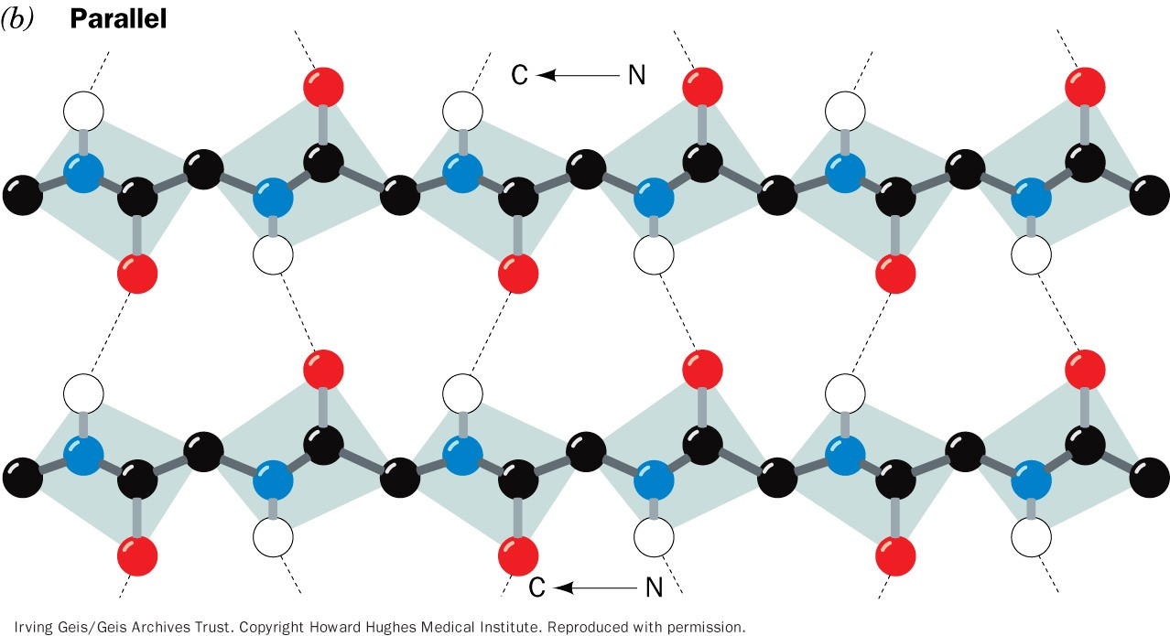
β pleated sheets. (b) The parallel β pleated sheets.
Page 227

Slide 17
Other secondary structures
Turns (reverse turns)
Loops
β bends
Random coils

Slide 18
Supersecondary structures or motifs:
  βαβ motif: α helix connects two β sheets
  β hairpin: reverse turns connect antiparallel β sheets
  αα motif: two α helices together
  β barrels: rolls of β sheets

Slide 19
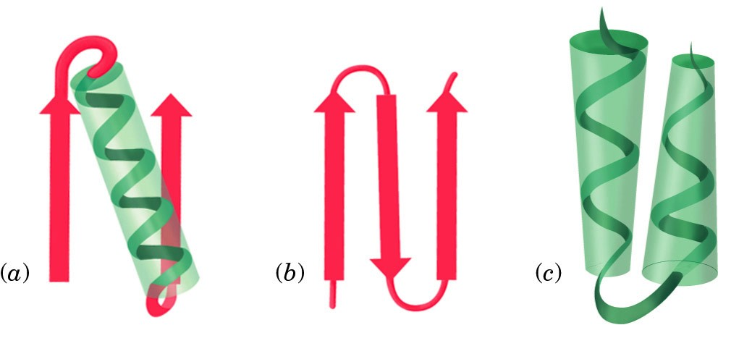
Schematic diagrams of supersecondary structures
Page 249
βαβ motif
β hairpin
αα motif

Slide 20
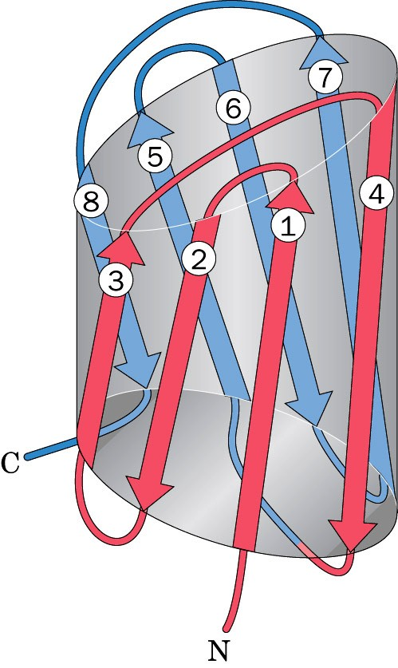
β barrel
Page 252

Slide 21
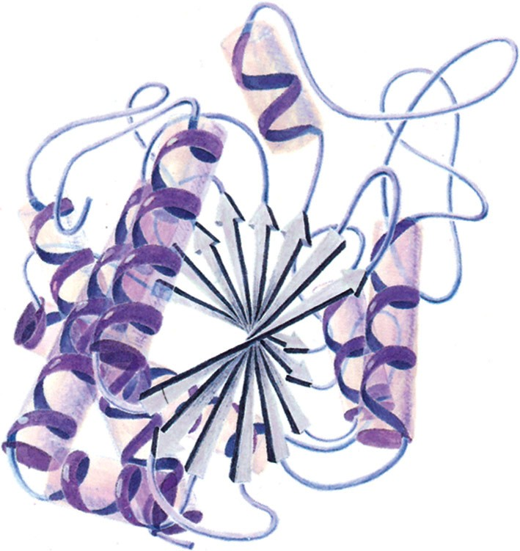
Secondary structure of proteins
(α-helix, β-sheets, loops, turns, random coils)
Page 229

Slide 22
Tertiary Structure
It is the three-dimensional structure of an entire polypeptide chain including side chains
It is the folding of secondary structure and side chains
Helices, sheets and side chains combined to form tertiary structure

Slide 23
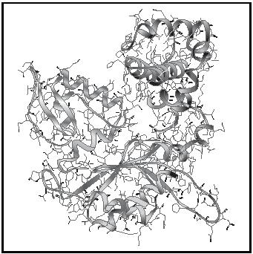
Tertiary structure of proteins
(Secondary structure + side chains)
Page 229

Slide 24
Domains
  Polypeptide chains (>200 amino acids) fold into two or more clusters known as domains
  Domains are units that look like globular proteins
  Domains are part of protein subunits

Slide 25
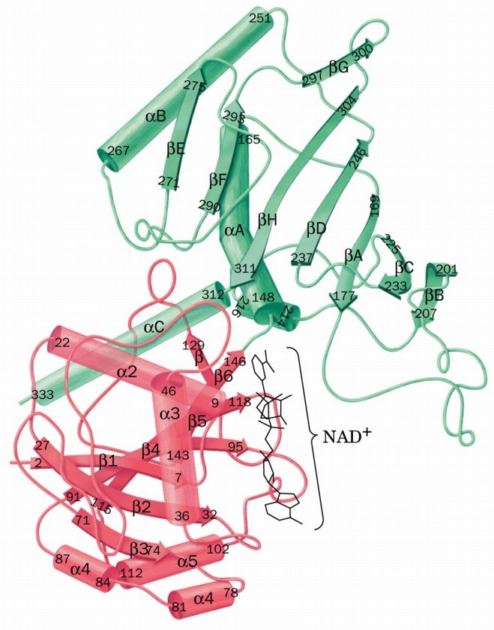
One subunit with two domains
Page 248

Slide 26
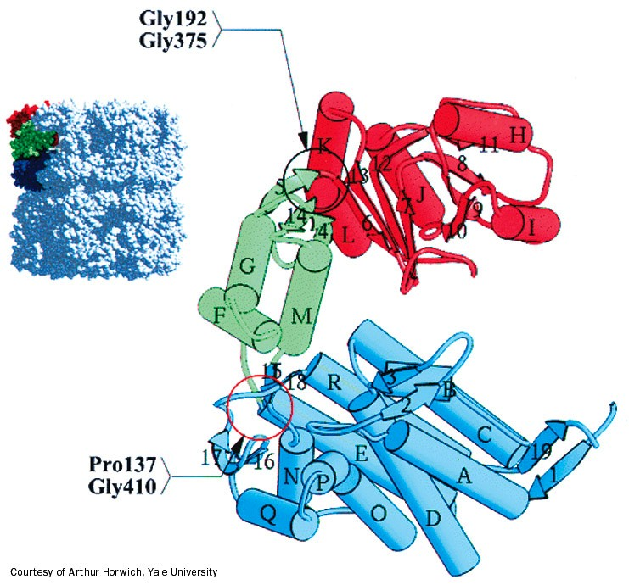
One subunit with three domains
Page 294

Slide 27
Quaternary Structure
Many proteins contain two or more polypeptide chains
Each chain forms a three-dimensional structure called subunit
It is the 3D arrangement of different subunits of a protein

Slide 28
Page 67

Slide 30
Hemoglobin is a globular protein
  A multisubunit protein is called oligomer
  Composed of α₂β₂ subunits (4 chains, 4 subunits)
  Two same subunits are called protomers

Slide 31
Protein folding
Forces that stabilize proteins
Protein denaturation

Slide 32
Forces that stabilize protein structure
Hydrophobic effect:
  Nonpolar groups to minimize their contacts with water
  Nonpolar side chains are in the interior of a protein
Hydrogen bonding

Slide 33
Electrostatic interactions (ion pairing):
  Between positive and negative charges
van der Waals forces (weak polar forces):
  Weak attractive or repulsive forces between molecules

Slide 34
Protein denaturation
Denaturation: A process in which a protein looses its native structure
Factors that cause denaturation:
  Heat: disrupts hydrogen bonding
  Change in pH: alters ionization states of aa
  Detergents: interfere with hydrophobic interactions
  Chaotropic agents: ions or small organic molecules that disrupt hydrophobic interactions

Slide 35
Protein misfolding
Every protein must fold to achieve its normal conformation and function
Abnormal folding of proteins leads to a number of diseases in humans
Alzheimer’s disease:
β-amyloid protein is a misfolded protein
It forms fibrous deposits or plaques in the brains of Alzheimer’s patients

Slide 36
Creutzfeldt-Jacob or prion disease:
Piron protein is present in normal brain tissue
In diseased brains, the same protein is misfolded
Therefore it forms insoluble fibrous aggregates that damage brain cells

Slide 37
That’s all folks!

