Slide 1
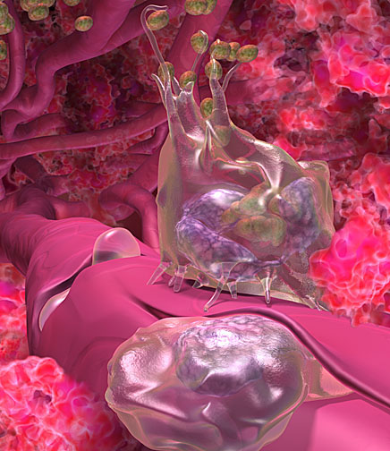
Introduction to Immunology
&
Lymphoid System
Immunology Unit
Department of Pathology
College of Medicine
KSU

Slide 2
Objectives
To know the historical perspective of immunology
To be familiar with the basic terminology and definitions of immunology
Cells of immune response
To understand types of immune responses
To know about the lymphoid system
To understand T and B cell functions

Slide 3
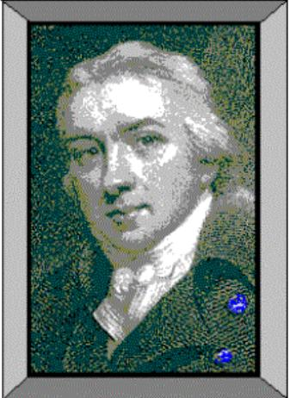
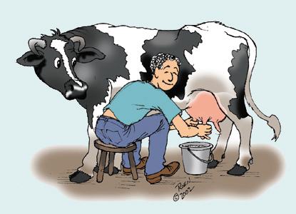
1798 Edward Jenner
Observation:
Milkmaids who contracted
cowpox (a mild disease)
were subsequently immune
to small pox

Slide 4
1798 Edward Jenner
Profound results:
Jenner’s technique of inoculating with
cowpox to protect against small pox
spread quickly throughout Europe.
(2) Began the science of Immunology,
the study of the body’s response
to foreign substances.

Slide 5
Louis Pasteur’s Contributions
Determined through studies of cholera in chickens that the virulence of a pathogen weakens with age
  Attenuated – weakened, non-virulent strain whose exposure can confer resistance to disease
Classical experiment
  Heat attenuated anthrax bacillus and subsequent challenge with virulent Bacillus anthracis in sheep

Slide 6
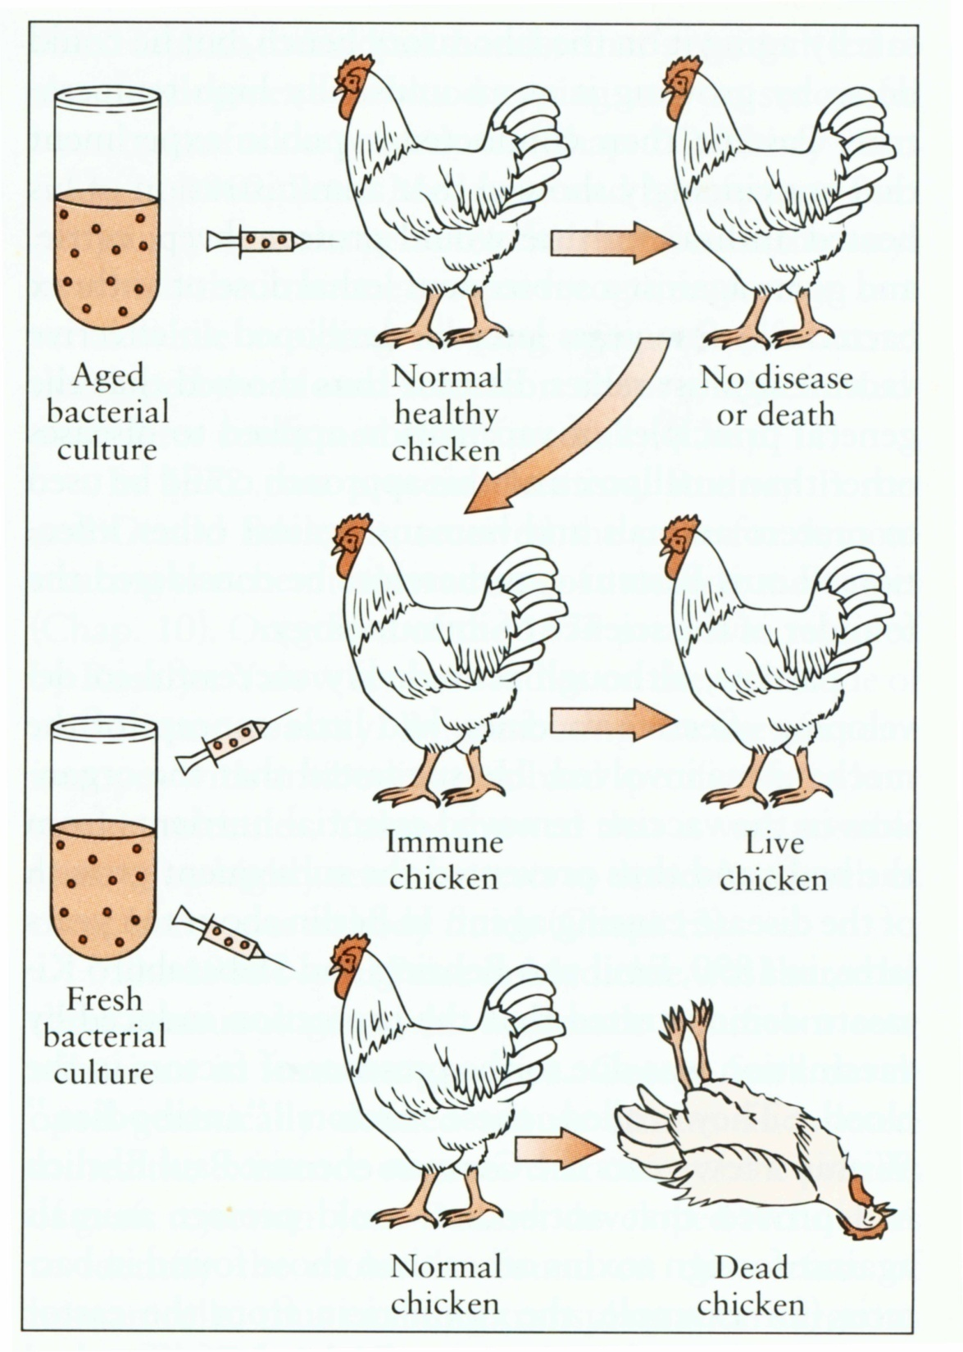
Louis Pasteur
Observation:
Cholera

Slide 7
What is immunology?
Immune (Latin- “immunus”)
  To be free, exempt
  People survived ravages of epidemic diseases when faced with the same disease again
  Immunity: The state of protection from infectious disease
The study of mechanisms that humans and other animals use to defend their bodies from invading organisms such as bacteria, viruses, fungi, parasites and toxins

Slide 8
Definitions
(CD) Cluster of Differentiation: molecule with a CD designation has a characteristic cell surface protein are often associated with the cell’s function.

Slide 9
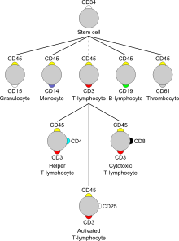
Cellular Markers (CD)

Slide 10
Definitions
Antigen (Ag): any substance (usually foreign) that binds specifically to a component of adaptive immunity.
Allergen: noninfectious antigens that induce hypersensitivity reactions, most commonly IgE-mediated type I reactions.
Immunogen: any substance capable of eliciting an immune response. All immunogens are antigens, but some antigens are not immunogens.

Slide 11
Definitions
Antibody (Ab): Secreted immunoglobulin from plasma cell
Immunoglobulin (Ig): an antibody or a heavy or light polypeptide chain that is a part of an antibody molecule.
Epitope (antigenic determinant): the portion of of Ag that is recognized and bound by an Ab or T cell receptor.

Slide 12
Definitions
Adaptive Immunity: Specific host defenses that are mediated by T & B cells following exposure to Ag.
Innate immunity: Nonspecific host defenses that exist prior to exposure to Ag.
Pathogen: a disease causing organism
Vaccination: deliberate induction of protective immunity to a pathogen

Slide 13
Where & what are antigens?
Microorganisms & their related products
(proteins, polysaccharides, lipids)
Environmental substances
Drugs
Organs, tissues, cells

Slide 14
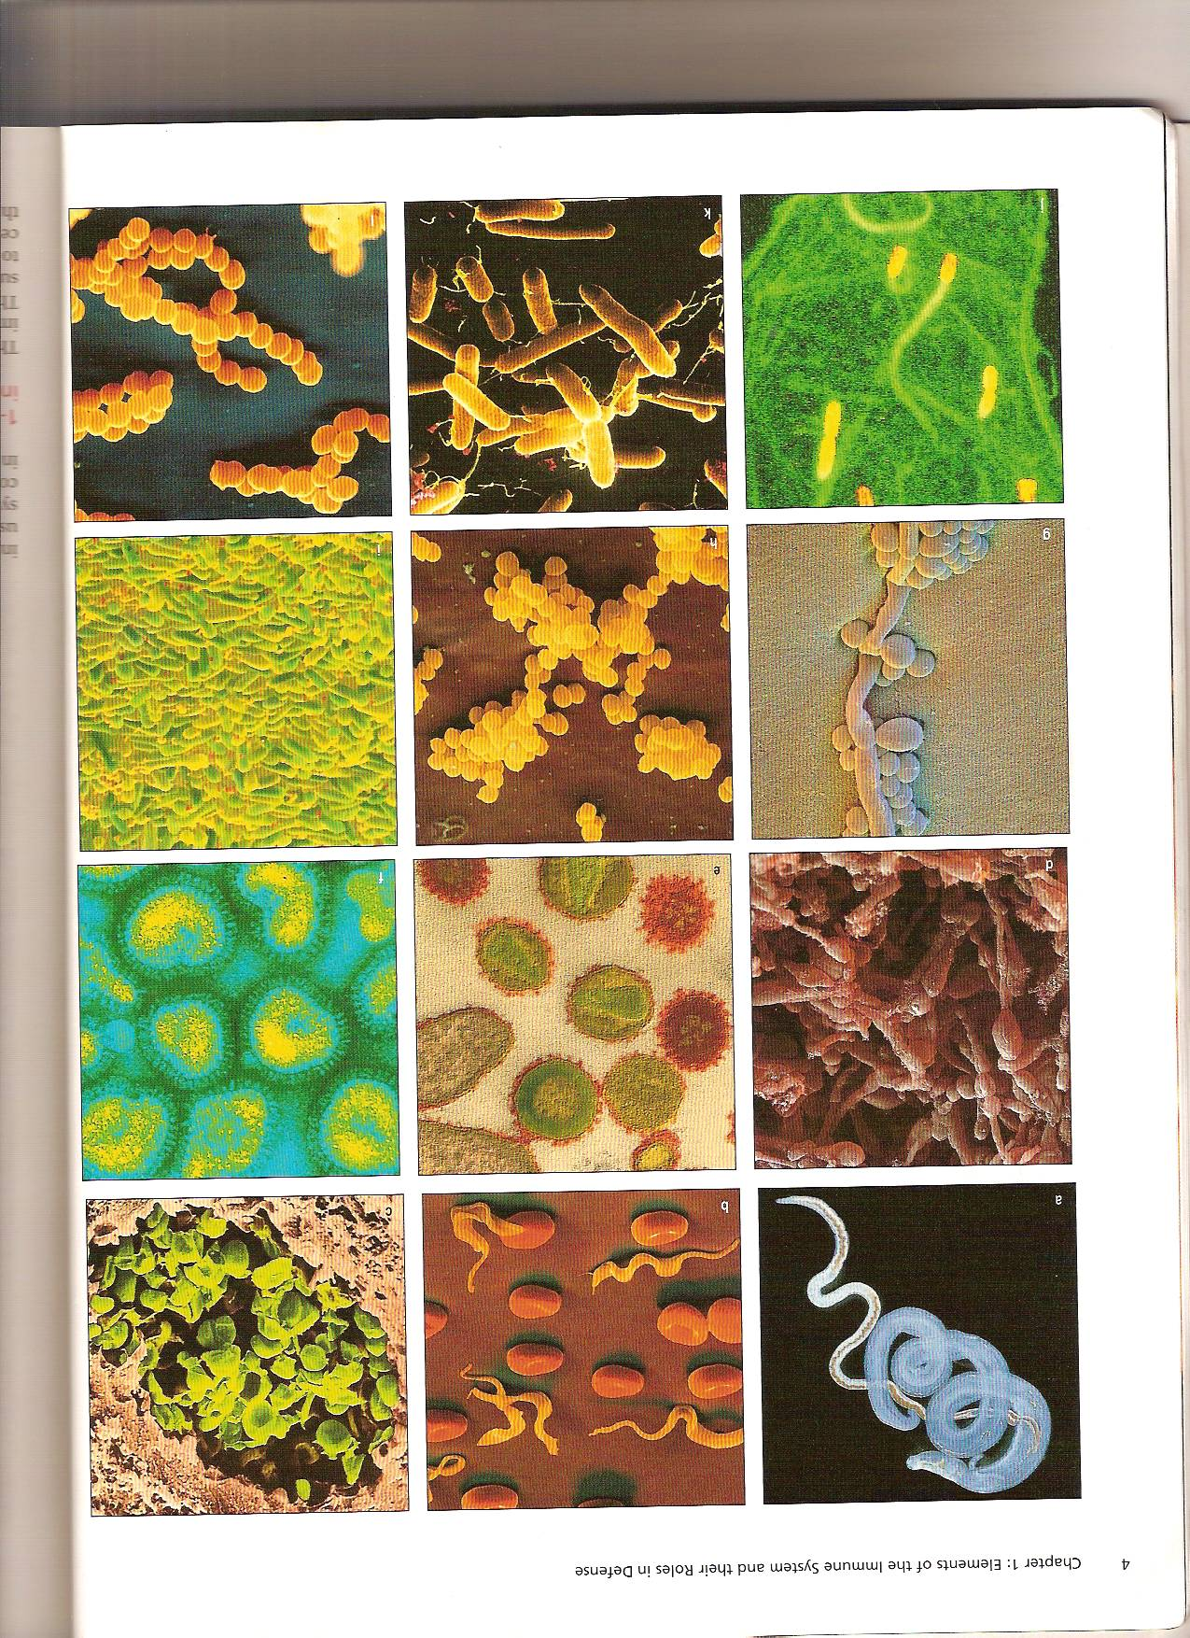

Slide 15
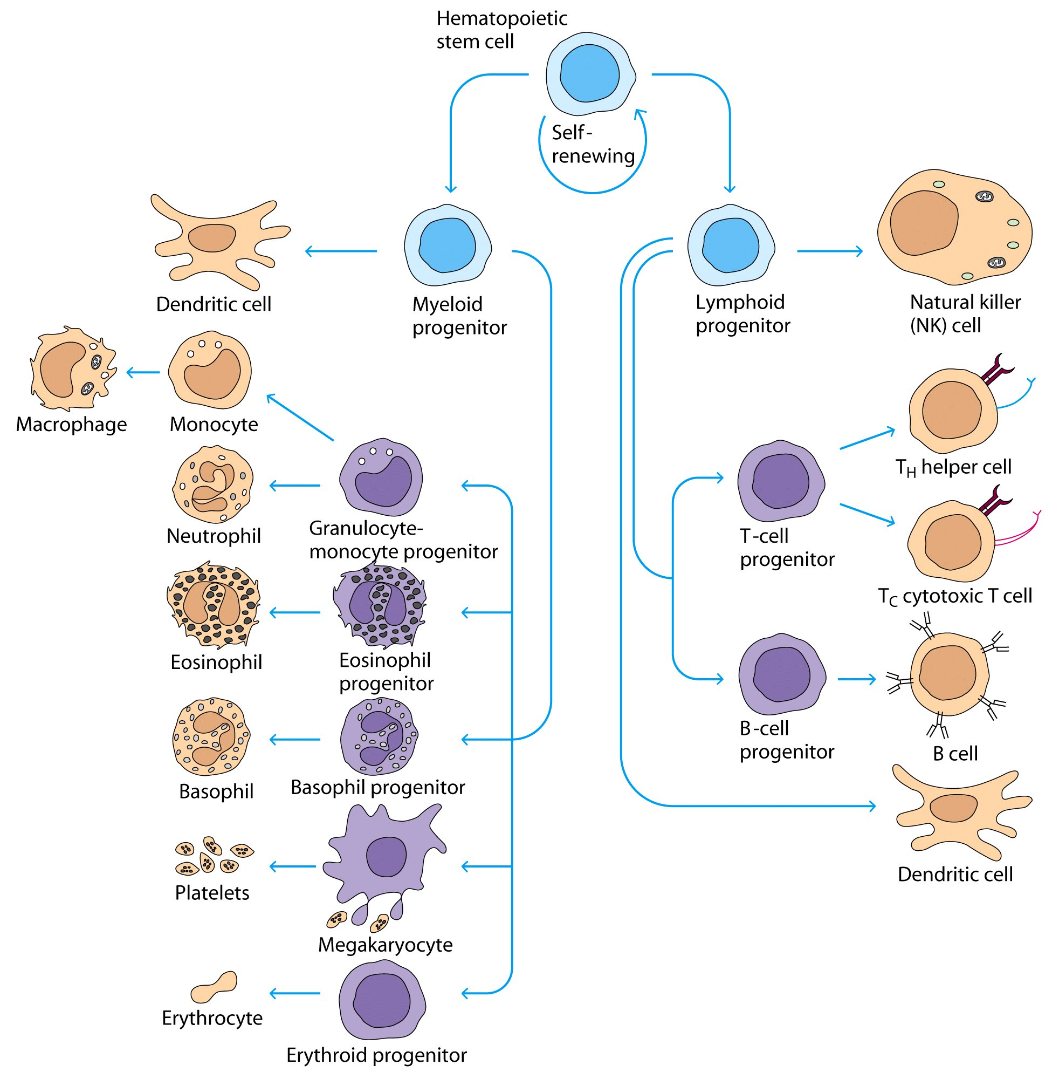

Slide 16
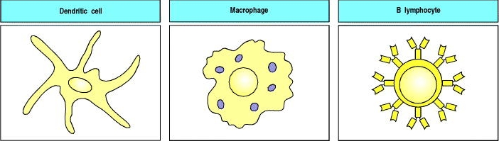

Antigen Presenting Cells
Responding Cells
CD3 Positive T Lymphocyte
T helper lymphocyte (CD4)
T cytotoxic lymphocyte (CD8)
Natural Killer Cell
B lymphocyte
Th1 (CD4)
Th2 (CD4)

Slide 17
Types of Immunity
Innate (nonspecific) Immunity
  Shorter duration
  No memory
Adaptive (specific) Immunity
  Response of an antigen specific B and T lymphocytes to an antigen
  Exhibit immunological memory, specificity and self/nonself recognition

Slide 18
Adaptive Immunity
Humoral immunity
  Immunity that is mediated by antibodies (B cells)
Cell Mediated Immunity
  Immune response in which antigen specific T cells dominate

Slide 19
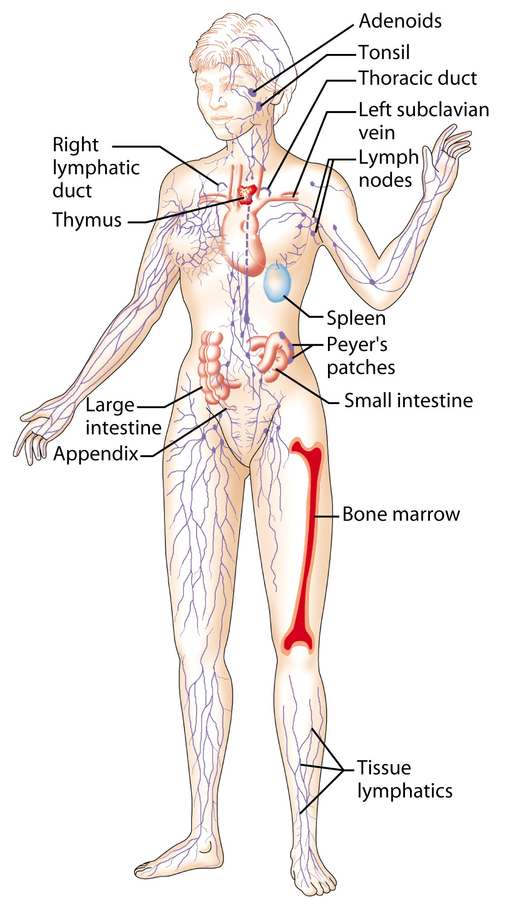
Lymphoid System
Lymphatic vessels and lymphoid organs

Slide 20
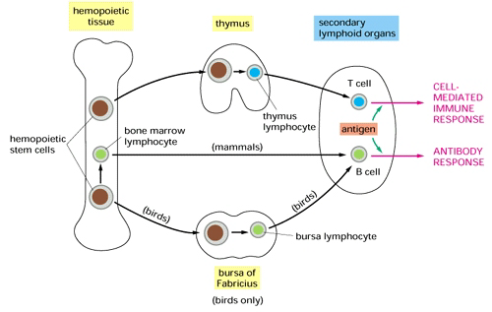
Primary Lymphoid Organs

Slide 21
Secondary Lymphoid Organs
Spleen
Lymph nodes
Tonsils
Appendix
MALT (Mucosa Associated Lymphoid Tissue) - Peyer’s patches

Slide 22
Lymphoid series comprise of two main lymphocyte populations
T cells and B cells

Slide 23
T-Lymphocyte Differentiation
Originate in Bone Marrow then migrate to Thymus for development.
T cell precursors differentiate into mature T cells in thymus
Stem cells lack antigen receptors and CD3, CD4, CD8 surface markers
During their passage through thymus they differentiate into T cells expressing these markers

Slide 24
T-Lymphocytes
All T cells have CD3 proteins on their cell surface
Mature T cells have either CD4 or CD8 proteins but not both

Slide 25
Functions of Helper Lymphocytes
CD4 Lymphocytes (Helper Type 1 and 2)
Functions
  Help B cells to develop into antibody producing plasma cells (Th2)
  Help CD8 cells to become activated cytotoxic T cells (Th1)
  Help macrophages in cell mediated immunity (Th1)

Slide 26
CD8 positive cells
About 35% of peripheral blood T cells
Perform cytotoxic functions
They kill virus-infected cells, tumor and allograft cells (transplant)

Slide 27
B cells
Origin
  During embryogenesis – fetal liver
  Migrate to bone marrow – final destination
They do not require thymus for maturation

Slide 28
B cells
B cells display surface IgM which serves as antigen receptor
Surface IgD on some B cells also serves as an antigen receptor
Pre B cells are found in bone marrow and mature B cells are found circulating in bloodstream

Slide 29
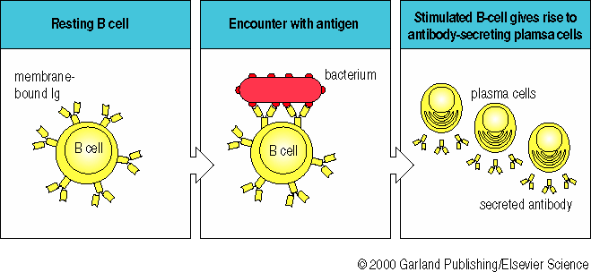
The Antibodies

Slide 30
Antibodies are also called Immunoglobulins
Immunoglobulins (Ig) are grouped into 5 classes:
IgG
IgM
IgA
IgD
IgE
Ig are glycoproteins
They differ in size, amount of CHO and biologic functions after binding to specific antigens

Slide 31
Concluding Remarks
Normal healthy state is maintained by intact immune response either innate (natural immunity) or adaptive (acquired immunity after exposure to antigens)
Cell mediated immunity and humoral immunity is mediated by T and B lymphocytes respectively
Lymphoid system provides suitable environment for development, maturation and proper functioning of cells of immune system

