Slide 1
GRANULOMATOUS INFLAMMATION
Dr. Ahmed Al-Humaidi
Assistant Professor and consultant of histopathology Office phone number: - 01-469265

Slide 2
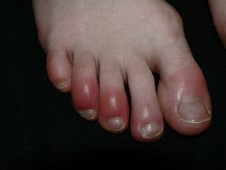
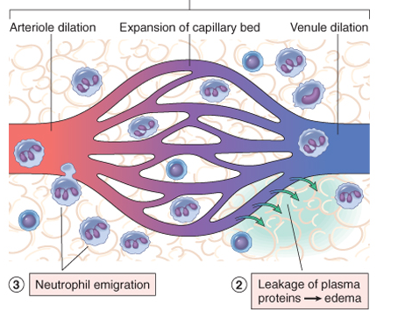
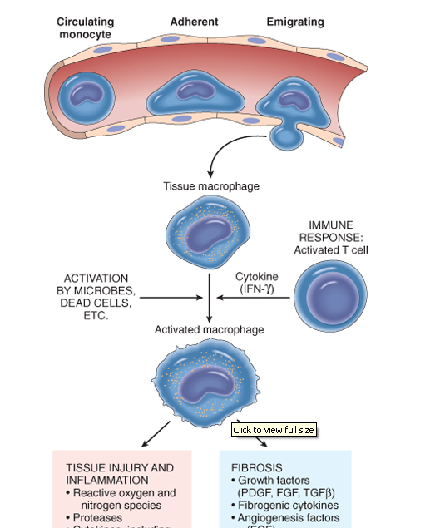
Inflammation
Acute inflammation
Chronic inflammation
Neutrophils
Macrophage
Lymphocytes
Plasma cells

Slide 3
OBJECTIVES AND KEY PRINCIPLES TO BE TAUGHT:
Upon completion of this lecture, the student should:
Define Granulomatous inflammation.
Recognize the morphology of granulomas (tubercles) and list the cells found in granuloma along with their appearance.
Understands the pathogenesis of granuloma formation.
Identify the two types of granulomas, which differ in their pathogenesis.
Foreign body granulomas
Immune granulomas
List the common causes of Granulomatous Inflammation.

Slide 4
Granulomatous inflammation
A form of chronic inflammation characterized by the formation of granulomas.

Slide 5
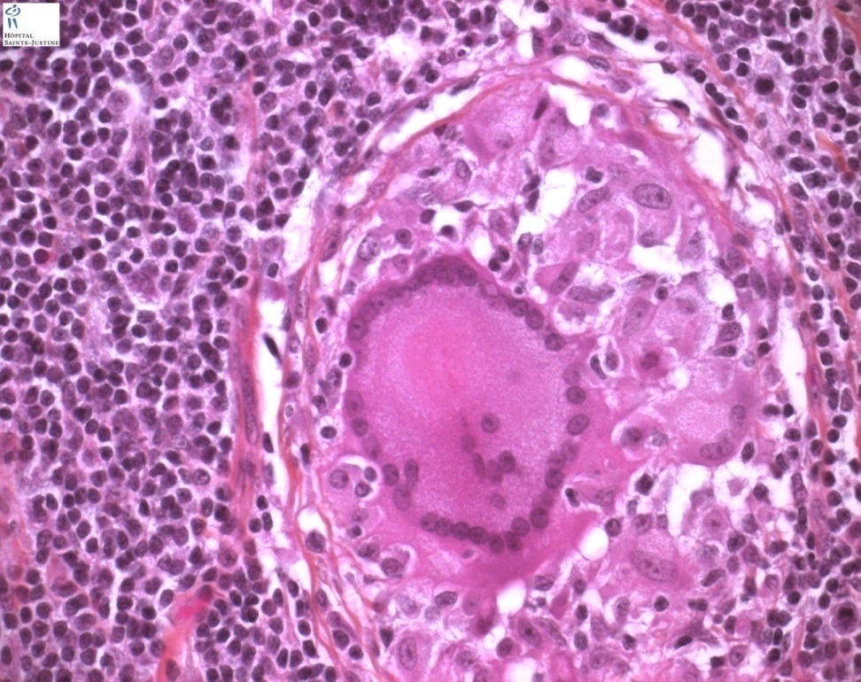
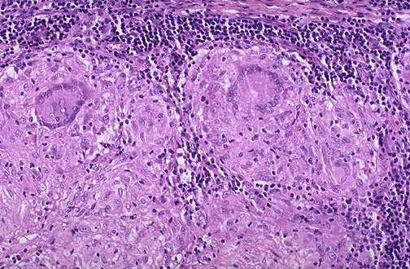
Granuloma = Nodular collection of epithelioid macrophages surrounded by a rim of lymphocytes
Epitheloid macrophages: squamous cell-like appearance

Slide 6
Why is it important?
Granulomas are encountered in certain specific pathologic states.
Recognition of the granulomatous pattern is important because of the limited number of conditions (some life-threatening) that cause it

Slide 7
Granulomatous Inflammation pathogenesis
Neutrophils ordinarily remove agents that incite an acute inflammatory response. However, there are circumstances in which reactive neutrophils cannot digest the substances that provoke acute inflammation.

Slide 8
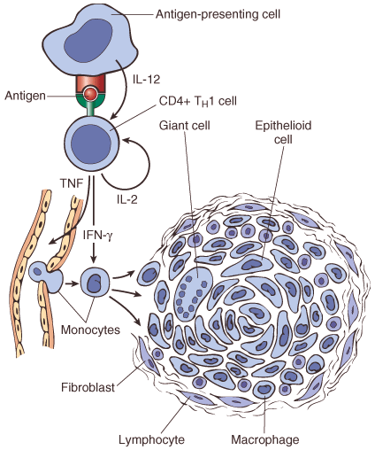
Granulomatous Inflammation mechanism
What is the initiating event in granuloma formation?
deposition of a indigestible antigenic material
IFN-γ released by the CD4+ T cells of the T_{H}1 subset is crucial in activating macrophages.
Type IV hypersensitvity

Slide 9
Epithelioid cell granulomas
When macrophages have successfully phagocytosed the injurious agent but it survives inside them.
When an active T lymphocyte-mediated cellular immune response occurs. Lymphokines produced by activated T lymphocytes inhibit migration of macrophages and cause them to aggregate in the area of injury and form granulomas.

Slide 10
Pathogenesis There are two types of granulomas
Foreign body granuloma
Immune granuloma
are incited by relatively inert foreign bodies. Typically, foreign body granulomas form when material such suture are large enough to preclude phagocytosis by a single macrophage
These material do not incite any specific inflammatory immune response.
The foreign material can usually be identified in the center of the granuloma, by polarized light (appears refractile).
are caused by insoluble particles, typically microbes, that are capable of inducing a cell-mediated immune response.

Slide 11
IL-2, and IFN-γ,

Slide 12
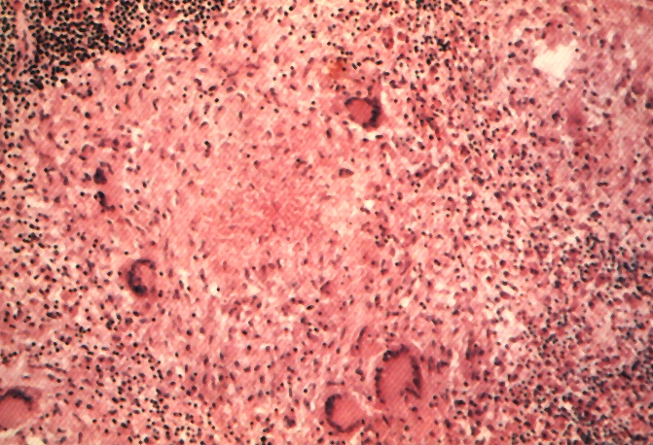
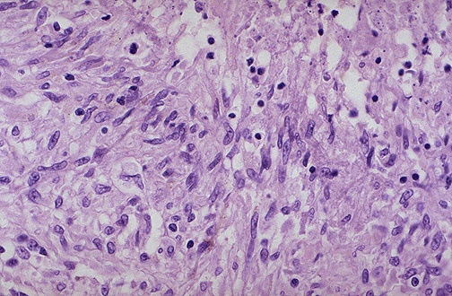
Granuloma
Langhans Giant Cell
Lymphocytic Rim
Caseous Necrosis
Epithelioid Macrophage

Slide 13
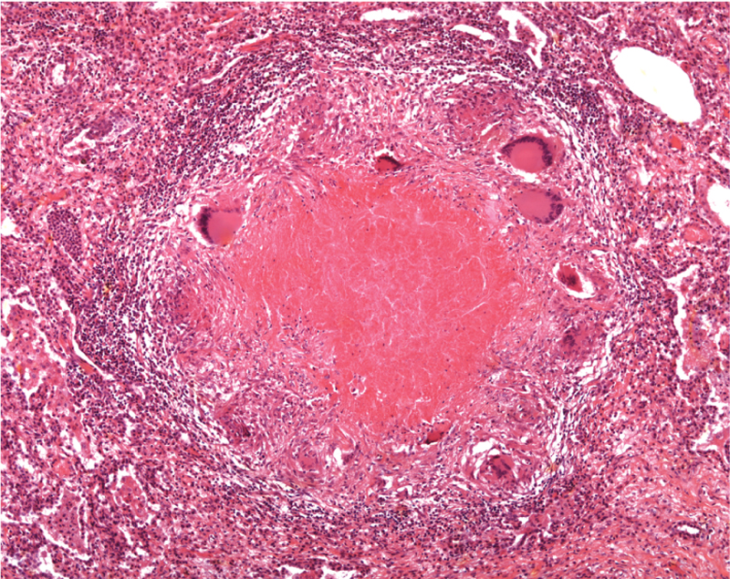
Epitheliod histiocytes
Lymphocytes
Multinucleated cell
Necrosis

Slide 14
Granulomatous Inflammation Causes
Non-immune granuloma
Immune granuloma:
Foreign body
Suture
Graft material
talc (associated with intravenous drug abuse)
Bacteria
Tuberculosis
Leprosy
Actinomycosis
Cat-scratch disease
Parasites
Schistosomiasis
Leishmaniasis
Fungi
Histoplasmosis
Blastomycosis
Metal/Dust
Berylliosis
Caseating granuloma
Non-Caseating granuloma
unknown
Sarcoidosis
Crohn’s disease

Slide 15
Tuberculosis

Slide 16
Sputum , tuberculosis

Slide 17
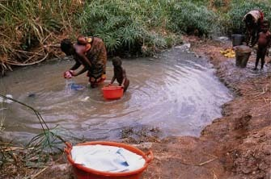
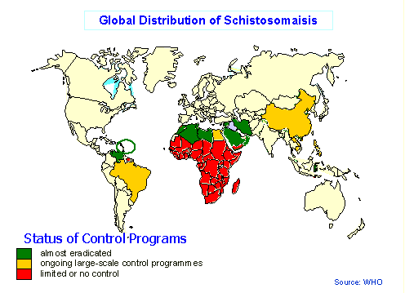
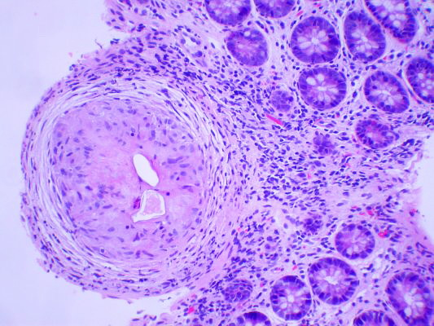
Schistosomiasis

Slide 18
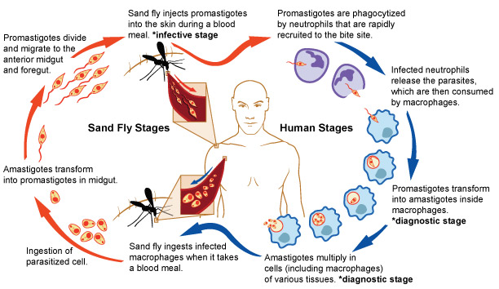
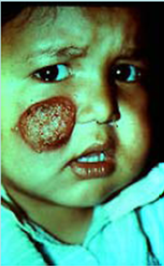
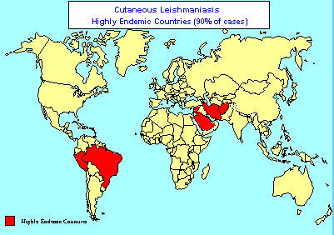
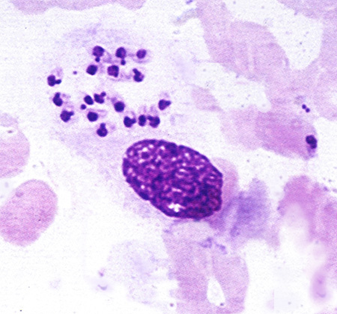
Leishmaniasis

Slide 19
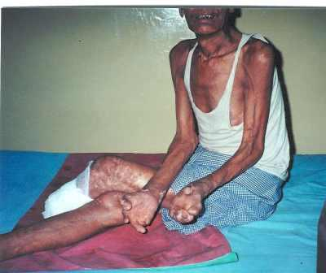
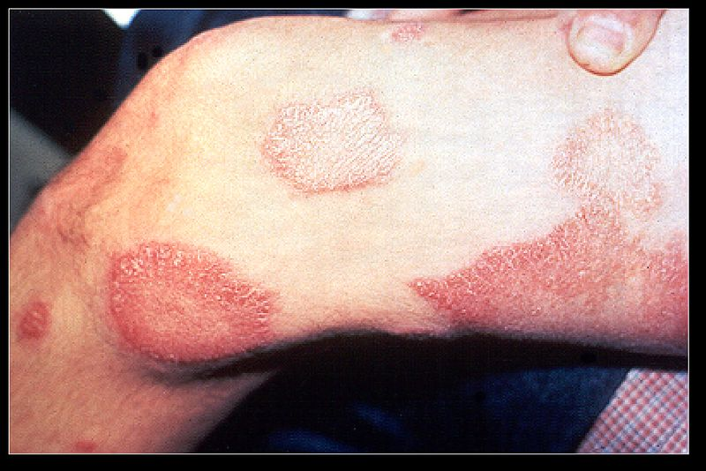
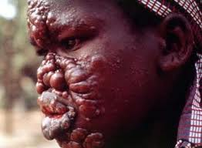
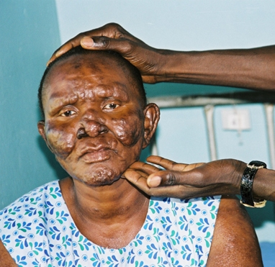
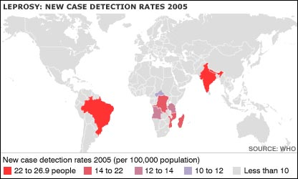
Leprosy

Slide 20
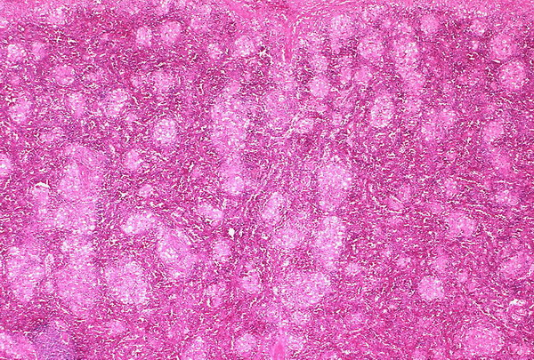
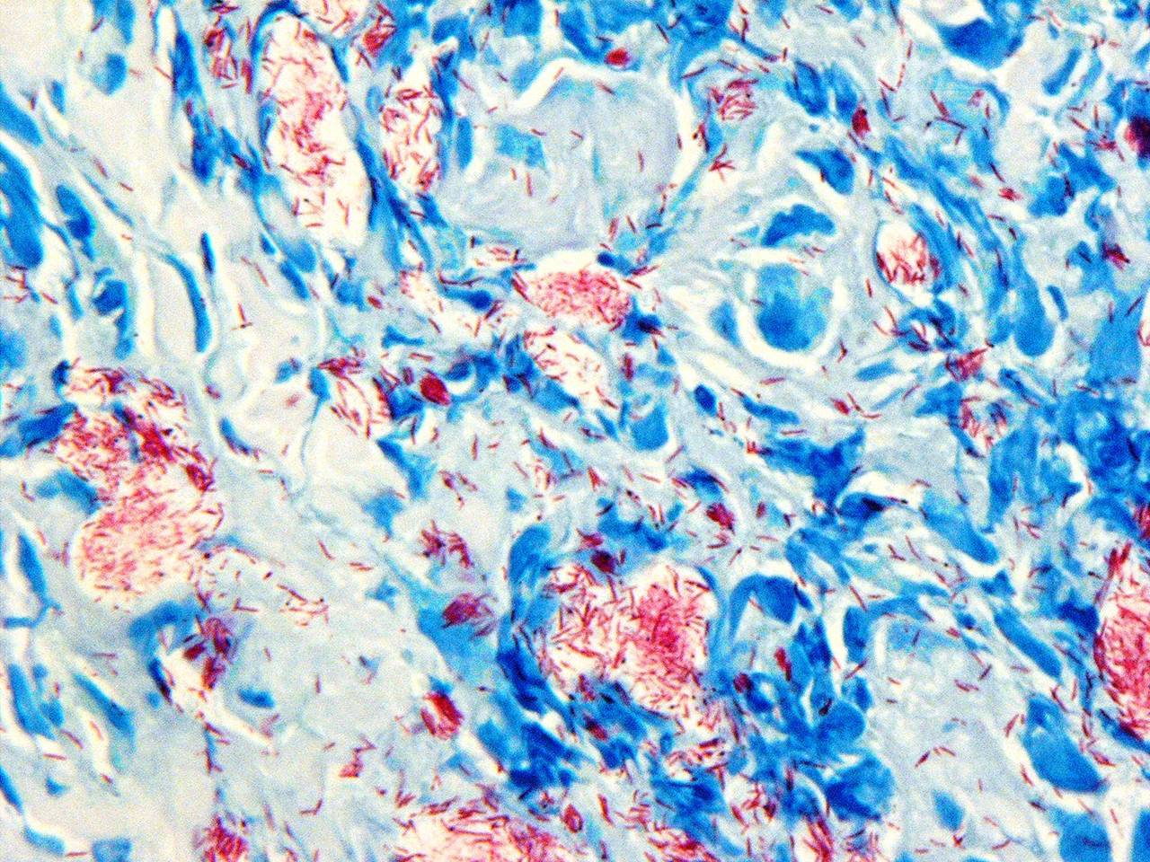
Leprosy

Slide 21
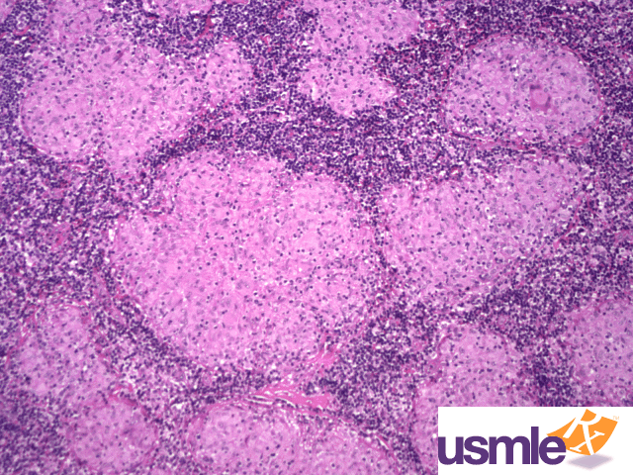
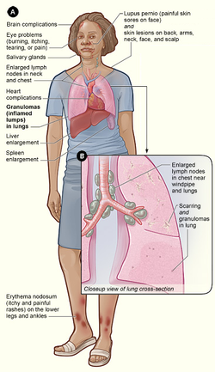
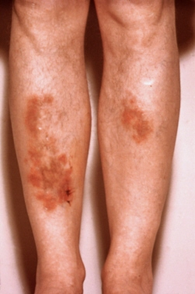
Sarcoidosis

Slide 22
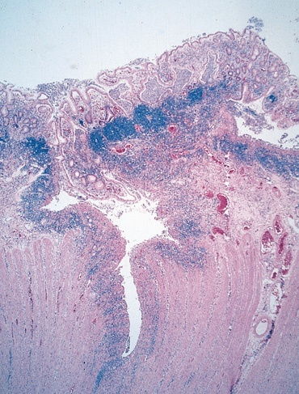
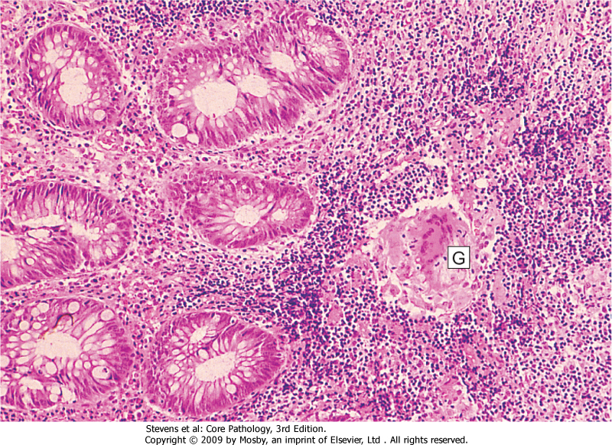
Crohn’s Disease
FISSURE
GRANULOMA

Slide 23
Match A and B
A
B
The most important cell in granulomatous inflammation
A cytokines that is important in activating macrophages and transforming them into epithelioid cells
Multinucleated cell in TB
Antigen presenting cells
pathogenesis of immune type granulomatous inflammation
Microscopic finding of TB
IFN-γ
Langhans cells
Epitheliod histiocyes
Cord factor
Langerhan’s cells
Type IV hypersensitivity reaction
Caseating granuloma

Slide 24
Which of the following diseases does not cause granulomatous inflammation
Cat-scratch disease
Actinomycosis
Sarcoidosis
Leishmaniasis
Staphylococcus infection

Slide 25
TAKE HOME MESSAGES:
Granulomatous inflammation is a distinctive pattern of chronic inflammation characterized by aggregates epithelioid macrophages
Damaging stimuli which provoke a granulomatous inflammatory response include: Microorganisms which are of low inherent pathogenicity but which excite an immune response.
Granulomata are produced in response to:
Bacterial infection
parasitic infection: e.g. Schistosoma infection
Certain fungi cannot be dealt with adequately by neutrophils, and thus excite granulomatous reactions.
Non-living foreign material deposited in tissues, e.g. keratin from ruptured epidermal cyst.
Unknown factors, e.g. in the disease 'sarcoidosis' and Crohn's diseas

