Slide 1
Introduction to the study of pathology and the study of diseases.
By Dr. Ammar C. Al-Rikabi

Slide 2

pathology provides the link between basic biological sciences and the practice of medicine.
Pathology in the study of disease processes.

Slide 3
The disease or illness is defined as a physiological defined as physiological or psychological dysfunction.

Slide 4
Epidemiology refers to sex (gender) age, prevalence, incidence and geographic distribution of a disease.

Slide 5
Aetiology is the direct cause of the disease
Pathogenesis is the mechanism of the disease production.

Slide 6
Factors effecting the incidence and prevalence of a disease include: time (disease variation over the course of time), place (geography) and the person (age, gender, occupation, race, social class and behavior).

Slide 7
Idiopathic disease is the disease of an unknown cause.

Slide 8
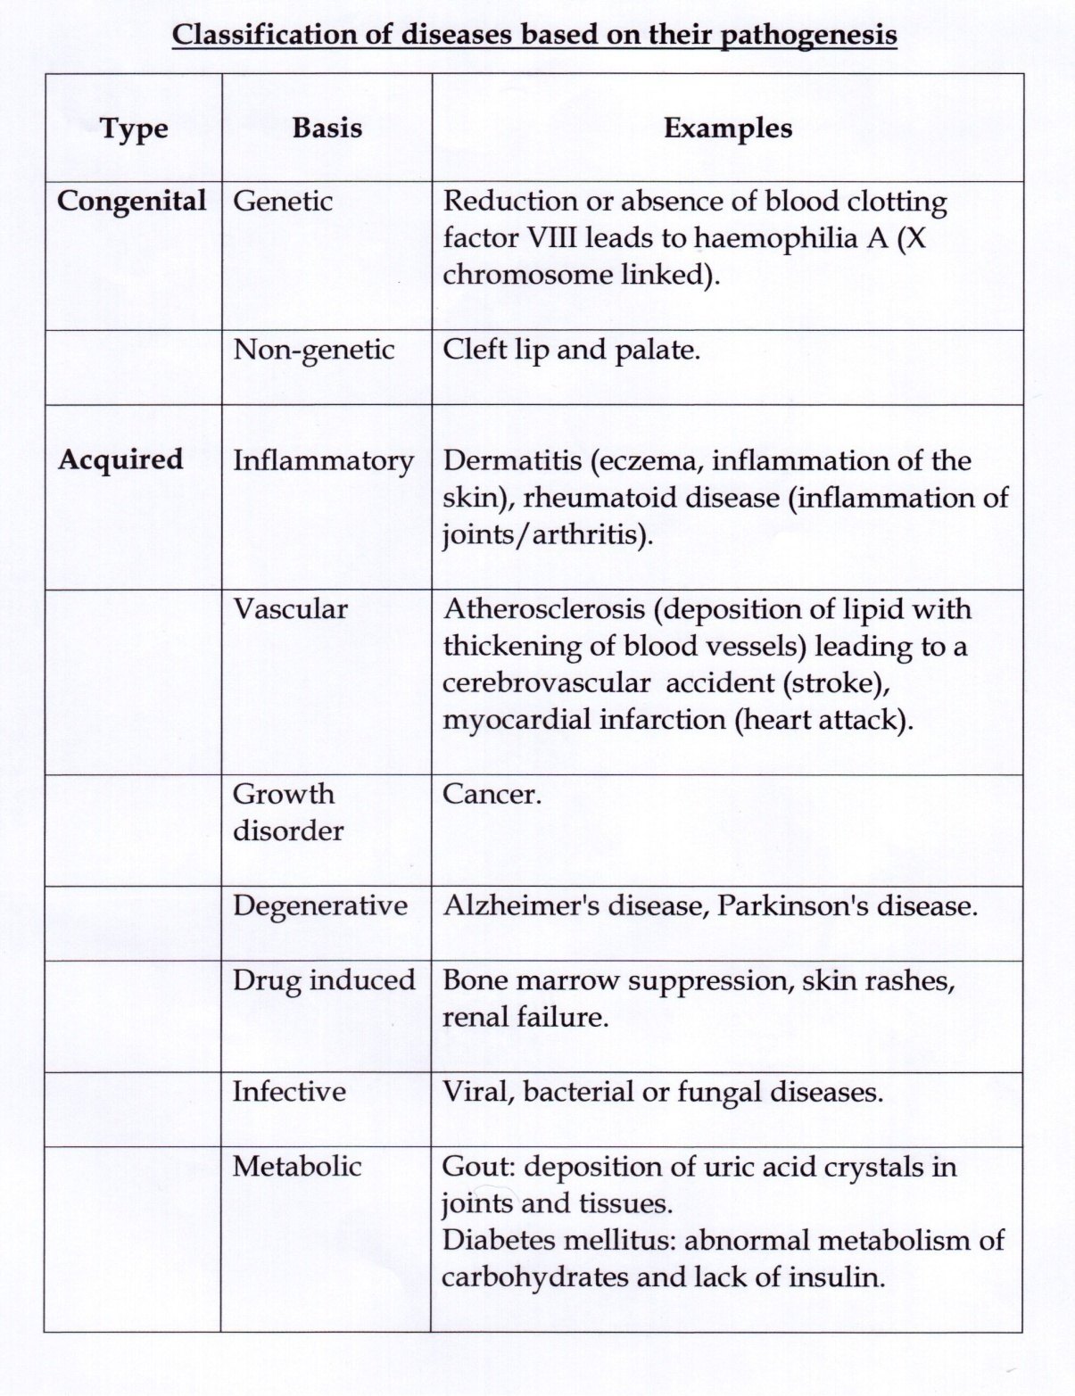

Slide 9
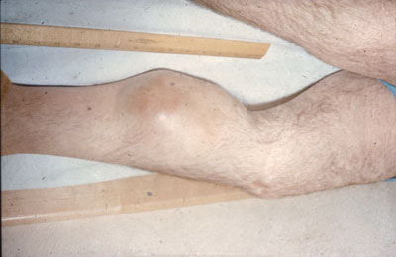
Classification of diseases based on their pathogenesis
Genetic Disease: Haemophilia A (X chromosome linked).

Slide 10
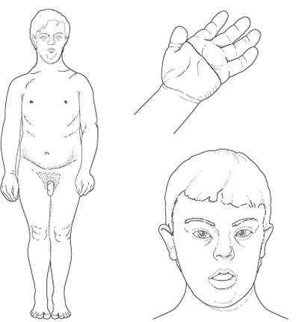
Classification of diseases based on their pathogenesis
Chromosomal disorder leading to Mongolism: trisomy 21.

Slide 11
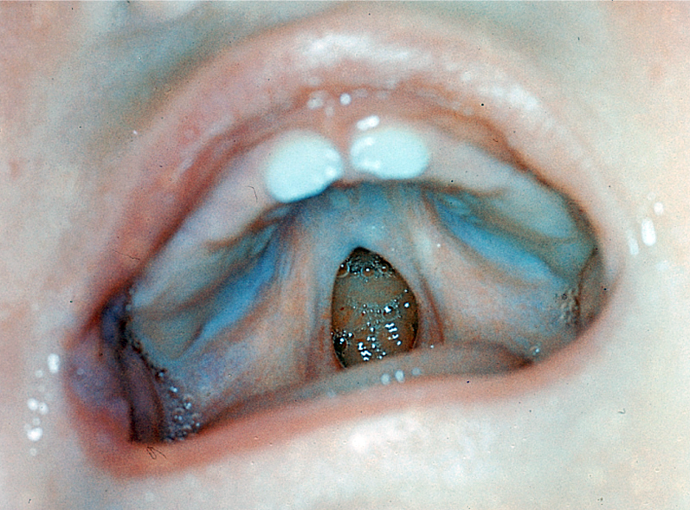
Classification of diseases based on their pathogenesis
Congenital but Non-genetic: Cleft lip and palate.

Slide 12
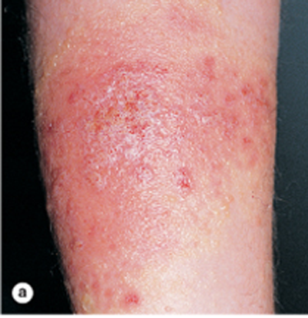
Classification of diseases based on their pathogenesis
Inflammatory : Dermatitis (eczema).

Slide 13
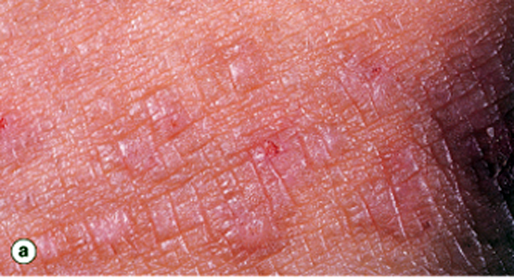
Classification of diseases based on their pathogenesis
Inflammatory: Chronic Dermatitis (eczema, inflammation of the skin),

Slide 14
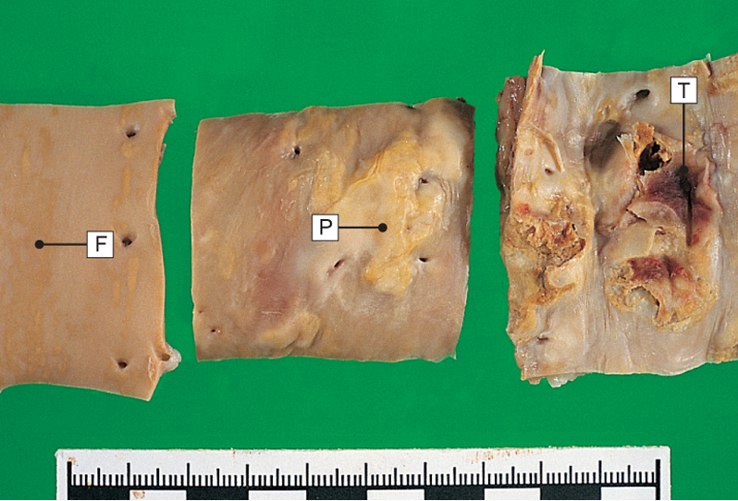
Classification of diseases based on their pathogenesis
Vascular: Atherosclerosis (deposition of lipid with thickening of blood vessels) leading to a cerebrovascular accident (stroke), myocardial infarction (heart attack).

Slide 15
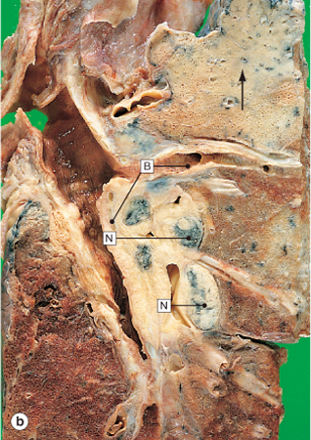
Classification of diseases based on their pathogenesis
Growth disorder : Cancer of the Lung.

Slide 16
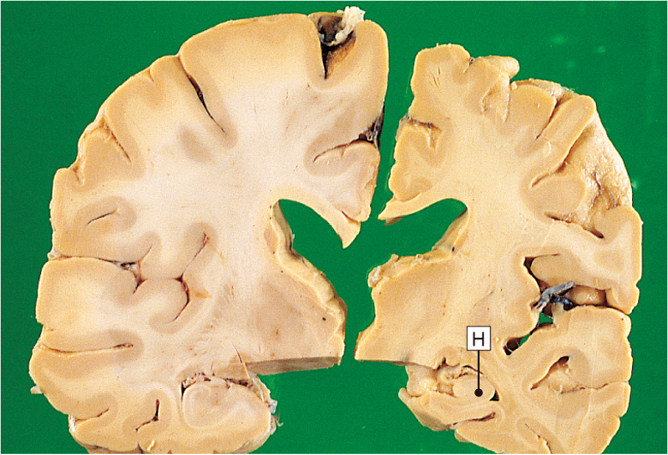
Classification of diseases based on their pathogenesis
Degenerative disease : Alzheimer's disease, the diseased brain on the right side is atrophic in comparison to the normal left brain section. The letter H shows the marked atrophy in the hippocampal region.

Slide 17
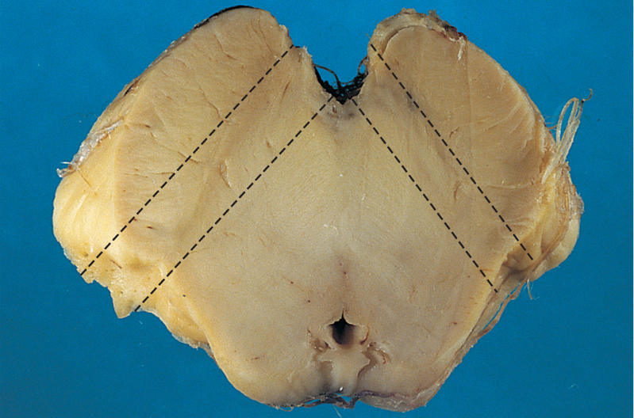
Classification of diseases based on their pathogenesis
Degenerative illness: Parkinson's disease (section through the mid-brain showing loss of pigmented neurons from the substantia negra between the dotted lines.

Slide 18
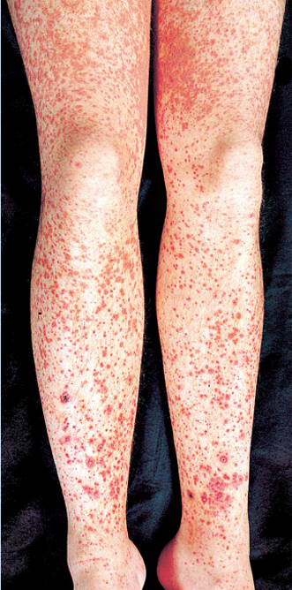
Classification of diseases based on their pathogenesis
Drug induced illness Causing a haemorrhagic skin rash affecting both legs.

Slide 19
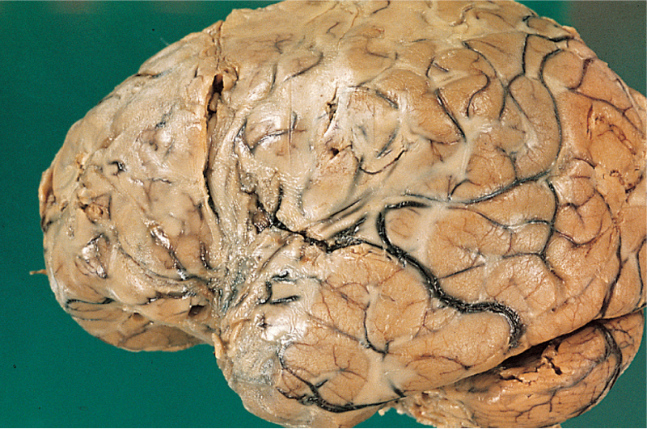
Classification of diseases based on their pathogenesis
Infective aetiology: Viral, bacterial or fungal causing a disease called meningitis.

Slide 20
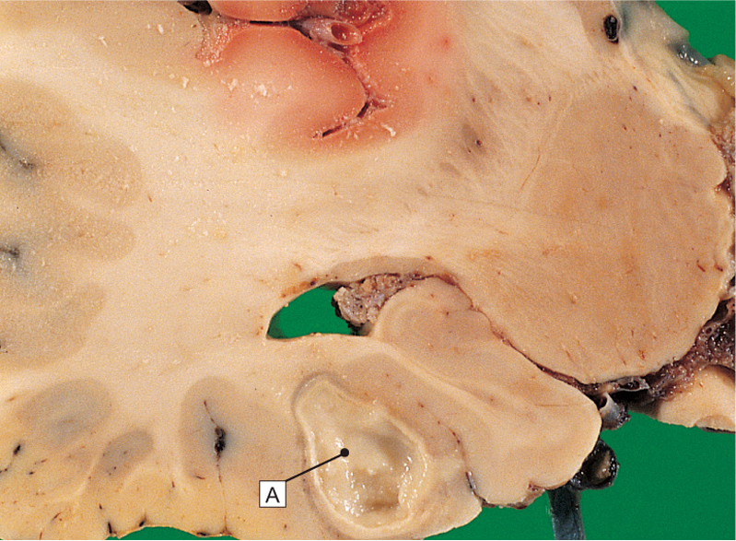
Classification of diseases based on their pathogenesis
Infective Pathogenesis: bacterial brain abcess.

Slide 21
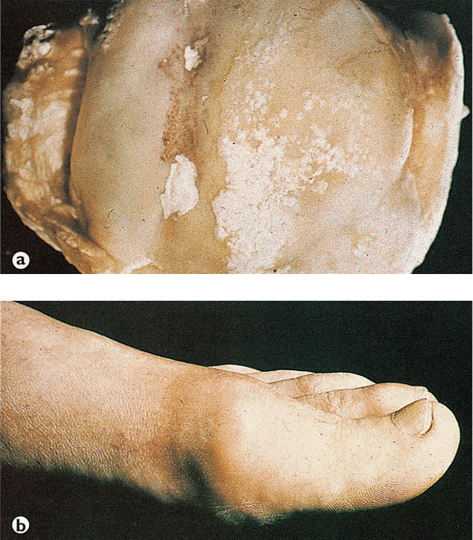
Classification of diseases based on their pathogenesis
Metabolic Pathogenesis: Gout caused by deposition of uric acid crystals in joints and tissues.

Slide 22
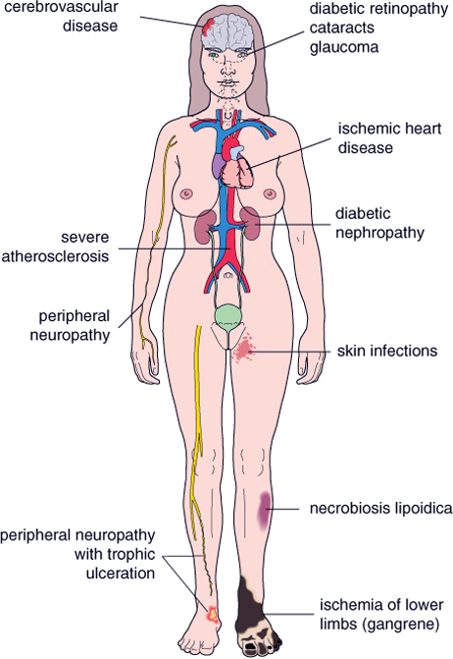
Classification of diseases based on their pathogenesis
Metabolic pathogenesis: Diabetes mellitus caused by abnormal metabolism of carbohydrates and lack of insulin.

Slide 23
How we should study a disease?

Slide 24
we should follow a logic sequence which include: definition, epidemiology, clinical presentation, understanding the underlying pathology by performing tests and X rays, making differential diagnosis, management, treatment and prognosis according to evidence based final diagnosis.

Slide 25
The diagnostic process include:
The clinician works through a series of questions:
Which organ system is most likely to be affected.
What do the signs and symptoms most likely suggest: inflammation, malignancy or poisoning.
Do other factors like race, age, sex, behavior and occupation provide diagnostic clues?

Slide 26
The role of pathologist in the diagnostic process.

Slide 27
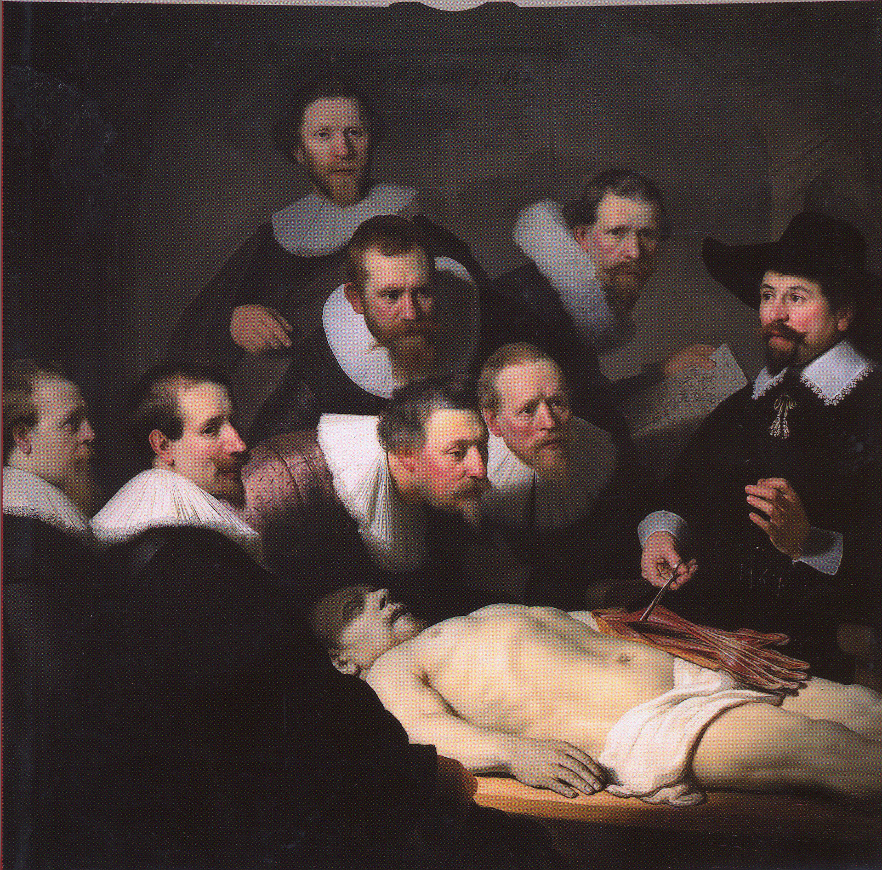

Slide 28
Indications for autopsy:
Determine the cause of death.
Auditing the clinical diagnosis.
Provision of useful material for teaching.
Research: causes and outcomes of diseases.

