Slide 1
Granulomatous diseases

Slide 2
Gross and histopathology

Slide 3
1- Tuberculosis of the lung

Slide 4
Ghon’s Complex

Slide 5
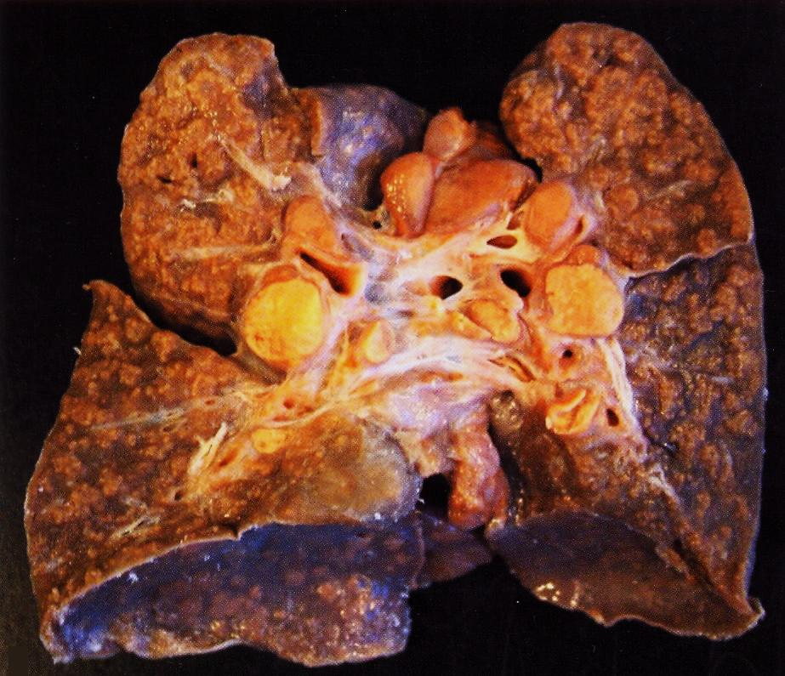
Miliary tuberculosis

Slide 6
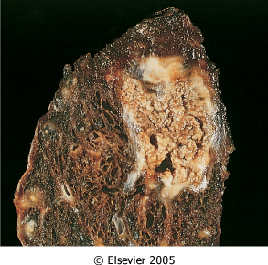
Organ: lung Dx : Caseous necrosis (tuberculosis)

Slide 7
Tuberculous Granulomas

Slide 8
Caseation Necrosis

Slide 9
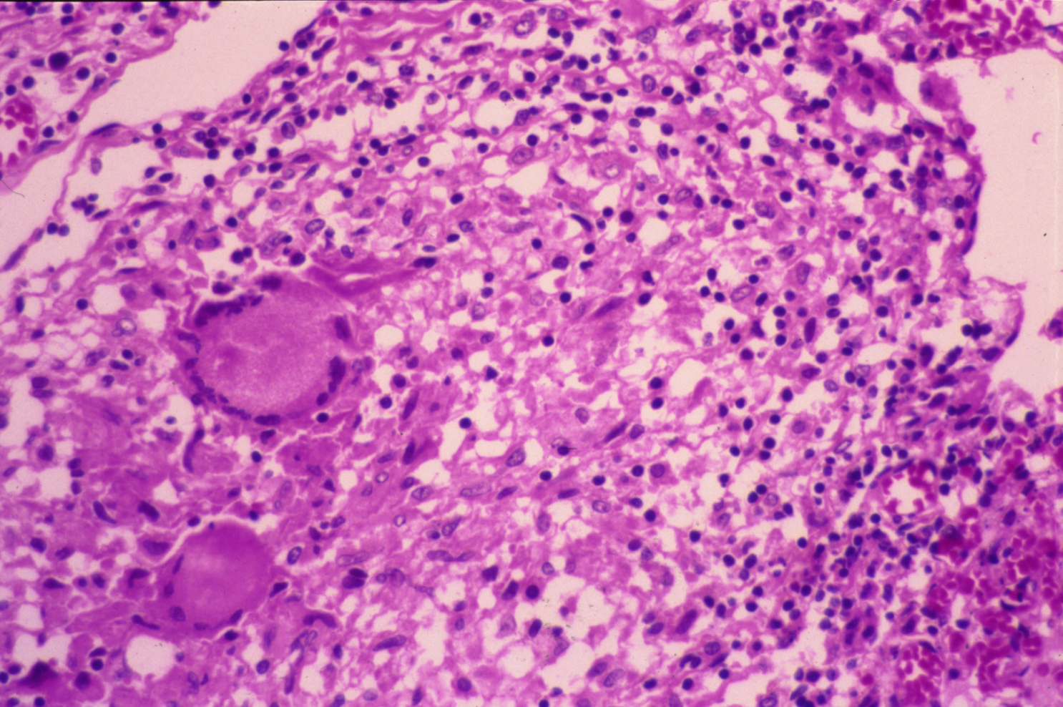
Epitheloid cells in Granuloma

Slide 10
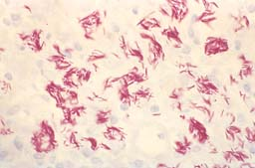
MORE ACID-FAST BACILLI, AFB
Notes:
The acid fast stain for acid fast bacteria is also called the Ziel-Neilseon stain, or simply AFB stain

Slide 11
Miliary tuberculosis of the lung :
Section of the lung shows : The alveolar septae contain many tubercles which consist of epithelioid cells , few langhan’s giant cells and peripheral rim of lymphocytes with or without caseation

Slide 12
2- Tuberculous lymphadenitis

Slide 13
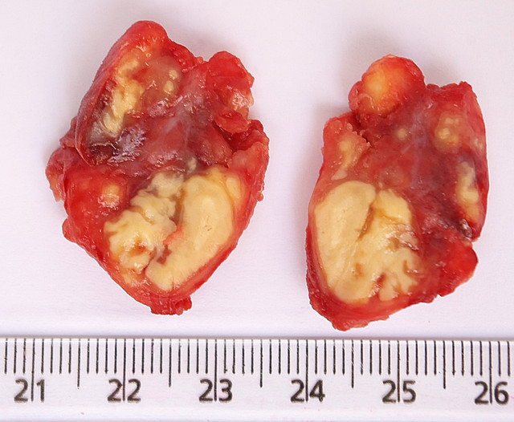

Slide 14
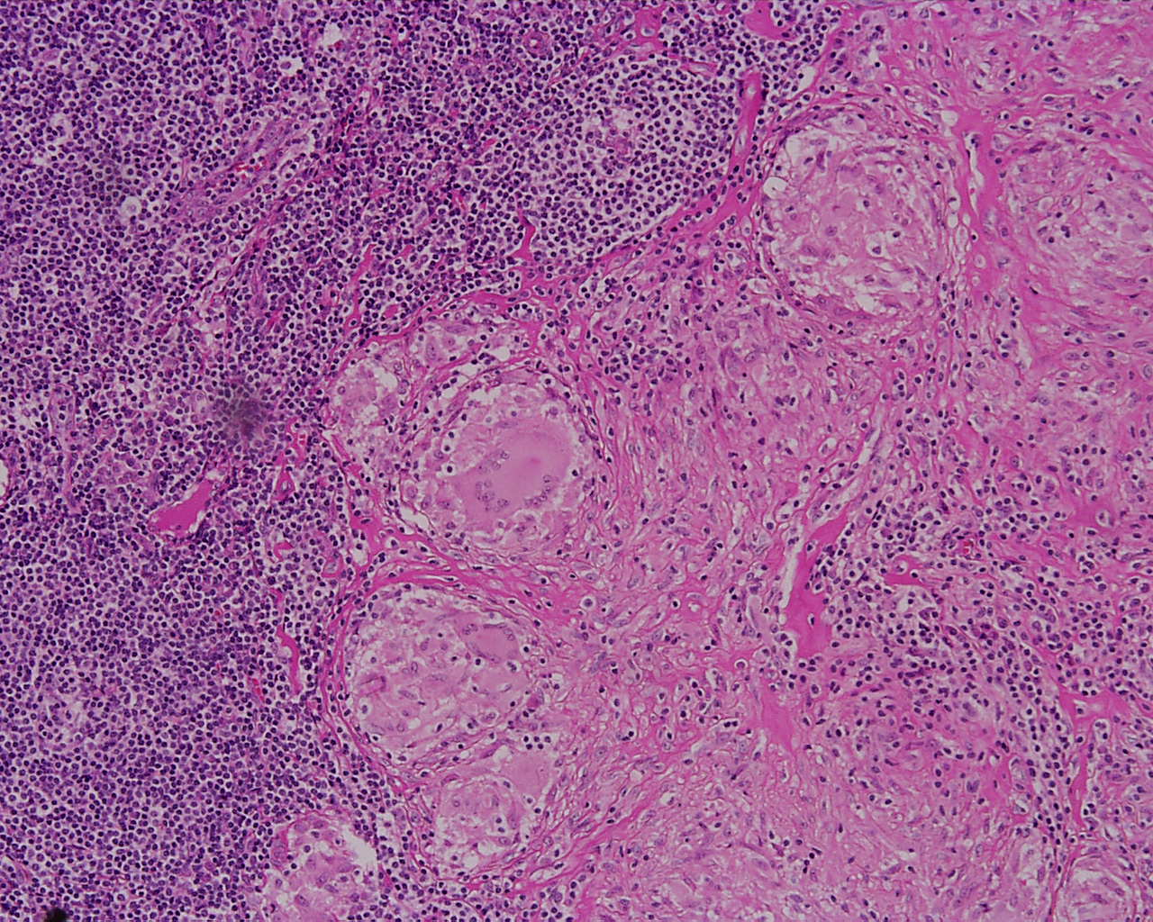

Slide 15
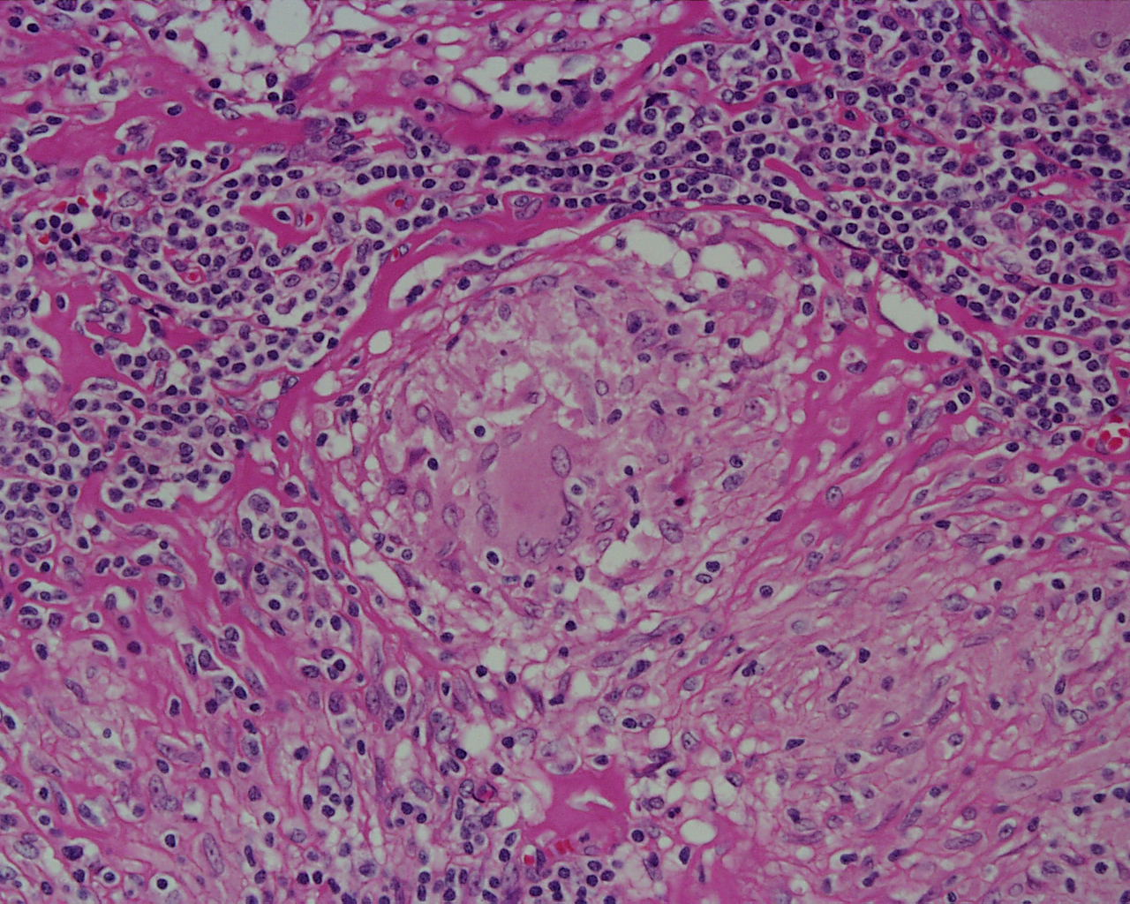

Slide 16
Tuberculous lymphadenitis : Section of a lymph node with connective tissue capsule and lymphoid tissue shows:
Many round and oval tubercles/ granulomas with or without central caseation that appears structureless, homogenous and pink in colour.
The granulomas consists of epithelioid cells, few langhan’s giant cells (large cell with multiple peripheral nuclei) and peripheral rim of lymphocytes.

Slide 17
3- Bilharziasis of the colon

Slide 18
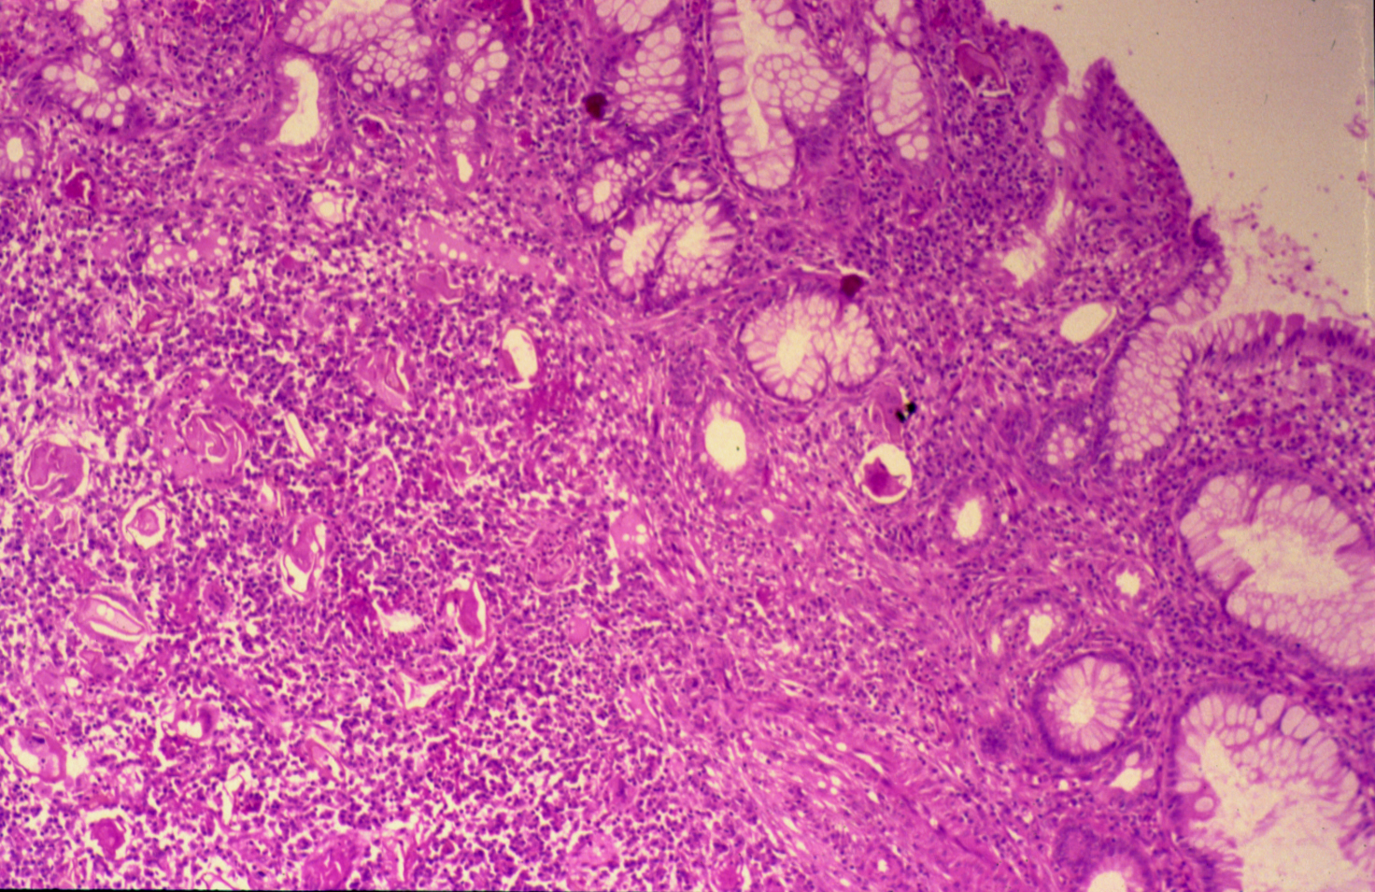
COLONIC BILHARZIASIS

Slide 19
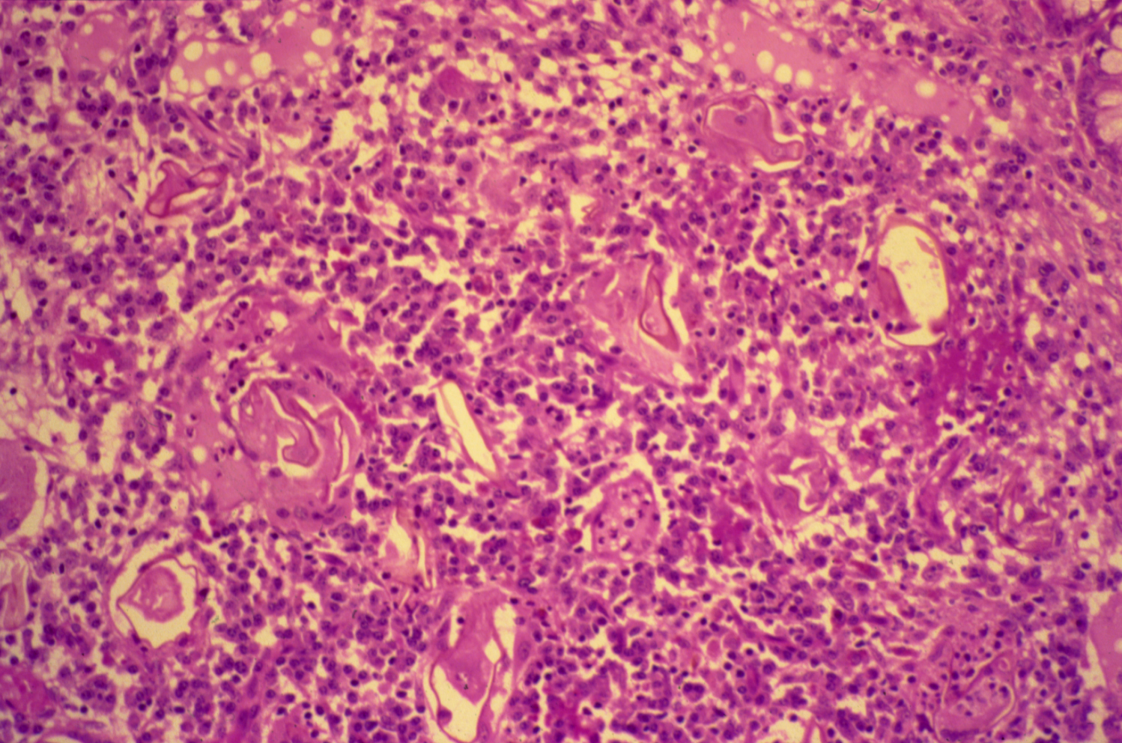
BILHARZIASIS (COLON)

Slide 20
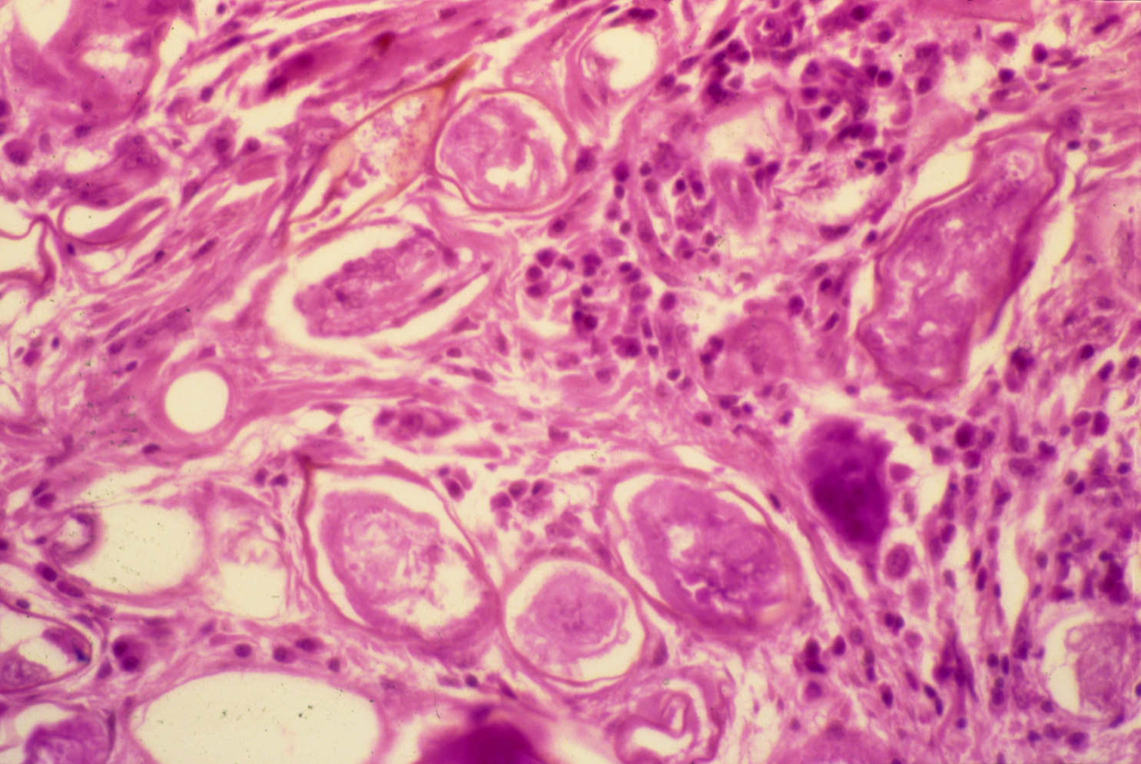
SCHISTOSOMIASIS OF THE URINARY BLADDER

Slide 21
Bilharziasis of the rectum\urinary bladder: Section of fragments of rectal\urinary bladder mucosa shows:
Many Bilharzial ova with yellow brown shells in mucosa and submucosa surrounded by fibrosis and chronic inflammatory cells consisting of lymphocytes, plasma cells and many eosinophils.
Few granulomas are seen around the ova.

Slide 22
4- Cutaneous leishmaniasis

Slide 23
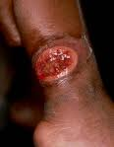
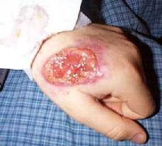

Slide 24
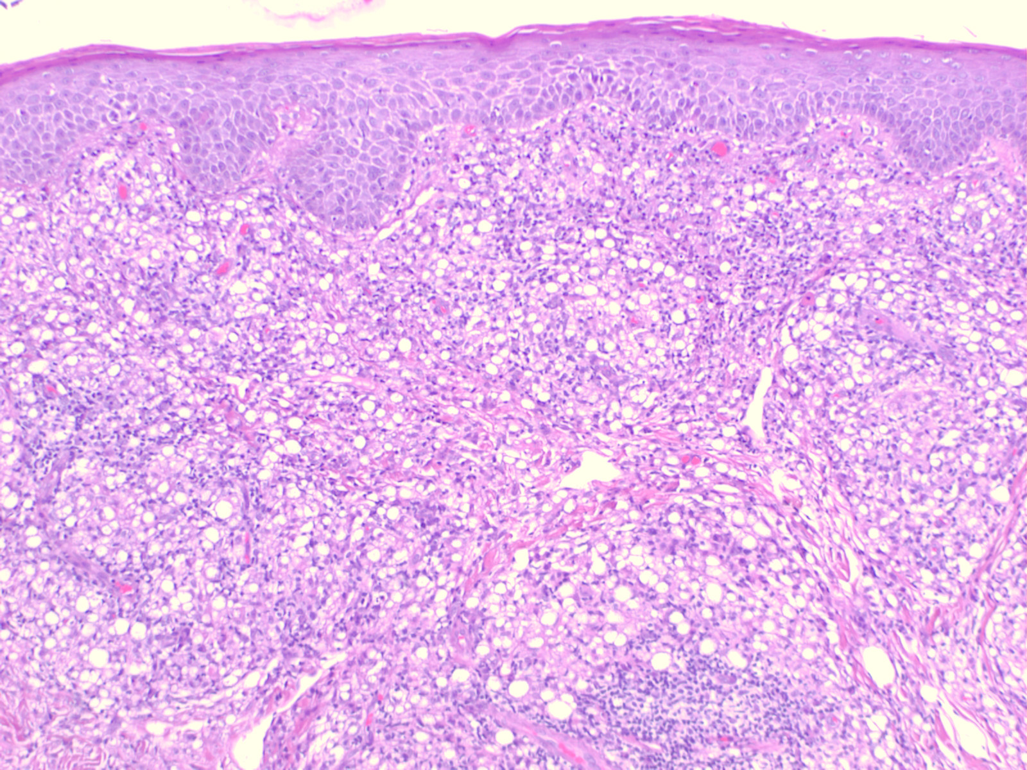

Slide 25
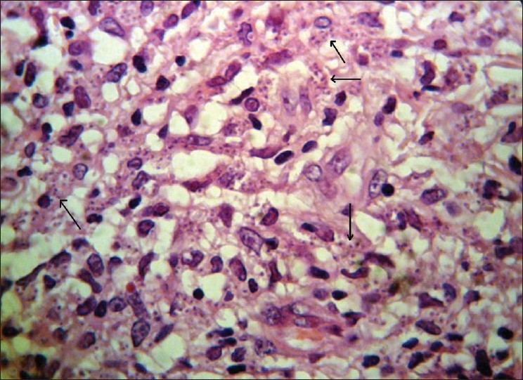
Histological view shows marked cellular infiltration and parasites (Leishman bodies) within macrophages

Slide 26
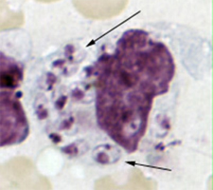
Picture shows a macrophage containing Leishmania amastigotes with characteristic features (round nucleus, rod-shaped kinetoplast; arrows) .

