Slide 1
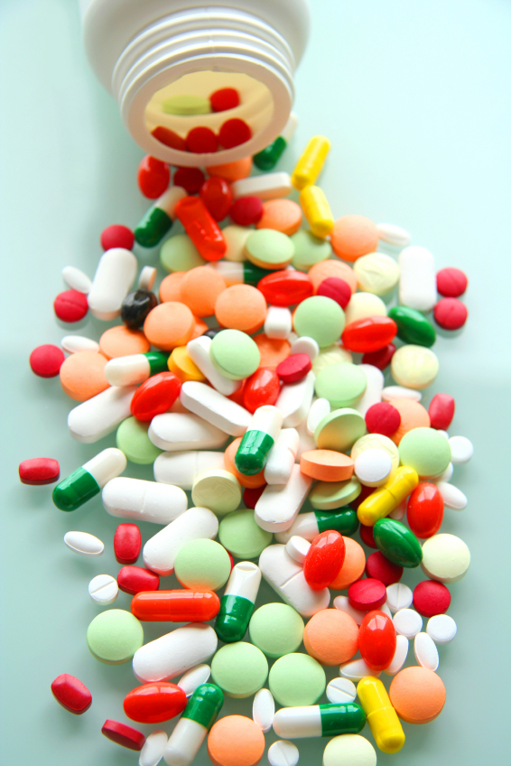
ilos
By the end of this lecture you will be able to :
Determine quantitative aspects of drug receptor binding
Recognize different dose response curves
Distinguish the therapeutic utility of each of these curves
Classify different types of antagonism
QUANTITATIVE ASPECTS OF DRUG ACTION

Slide 2
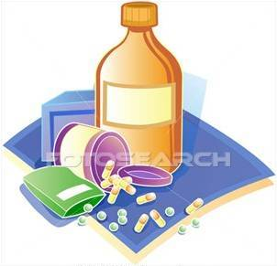
The tendency of a drug to bind to the receptors is governed by its affinity.
AFFINITY
The ability for it, once bound, to activate the receptor is denoted by its efficacy.
EFFICACY
QUANTIFY ASPECTS OF DRUG ACTION
Bind
Occupy
Initiate
Activate
D
+
R
D
R
DR*
RESPONSE[R]
Relate concentration [C] of D used (x- axis) to the binding capacity at receptors (y-axis)
Relate concentration [C] of D used (x- axis) to the R produced (y-axis)
Concentration-Binding Curve
Dose Response Curve
AFFINITY
EFFICACY
POTENCY

Slide 3
Concentration-Binding Curve
Bind
Occupy
Initiate
Activate
association rate constant
k₁
D
+
R
D
R
DR*
RESPONSE[R]
k₂
dissociation rate constant
The relationship between drug binding & drug concentration is expressed mathematically by the following equation
B_{max} xC
B = -----------
C+ KD₅₀

Slide 4
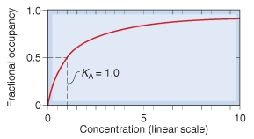
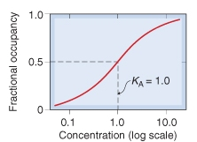
Concentration-Binding Curve
(B_{max}): Total density of receptors in the tissue
K_{D}
K_{D}
(k_{D} ) = [C] of D required to occupy 50% of receptors at equilibrium
?
Concentration-Binding curves are used to determine:
The binding capacity (B_{max}) → total density of receptors in the tissues.
The affinity of D for receptor
The higher the affinity of D for receptor the lower is the K_{D} i.e. inverse relation
?
?

Slide 5
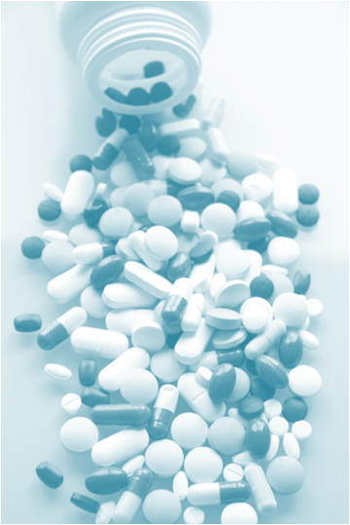
DOSE RESPONSE CURVE
GRADED DOSE RESPONSE CURVE
QUANTAL DOSE RESPONSE CURVE

Slide 6
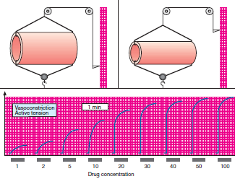
GRADED DOSE RESPONSE CURVE
A continuous response
BP, HR, FBG, Cholesterol,…

Slide 7
GRADED DOSE RESPONSE CURVE
Max effect = E_{max}
Effect when all the receptors are occupied by D
100
100
80
As C ↑ response increment ↓
80
60
% of Maximal Effect
% of Maximal Effect
60
E_{max} xC
E= -----------
40
40
C+ EC₅₀
20
20
0
0
0
200
400
600
800
1
10
100
1000
[C]
EC₅₀
[C]
EC₅₀
Graded dose-response curves are used to determine:
The max efficacy (E_{max}) → highest limit of dose-response relationship on response axis.
The potency = The concentration of drug required to produce a specified response
The smaller the EC₅₀ , the greater the potency of the agonist, i.e the lower C needed to elicit the maximum biological response.
3. Compare the relative potency and efficacy of drugs that produce the same effect.
C that gives the half-maximal effect

Slide 8
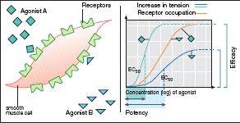
GRADED DOSE RESPONSE CURVE
EFFICACY
B Partial Agonist
A > efficacy than B
POTENCY
A > potent B

Slide 9
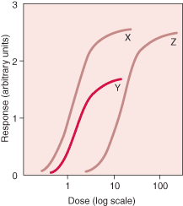
GRADED DOSE RESPONSE CURVE
X & Z are equal efficacy
X & Z > efficacy than Y
Y > potent but
< efficacious than Z
X > potent than Y & Z
Y> potent than Z

Slide 10
DOSE RESPONSE CURVE
GRADED DOSE RESPONSE CURVE
QUANTAL DOSE RESPONSE CURVE

Slide 11
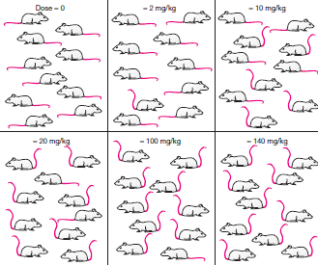
QANTAL DOSE RESPONSE CURVE
All-non responses
* specified therap. response
* adverse response
* lethal outcome
% subjects responding
Dose-frequency relationship

Slide 12
QANTAL DOSE RESPONSE CURVE: used to determine
100
Lethal Effect
80
Toxic Effect
Therapeutic Effect
Predict the safety profile
60
% subjects responding
40
20
[Dose]
0
1
10
100
1000
ED₅₀
TD₅₀
LD₅₀
Median Effective Dose
Median toxic dose
Median lethal dose
50% of individuals exhibit the specified therapeutic response
Therapeutic Index
TD₅₀
The relation between dose to induce a desired effect versus that producing the unwanted effect.
When low → the drug has a narrow margin of safety digoxin
ED₅₀
When high → the drug has a safe profile diazepam

Slide 13
ANTAGONISM
It is the diminution or the complete abolishment of the effect of one drug in the presence of another.
Types
Chemical
Pharmacokinetic
Non-Competitive
The antagonist effectively reduces the concentration of the active drug at the site of action
Two drugs react chemically resulting in loss of activity of active drug
Physiological
Receptor Blockade
Competitive
Dimercaprol reduces heavy metal toxicity [ lead, ….]
Phenobarbitone induces an accelerated hepatic metabolism warfarine
Two drugs possess opposing actions in the body, so tend to cancel each other’s effect
Omeprozole & histamine

Slide 14
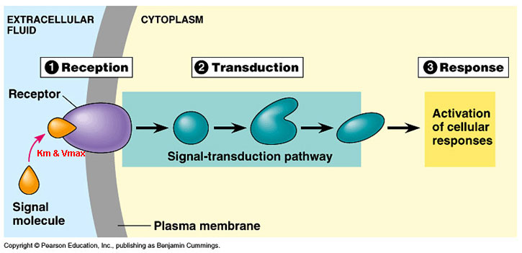
ANTAGONISM
Non-Competitive
Antagonist block at some point the chain of events that ignite the response of agonist
Agonist and Antagonist can be bound simultaneously
Receptor Blockade
Competitive
Reversible
Antagonist prevents binding of agonist to the receptor at the same binding site ( = competes with it at same occupancy site )
Agonist and Antagonist compete
( only one is bound)
Irreversible

Slide 15
COMPETATIVE ANTAGONISM
Antagonist readily dissociate from binding site of agonist to the receptor
Reversible
Antagonism can be overcomed by increasing concentration of agonist = Surmountable
Atropine vs Ach
Irreversible
Antagonist form stable, permanent / near permanent chemical bond with receptor.
Inactivation lasts for duration of receptor turnover or its de- novo synthesis → explains its longevity of action
Phenoxybenzamine & Noradrenaline

Slide 16
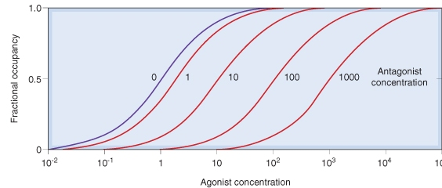
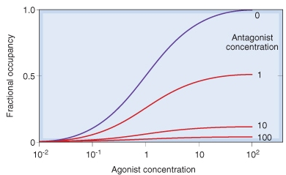
Competitive Antagonism
Reversible
Parellel shift to the right, without any change in slope or maximum
Irreversible
No parellel shift but both a decrease in slope and a reduced maximum are obtained.

Slide 17
Competitive vs Noncompetative Antagonism
Antagonism can be overcomed by increasing concentration of agonist = SURMOUNTABLE
% of Maximal Effect
Agonist + reversible competitive antagonist
100
Agonist
80
Agonist + irreversible competitive antagonist
60
Agonist + non-competitive antagonist
Depression of maximal response +/- rightward shifts ( if some R are spare )
40
Verapamil vs noradrenaline
20
0
[C]
1
10
100
1000
Antagonism cannot be overcomed by increasing concentration of agonist = NON-SURMOUNTABLE

Slide 18
QUANTITATIVE ASPECTS OF DRUG ACTION
G
O
O
D
L
U
C
K
By the end of this lecture you ARE able to :
Determine quantitative aspects of drug receptor binding
Recognize different dose response curves
Distinguish the therapeutic utility of each of these curves
Classify different types of antagonism

