Slide 1
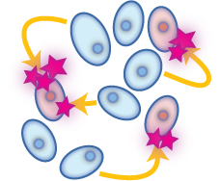
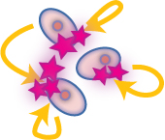
LOCAL COMMUNICATION
PARACRINE MEDIATORS
Secreted by one cell & acts upon adjacent cells or surrounding extracellular matrix [ECM]
AUTOCRINE MEDIATORS
Secreted from a cell and acts on the same cell

Slide 2
Paracrine Autocrine Mediators
Chemically they are classified into


EICOSANOIDS
Prostaglandins
Prostacyclines
Thromboxane A₂
Leukotrienes …etc
OTHERS
Cytokines
Chemokine
Growth Factors
….etc.
NO
PEPTIDES
Contractants Angiotensin Endothelin
NPY
Vasopressin
Relaxants Kinines
ANP
Tachykinins [SP]
VIP ….etc

PURINES
ATP / ADP
Adenosine

MONOAMINES
Histamine
Serotonin …etc


Slide 3
MonoAmine (HISTAMINE )

Slide 4
Storage Sites
Highest amounts in mast cells
Basophils
Skin
Lung
Intestinal mucosa
Stomach
Brain

Slide 5
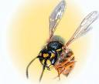
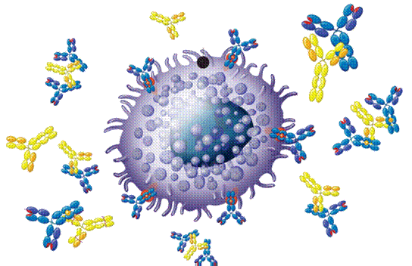
RELEASE

Slide 6
Storage and release:
Histamine is usually found in storage granules as complex with sulfated polysacharides, heparin and released (locally) by:
a) immunologicl Mechanism (During Allergic Reaction (see Fig 56-5)
b) Tissue injury Mast cell degranulation
c) Chemical and physical Conditions ( see table 51-2)

Slide 7
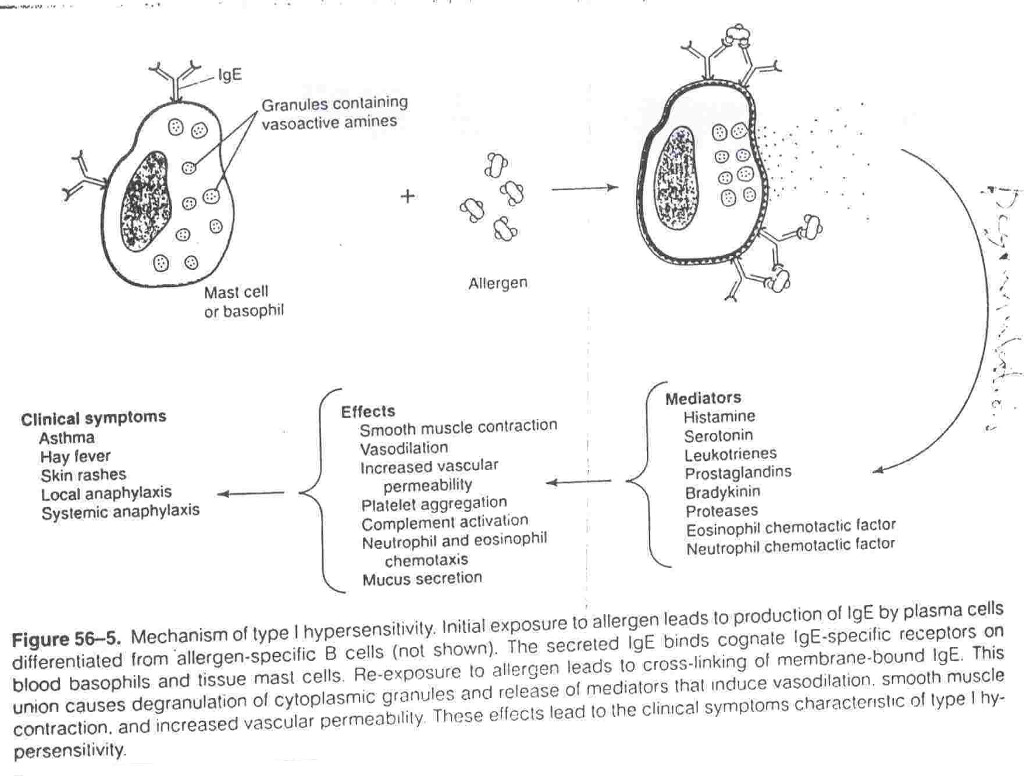

Slide 8
Chemical and Physical Agents that Release Histamine
Physical Agents | Chemical Agents
Mechanical trauma, Radiant energy, Thermal energy | Chymotrypsin, Compound 48/80, Detergents, Dextran, DMSO (dimethyl- sulfoxide), Morphine and other Opiods, Pentamidine , Polymyxin B, Polyvinyl pyrrolidine, Propamidine, eserpine, Surface active agents, Stilbamidine, Toxins, Tubocurarine, venoms, X-ray contrast media

Slide 9
SYNTHESIS & INACTIVATIONTION

Slide 10
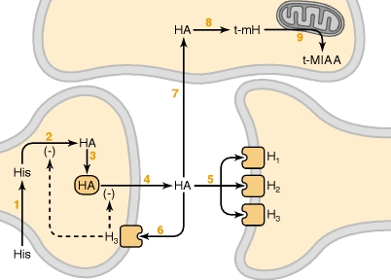
H istamine
Mediator
Neurotransmitter
CNS
ANS
H ₁
+
H ₂
+
H ₁
H ₃
+
H ₃
-ve presynaptic autoregulation

Slide 11
Histamine receptors
Receptor Type | Major Tissue Locations | Major Biologic Effects
H₁ | smooth muscle, endothelial cells | acute allergic responses
H₂ | gastric parietal cells | secretion of gastric acid
H₃ | central nervous system | modulating neurotransmission
H₄ | mast cells, eosinophils, T cells | regulating immune responses

Slide 12
Histamine receptors antagonists What is the physiological Antagonist of Histamine?

Slide 13
First generation Diphenhydramin, Promethazine etc
(Sedating and Pass Blood Brain Barriers)
H₁ antagonists
Clinical uses :
Antinausia and Vomiting
Insomnia
Cough
Motion sickness
Allergy

Slide 14
Second generation.
Loratadine
H₁ antagonists
Non-sedating
Clinical uses
Allergic conditions
Allergic rhinitis
Conjunctivitis
Urticaria

Slide 15
Ranitidine
H₂ antagonists
Inhibitor of gastric acid secretion
Used in the treatment of
peptic ulcers

Slide 16
BETAHISTINE (Betaserc)
H₃ antagonists
Used in treatment of
vertigo in middle ear

Slide 17
Eicosanoids (Prostaglandins)

Slide 18
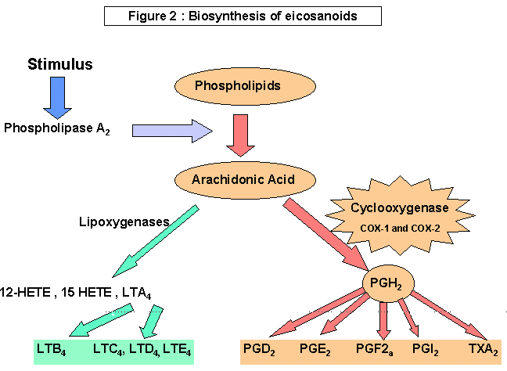

Slide 19
INHIBITORS OF EICOSANOIDS

Slide 20
Drugs
Phospholipids
Corticosteroids
Phospholipase A₂
Arachidonic Acid
Zileuton
NSAIDs
Lipoxygenase
COX1 & COX2
Leukotrienes
LTA4, B4, D4, C4 (Zafirlukast
as Antagonist)
Prostaglandins
PGE2, PGD2, PGF2α
Prostacyclin (PGI2)
Thromboxane (TXA2)

Slide 21
ACTIONS

Slide 22
Vascular smooth muscles:
PGE₂ and PGI₂
Thromboxane A₂
Potent vasoconstrictor.
Potent vasodilators .

Slide 23
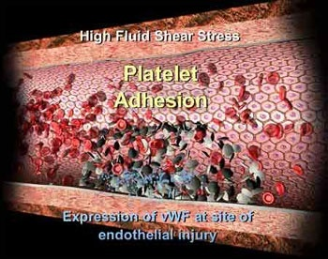
Blood:
TXA2
a potent inducer of platelet aggregation.
PGE₂ and PGI₂
inhibit platelet aggregation

Slide 24
Inflammation:
One of the chemical mediators in inflammatory reactions.

Slide 25
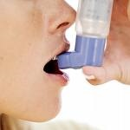
Bronchial smooth muscle:
-PGE₂ cause dilatation.
-PGF_{2α}
-LTs and thromboxane are potent bronchoconstrictors in man → allergic bronchospasm.

Slide 26
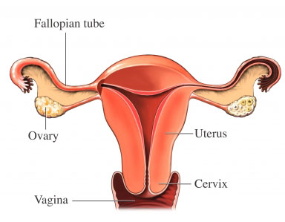
Uterine smooth muscle:
PGE₂ and PGF_{2α} → Menstruation/ Dysmenorrhea/ Labor contractions

Slide 27
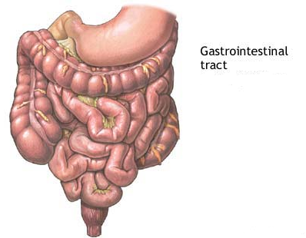
GIT smooth muscle:
- PGE₂ and PGF_{2α}
GIT
motility

Slide 28
GIT secretions:
PGE₂ , PGE₁ PGI₂
↓acid and pepsinogen secretion .
mucin, water and bicarbonate & Blood flow.
Thus, it is cytoprotective

Slide 29
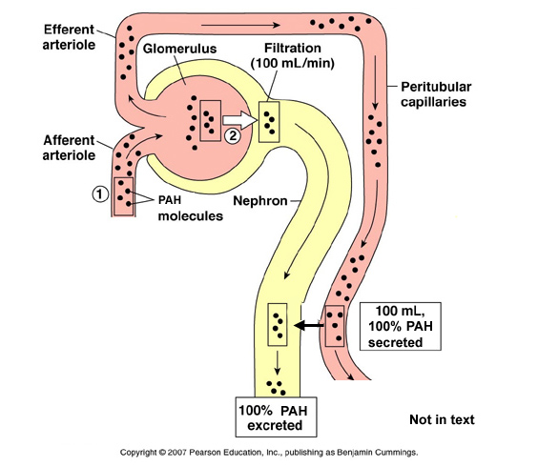
Kideny
PGE2 and PGI2 increase renal blood flow and diuresis.

Slide 30
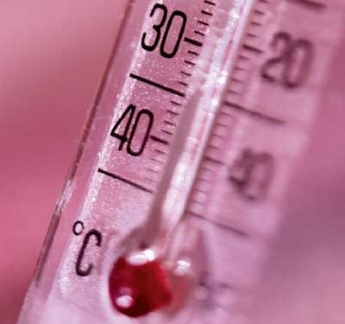
Central and peripheral nervous systems
Fever: PGE₁ and PGE₂ increase body temperature.

Slide 31
CLINICAL USES OF PGs ANALOGS

Slide 32
Carboprost
PGF_{2α} ( analog)
Abortifacient:
Trigger abortion in first trimester.

Slide 33
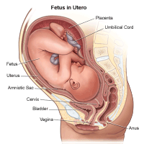
2) For postpartum haemorrhage
vasoconstriction

Slide 34
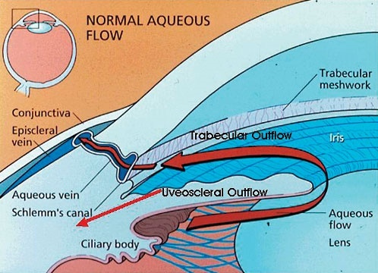
Latanoprost
(PGF_{2α} analog )
eye drops in open angle glaucoma.
↓ IOP by enhancing outflow of the aqueous humar.

Slide 35
Alprostadil
(PGE₁analog)
1- Injected in corpus cavernosum of the penis for some forms of male impotence.

Slide 36
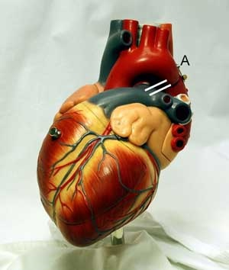
2- In congenital heart anomalies
to keep the patent ductus arteriosus until surgery.

Slide 37
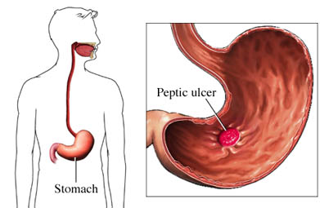
Misoprostol
(PGE₁ analog)
Peptic ulcer

Slide 38
Clinical Uses:
Oxytocis agents: (e.g.: Dinoprostone PGE2)
Asthma: Leukotrien antagonists (Zafirleukast; Montelukast); Zileuton
Impotance: Alprostadil PGE2
Glaucoma: Latanoprost PGF2
Anti-inflammatory and RA (NSAIDs)
Antiplatelet action (Aspirin)
Peptic Ulcer (Minoprostol PGE1)(Cytotec)

Slide 39
Thank you & Good Luck

