Slide 1
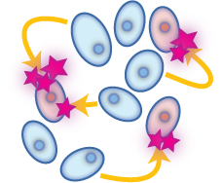
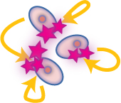
DRUGS Acting On Paracrine Autocrine Mediators
Part I
ILOs
By the end of this lecture you will be able to:
Recognize the role of NO in cellular communication.
Classify the different NOS available
Expand on its formation, actions termination and pharmacological modulation.
Identify role of angiotensin in body homeostasis and local regulation.
Explain its formation, target receptors, feedback regulatory actions, breakdown, intersection with the kinin system and pharmacological modulation.

Slide 2
Paracrine Autocrine Mediators
General Features
Act mostly on:
smooth muscles (SMC) [vascular (VSMC) or non vascular (NVSMC)]
nerve endings [> nonadrenergic non-cholinergic (NANC) co-transmission] + heart + exocrine glands + CNS …etc
Exist either:
Preformed & stored in tissues & released by a stimulus
[Monamines (histamine), most peptides ]
Formed de novo in response to a stimulus
[NO, eicosanoids, some peptides, cytokines] ]
Their presence is either:
Constitutive: present all times, to share in normal basic functional regulation within the cells (eNOS / COXI )
Inducible: only present upon demand i.e. gets expressed [gene transcription, mRNA formation and ribosomal translation into protein]
(iNOS / COXII)

Slide 3
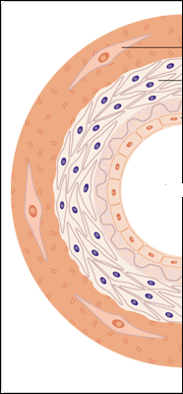
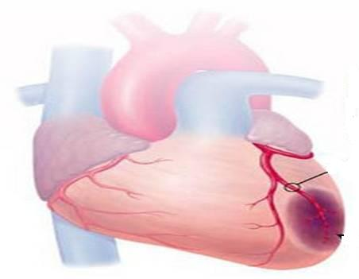
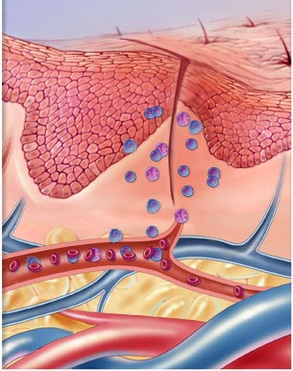
Nitric Oxide

Slide 4
Nitric Oxide
Is a highly diffusible stable gas
L-arginine + O₂ NO + Citrulline + H₂O
Synthesis
NADPH, FAD, CaCAM
Nitric oxide synthase (NOS)
NOS Isoforms
Type I [n-NOS] Neuronal NOS | Type III [E-NOS] Endothelial NOS | Type II [I-NOS] Inducible NOS
Cytosol of Neuronal cells | Bound to membrane of endothelial cell [EC], platelets …etc. | Cytosol of macrophage, neutrophil, kupffer cells … etc
Constitutive | Constitutive | Inducible
Neuronal messenger Cytoprotective | Relaxation of VSMC Cytoprotective | Immunocytotoxicity
Shear Stress or Agonists as; Ach, histamine, bradykinin, …..when bind to receptors  intracellular Ca activate eNOS NO formation
EC= Endothelial Cells / VSMC= Vascular Smooth Muscle Cell

Slide 5
Nitric Oxide
Action
1.Vasodilatation
Diffuse to VSMC
Binds soluble GC
Change GTP to cGMP
PARACRINE
Diffusion
Endothelial Cell [EC]
Vascular Smooth Muscle [ VSMC]
Activate PKG &
Ca
Inactivate MLCK
Prevent actin myosin cross link
No contraction
RELAXATION
Site of formation
-
MLCK
2. Cytoprotection
platelet aggregation
inflammatory cell recruitment
Cholesterol deposition…etc.
PARACRINE
AUTOCRINE
MLCK=
Myosin Light Chain Kinase

Slide 6
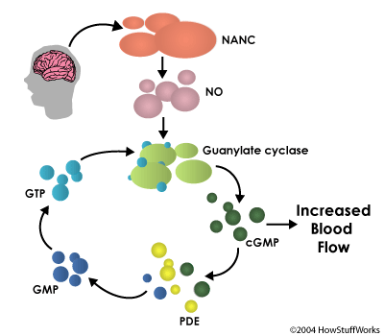
Nitric Oxide
Termination of action
By formation of
1. Stable analogues  with
proteins containing SH ….
2. Free radical Peroxynitrite  in oxidative stress
By break down of its downstream signal cGMP
by PDE
to form GMP
BV

Slide 7
Nitric Oxide
Drugs modulating (very important)
1. Express eNOS:
Statins, Estrogen CVS Cytoprotection
2. Act as NO donners:
a. Nitrates  >Venulodilators in angina
b. Na Nitroprusside  Arteriolar dilator in hypertension
3. Prevent breakdown of PDE:
Selective PDE₅ Inhibitors; Sildenafil  Erectile dysfunction

Slide 8
Vasoactive Peptides
A. Vasoconstrictors (angiotensin II ;
vasopressin ; endothelins and neuropeptide Y
B. Vasodilators (Bradykinin and related
Kinins : natriuretic pepties ; vasoactive intestinal peptide ; substance P ; neurotensin)

Slide 9
Angiotensin

Slide 10
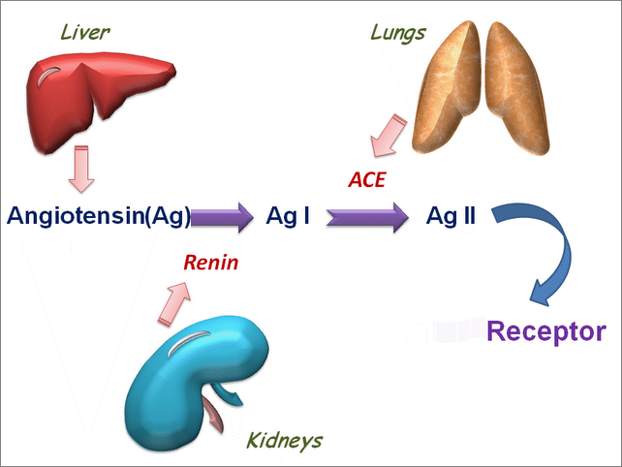
Angiotensin [Ag]
A the most vasoconstrictor peptide
Synthesis
Precursor is Angiotensinogen; a plasma α-globulin synthesized in the liver.
Lungs Endothelium & Brain
Angiotensinogen (Ag)
The active form
Other Proteolytic Enzymes
Chymase
Endoperoxidase
Secreted by renal juxtaglomerular apparatus. HOW ?
AT₁
AT₂
When Blood Pressure   Blood flow 
○ Renin is released
Vasoconstriction

Slide 11
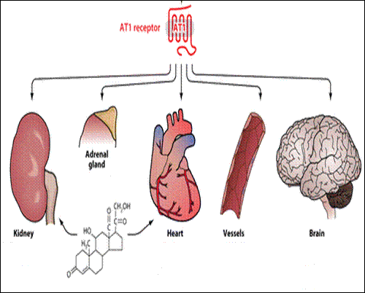
Angiotensin
Ag II
Ag II
Ag II
Ag II
Action
Thirst
RAAS
SNS activation
ENDOCRINE / PARACRINE
Ag II
ALDOSTERONE
ADH
Na retention
Inotropy
Chronotropy
Vasoconstriction
Blood Pressure
Ag II
AUTOCRINE
Hypertrophy
Fibrosis
Remodeling
=Hypertrophy
Fibrosis

Slide 12
Angiotensin
Mechanism of action
Termination of action
Ag II
AT₁
AT₂
AgII acted upon by peptidases
aminopeptidases (angiotensinase)
to Ag III
[a less active] & then to fragmentation products
GP- Coupled Receptors
Vasoconstriction
Vasodilatation

Slide 13
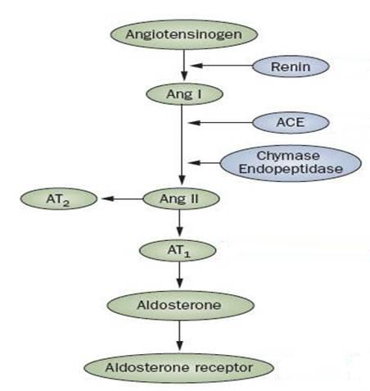
Angiotensin
Clonidine
Propranolol
SN
BF [β₂ ]
Drugs modulating
INHIBITION OF RAAS SYSTEM
is beneficial in treatment of:
Hypertension (hypertrophy)
Heart Failure (hypertrophy & fibrosis)
Diabetics (Protect the kidney)
RENIN Inhibitors
Aliskiren
ACE Inhibitors
Lisinopril
VASOPEPTIDASE Is
Omapatrilat
ARBs
Candisartan
Inactive metabolites
ADOSTERONE Antagonists
Spirinolactone Eplerenone

Slide 14
Bradykinins

Slide 15
Kinins
Bradykinin is a vasodilator peptides
Synthesis
Kininogen
From liver
Plasma Kallikrin
TissueKallikrin
Action
Aminopeptidase
Bradykinin
Kallidin
Vasodilatation
Inflammation & Exudation
Pain (sensory nerves)
Bronchoconstriction
Exocrine gland secretion
ACE & Neutral Endopeptidase (NEP)
Termination of action
Inactive metabolites

Slide 16
Kinins
◉ Action bradykinin mediated pain → NSAIDs
Drugs modulating .
Breakdowntheir concentration  ACE Inhibitors VASOPEPTIDASE Is
Antihypertensive drugs
ACE Inhibitors

Bradykinin
ACE

BK R
Inactive metabolites
L-arginine + O₂ NO + Citrulline + H₂O
(eNOS)
Vasodilatation

Slide 17
Difference between ACE Is & ARBs action
ACE Inhibitors
Ramipril
Inhibit activation of AgI to AGII (decrease vasoconstriction) + decrease degradation of bradykinin (increase vasodilation)
ARBs (Angiotensin Receptor Blockers
Candisartan, Valsatran
Block action of AgII on AT1 in VSMCs that is causing vasoconstriction, thus
The AgII act on non-blocked AT2 on endothelial cells causing vasodilatation

Slide 18
Quiz?
NO is an example of mediator that is:
Stored in preformed granules
Synthesized de novo
Only inducible
Vasoconstrictor

Slide 19
Quiz?
Renin is:
Secreted by the liver
Changes angiotensin I to II
Inhibited by alsikiren
Activated by elevated blood pressure

Slide 20
Quiz?
Bradykinin is responsible for:
Vasoconstriction
Pain sensation
Endocrine gland secretion
Skeletal muscle contraction

Slide 21
Quiz?
ACE is:
Responsible for activation of kininogen to bradykinin
Responsible for activation of angiotensinogen to angiotensin I.
Mostly concentrated in the kidney
Inactivated by vasopetidase inhibitors.

Slide 22
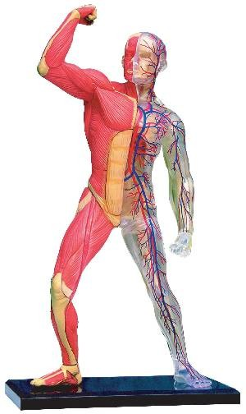
DRUGS Acting OnParacrine Autocrine Mediators
GOOD LUCK

