Slide 1
BLOOD PRACTICAL
RBC, WBC, HB & PCV

Slide 2
Aims of the Practical
Counting Red blood cells
Counting White blood cells
Determination of hemoglobin concentration
Determination of packed cell volume (PCV) hematocriet
Calculation of red blood cell indices

Slide 3
Objectives
At the end of this lesson the student should be able to
Recognize the methods used to measure the different hematological values, and compare it with the normal values.
Do the calculation of indices, their normal values and their importance in diagnosis of different types of anemia.
To be familiar with the procedure of taking both venous and capillary blood.

Slide 4
Material and methods
Coulter analyzer
Diluent reagents
Lytic reagent
Calibrator kit
EDTA anticoagulant blood

Slide 5
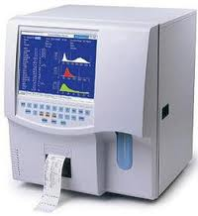
Coulter Counter

Slide 6
RBC, WBC cell count & HB
5ml of venous blood will be drawn in EDTA anticoagulant tube
Diluted by the reagent I and used to count RBC
Lysing RBC using reagent II and used for counting WBC and Hb

Slide 7
Normal Values
 | Male | Female | Average
RBC | 4.5-6.5 x10⁶/μl | 3.8-5.8 x10⁶/μl | 4.7–6.5 x10⁶/μl
WBC | 4 – 11 x10³ /μl | 4 – 11 x10³ /μl | 4 – 11 x10³ /μl
HB | 13-18 g/dl | 11.5-16.5 g/dl | 13 –18 g/dl
Platelet | 150-400x10³ /μl | 150-400x10³ /μl | 150-400x10³ /μl

Slide 8
Clinical application
↓ RBC = aneamia
↑ RBC = polycythemia
↓ WBC = leucopenia
↑ WBC = leucocytosis
↓ Platelets = thrombocytopenia
↑ Platelets = thrombocytosis

Slide 9
The packed cell volume (PCV) hematocrit
The ratio of packed blood cells volume to plasma
Capillary blood obtained from pricking finger tip after cleaning it with alcohol
Fill a non-heparinised capillary tube, then seal one end by plasticine
Centrifuge for 15 minutes to packed the cells at one end of the tube leaving a clear plasma on top
Use the hematocrit reader to find the packed cell volume

Slide 10
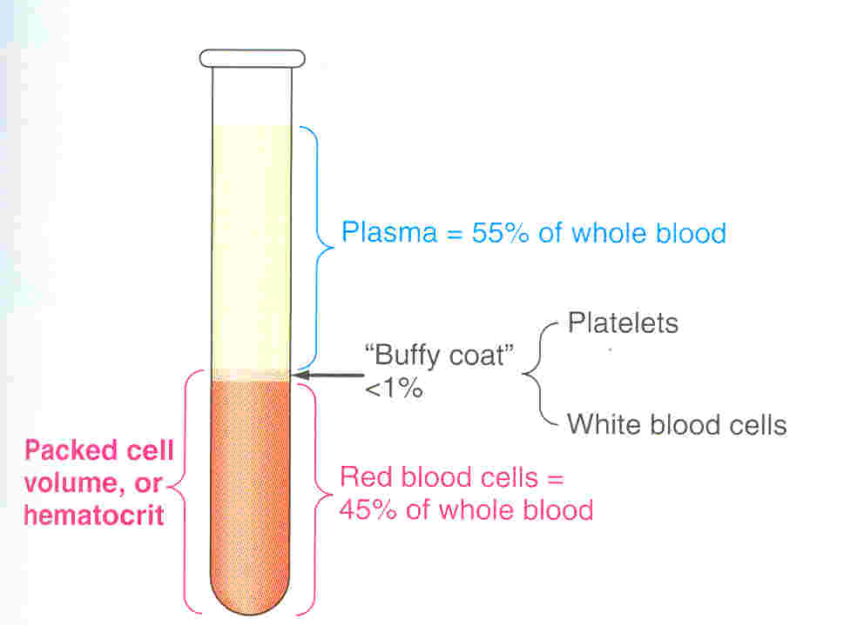
Packed Cell Volume

Slide 11
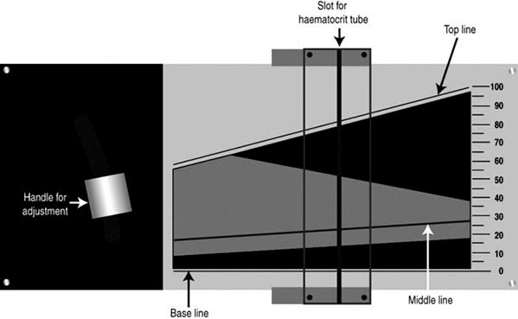
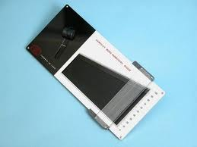
Haematocrit Reader

Slide 12
Packed Cell Volume
 | Male | Female | Average
PCV % | 40-54 | 35-47 | 35-54

Slide 13
Clinical application
↑ PCV:
↑ RBC (polycythemia) ;
↓ plasma volume (hemo-concentration, dehydration)
↓ PCV:
↓ RBC (anemia),
↑ plasma volume (hem-dilution)

Slide 14
The calculation of Red Blood Indices
Mean cell volume (MCV)
The average volume of red blood cell
MCV = PCV x 10 = 85 + 8 Fl
RBC count
Mean cell hemoglobin (MCH)
The average weight of Hb in red cells
MCH = Hb x 10 = 29.5 + 2.5 pg
RBC count.
Mean cell Hb concentration (MCHC)
Concentration of Hb per 100 ml of RBC
MCHC = Hb x 100 = 33 + 3 g/dl
PCV

Slide 15
Normal values
 | Average
MCV | 78-98 Fl
MCH | 27-32 pg
MCHC | 30-35 g/dl

Slide 16
Types of anemia
 | Case A | Case B
RBC | Low | Low
HB | Low | Low
PCV | Low | Low
MCV | Low | high
MCH | Low | N/ high
MCHC | Low | N/low
Type of anemia | Microcytic Hypochromic | Macrocytic megaloblastic
cause | Iron defic | Vit B12 or Folic deficiency

