Slide 1
Differential WBC count

Slide 2
WBC
A white blood cell (WBC) count determines the concentration of white blood cells in the patient's blood.
A differential determines the percentage of each of the five types of mature white blood cells

Slide 3
WBC Differential count
Automatic using Coulter counter
Manual Using Slide and microscope

Slide 4
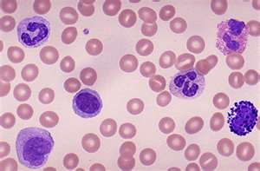
Direct counting

Slide 5
Reagents and apparatus
A microscope with an oil immersion objective
Mineral or cedar wood oil
Various dyes for staining blood films (e.g., Leishman's stain)
Microscope slides

Slide 6
Procedure
Examine the stained blood film under the oil immersion objective and identify the different leucocytes.
Make colour diagrams of these cells.
Count at least 100 leucocytes and record your findings in the table below.
Express your results as the percentage of the total white blood cells identified.

Slide 7
Cells |  | Number of cells | %
Neutrophils |  | 59 | 40-60%
Eosinophils |  | 3 | 1-4%
Basophils |  | 1 | 0.5-1%
Monocytes |  | 5 | 2-8%
Lymphocytes |  | 32 | 20-40%
Total |  | 100 | 100%

Slide 8
Clinical Application
Leucocytosis: High WBC count, in infection, allergy, systemic illness, inflammation, tissue injury.
Differential count provides clues about certain illnesses
Neutrophilia: pyogenic illness
Eosinophilia: Allergy
Lymphocytosis: infectious mononucleosis

Slide 9
OBJECTIVES
At the end of this lesson student should be able:
to identify the different types of leucocytes under the microscope using theoretical knowledge of the histological characteristics of these cells.
To practice the procedure for differential leucocytes counting.
To know the normal values expected for the differential white cell count.
To understand the use of the differential white cell count in the diagnosis of disease processes.

