Slide 1
ANTERIOR & MEDIAL COMPARTMENTS OF THIGH
Dr. Ahmed Fathalla Ibrahim
&
Dr. Zeenat Zaidi

Slide 2
OBJECTIVES
At the end of the lecture, students should be able to:
List the name of muscles of anterior compartment of thigh.
Describe the anatomy of muscles of anterior compartment of thigh regarding: origin, insertion, nerve supply and actions.
List the name of muscles of medial compartment of thigh.
Describe the anatomy of muscles of medial compartment of thigh regarding: origin, insertion, nerve supply and actions.
Describe the location, boundaries and contents of femoral triangle & adductor canal

Slide 3
The thigh is divided into 3 compartments
by 3 intermuscular septa (extending from deep fascia into femur)
Anterior Compartment
Extensors of knee:
Quadriceps femoris
Flexors of hip:
1. Sartorius
2. Pectineus
3. psoas major
4. Iliacus
Nerve supply:
Femoral nerve
Medial Compartment
Adductors of hip:
1. Adductor longus
2. Adductor brevis
3. Adductor magnus
(adductor part)
4. Gracilis
Nerve supply:
Obturator nerve
Posterior Compartment
Flexors of knee & extensors of hip:
Hamstrings
Nerve supply:
Sciatic nerve

Slide 4
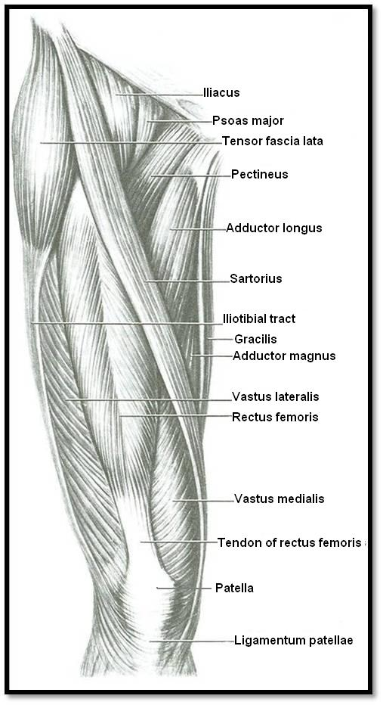
Anterior Compartment of Thigh
Contains the:
Flexor of the hip:
Sartorius
Pectineus
psoas major
Iliacus
Extensors of knee (Quadriceps femoris):
Rectus femoris
Vastus lateralis
Vastus medialis
Vastus intermedius (deep to rectus femoris)
Nerve supply: Femoral nerve
4
3
2
1
2
1
4
Vastus Intermedius
(deep to rectus femoris)
3

Slide 5
Sartorius
ORIGIN
Anterior superior iliac spine
ACTION
(TAILOR’S POSITION)
Flexion, abduction & lateral rotation of hip joint
Flexion of knee joint
S
INSERTION
Upper part of medial surface of tibia

Slide 6
Pectineus
ACTION:
Flexion & adduction of hip joint
ORIGIN:
Superior pubic ramus
INSERTION:
Back of femur (below lesser trochanter)

Slide 7
Iliacus & Psoas major (Iliopsoas)
ORIGIN:
Psoas major: T12 & lumbar vertebrae
Iliacus: Iliac fossa
ACTION:
Flexion of hip joint
INSERTION:
Lesser trochanter of femur
In less than 50 percent of humans the psoas major is accompanied by the psoas minor. It is located in front of the psoas major muscle.

Slide 8
Quadriceps Femoris
ORIGIN:
Rectus femoris: Anterior inferior iliac spine
Vastus intermedius:
Front of shaft of femur
Vastus medialis:
Posterior border of femur
Vastus lateralis:
Posterior border of femur

Slide 9
Quadriceps Femoris
INSERTION:
Into PATELLA
(Patella is a sesamoid bone)
From patella into TUBEROSITY OF TIBIA through Ligamentum Patellae (Patellar Ligament)
ACTION:
Extension of knee joint

Slide 10
Medial Compartment of Thigh
MUSCLES:
Adductor longus
Adductor brevis
Adductor magnus (Adductor portion)
Gracilis
ACTION:
ADDUCTION OF HIP JOINT
N.B.: Gracilis also flexes knee joint
NERVE SUPPLY:
OBTURATOR NERVE
1
2
1
2
4
3
3
4
Adductor magnus
(Adductor portion)
Adductor magnus
(Hamstring portions)

Slide 11
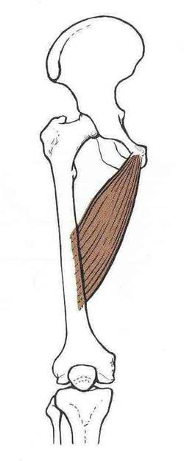
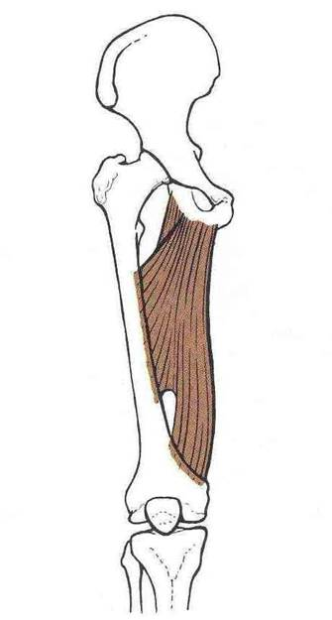
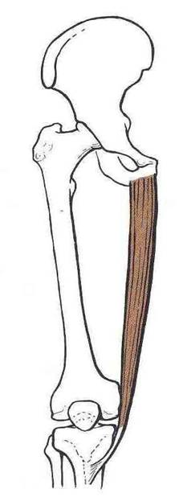
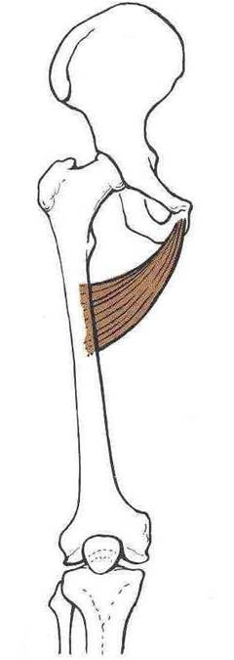
Origin
Inferior pubic ramus
Ischial ramus
Body of pubis
Body of pubis
Inferior pubic ramus
Adductor part
Hamstring hiatus
Adductor hiatus
Adductor magnus
(adductor portion)
Gracilis
Adductor longus
Adductor brevis
Insertion
Upper part of medial
surface of tibia
(behind sartorius)
Posterior border of femur (Linea Aspera)

Slide 12
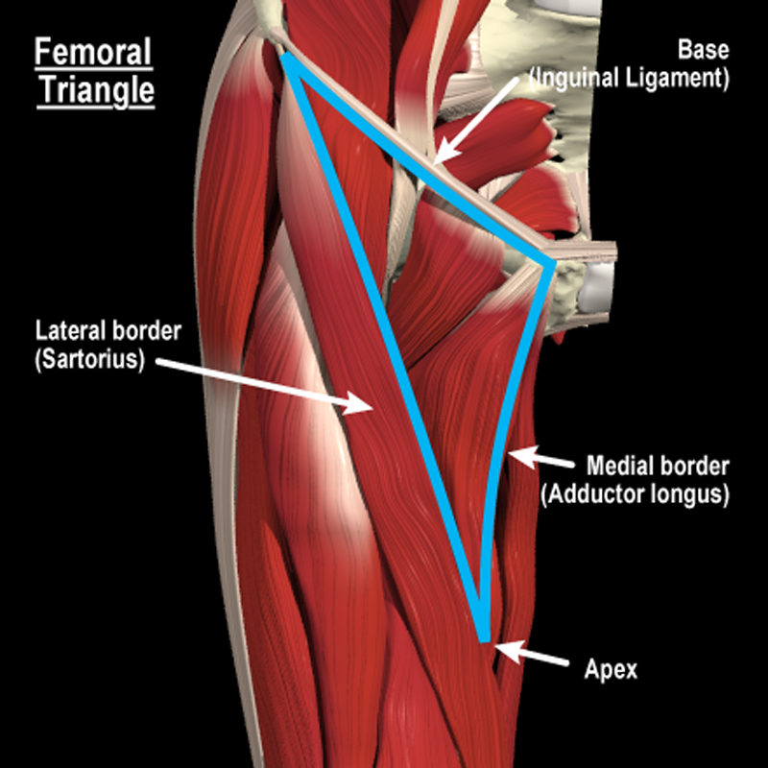
Femoral Triangle: Location & Boundaries
It is a deep hollow in the Upper third of front of thigh inferior to the inguinal ligament
Boundaries
Base: Inguinal ligament
Medial: Medial border of the adductor longus muscle
Lateral: Medial border of the sartorius muscle
Floor: (from media to lateral)
adductor longus
Pectineus
Psoas major
Iliacus
Roof: Skin, superficial & deep fascia.
Iliopsoas
Pectineus

Slide 13
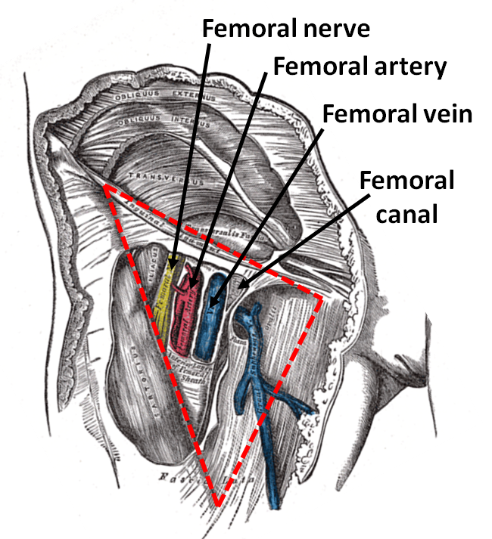
Femoral Triangle: Contents
From lateral to medial:
Femoral nerve & its branches
Femora artery
Femoral vein
Lymphatic vessels and some deep inguinal lymph nodes
The femoral artery, femoral vein and the lymph nodes lies within the fascial envelope, the Femoral sheath, occupying its lateral, intermediate and medial compartments respectively. The medial compartment is called the femoral canal.
Femoral sheath

Slide 14
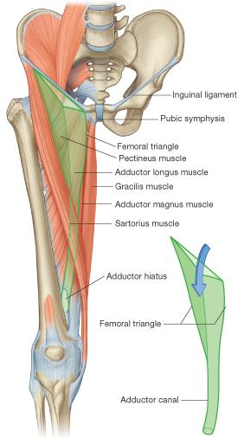
ADDUCTOR CANAL (Subsartorial/Hunter’s canal)
Adductor hiatus
DEFINITION: an aponeurotic tunnel for femoral artery & vein
SITE: In middle third of front of thigh deep to sartorius
EXTENT: From apex of femoral triangle to adductor hiatus
BOUNDARIES:
Roof (Anterior): Sartorius (medially) and vastus medialis (laterally)
Floor (Posterior): Adductor longus & magnus

Slide 15
Thank You

