Slide 1
ANATOMY OF THE SHOULDER REGION
Dr. Ahmed Fathalla Ibrahim
&
Dr. Zeenat Zaidi

Slide 2
OBJECTIVES
At the end of the lecture, students should:
List the name of muscles of the shoulder region.
Describe the anatomy of muscles of shoulder region regarding: attachments of each of them to scapula & humerus, nerve supply and actions on shoulder joint
List the muscles forming the rotator cuff and describe the relation of each of them to the shoulder joint.
Describe the anatomy of shoulder joint regarding: type, articular surfaces, stability, relations & movements.

Slide 3
Bone of shoulder region: The SCAPULA

Slide 4
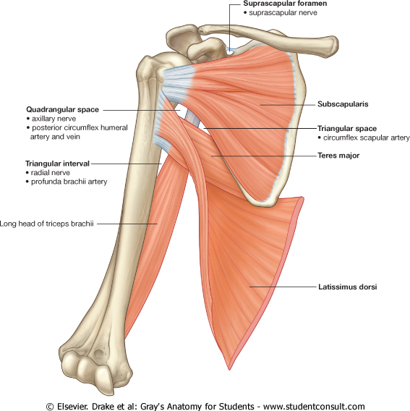
MUSCLES OF SHOULDER REGION
These muscles connect scapula to humerus (move humerus through shoulder joint).
Deltoid.
Supraspinatus.
Infraspinatus.
Teres minor.
Teres major.
Subscapularis.
Posterior view
2
1
3
4
5
Anterior view
6

Slide 5
DELTOID
A triangular muscle, forms the contour of the shoulder.
Origin: lateral 1/3 of clavicle + acromion and spine of scapula (look to insertion of trapezius).
Insertion: deltoid tuberosity of humerus.
Nerve supply: axillary nerve.
Actions:
Anterior fibers: flexion & medial rotation of humerus (arm, shoulder joint).
Middle fibers: abduction of humerus from 15° - 90 °.
Posterior fibers: extension & lateral rotation of humerus.

Slide 6
SUPRASPINATUS & INFRASPINATUS
Origin:
Supraspinatus: supraspinous fossa.
Infraspinatus: infraspinaous fossa.
Insertion: greater tuberosity of humerus.
Nerve supply: suprascapular nerve.
Action:
Supraspinatus: abduction of humerus from 0° - 15°.
Infraspinatus: lateral rotation of humerus.
Supraspinatus
Infraspinatus

Slide 7
TERES MINOR
Origin: lateral border of scapula
Insertion: greater tuberosity of humerus.
Nerve supply: axillary nerve.
Action: lateral rotation of humerus.

Slide 8
TERES MAJOR
Origin: lateral border of scapula
Insertion: bicipital groove of humerus (look to insertion of latissimus dorsi & pectoralis major).
Nerve supply: lower subscapular nerve.
Actions: extension, adduction & medial rotation of humerus (look to action of latissimus dorsi).

Slide 9
SUBSCAPULARIS
Origin: subscapular fossa.
Insertion: lesser tuberosity of humerus.
Nerve supply: upper & lower subscapular nerves.
Action: medial rotation of humerus.

Slide 10
SHOULDER (Glenohumeral) JOINT
TYPE: Synovial, multiaxial, ball & socket
ARTICULAR SURFACES:
Head of humerus
Glenoid cavity (fossa) of scapula
Covered with hyaline cartilage

Slide 11
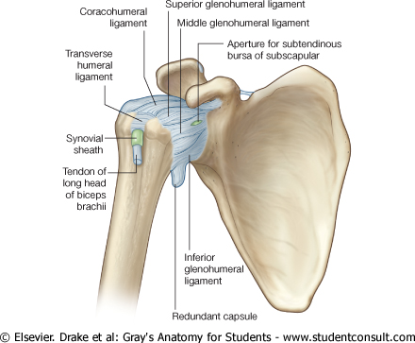
STABILITY
NOT STABLE DUE TO:
Head of humerus is 3 times larger than glenoid cavity
Capsule is redundant.
Little ligamentous support: glenoid labrum, coracohumeral ligament
Wide range of movement (it is the most mobile joint of the human body)
Main support: muscles around the joint (ROTATOR CUFF)

Slide 12
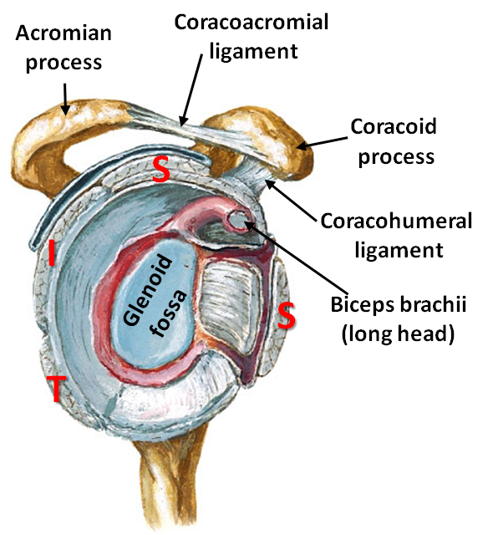
ROTATOR CUFF
A tendinous cuff around the shoulder joint covering its anterior, posterior and superior aspects.
The cuff is deficient inferiorly and this is the site of potential weakness of the joint.
It is formed of 4 muscles: supraspinatus, infraspinatus, teres minor & subscapularis (SITS).
The tone of these muscles helps in stabilizing the shoulder joint.

Slide 13
Rotator cuff can be damaged due to trauma (during playing baseball) or disease (in older individuals).
Trauma can tear or rupture one or more tendon (s) forming the cuff. Patients with rotator injury will present with pain, shoulder instability, and limited range of motion.
Supraspinatus tendon is the most common site of rotator cuff injury.

Slide 14
BURSAE IN RELATION TO SHOULDER JOINT
They reduce friction between tendons, joint capsule & bone.
They are liable to be inflammed following injury of rotator cuff muscles.
Subscapularis bursa: between subscapularis tendon & capsule.
Infraspinatus bursa: between infraspinatus tendon & capsule.
Subacromial bursa: between deltoid, supraspinatus and capsule.
3
2
1

Slide 15
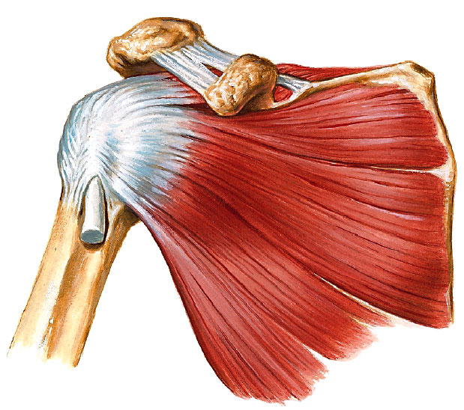
RELATIONS OF SHOULDER JOINT
Supraspinatus
Subscapularis
Infraspinatus
Teres minor
ANTERIOR: subscapularis
POSTERIOR: infraspinatus, teres minor
SUPERIOR: supraspinatus
INFERIOR: axillary nerve
Axillary nerve

Slide 16
MOVEMENTS OF SHOULDER JOINT
FLEXION:
Anterior fibers of deltoid
Pectoralis major
Coracobrachialis (muscle of arm)
Short head of biceps brachii (muscle of arm)
EXTENSION:
Posterior fibers of deltoid
Latissimus dorsi
Teres major

Slide 17
MOVEMENTS OF SHOULDER JOINT cont’d
ABDUCTION:
From 0° - 15°: Supraspinatus
From 15° - 90 °: Middle fibers of deltoid
ADDUCTION:
Pectoralis major
Latissimus dorsi Inserted in bicipital groove
Teres major

Slide 18
MOVEMENTS OF SHOULDER JOINT cont’d
MEDIAL ROTATION:
Pectoralis major
Latissimus dorsi Inserted in bicipital groove
Teres major
Anterior fibers of deltoid
Subscapularis
LATERAL ROTATION:
Posterior fibers of deltoid
Infraspinatus
Teres minor

Slide 19
SUMMARY
MUSCLES OF SHOULDER REGION:
Origin: scapula.
Insertion: humerus.
Action: move humerus (SHOULDER JOINT)
Nerve supply: anterior rami of spinal nerves through brachial plexus.
ROTATOR CUFF: 4 muscles in scapular region surrounds and helps in stabilization of shoulder joint (supraspinatus, infraspinatus, teres minor, subscapularis).

Slide 20
SUMMARY
Shoulder joint:
Type: synovial, ball & socket
Articular surfaces: head of humerus & glenoid cavity of scapula
Stability: depends on rotator cuff
Relations: rotator cuff and axillary nerve
Movement: flexion, extension, abduction, adduction, medial & lateral rotation

Slide 21
QUESTION 1
Which one of the following muscles is inserted into the lesser tuberosity of the humerus?
Subscapularis
Deltoid
Teres major
Infraspinatus

Slide 22
QUESTION 2
Which one of the following muscles belong to the rotator cuff?
Subscapularis.
Deltoid.
Teres major.
Rhomboid minor.

Slide 23
QUESTION 3
Regarding the shoulder joint, which one of the following statement is correct?
It is a stable joint.
It is a synovial joint of hinge variety.
Deltoid muscle adducts shoulder joint.
Downward dislocation of shoulder joint may cause injury to axillary nerve.

Slide 24
THANK YOU

