Slide 1
MUSCULOSKELETAL BLOCK Pathology OSTEOMYELITIS and SEPTIC ARTHRITIS
Dr. Maha Arafah
2012

Slide 2
Objectives
1. Pyogenic osteomyelitis
1. List routes by which bacteria reach bone
2. List organisms commonly responsible for pyogenic infection in bone
3. Understand how location of osteomyelitis is influenced by vascular supply to the bone.
4. Know morphology of acute and chronic lesions
5. Define the terms involucrum and sequestrum
2. Tuberculous osteomyelitis (Pott disease)
Describe the following aspects of tuberculous osteomyelitis:
1. Incidence
2. Bones affected
3. Clinical consequences
3. Pyogenic suppurative arthritis
Describe the following aspects of pyogenic suppurative arthritis:
1. Pathogenesis
2. Bacteria commonly involved
3. Characteristics of joint fluid

Slide 3
OM)) OSTEOMYELITIS
Definition
When?
Which organisms?
Which is most common?
Denotes inflammation of bones and bone marrow
May be a complication of any systemic infection but frequently manifests as a primary solitary focus of disease.
All types of organisms, including viruses, parasites, fungi and bacteria can produce osteomyelitis.
The most common are infections caused by certain pyogenic bacteria and mycobacteria

Slide 4
PYOGENIC OSTEOMYELITIS
Cause
is almost always caused by bacteria.
Staphylococcus aureus is responsible for 80% to 90% the cases of pyogenic osteomyelitis in which an organism is recovered. Why?
Staph. aureus expresses receptors to bone matrix components, may be related to the fact that facilitating its adherence to bone tissue.
What is the most common bacteria?

Slide 5
PYOGENIC OSTEOMYELITIS
:Bacteria which are common in certain conditions
Neonates: Escherichia coli and group B streptococci.
Persons with sickle cell disease: Salmonella

Slide 6
PYOGENIC OSTEOMYELITIS
:Bacteria which are common in certain conditions
Patients with genitourinary tract infections or with intravenous drug abusers: E.coli, Klebsiella and Pseudomonas
Direct spread during surgery or open fractures (secondary to bone trauma): Mixed bacterial infections, including anaerobes

Slide 7
PYOGENIC OSTEOMYELITIS
Are bacteria isolated in all cases of pyogenic OM?
In 50% of the cases no organisms can be isolated.

Slide 8
PYOGENIC OSTEOMYELITIS
Routes of infection
Hematogenous spread, most common.
Extension from a contiguous site.
Direct implantation.

Slide 9
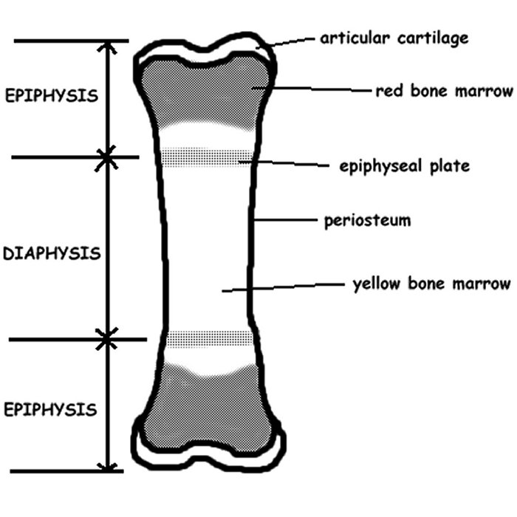
PYOGENIC OSTEOMYELITIS:
Sites of involvement:
The long bones of the extremities are most commonly involved
The most common sites are the distal femur and proximal tibia
Metaphysis
metaphysis
metaphysis

Slide 10
PYOGENIC OSTEOMYELITIS
Sites of involvement:
Influenced by the vascular circulation, which varies with age.
Neonates: the metaphyseal vessels penetrate the growth plate, resulting in frequent infection of the metaphysis, epiphysis or both.
Children: metaphyseal.
Adults: epiphyses and subchondral regions.

Slide 11
PYOGENIC OSTEOMYELITIS
Risk factors
It occurs most frequently in children and young adults.
Diabetes mellitus (especially involving the foot)
Compromised immunity (including AIDS)
Sickle-cell disease

Slide 12
PYOGENIC OSTEOMYELITIS
Stages :
Acute
Sub acute
Chronic.

Slide 13
PYOGENIC OSTEOMYELITIS Pathophysiology
Necrosis of the bone within first 48hrs.
Spread of bacteria and inflammation within the shaft of the bone and may percolate through the haversian systems to reach the periosteum.
In children, the periosteum is loosely attached to the cortex; therefore sizable subperiosteal abscess formation occurs.
Further ischemia and bone necrosis occurs.

Slide 14
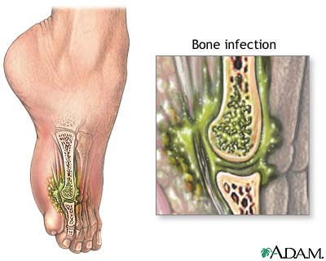
PYOGENIC OSTEOMYELITIS

Slide 15
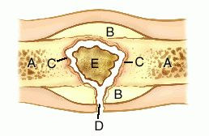
SEQUENCE OF INFECTION:
Once localized in bone, the bacteria proliferate and induce an acute inflammatory reaction and cause cell death.
Dead pieces of bone is known as the sequestrum.
sequestrum

Slide 16
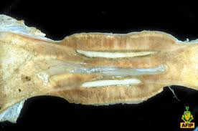
After the first week chronic inflammatory cells become more numerous with the release of cytokines and deposition of new bone formation at the periphery.
New bone may be deposited as a sleeve of living tissue known as the Involucrum
Involucrum

Slide 17
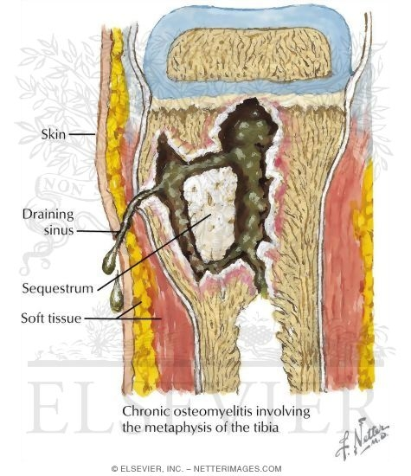
Brodie abscess:
is a small intraosseus abscess that frequently involves the cortex and is walled off reactive bone.
In infants epiphyseal infection may spread to the adjacent joint and causes septic or suppurative arthritis; may lead
to permanent disability.
Rupture of the periosteum→soft tissue abscess formation→draining sinuses.

Slide 18
Pathophysiology of Pyogenic osteomyelitis
The primary site of infection is usually in the metaphysial region
The infection may spread to involve the cortex and form a subperiosteal abscess; may spread into the medullary cavity
Rarely, may spread into the adjacent joint space.
sequestrum

Slide 19
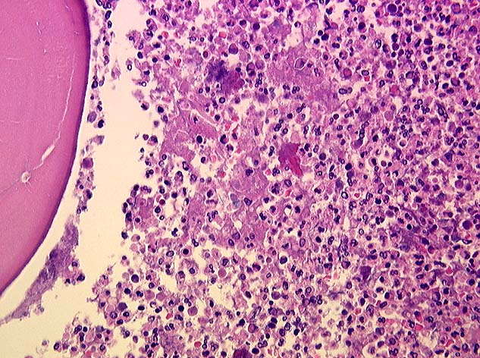
PYOGENIC OSTEOMYELITIS

Slide 20
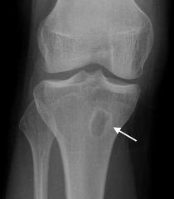
PYOGENIC OSTEOMYELITIS
Clinical Course:
Fever ,chills, malaise, marked to intense throbbing pain over the affected region.
Diagnosis;
Sign/symptoms.
X-ray: a destructive lytic focus surrounded by edema and a sclerotic rim
Blood cultures: +ve in 70%
Biopsy

Slide 21
PYOGENIC OSTEOMYELITIS
Rx :
Pain relief
Parenteral antibiotics for at least 2 weeks, followed by oral antibiotics for at least 4 weeks
Surgical decompression and removal of any dead bone
Rehabilitation.

Slide 22
PYOGENIC OSTEOMYELITIS
Chronicity may develop with:
delay in diagnosis
extensive bone necrosis
abbreviated antibiotic therapy
inadequate surgical debridement
weakened host defenses

Slide 23
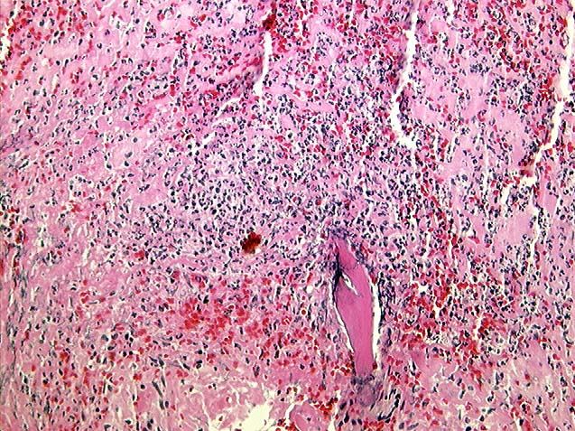
CHRONIC OSTEOMYELITIS

Slide 24
PYOGENIC OSTEOMYELITIS
Complications:
Pathologic fracture.
Secondary amyloidosis
Endocarditis
Sepsis
Squamous cell carcinoma if the infection creates a sinus tract.
Rarely sarcoma in the affected bone

Slide 26
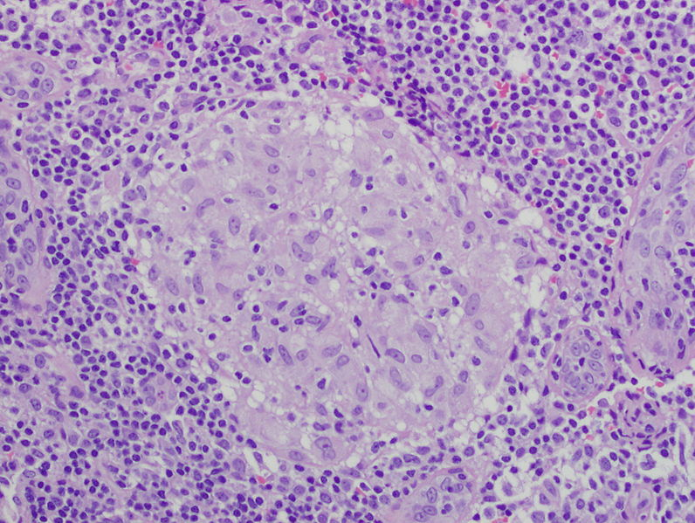
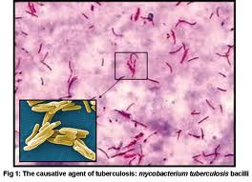
Tuberculous osteomyelitis
Mycobacterium. tuberculosis is an aerobe Gram-positive mycobacterium
Acid-fast stain

Slide 27
Tuberculous osteomyelitis
Mycobacterial infection of bone is a problem in developing countries
Routes of entry;
Usually blood borne and originate from a focus of active visceral disease.
Direct extension (e.g. from a pulmonary focus into a rib or from tracheobronchial nodes into adjacent vertebrae) or spread via draining lymphatics.
Bone infection complicates an estimated 1% to 3% of cases of pulmonary tuberculosis

Slide 28
Tuberculous osteomyelitis

Slide 29
Tuberculous osteomyelitis
The most common sites of skeletal involvement are:
thoracic and lumber vertebrae followed by the knees and hips
In patients with AIDS frequently multifocal.
Pott’s disease is the involvement of spine.

Slide 30
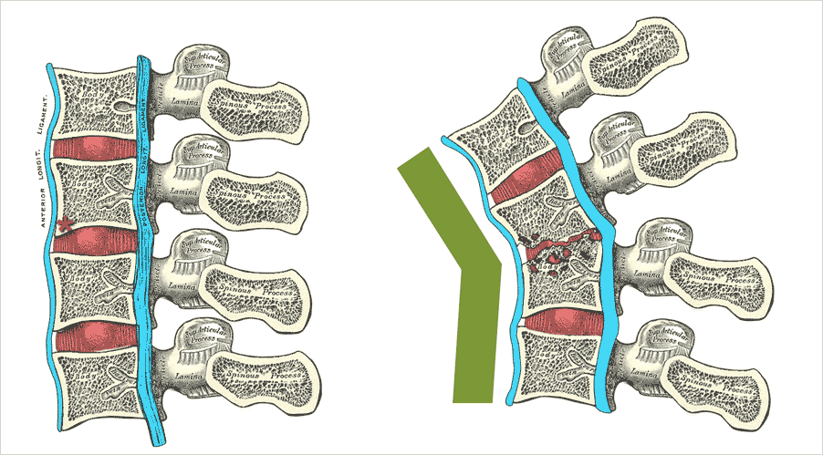
Pott’s disease
TB of spine
The infection breaks through the intervertebral discs and extends into the soft tissues forming abscesses.

Slide 31
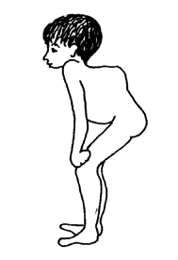
Tuberculous osteomyelitis Pott’s disease

Slide 32
Pott’s disease

Slide 33
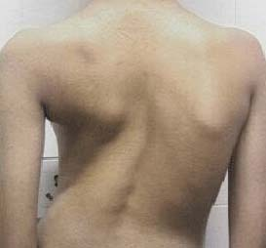
Pott’s disease

Slide 34
Tuberculous osteomyelitis
Clinical features :
Pain
Fever, low grade, cold abscess
weight loss
May form an inguinal mass “ psoas abscess”.

Slide 35
Tuberculous osteomyelitis

Slide 36
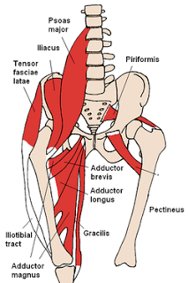
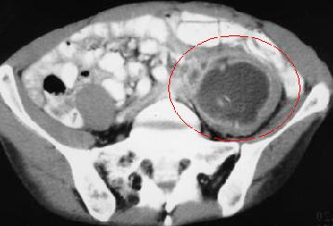
The infection breaks through the intervertebral discs and extends into the muscle forming Psoas abscesses.

Slide 37
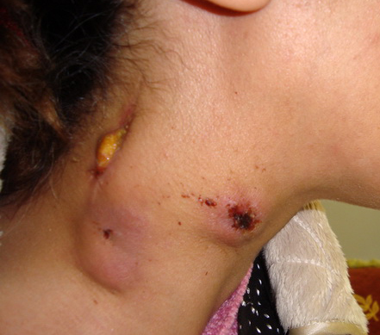
Tuberculous osteomyelitis
Complications:
Bone destruction.
Tuberculous arthritis.
Sinus tract formation
Amyloidosis

Slide 39
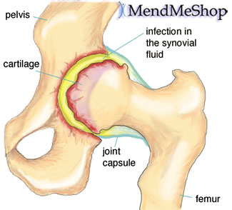
Infectious Arthritis (Suppurative Arthritis)
Infectious arthritis is serious because it can cause rapid joint destruction and permanent deformities.
Infectious Arthritis

Slide 40
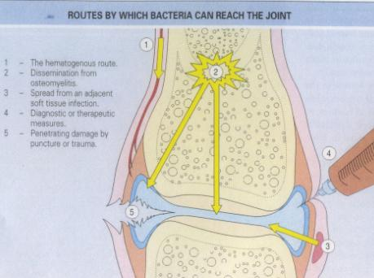
Routes of infection:
hematogenous
direct inoculation
contiguous spread from osteomyelitis or a soft tissue abscess
Iatrogenic
Traumatic

Slide 41
Risk factors
Any concurrent bacterial infection (of the genitourinary or the upper respiratory tract)
Serious chronic illness (cancer, renal failure, diabetes, or cirrhosis)
Alcoholics and elderly people
Diseases that depress the autoimmune system
I.V. drug abuse
Other predisposing factors include recent articular trauma, joint surgery and intra-articular injections.

Slide 42
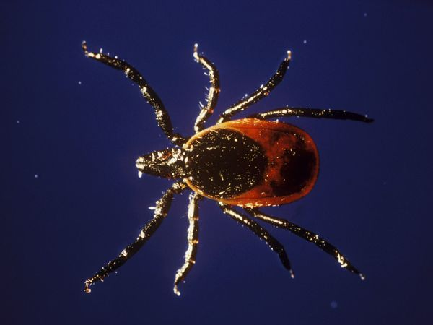
Infectious Arthritis
Any bacteria can be causal:
Haemophilus influenzae predominates in children under age 2 years
S. aureus is the main causative agent in older children and adults
gonococcus is prevalent during late adolescence and young adulthood.
Individuals with sickle cell disease are prone to infection with Salmonella at any age.
cross-reactive immune responses to systemic infections (e.g. Lyme arthritis caused by spirochete Borrelia burgdorferi) can lead to joint inflammation and injury.
Both genders are affected equally

Slide 43
Infectious Arthritis
Sites of involvement
The infection involves only a single joint
usually the knee-followed in order by hip, shoulder, elbow, wrist, and sternoclavicular joints.
Joint aspiration is typically purulent
Culture allows identification of the causal agent.

Slide 44
Infectious Arthritis
Clinical features:
Sudden onset of pain
Redness, and swelling of the joint with restricted range of motion.
Fever, leukocytosis, and elevated erythrocyte sedimentation rate

Slide 45
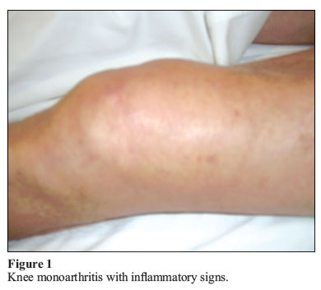
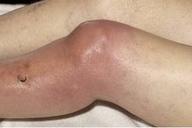
Infectious arthritis must be rapidly diagnosed and treated promptly to prevent irreversible and permanent joint damage.

Slide 46
Complication
Septic arthritis can lead to ankylosis and even fatal septicemia.
However, prompt antibiotic therapy and joint aspiration or drainage cures most patients.

