Slide 1
MUSCULOSKELETAL BLOCK
Pathology
Lecture 2:
Congenital and developmental bone diseases
Dr. Maha Arafah
Dr. Abdulmalik Alsheikh, MD, FRCPC

Slide 2
Diseases of Bones
Objectives
  Be aware of some important congenital and developmental bone diseases and their principal pathological features
  Understand the etiology, pathogenesis and clinical features of osteoporosis

Slide 3
Diseases of Bones
Congenital
Acquired
  Metabolic
  Infections
  Traumatic
  Tumors

Slide 4
Congenital Diseases of Bones
Localized or entire skeleton
Dysostoses
Dysplasias
  Osteogenesis imperfecta
  Achondroplasia
  Osteopetrosis
Developmental anomalies resulting from localized problems in the migration of mesenchymal cells and the formation of condensations

Slide 5
Dysostoses
The more common lesions include:
  aplasia (e.g., congenital absence of a digit or rib)
  the formation of extra bones (e.g., supernumerary digits or ribs)
  abnormal fusion of bones (e.g., premature closure of the cranial sutures or congenital fusion of the ribs).
  Such malformations may occur as isolated, sporadic lesions or as components of a more complex syndrome.

Slide 6
Dysplasias
Mutations that interfere with bone or cartilage formation, growth, and/or maintenance of normal matrix components
This include:
  Osteogenesis imperfecta
  Achondroplasia
  Osteopetrosis

Slide 7
Congenital Diseases of Bones
Osteogenesis imperfecta
  Osteogenesis imperfecta is a group of inherited diseases characterized by brittle bones
  Defect in the synthesis of type I collagen
  Extreme fragility of skeleton with susceptibility to fractures
  Four main types with different clinical manifestations classified according to the severity of bone fragility, the presence or absence of blue scleras, hearing loss, abnormal dentition, and the mode of inheritance.
    Type 1: blue sclera in both eye, deformed teeth and hearing loss

Slide 8
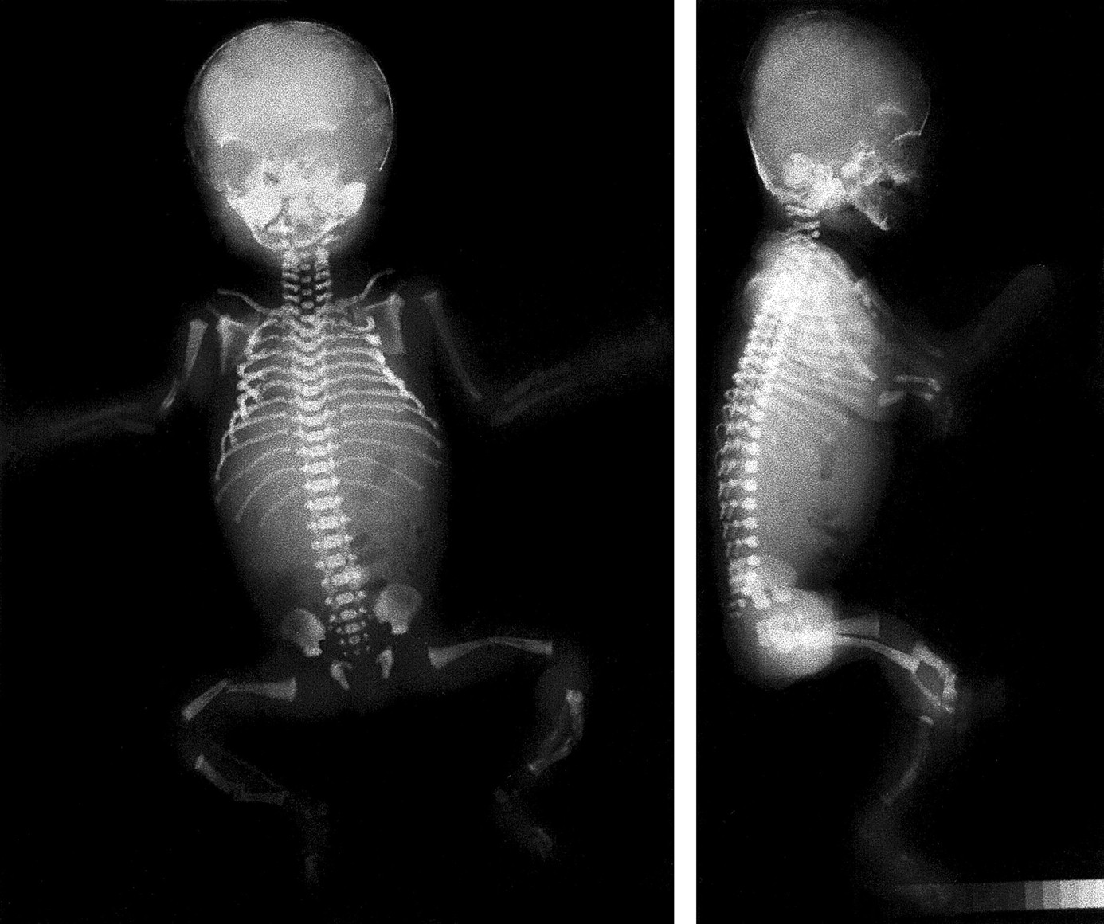
Osteogenesis imperfecta

Slide 9
Congenital Diseases of Bones
Achondroplasia
Is transmitted as an autosomal dominant trait resulting from:
  Defect in the cartilage synthesis at growth plates due to mutation in Fibroblast growth factor receptor 3 (FGFR3) lead to inhibition of chondrocytes proliferation
It is characterized by failure of cartilage cell proliferation at the epiphysial plates of the long bones, resulting in failure of longitudinal bone growth and subsequent short limbs.
Membranous ossification is not affected, so that the skull, facial bones, and axial skeleton develop normally.

Slide 10
Congenital Diseases of Bones
Achondroplasia
Achondroplasia
  Dwarfism
  General health is not affected, and life expectancy is normal.

Slide 11
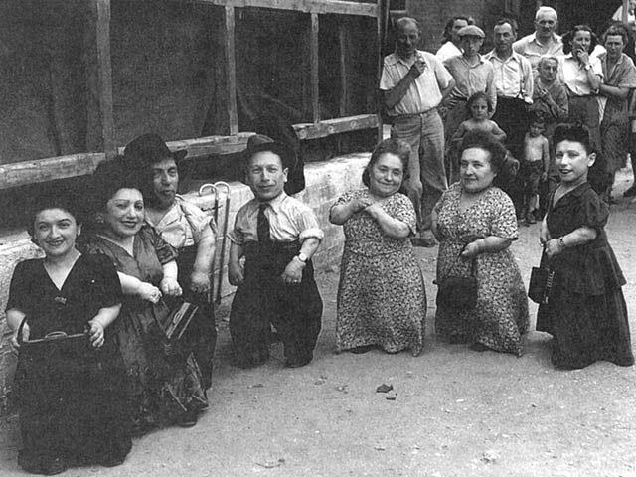
Achondroplasia
Autosomal Dominant

Slide 12
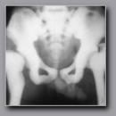
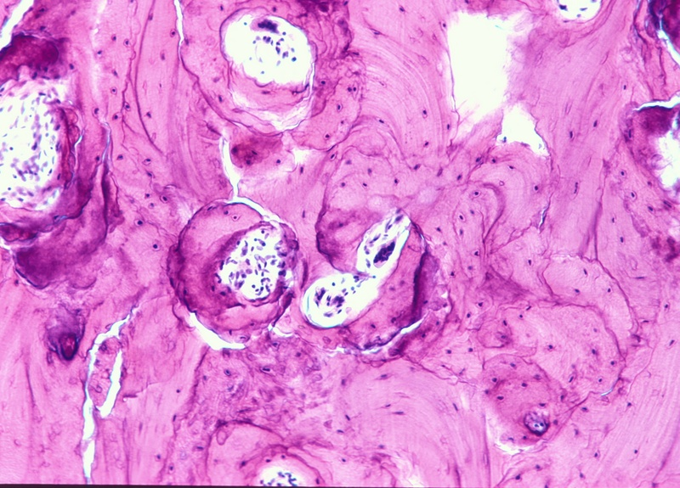
Congenital Diseases of Bones Osteopetrosis
Rare diseases
failure of normal bone resorption by osteoclasts results in uniformly thickened, dense bones
due to abnormal function of osteoclasts (deficiency of carbonic anhydrase leads to an abnormal environment around the osteoclast, resulting in defective bone resorption)
Sclerotic Bone
increased tendency to fractures and osteomyelitis
anemia and extramedullary hematopoiesis

Slide 13
METABOLIC BONE DISESES

Slide 14
Metabolic bone disease
comprises four fairly common conditions in which there is an imbalance between osteoblastic (bone forming) and osteoclastic (bone destroying) activity.
osteoporosis
osteomalacia
Paget's disease of bone
hyperparathyroidism

Slide 15
OSTEOPOROSIS
There is a slowly progressive increase in bone erosion
The cortical bone is thinned, and the bone trabeculae are thinned and reduced in number
→ increased porosity of the skeleton leading to reduction in the bone mass but without distortion of architecture.
It may be localized →disuse osteoporosis of a limb.
or
may involve the entire skeleton, as a metabolic bone disease.

Slide 16
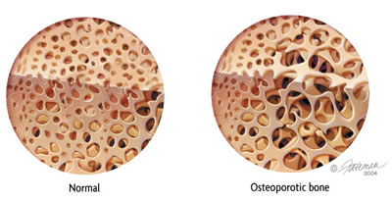

Slide 17
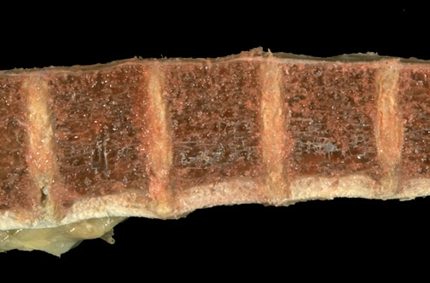
OSTEOPOROSIS

Slide 18
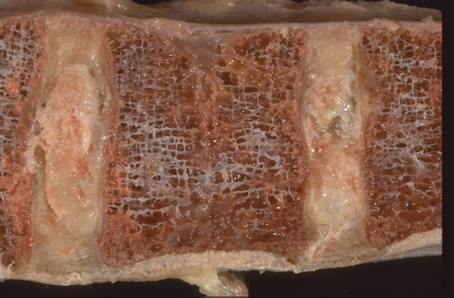

Slide 19
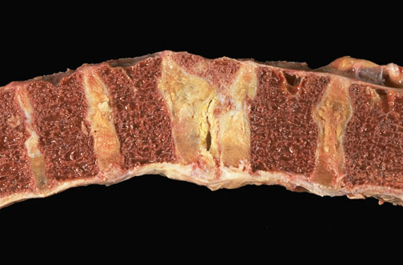
Vertebral bone with osteoporosis and a compression fracture

Slide 20
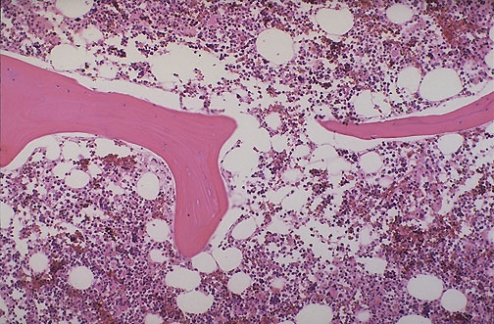
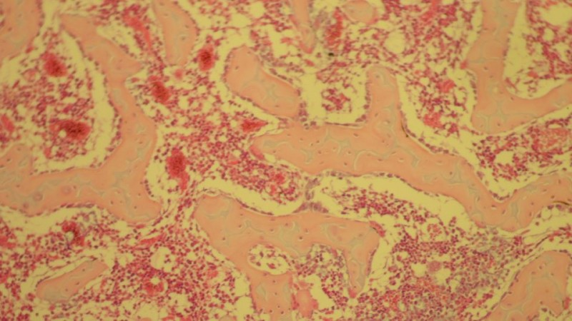
OSTEOPOROSIS
Notes:
Normal vertebral bone and marrow is demonstrated at low power microscopically. Note the size and number of bone spicules.

Slide 21
OSTEOPOROSIS
Primary
Secondary
PRIMARY: Post menopausal probably a consequence of declining levels of estrogen
Senile
Environmental factors may play a role in osteoporosis in the elderly: decreased physical activity and nutritional protein or vitamin deficiency (1,25-dihydroxycholecalciferol)

Slide 22
OSTEOPOROSIS
such as Cushing's syndrome, hyperthyroidism, and acromegaly.
Secondary:
  Endocrine Disorders
  Gastrointestinal disorders
  Neoplasia
  Drugs
Malnutrition
Malabsorption
Hepatic insufficiency
Vitamin C, D deficiencies
Multiple myeloma
Carcinomatosis
Pituitary tumors
Drugs:
Anticoagulants
Chemotherapy
Corticosteroids
Anticonvulsants
Alcohol

Slide 23
OSTEOPOROSIS
Pathophysiology:
Occur when the balance between bone formation and resorption tilts in favor of resorption

Slide 24
OSTEOPOROSIS
Pathophysiology:
  Genetic factors
  Nutritional effects
  Physical activity
  Aging
  Menopause

Slide 27
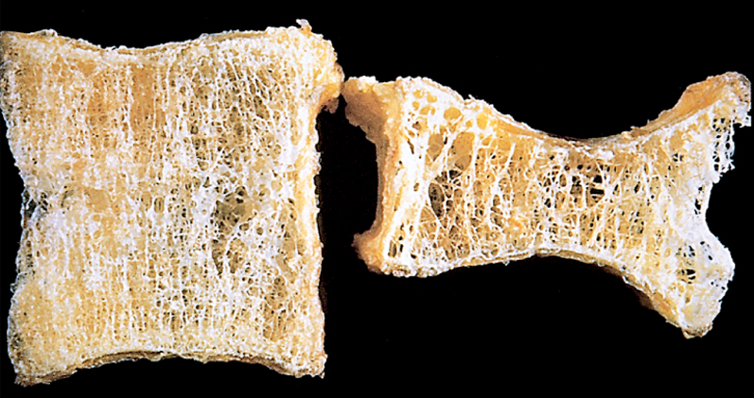

Slide 28
OSTEOPOROSIS
Clinical features
  Difficult to diagnose
  Remain asymptomatic ----fracture
  Fractures
    Vertebrae
    Femoral neck
  Patients with osteoporosis have normal serum levels of calcium, phosphate, and alkaline phosphatase

Slide 29
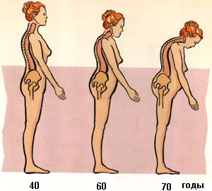

Slide 30
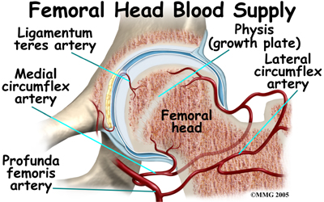
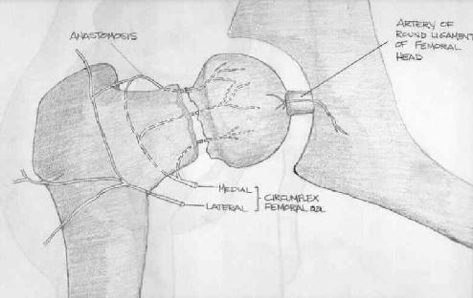
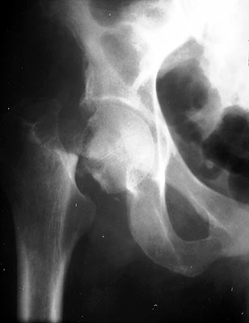
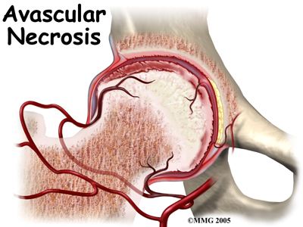
Complication of fracture

Slide 31
  Diagnosis
  Bone density by radiographic measures
Plain X ray: cannot detect osteoporosis until 30% to 40% of bone mass has already disappeared.
Dual-emission X-ray absorptiometry (DXA scan): is used primarily to evaluate bone mineral density, to diagnose and follow up pt. with osteoporosis.

Slide 32
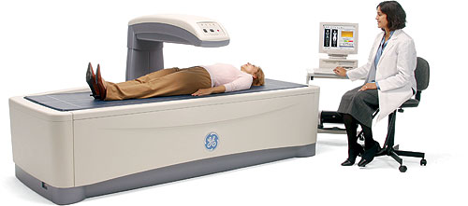
DXA scan

Slide 33
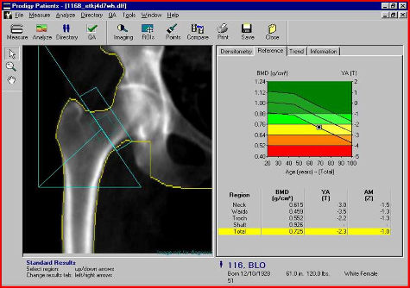

Slide 35
Prognosis
Osteoporosis is rarely lethal.
Patients have an increased mortality rate due to the complications of fracture.
E.g. hip fractures can lead to decreased mobility and an additional risk of numerous complications: deep vein thrombosis, pulmonary embolism and pneumonia

Slide 36
OSTEOPOROSIS
Prevention Strategies
The best long-term approach to osteoporosis is prevention.
children and young adults, particularly women, with a good diet (with enough calcium and vitamin D) and get plenty of exercise, will build up and maintain bone mass.
This will provide a good reserve against bone loss later in life. Exercise places stress on bones that builds up bone mass

Slide 37
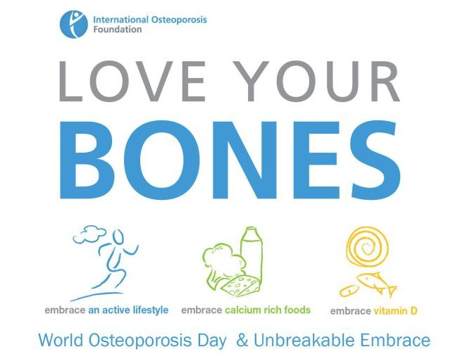

Slide 38
Metabolic bone disease
In osteomalacia, osteoblastic production of bone collagen is normal but mineralization is inadequate.
In Paget's disease of bone there is excessive uncontrolled destruction of bone by abnormally large and active osteoclasts, with concurrent inadequate attempts at haphazard new bone formation by osteoblasts, producing physically weak woven bone.
In hyperparathyroidism, excessive secretion of PTH produces increased osteoclastic activity. There is excessive destruction of cortical and trabecular bone, with inadequate compensatory osteoblastic activity.

Slide 39
Metabolic bone disease

Slide 40
