Slide 1
WRIST & HAND
Dr. Saeed Vohra
Dr. Jamila El-Medany

Slide 2
OBJECTIVES
At the end of the lecture, students should be able to:
Describe the anatomy of the deep fascia of the wrist & hand (flexor & extensor retinaculae & palmar aponeurosis).
List the structures passing superficial & deep to flexor retinaculum.
Describe the anatomy of the insertion of long flexor & extensor tendons.
Describe the anatomy of the small muscles of the hand (origin, insertion action & nerve supply)

Slide 3
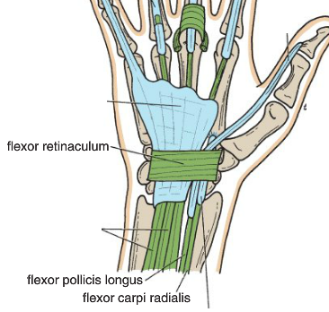
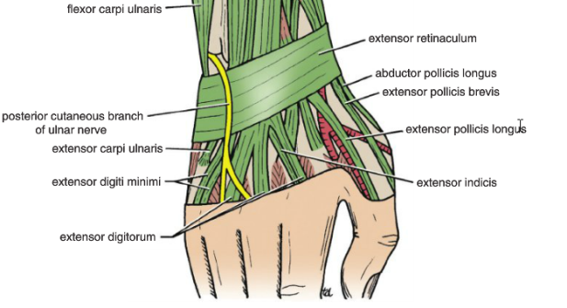
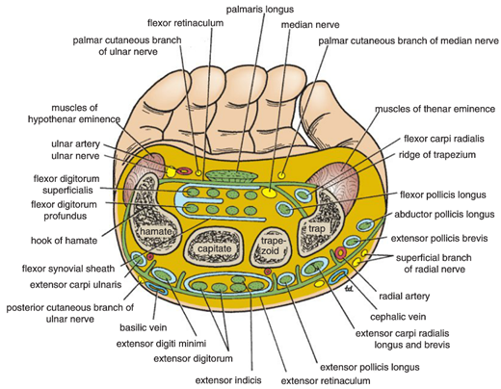
The Wrist
Flexor & Extensor Retinaculae
Bands of Deep Fascia
Function:
Hold the long flexor and extensor tendons in position at the wrist.
Attachments:
Medially
both attached to Pisiform & Hook of Hamate.
Laterally:
Flexor Retinaculum to Scaphoid & Trapezium.
Extensor Retinaculum to Distal end of Radius

Slide 4
The Wrist
Structures pass superficial to the flexor retinaculum
Flexor carpi ulnaris
Ulnar nerve
Ulnar artery
Palmar cutaneous branch of ulnar nerve
Palmaris longus
Palmar cutaneous branch of median nerve
Structures pass deep to the flexor retinaculum
FDS & FDP
Median nerve
FPL
Flexor carpi radialis
Medial to Lateral

Slide 5
The Wrist
Structures pass supercial to the extensor retinaculum
Dorsal cutaneous branch of the ulnar nerve
Basilic vein
Cephalic vein
Supercial branch of the radial nerve
The following structures pass beneath the extensor retinaculum
Extensor carpi ulnaris
Extensor digiti minimi
Extensor digitorum and extensor indicis
Medial to Lateral

Slide 6
Carpal Tunnel
Definition
Is fibro-osseous tunnel formed by the concave anterior surface of the carpal bones & close by the flexor retinaculum
Contents
(Structures Beneath Flexor Retinaculum
Flexure digitorum superficialis & profundus
Median nerve
Flexor carpi radialis

Slide 7
Capal tunnel Syndrome
Definition:
Compression of the median nerve with in the carpal tunnel called carpal tunnel syndrome
Causes:
The exact cause of the compression is unknown but the thickening of the synovial sheaths of the flexor tendons or arthritic changes in carpal are responsible in many cases
Manifestations:
Burning pain “pins & needles” in the lateral 3 1/2 fingers.
Weakness or atrophy of the thenar muscles Ape Hand.
Inability to oppose the thumb.
No parethesia over the thenar eminence?
The condition is relieved by decompressing the tunnel by making a longitudinal incision through flexor retinaculum

Slide 8
Hand
Palmar Aponeurosis
Thickened deep fascia of the hand
Triangular in shape
Occupies the central area of the palm
The apex is attached to the distal border of flexor retinaculum and receives the insertion of palmaris longus tendon.
Base divides at the bases of the fingers into four slips that pass into the fingers
Functions:
Gives firm attachment to the overlying skin and improves the grip.
Protects the underlying tendons, vessels & nerves.

Slide 9
Palmaris Brevis
ORIGIN | INSERTION | NS | ACTION
Flexor retinaculum & Palmar aponeurosis | Skin of Palm | Ulnar (Sup. Branch) | Corrugation of skin to improve grip of palm

Slide 10
Short Muscles of Thumb & Little Finger

Slide 11
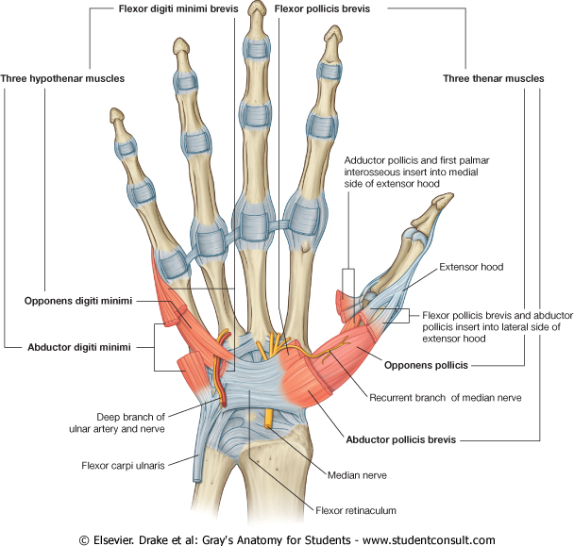
Hypothenar Eminence
Act | NS | Ins | Orig | Name
AB | Ulnar | Base of prox phalanx | Pisiform | Abductor Diditi minimi
FLX |  | Base of prox phalanx | Fr | Flexor (Dig mini)
Pulls the 5th metac forward (Cupping the palm) |  | Medial Border of 5th Merta carpal | Fr | Opponens (Dig mini)

Slide 12
Thenar Eminence
ACT | NS | INS | ORIG | Name
AB | Median | Base of proximal phalanx of thumb | FR, Scaphoid, & Trapezium | Abductor pollicis brevis
FLX |  | Base of proximal phalanx of thumb | FR | Flexor Pollicis brevis
opposition |  | Shaft of the metacarpal of thumb | FR | Opponens pollicis

Slide 13
Adductor Pollicis Brevis
NS | ACT | INSER | Name
Ulnar | Adduction of thumb | base of proximal phalanx of thumb | Oblique head 2nd & 3rd metacarpal Transverse head 3rd metacarpal

Slide 14
Insertion of Flexor Dig Superficialis
Each tendon
Divides into two halves pass around the profundus tendon
The two halves meet on the posterior aspect of Profundus tendon
Reunion of the two halves
Further division into two slips attached to the borders of middle phalanx

Slide 15
Insertion of Flexor Dig Profundus
Each tendon
Inserted into the Base of the Distal Phalanx.

Slide 16
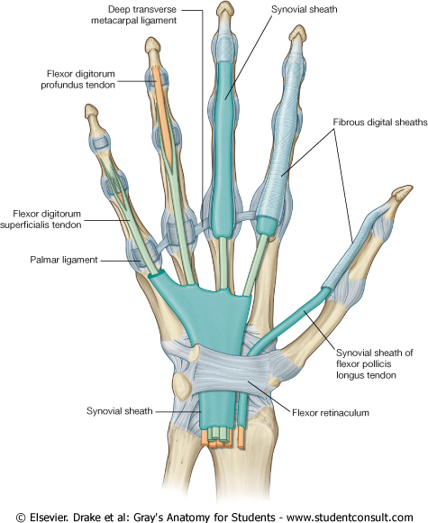
Fibrous Flexor Sheath
A Strong Fibrous Sheath which covers the anterior surface of the fingers and attached to the sides of the phalanges.
Its proximal end is opened, Its distal end is closed
The sheath with the anterior surfaces of the phalanges & the interphalangeal joints form an Osteofibrous blind Tunnel, for the long flexor tendons of the fingers

Slide 17
Synovial Flexor Sheaths
Common Synovial sheath
(Ulnar Bursa)
Invigilates all tendons of flexor digitorum superficialis & profundus
The Medial part of the sheath extends distally (without interruption) on the tendons of the little finger.
The Lateral part of the sheath stops on the middle of the palm.
The distal ends of the long flexor tendons to(Index, Middle & Ring) fingers acquire digital synovial sheaths.
The synovial sheath
(Radial Bursa)
of flexor pollicis longus tendon has its
own synovial sheath
Ulnar Bursa

Slide 18
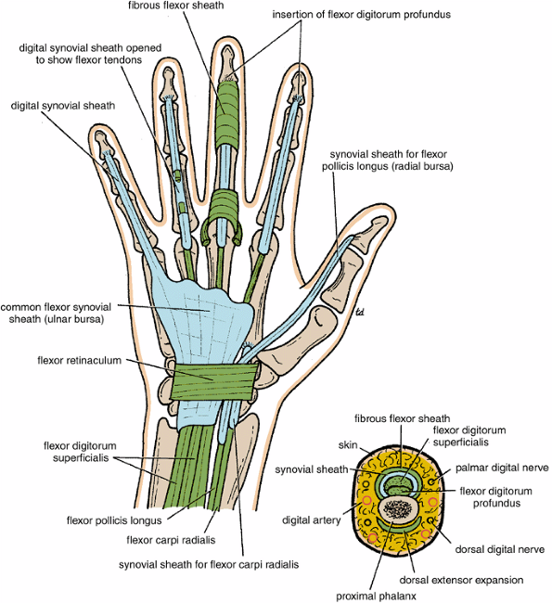
Function of synovial sheaths
They protect & lubricate the flexor & extensor tendons.

Slide 19
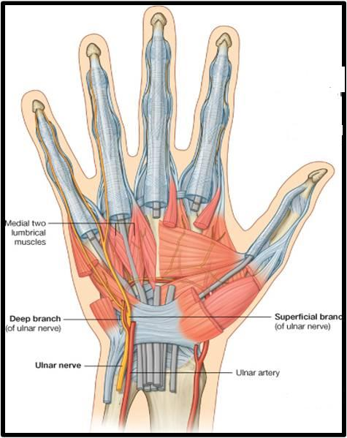
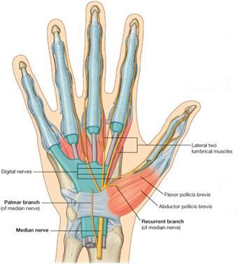
Lumbrical Muscles (4)
ORIGIN | INSERTION | NS
Tendons of Flex.dig. profundus | EXT. EXP | 1ST & 2ND (MEDIAN N). 3RD & 4TH ULNAR N (Deep branch)
Action
Flex the metacarpophalangeal joints & extend interphalangeal joints except thumb

Slide 20
Action of Lumbricals & Interossei

Slide 21
Palmar Interossei (4)
ORIG | INSERTION | NS | ACT
1stbase of 1st metacarpal. Other three: From ant surface of shafts of 2nd , 4th & 5th metacarpals. | Proximal phalanges of thumb, index, ring, & little fingers and dorsal extensor expansion of each finger | Deep branch of Ulnar nerve | Adduct fingers toward center of the 3rd finger
3
2
4
2
1
3
4

Slide 22
Dorsal Interossei (4)
AB
ORIGIN | INSERTION | ACTION
Contiguous sides of shafts of metacarpals | Proximal Phalanges of index, middle & ring finger & dorsal extensor expansion | Abduct fingers away fromcenter of 3^{rd.} ^{Flex} metacarpo-phalangeal & extend inter phalangeal joints
AB
4
3
2
1

Slide 23
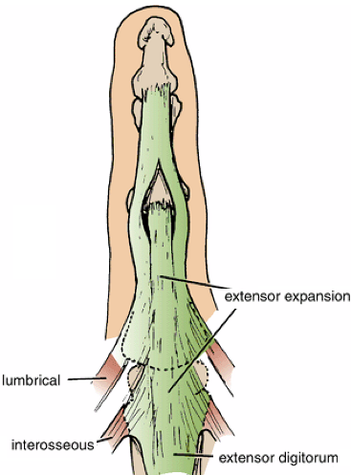
Extensor Expansion
Formed from the expansion of extensor digitorum tendons
At the PIJ, the expansion splits into 3 parts
One Central inserted into the base of Middle phalanx.
Two laterals inserted into the base of the Distal phalanx.
The Expansion Receives the insertions of:
Corresponding Interosseous muscle (on each side).
Lumbrical muscle (on the lateral side).

Slide 24
Thank you

