Slide 1
Anterior, Lateral Compartments of the Leg & Dorsum of the Foot
Dr Jamila EL Medany & Dr. Saeed Vohra

Slide 2
OBJECTIVES
At the end of the lecture, student should be able to:
Identify the deep fascia of leg
Identify the fascial compartments of the leg.
Describe the anatomy of the anterior & lateral compartments.
List the contents of each compartment (muscles, vessels & nerves).
Describe the anatomy and contents of the dorsum of the foot

Slide 3
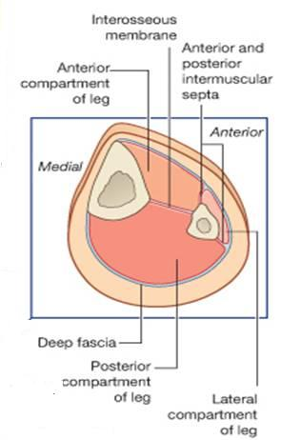
Fascial Compartments of the Leg
The deep fascia surrounds the leg and attached to anterior & medial borders of tibia.
Intermuscular Septa
Pass from the deep aspect of this fascia to be attached to
Anterior border of fibula (Anterior fascial septum)
Posterior border of fibula (Posterior fascial septum)
Interosseous membrane:
A thin & strong membrane, that binds the interosseous borders of tibia & fibula. It binds the two bones and provides attachment for muscles

Slide 4
Compartments of the Leg
Together with the interosseous membrane, the septa divide the leg into 3 compartments:
Anterior
Lateral (Peroneal)
Posterior
Each compartment has its own muscles, blood supply and nerve supply

Slide 5
Anterior Compartment
Tibialis anterior
Muscles | Artery | Nerve
Tibialis Anterior | Anterior Tibial | Deep Peroneal
Ext Dig Longus
Ext Hallucius Longus
Peroneus Tertius

Slide 6
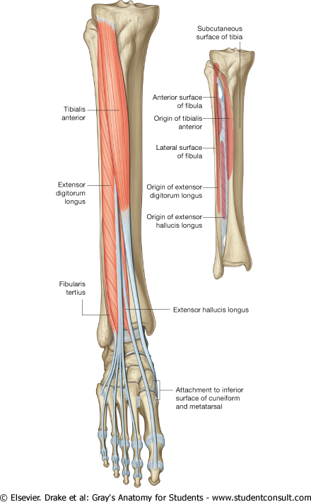
Tibialis
anterior
Extensor digitorum
longus
Peroneus tertius
Extensor hallucis longus

Slide 7
Muscle | Origin | Insertion | Action
Tibialis anterior | Lateral surface of shaft of tibia & interosseous membrane. | Medial cuneiform & base of 1st metatarsal bone | Dorsi flexion & Inversion of foot and maintains Medial Long arch
Extensor dig longus | Anterior surface of shaft of fibula | Extensor expansion of lat (4) toes | Extension of toes & Dorsi flexion of foot
Extensor hallucis longus | Anterior surface of shaft of fibula | Base of distal phalanx of great toe | Dorsi flexion& Inversion of the foot and extension of big toe
Peroneus tertius | Anterior surface of shaft of fibula | Base of 5th metatarsal bone | Dorsiflexion and Eversion of the foot.

Slide 8
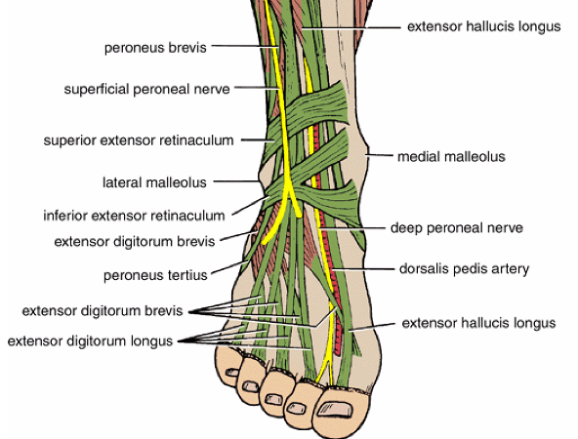
Extensor Retinacula
Thickening of deep fascia that keep the long tendons around ankle joint in position
Superior Extensor Retinaculum:
Attached to anterior borders of tibia & fibula above the ankle
Inferior Extensor Retinaculum:
Y-shaped band located inferior to the ankle

Slide 9
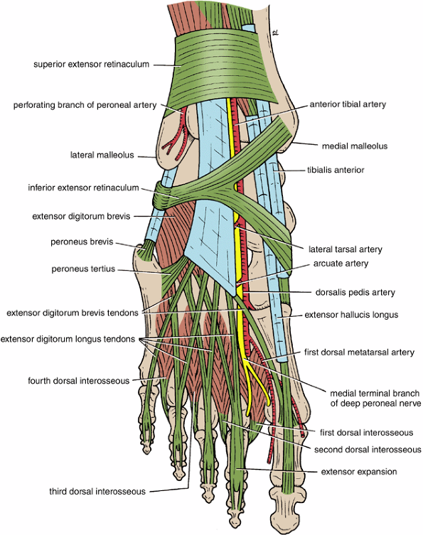
Structures passing Deep to Extensor Retinacula
From Medial to Lateral
Tibialia anterior tendon
Extensor hallucis longus tendon
Anterior tibial artery with venae comitantes
Deep peroneal nerve
Extensor digitorum longus tendons
Peroneus tertius tendon

Slide 10
Lateral Compartment of Leg
Muscles | Nerve | Artery
Peroneus Longus | Superficial Peroneal | Peroneal (Fibular)
Peroneus Brevis

Slide 11
Lateral Compartment of Leg
Muscle | Origin | Insertion | Action
Peroneus longus | Lateral surface of shaft of fibula | Medial cuneiform & base of 1st metatarsal bone | Plantar flexion & Eversion of the foot and supports lateral longitudinal arch
Peroneus brevis |  | Base of 5th metatarsal bone | Plantar flexion & Eversion of the foot and supports lateral longitudinal arch

Slide 12
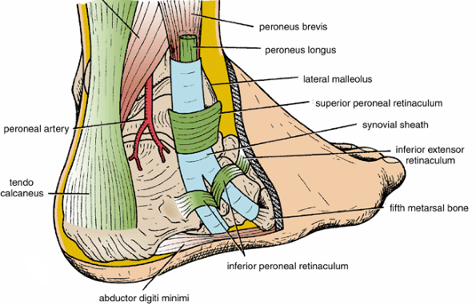
Peroneal Retinacula
Superior & Inferior Peroneal
Retinacula
Connect the lateral
malleolus to calcaneum &
hold the tendons of
Peroneus longus & brevis
Synovial Sheaths of Peroneal Longus & Brevis
Tendons of peronei are surrounded by a single common tubular
synovial sheath, deep to inferior peroneal retinaculum they have
separate sheaths

Slide 13
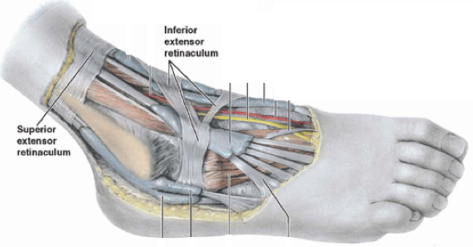
Deep Fascia of Dorsum of Foot
It is very thin, but just distal to ankle joint, it is thickened to form Inferior extensor retinaculum

Slide 14
Dorsum of Foot
Muscle | Artery | Nerve
Ext Dig Brevis | Dorsalis Pedis | Deep Peroneal

Slide 15
Ext Digitorum Brevis
Origin | Insertion | Action
Inferior extensor retinaculum & Calcaneum | Extensor Hallucius Brevis to base of proximal phalanx of big toe. Other (3) to extensor expansion | Extension of Interphalangeal & Metatarsophal-angeal joint of 1st, 2nd, 3^{rd& 4th} toes (during Dorsi flex).

Slide 16
Insertion of Long Extensor Tendons
The tendon of Extensor digitorum longus divides into (4) to the lateral four toes.
Each tendon to the 2nd , 3rd & 4th toes is joined on its lateral side by a tendon of Extensor digitorum brevis.
The extensor tendons form
A fascial Expansion (Extensor Expansion) on the dorsum of each toe.
The expansion divides into (3) parts:
Central: inserted into the base of middle phalanx.
Two lateral : inserted into the base of distal ph.
The extensor tendon receives insertion of Interossei & Lumbrical muscles.

Slide 17
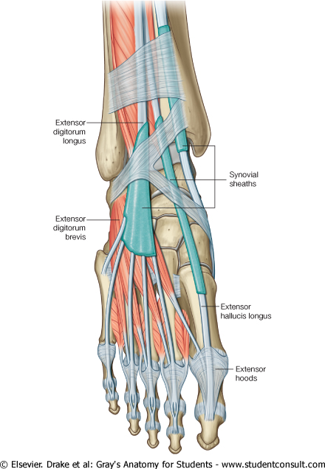
Synovial Sheaths of Extensor Tendons on the Dorsum of Foot
A separate sheath for each of:
Tibialis anterior
Extensor hallucis longus
A common sheath for :
Extensor digitorum longus &
peroneus tertius,
It extends to the level of base of 5th
metatarsal bone.

Slide 18
THANK YOU

