Slide 1
Hyaline Cartilage

Slide 2
Hyaline Cartilage

Slide 3
Elastic Cartilage

Slide 4
Elastic Cartilage

Slide 5
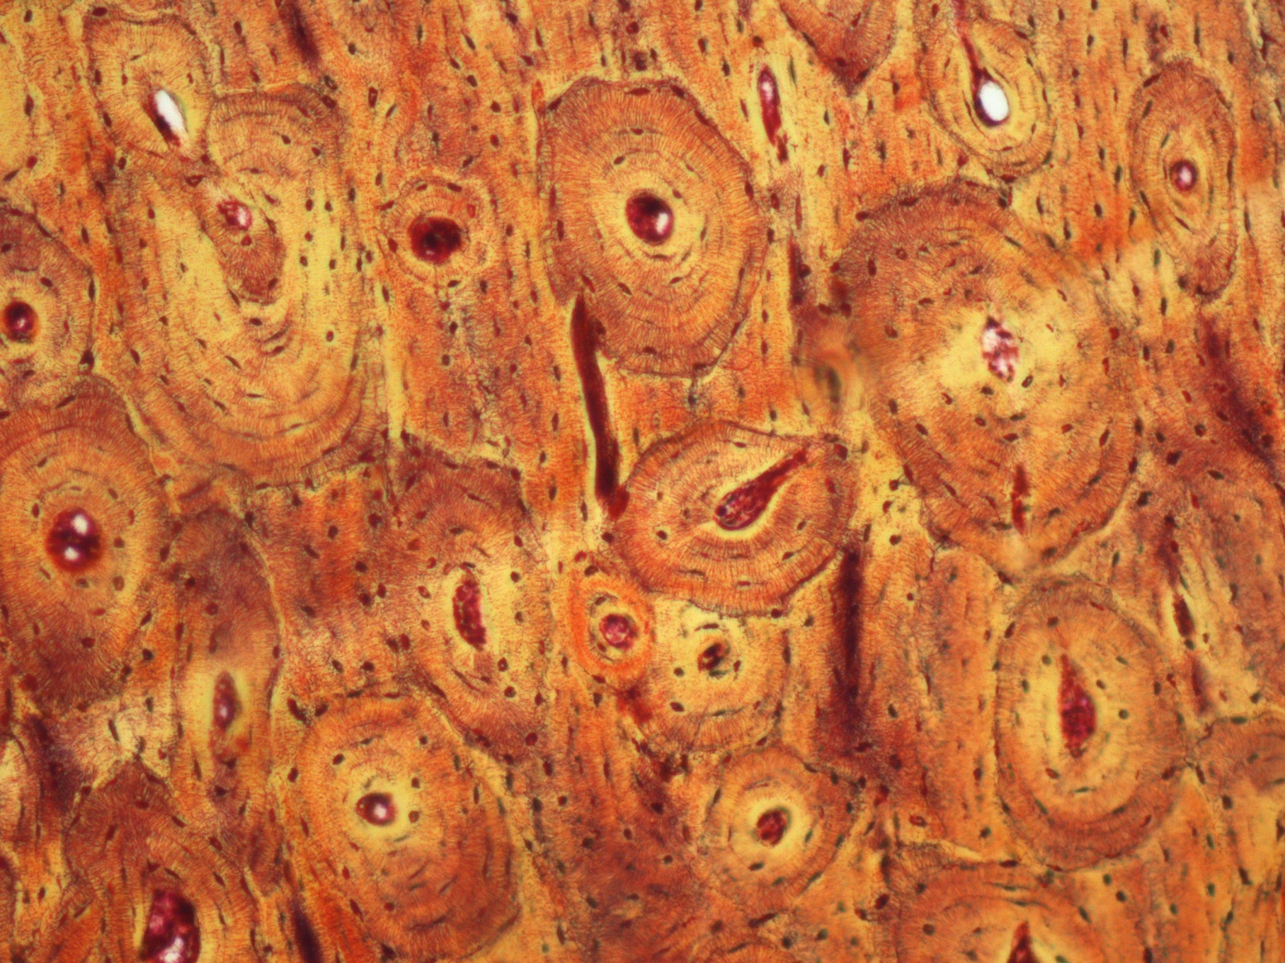
Compact Bone

Slide 6
Osteon (Haversian system)

Slide 7
Spongy Bone

Slide 8
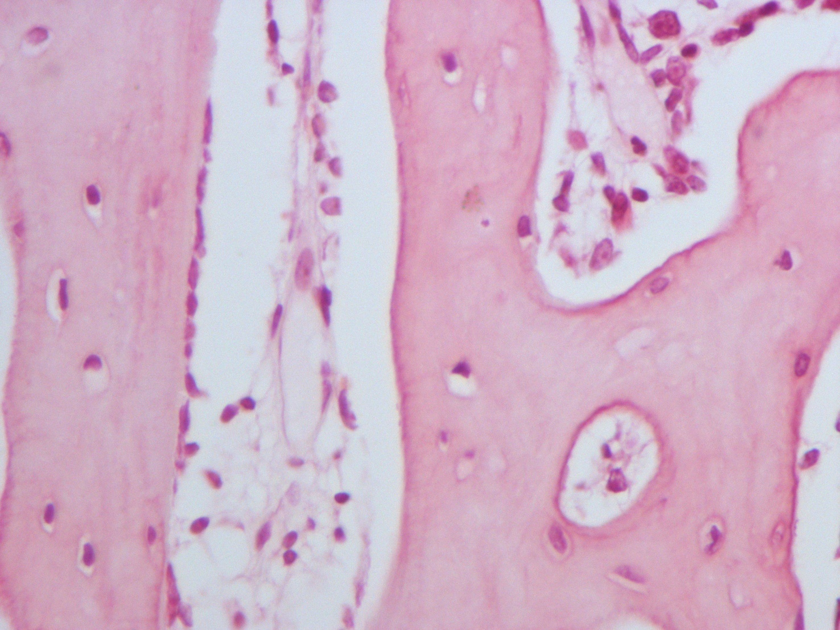
Spongy Bone

Slide 9
Cardiac Muscle

Slide 10
Cardiac Muscle

Slide 11
Skeletal Muscle

Slide 12
Skeletal Muscle

Slide 13
Skeletal Muscle

Slide 14
Skeletal Muscle

Slide 15
Smooth Muscle

Slide 16
Smooth Muscle

