Slide 3
Myopathies
Pathology

Slide 4
Skeletal muscle Fiber types
Depending on the nature of the nerve fiber doing the enervation, the associated skeletal muscle develops into one of two major subpopulations
A single "type I" or "type II" neuron will innervate multiple muscle fibers and these fibers are usually randomly scattered in a "checkerboard pattern" within a circumscribed area within the larger muscle

Slide 5
Skeletal muscle Fiber types
The different fibers can be identified using specific staining techniques:
type I:
"slow twitch“
more dependent on fat catabolism for energy through mitochondrial oxidative phosphorylation
red, refers to this being the dark (red) meat on birds where fiber type grouping in different muscles (e.g., thigh vs. breast meat) is quite pronounced
type II:
"fast twitch“
more dependent on glycogen catabolism for energy through glycolysis
white

Slide 7
MYOPATHY
Myopathy as a term may encompasses a heterogeneous group of disorders, both morphologically and clinically
Recognition of these disorders is important for genetic counseling or appropriate treatment of acquired disease

Slide 8
Myopathies
Diseases that affect skeletal muscle can involve any portion of the motor unit:
primary disorders of the motor neuron or axon
abnormalities of the neuromuscular junction
a wide variety of disorders primarily affecting the skeletal muscle itself (myopathies)

Slide 9
Myopathies
skeletal muscle disease can be divided into:
Neurogenic
Muscular dystrophies
Congenital
Toxic
Infectious
Disorders of the neuromuscular junction (e.g. myasthenia gravis)

Slide 11
MUSCLE ATROPHY
A non-specific response
Characterized by abnormally small myofibers
The type of fibers affected by the atrophy, their distribution in the muscle, and their specific morphology help identify the etiology of the atrophic changes

Slide 12
MUSCLE ATROPHY
Simple disuse (e.g., prolonged bed rest, immobilization to allow healing of a bone fracture, etc.) can cause profound atrophy
Exogenous glucocorticoids or endogenous hypercortisolism (e.g., in Cushing syndrome) are another cause of muscle atrophy, typically involving proximal muscle groups more than distal ones
Disuse- and steroid-induced atrophy primarily affects the type II fibers and causes a random distribution of the atrophic myofibers
Atrophic myofibers are also found in myopathies
the finding of additional morphologic changes like myofiber degeneration and regeneration or inflammatory infiltrates are features that suggest a myopathic etiology

Slide 14
MUSCLE ATROPHY Neurogenic Atrophy

Slide 15
MUSCLE ATROPHY Neurogenic Atrophy
Neurogenic Atrophy :
Characterized by involvement of both fiber types and by clustering of myofibers into small groups
Deprived of their normal enervation, skeletal fibers undergo progressive atrophy
Loss of a single neuron will affect all muscle fibers in a motor unit, so that the atrophy tends to be scattered over the field

Slide 16
MUSCLE ATROPHY Neurogenic Atrophy
However, following re-enervation, adjacent intact neurons send out sprouts to engage the neuromuscular junction of the previously de-enervated fibers→ new connection is established → these fibers assume the type of the innervating neuron → whole groups of fibers can eventually fall under the influence of the same neuron, and become the same fiber type (fiber type grouping)
In that setting, if the relevant enervating neuron now becomes injured, rather large coalescent groups of fibers are cut off from the trophic stimulation and wither away (grouped atrophy), a hallmark of recurrent neurogenic atrophy

Slide 18
MUSCULAR DYSTROPHY
A heterogeneous group of inherited disorders
Often presenting in childhood
Characterized by progressive degeneration of muscle fibers leading to muscle weakness and wasting
Histologically, in advanced cases muscle fibers are replaced by fibrofatty tissue
This distinguishes dystrophies from myopathies, which also present with muscle weakness

Slide 19
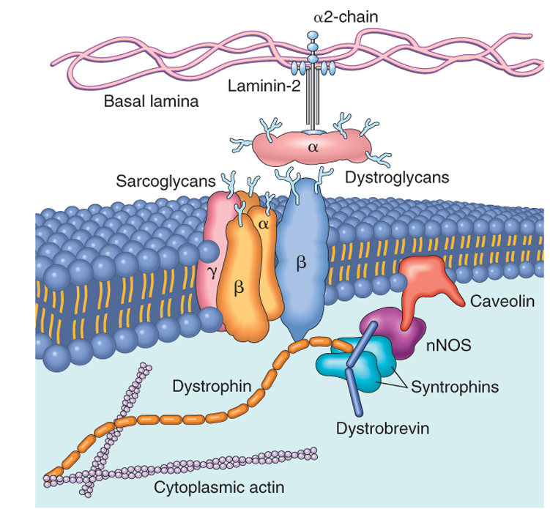
The relationship between the cell membrane (sarcolemma) and the sarcolemmal associated proteins
Dystrophin,, forms an interface between the cytoskeletal proteins and a group of transmembrane proteins, the dystroglycans and the sarcoglycans. These transmembrane proteins interact with the extracellualr material, including the laminin proteins.
mutations in caveolin and the sarcoglycan proteins with the autosomal limb girdle muscular dystrophies

Slide 20
Duchenne and Becker Muscular Dystrophy
X-Linked Muscular Dystrophy
The two most common forms of muscular dystrophy
DMD is the most severe and the most common form of muscular dystrophy, with an incidence of about 1 per 3500 live male births
DMD becomes clinically evident by age of 5, →progressive weakness leading to wheelchair dependence by age 10 to 12 years →death by the early 20s
Although the same gene is involved in both BMD and DMD, BMD is less common and much less severe

Slide 22
Duchenne and Becker Muscular Dystrophy
Morphology:
The histologic features of DMD and BMD are similar
Marked variation in muscle fiber size, caused by concomitant myofiber hypertrophy and atrophy
Many show a range of degenerative changes, including fiber necrosis
Other fibers show evidence of regeneration, including sarcoplasmic basophilia, nuclear enlargement, and nucleolar prominence
Connective tissue is increased throughout the muscle
The definitive diagnosis is based on the demonstration of abnormal staining for dystrophin in immunohistochemical preparations or by western blot analysis of skeletal muscle
In the late stages of the disease, extensive fiber loss and adipose tissue infiltration are present in most muscle groups.

Slide 23
Dystrophin
Dystrophin is a large protein (427 kD) that is expressed in a wide variety of tissues, including muscles of all types, brain, and peripheral nerves
Dystrophin attaches portions of the sarcomere to the cell membrane, maintaining the structural and functional integrity of skeletal and cardiac myocytes
The dystrophin gene (Xp21) spans (∼1% of the total X chromosome), making it one of the largest in the human genome; its enormous size is a probable explanation for its particular vulnerability to mutation
Deletions appear to represent a large proportion of the genetic abnormalities, with frameshift and point mutations accounting for the rest
Approximately two-thirds of the cases are familial, with the remainder representing new mutations
In affected families, females are carriers; they are clinically asymptomatic but often have elevated serum creatine kinase and can show mild histologic abnormalities on muscle biopsy

Slide 24
Pathogenesis
DMD and BMD are caused by abnormalities in the dystrophin gene
The role of dystrophin in transferring the force of contraction to connective tissue has been proposed as the basis for the myocyte degeneration that occurs with dystrophin defects, or with changes in other proteins that interact with dystrophin

Slide 25
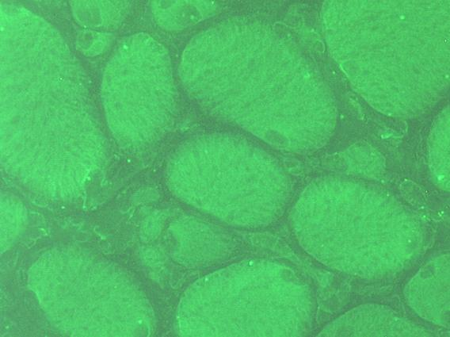

Slide 26
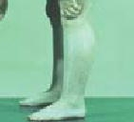
Clinical Features
Boys with DMD:
Normal at birth, and early motor milestones are met on time
Walking is often delayed
Weakness begins in the pelvic girdle muscles and then extends to the shoulder girdle
Enlargement of the calf muscles associated with weakness, a phenomenon termed pseudohypertrophy, is an important clinical finding
The increased muscle bulk is caused initially by an increase in the size of the muscle fibers and then, as the muscle atrophies, by an increase in fat and connective tissue
Pathologic changes are also found in the heart, and patients may develop heart failure or arrhythmias

Slide 27
Clinical Features
Cognitive impairment seems to be a component of the disease and is severe enough in some patients to be considered mental retardation
Serum creatine kinase is elevated during the first decade of life but returns to normal in the later stages of the disease, as muscle mass decreases
Death results from respiratory insufficiency, pulmonary infection, and cardiac decompensation

Slide 28
BMD
Boys with BMD develop symptoms at a later age than those with DMD. The onset occurs in later childhood or in adolescence, and it is accompanied by a generally slower and more variable rate of progression
Although cardiac disease is frequently seen in these patients, many have a nearly normal life span

Slide 30
Autosomal Muscular Dystrophies
Other forms of muscular dystrophy share many features of DMD and BMD but have distinct clinical and pathologic characteristics
Some of these muscular dystrophies affect specific muscle groups, and the formal diagnosis is based largely on the clinical pattern of muscle weakness
Several autosomal muscular dystrophies affect the proximal musculature of the trunk and limbs (similar to the X-linked muscular dystrophies), and are termed limb girdle muscular dystrophies
Limb girdle muscular dystrophies can be inherited either as autosomal dominant or autosomal recessive disorders
Mutations of the sarcoglycan complex of proteins are a classic example of limb girdle muscular dystrophy.

Slide 32
Congenital Myopathies
Important subcategories:
inherited mutations of ion channels (channelopathies), e.g. Hyperkalemic periodic paralysis
inborn errors of metabolism (exemplified by glycogen and lipid storage diseases)
mitochondrial abnormalities

Slide 33
Mitochondrial myopathies
Can involve mutations in either mitochondrial or nuclear DNA that encodes mitochondrial constituents
Mitochondrial myopathies typically present:
in young adulthood
with proximal muscle weakness
sometimes with severe involvement of the ocular musculature (external ophthalmoplegia)

Slide 34
Mitochondrial myopathies
There can be neurologic symptoms, lactic acidosis, and cardiomyopathy
The most consistent pathologic findings in skeletal muscle are irregular muscle fibers and aggregates of abnormal mitochondria; the latter impart a blotchy red appearance to the muscle fiber on the modified Gomori trichrome stain, hence the term ragged red fibers
The electron microscopic appearance is also often distinctive: there are increased numbers of, and abnormalities in, the shape and size of mitochondria, some of which contain paracrystalline parking lot inclusions or alterations in the structure of cristae

Slide 37
Toxic Myopathies
Important subcategories include disorders caused by intrinsic exposures (e.g. thyroxine) versus extrinsic exposures (e.g., alcohol, therapeutic drugs)
Thyrotoxic myopathy can present as either acute or chronic proximal muscle weakness, and can precede the onset of other signs of thyroid dysfunction
Findings include myofiber necrosis, regeneration, and interstitial lymphocytes
Ethanol myopathy can occur with binge drinking
Acute toxic rhabdomyolysis with accompanying myoglobinuria that can cause renal failure
On histology, there is myocyte swelling and necrosis, myophagocytosis, and regeneration
Chloroquine can also produce a proximal myopathy
The most prominent finding is myocyte vacuolization, and with progression, myocyte necrosis

Slide 39
Inflammatory Myopathies
Inflammatory myopathies make up a heterogeneous group of rare disorders characterized by immune-mediated muscle injury and inflammation
Based on the clinical, morphologic, and immunologic features, three disorders:
Polymyositis
Dermatomyositis
Inclusion body myositis

Slide 40
Inflammatory Myopathies
Occur alone or in conjunction with other autoimmune diseases, such as systemic sclerosis
Women with dermatomyositis have a slightly increased risk of developing visceral cancers (of the lung, ovary, stomach)
Clinically:
usually symmetric muscle weakness
initially affecting large muscles of the trunk, neck and limbs
Thus, tasks such as getting up from a chair or climbing steps become increasingly difficult
In dermatomyositis: an associated rash (classically described as a lilac or heliotrope discoloration) affects the upper eyelids and causes periorbital edema

Slide 41
Inflammatory Myopathies
Histologically:
infiltration by lymphocytes
degenerating and regenerating muscle fibers
The pattern of muscle injury and the location of the inflammatory infiltrates are fairly distinctive for each subtype

Slide 42
Inflammatory Myopathies
The immunologic evidence supports antibody-mediated tissue injury in dermatomyositis
Polymyositis and inclusion body myositis seem to be mediated by CTLs (cytotoxic T cells)
The diagnosis of these myopathies is based on clinical features, laboratory evidence of muscle injury (e.g., increased blood levels of creatine kinase), electromyography, and biopsy

Slide 43
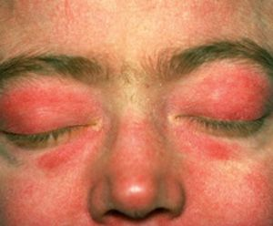

Slide 46
Homework
Define Myotonia?
What is the clinical presentation of myotonic dystrophy?
Source: Robbins basic pathology, 8th edition

