Slide 1
Musculoskeletal Block Lecture Three Osteomyelitis and Septic Arthritis
Dr. AMMAR C. AL-RIKABI

Slide 2
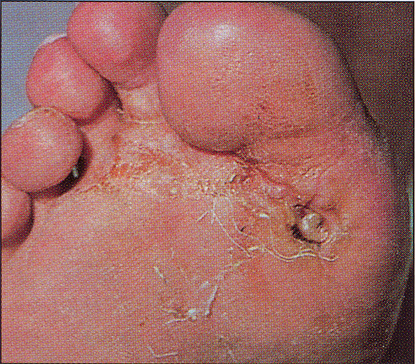
A purulent discharging ulcer at the base of the big toe in a diabetic patient.

Slide 3
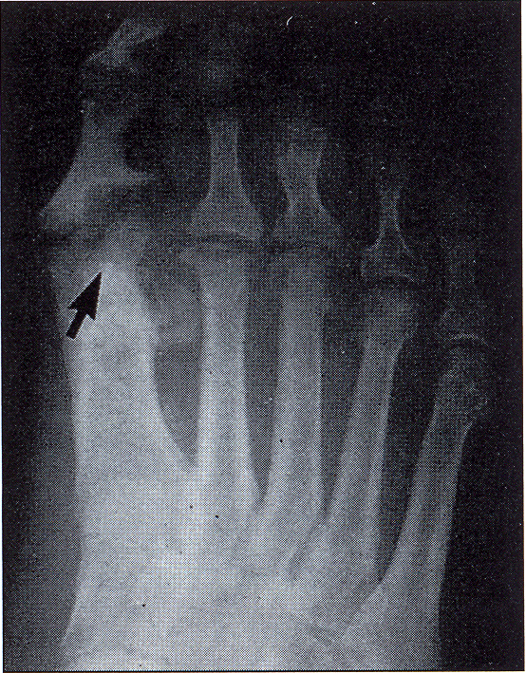
Osteomyelitis at the base of the ulcer, associated with x-ray changes, including bone erosion and sequestration formation.

Slide 4
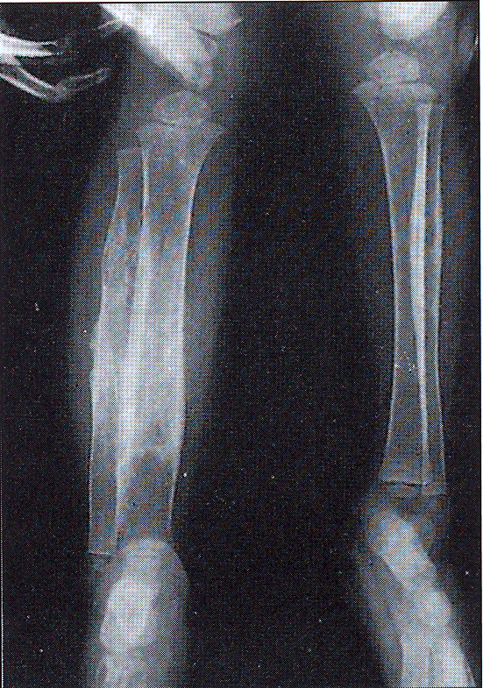
Salmonella osteomyelitis is a common complication of sickle-cell disease.

Slide 5
Chronic osteomyelitis

Slide 6
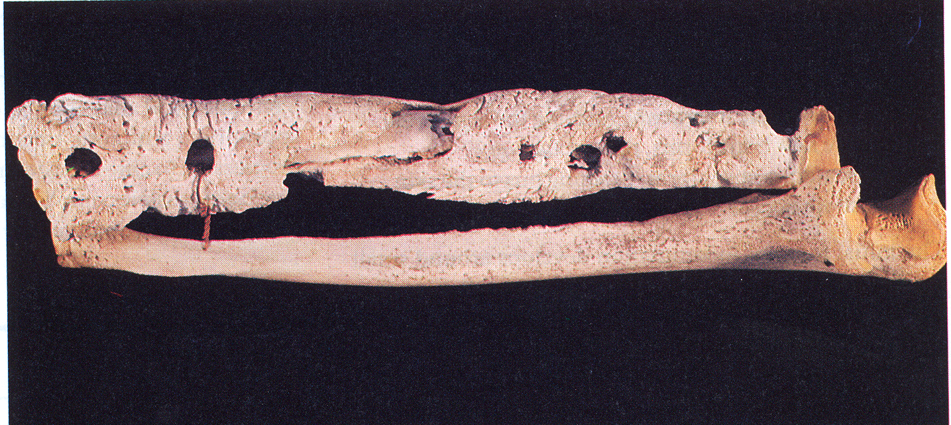
The radius and ulna of an 18-th century sailor. The “granular bone” is the involucrum and the circular defects are “cloacae” through which pus drained.

Slide 7
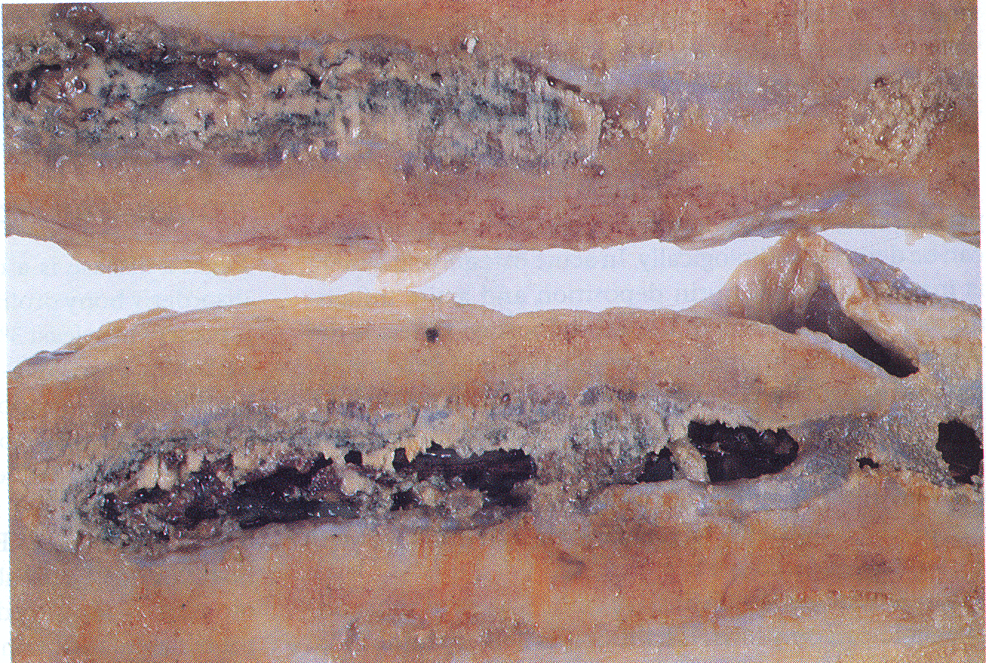
The cut surface of the femur of a 78-year-old male who received a shrapnel wound to his thigh in World War I.

Slide 8
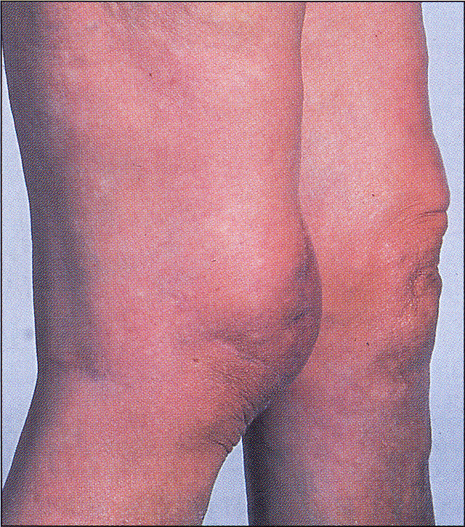
Tuberculosis infusion of the right knee
In this patient, arthritis followed untreated pulmonary tuberculosis. The knee joint was destroyed and arthrodesis was required.

Slide 9
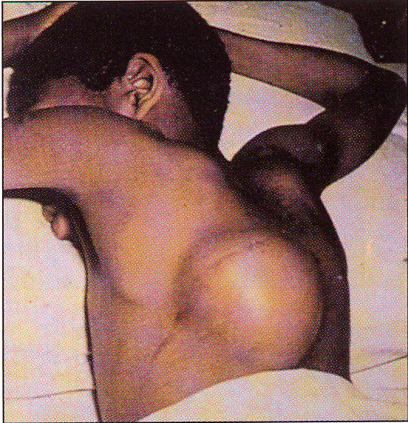
A “cold” abscess may be presenting the feature of tuberculosis of the spine, as in this child who presented with a painless loin swelling.

Slide 10
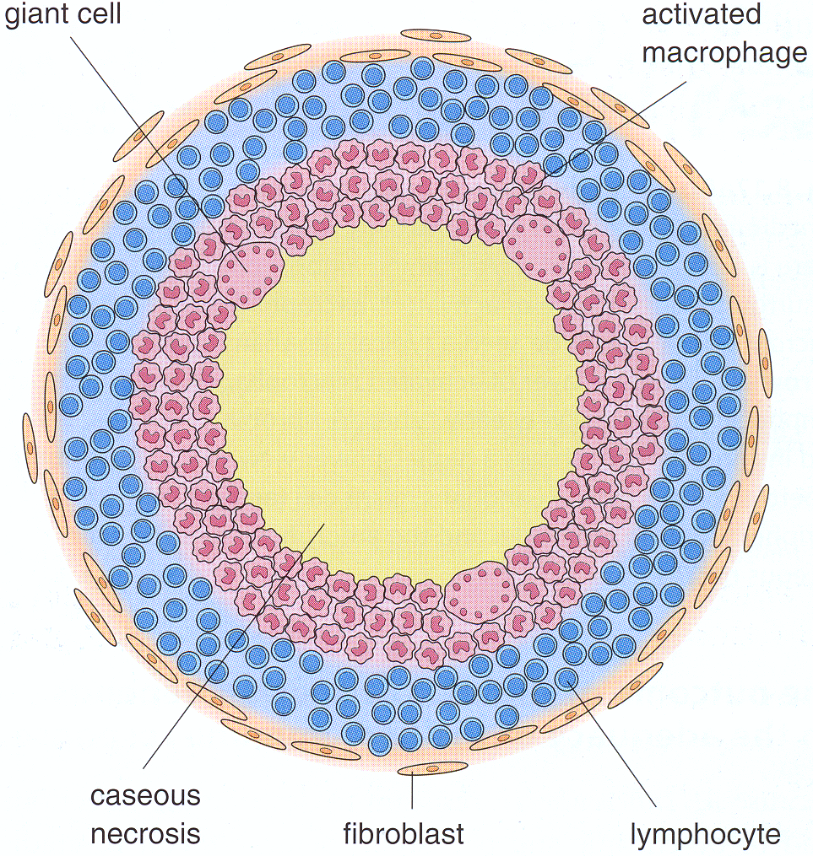
A tuberculous granuloma (Tubercle)
This simple diagram shows the structure of an early tuberculous granuloma. There is a central area of amorphous necrotic debris (caseous necrosis) surrounded by a zone of activated macrophages.

Slide 11
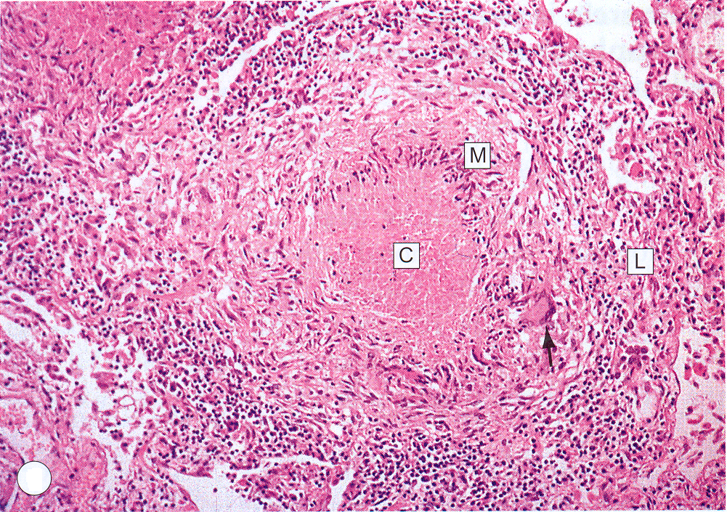
An early tuberculous granuloma
This shows a medium-power view of an entire early tuberculous granuloma. There is a central area of pink-staining amorphous caseous necrosis C, surrounded by a zone of activated macrophages M. Within the macrophage layer can be seen a typical Langhan’s giant cell (arrow). Outside the layer of activated macrophages is a ring of lymphocytes L.

Slide 12
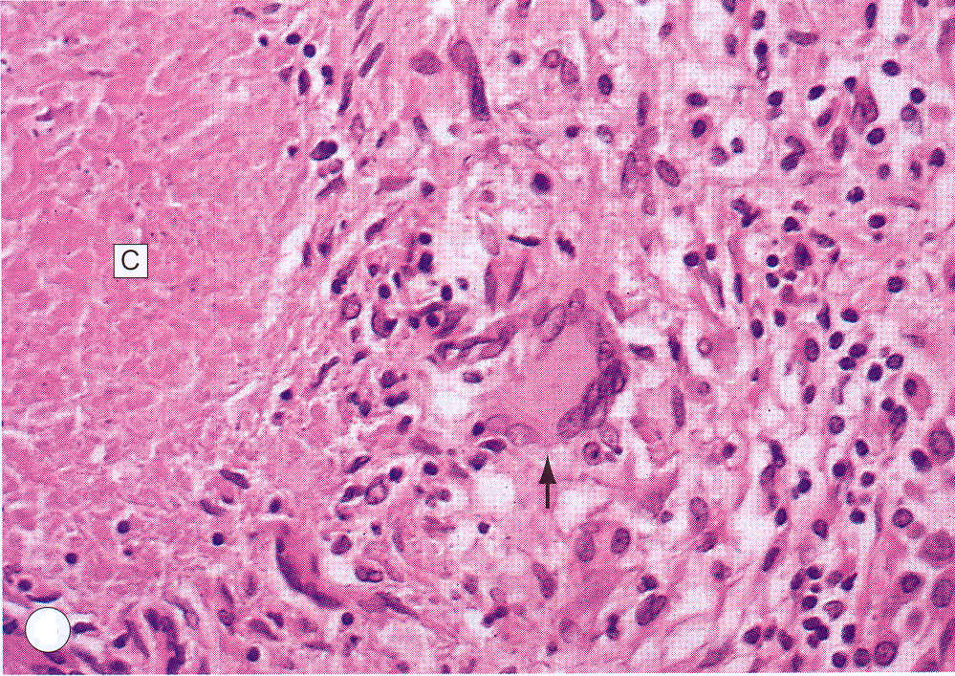
This shows a higher-power view of that part of the tubercle containing the Langhan’s giant cell (arrow); note its peripherally arranged nuclei and the amorphous nature of the caseous necrosis C.

