Slide 1
Non-steroidal anti-inflammatory drugs

Slide 2
BY
PROF.
AZZA EL-MEDANY
DR.
OSAMA YOUSIF

Slide 3
OBJECTIVES
At the end of the lecture the students should :
Define NSAIDs
Describe the classification of this group of drugs
Describe the general mechanism of actions
Define the following terms :
Analgesic
Antipyretics

Slide 4
Objectives ( continue)
Anti-inflammatory
Anti-platelet
Describe the general pharmacological actions
Describe the general therapeutic uses
Describe the general adverse effects
Describe the general contraindications
Know some examples of each group of NSAIDs
Know the difference between the selective & non-selective NSAIDs

Slide 5
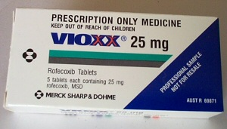



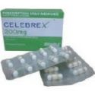


Classification of NSAIDs
Non-Selective COXs Inhibitor
Selective COX2 Inhibitor

Slide 6
NON- SLECTIVE -NON -STEROIDAL ANTI-INFLAMMATORY DRUGS
Are group of drugs that share in common the capacity to induce the following actions :
Analgesic
Antipyretic
Anti-inflammatory
Anti-platelet
Actions on the kidney

Slide 7
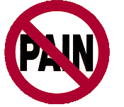
ANALGESIC
Drug that relieve pain.

Slide 8
ANTIPYRETIC
Drug that lower the elevated body temperature to normal.

Slide 9
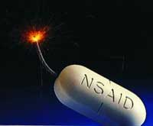
Pharmacokinetic
Oral administration
Most metabolized in liver (oxidation & conjugation)
95% bound to plasma-protein (high bioavailability)
Most NSAIDs are weak acid (absorbed well in stomach and intestinal mucosa)

Slide 10
DISCUSS

Slide 11

MECHANISM OF ACTION OF N-NSAIDS

Slide 12
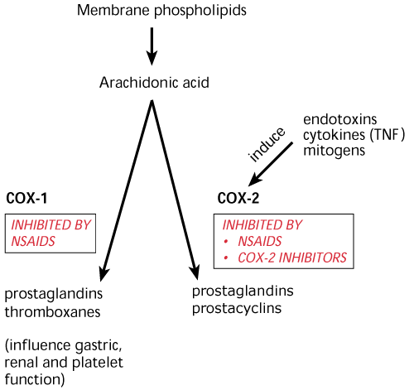

Slide 13
ASPIRIN is IRREVERSIBLY INactivates
CYCLOOXYGENAS ENZYMES

Slide 14
Mechanism Of Action
Analgesic
Centrally
Anti-Inflammatory action
Antipyretic
Centrally inhibition of COX enzymes
inhibition of interleukin-1
Anti-Inflam.
Peripherally inhibition of COX enzymes
Antioxidant effect
inhibition of COX enzymes in CNS
periperally
in CNS

Slide 15
( continue)
Effect on platelets
Inhibit platelet aggregation through inhibition the synthesis of TXA₂ ( inhibit cox-1)

Slide 16
Actions on the kidney
Salt &water retention & may cause edema
( inhibit synthesis of PGE2 & PGI2 that are responsible for maintaining renal blood flow)
Hyperkalemia
Interstitial nephritis ( except aspirin)

Slide 17
Respiratory actions ( specific for aspirin)
Therapeutic doses aspirin elevates CO2 & increased respiration
High doses acts directly on the respiratory center resulting in hyperventilation & respiratory alkalosis
Toxic doses , central respiratory paralysis & respiratory acidosis ( continued production of CO2)

Slide 18
THERAPEUTIC USES SHARED BY NS-NSAIDs

Slide 19
Antipyretic
Analgesic (Type of pain?)
Headache, Migraine,
Dental pain
Common cold.

Slide 20
Continue
Rheumatic / Rheumatoid arthritis / myositis or other forms of inflammatory conditions.
Dysmenrrhea

Slide 21
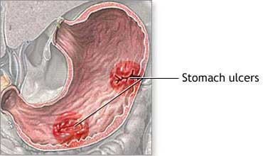
Adverse effects shared by N-NSAIDs
GIT upsets ( nausea, vomiting)
GIT bleeding & ulceration
Bleeding
Hypersensitivity reaction
Inhibition of uterine
contraction
Salt & water retention

Slide 22
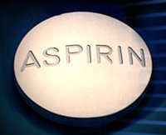

Slide 23
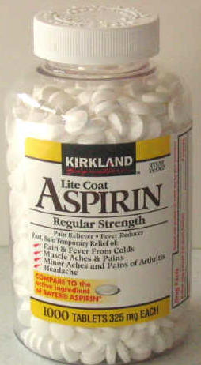
Clinical uses
Acute rheumatic fever
Low doses reduce the incidence of myocardial infarction & unstable angina ( cardioprotective)

Slide 24
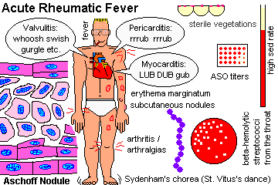

Slide 25
( continue)
Chronic gouty arthritis with
large doses
Chronic use of small doses of aspirin reduces the incidence of colorectal cancer

Slide 26
Continue
External applications :
Salicylic acid is used topically to treat corns
Methyl salicylate ( oil of wintergreen ) is used as counter irritant

Slide 27
Adverse Effects Related to
(A) Therapeutic Doses Of Aspirin
Nausea & vomiting
Hypersensitivity
( Aspirin asthma)
Acute Gouty arthritis
Reye's syndrome

Slide 28
( B) LARGE doses or Chronic use of aspirin
Salicylism ( ringing of ear( tinnitus) , vertigo)
Hyperthermia
Gastric ulceration & bleeding
Respiratory depression & uncompensated respiratory & metabolic acidoses

Slide 29
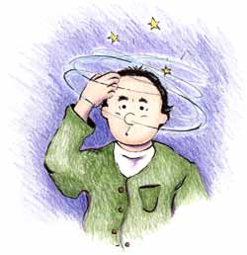
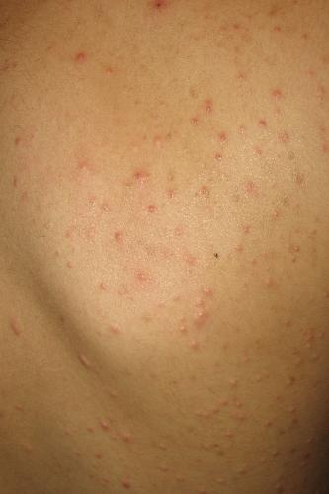
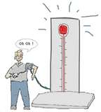
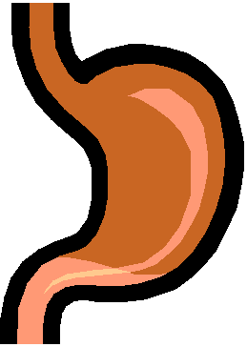

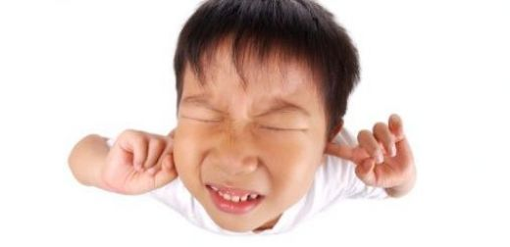
ADVERSE effects Related to High doses

Slide 30
Contraindications
Peptic ulcer
Pregnancy
Hemophilic patients
Patients taking anticoagulants
Children with viral infections
Gout ( small doses )

Slide 31

Quiz?
Which of the following is the most effective in reducing risk of myocardial infarction?
A. Acetaminophen
B. Aspirin
C. Celecoxib
D. Ibuprofen

Slide 32

PARACETAMOL
IS commonly used as analgesic antipyretic

Slide 33
Therapeutic applications of paracetamol as analgesic & antipyretic

Slide 34
In patients with :
Peptic or gastric ulcers.
Bleeding tendency.
Allergy to aspirin.
Viral infections especially in children .
During Pregnancy.

Slide 35
Adverse Effects
Mainly on liver due to its active metabolite
( N-acetyl-p-benzoquinone)
Therapeutic doses elevate liver enzymes
Large doses cause liver & kidney necrosis
Treatment Of toxicity of paracetamol by :
N- acetylcysteine ( SH- donor to neutralize the toxic metabolite

Slide 36
Quiz?
A 26-year-old woman takes a "handful" of acetaminophen in a suicide attempt. At the emergency department, it is determined that she has taken enough to be potentially harmful. Which of the following is the best treatment for this patient?
A. Calcium gluconate
B. IgG against acetaminophen
C. N-acetylcysteine
D. Penicillamine

Slide 37
DICLOFENAC
Clinical uses
Long-term use in treatment of rheumatoid arthritis , osteoarthritis & ankylosing spondylitis
Analgesic
Antipyretic
Acute gouty arthritis
Locally to prevent post-opthalmic inflammation

Slide 38
Preparations of Diclofenac
Diclofenac with misoprostol decreases upper gastrointestinal ulceration ,but result in diarrhea.
Diclofenac with omeprazole to prevent recurrent bleeding.
.1% opthalmic preparation for postoperative opthalmic inflammation.
A topical gel 3% for solar keratoses.
Rectal suppository as analgesic

Slide 39
Continue
Oral mouth wash.
Intramuscular preparations.

Slide 40
Selective COX-2 inhibitors
General advantages :
Potent anti-inflammatory
Antipyretic & analgesic
Lower incidence of gastric upset
No effect on platelet aggregation ( COX-1)

Slide 41
General adverse effects
Renal toxicity
Dyspepsia & heartburn
Allergy
Cardiovascular ( do not offer the cardioprotective effects of non-selective group).

Slide 42
GENERAL CLINICAL USES
Rheumatoid arthritis
Osteoarthritis
Acute gouty arthritis
Acute musculoskeletal pain
Ankylosing spondylitis
Dysmenorrhea

Slide 43
Continue
    They are recommended in postoperative patients undergoing bone repair.
    Indicated in primary familial adenomatous polyposis,

Slide 44
Celecoxib
Half-life 11 hours
Food decrease its absorption
Highly bound to plasma proteins

Slide 45
Quiz?
Which of the following is the advantage of specific cyclooxygenase-2 (COX-2) inhibitors?
A. Decreased GI side effects B. Decreased vasoconstrictor activity C. Increased anti-inflammatory activity D. Increased inhibition of platelet aggregation

Slide 46
Clinical uses & Adverse effects
Discussed before

Slide 47
Drug interactions
With warfarin potentiate its actions through interfering with its metabolism.

Slide 48
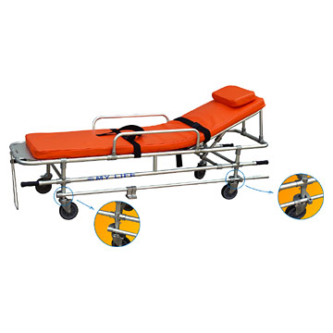
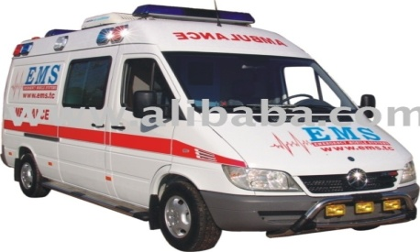
Case
A 16-year-old female comes to the physician's office because of menstrual cramps. She had menarche at age 13. Her menses lasts for 4–5 days, and she has 28-day cycles. For the first 2–3 days of her menses she states that she has very bad cramping. The cramps have occurred since menarche and seem to have worsened in the past year. They have been so bad at times that she has missed school and has not been able to participate in her after-school sports. She has been taking acetaminophen and over-the-counter "menstrual cramp" pills without adequate relief. She has no significant medical history, takes no medications regularly, and is not sexually active. Her examination is normal. You assess the problem as primary dysmenorrhea and prescribe diclofenac to be used on an as-needed basis.
Notes:
<procedure, surgery> General term for abdominal surgery

Slide 49
Q
1-What are the therapeutic effects of nonsteroidal anti-inflammatory drugs (NSAIDs)?
2-What is the mechanism of the anti-inflammatory action of NSAIDs?

Slide 50
Summary
NSAIDs are group of drugs that have analgesic , antipyretic , anti-platelet & anti-inflammatory effects.
They are classified according to their action on COX-enzymes into non-selective that inhibit both COX-1 & COX-2 & selective that inhibit only COX-2 enzymes.
They are sharing in common therapeutic uses as analgesic to relief mild to moderate pain not visceral pain , reducing high body temperature, preventing clot formation , so aspirin can be used as prophylaxis in ischemic heart disease.

Slide 51
Summary ( Continue)
As anti-inflammatory in rheumatic , rheumatoid arthritis, desmenrrhea and other inflammatory conditions including muscles or bones.
The common adverse effects includes : gastric upset ( nausea, vomiting ,gastric ulceration or bleeding).
Allergy
Edema
They are contraindicated mainly in patients with peptic ulcer , bleeding tendency or in pregnancy .

Slide 52
Summary ( Continue)
Selective COX-2 inhibitors as celecoxib are potent anti-inflammatory & analgesic ,but have no anti-platelet effect & less gastric upset.
They can be used in patients with gastric ulcer , haemophilia .
Their common adverse is mainly on kidney & cardiovascular system.

Slide 53

Thank You

