Slide 1
Skeletal muscle relaxants
Classification
Peripherally acting (Neuromuscular blockers).
Centrally acting skeletal muscle relaxants
e.g. Baclofen - Diazepam
Direct acting skeletal muscle relaxants
e.g. Dantrolene

Slide 2
Neuromuscular blockers
Classification:
1) Competitive (non depolarizing blockers)
2) Depolarizing blockers
Depolarizing muscle relaxants act as acetylcholine (ACh) receptor agonists, whereas nondepolarizing muscle relaxants function as competitive antagonists.

Slide 3
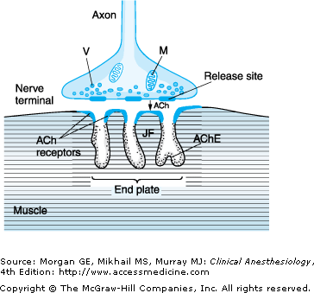

Slide 4
Neuromuscular Blockers
Competitive (Nondepolarizing) NM blockers
d-tubocurarine (prototype)
Atracurium
Mivacurium
Pancuronium
Vecuronium
Depolarizing NM blockers
Succinylcholine

Slide 5
Uses of NMB blockers
control convulsion → electroshock therapy in psychotic patient .
Relieve of tetanus and epileptic convulsion.
Facilitate endoscopy
As adjuvant in general anesthesia to induce muscle relaxation
orthopedic surgery.

Slide 6
Competitive NM blockers
Mechanism of Action
Are competitive antagonists for Ach at the nicotinic receptors present in postjunctional membrane of motor end plate.
No depolarization of postjunctional membrane.
Cholinesterase inhibitors can reverse blockade (Neostigmine).

Slide 7
Pharmacokinetics
They are polar compounds
inactive orally & taken parenterally
Do not cross placenta & CNS
Elimination depend upon kidney or liver Except
Mivacurium (degraded by acetylcholinesterase enzyme)
Atracurium (spontaneous degradation)

Slide 8
Pharmacological actions:
Skeletal muscle relaxation.
They produce different effects on CVS
Some release histamine and produce hypotension
d.Tubocurarine (not used clinically)
Atracurium
Mivacurium
Others produce tachycardia (↑ H.R)
Pancuronium

Slide 9
d – Tubocurarine
Prototype skeletal muscle relaxant (first muscle relaxant used clinically) .
Not used now clinically due to adverse effects
Histamine releaser
Bronchospasm
Hypotension
Blocks autonomic ganglia (Hypotension)
More safer derivatives are now available.

Slide 10
Atracurium
As potent as curare (1.5)
Has intermediate duration of action (30 min).
Eliminated by non enzymatic chemical
degradation in plasma
(spontaneous hydrolysis at body pH).
used in liver failure & kidney failure (drug of choice).
Liberate histamine → (Transient hypotension), bronchospasm.
Anti-histamine pretreatment may prevent these side effects.
No effect on muscarinic receptor nor ganglia .

Slide 11
Atracuriam should be avoided in asthma patients b/c it causes bronchospasm due to histamine release.

Slide 12
Mivacurium
Chemically related to atracurium
Fast onset of action
Metabolized by pseudo cholinesterases.
Shortest duration of action of all the nondepolarzing drugs (15 min).
Longer duration in patient with liver disease or genetic cholinesterase deficiency.
Transient hypotension (histamine release, similar to atracurium).

Slide 13
Mivacuriuam induced prolonged muscle paralysis can be reversed by acetycholinesterase inhibitors such as endrophonium,
acetycholinesterase inhibitors increase the Ach level in NMJ and displace Mivacuriam from nicotinic receptors in NMJ.

Slide 14
Pancuronium
More potent than curare ( 6 times ).
metabolized in liver and excretion is renal ( 80 % ).
Long duration of action (metabolic products have some NM blocking activities).
Tachycardia
Antimuscarinic action (atropine like effects)
Blocks muscarinic receptor in SA node
↑ NE release from adrenergic nerve endings.
Avoid in patient with coronary diseases.

Slide 15
Vecuronium
More potent than tubocurarine ( 6 times ).
Metabolized mainly by liver.
Excretion mainly in bile.
Intermediate duration of action.
Has few side effects.
No histamine release.
No ganglion block.
No antimuscarinic action.

Slide 17
Notes | Side effects | Duration | Drug
# Renal failure | Hypotension | Long 1-2 h | Tubocurarine
# Renal failure | Tachycardia | Long 1-2 h | Pancuronium
Spontaneous degradation Used in liver and kidney failure | Transient hypotension Histamine release | Short 30 min. | Atracurium
# Liver failure | Few side effects | Short 40 min. | Vecuronium
Metabolized by pseudocholinesterase # Choline esterase deficiency | Similar to atracurium | Short 15 min. | Mivacurium
# CVS Diseases # Glaucoma # Liver disease | Hyperkalemia Arrhythmia Increase IOP | Short 10 min. | Succinyl choline

Slide 18
Depolarizing Neuromuscular Blockers
Mechanism of Action
Phase I ( Depolarizing )
combine and activates nicotinic receptors → depolarization of motor end plate → initial muscle twitching →
Phase II: Persistent depolarization → paralysis (Phase II clinically resembeles non-depolarizing muscle relaxants .

Slide 19
Succinylcholine (suxamethonium)
Pharmacological Actions (due to depolarization of muscle)
SK. muscle : fasciculation → spastic paralysis.
Hyperkalemia (due to sk muscle contraction) : Cardiac arrest.
Eye : ↑ intraocular pressure (depolarization and contraction of extraocular muscle.
GIT :↑ intragastric pressure → regurgitation of gastric content to esophagus. Difficulty in opening mouth.
CVS : arrhythmia

Slide 20
Pharmacokinetics
Short onset of action (1 min.).
Short duration of action (5-10 min.).
Destroyed by pseudocholinesterase
Half life is prolonged in
Neonates
Elderly
Pseudcholinesterase deficiency

Slide 21
Side Effects
Hyperkalemia
CVS arrhythmia
↑ IOP # glaucoma
Can produce malignant hyperthermia
May cause succinylcholine apnea due to deficiency of pseudocholinesterase by:
liver disease
Malnutrition
Organophosphorous poisoning (acetylcholinesterase inhibition).

Slide 22
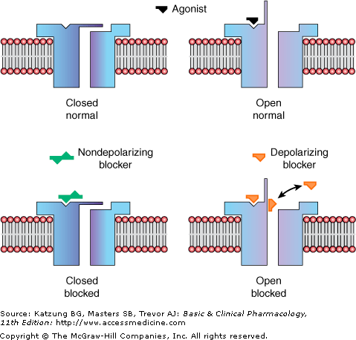
Mechanism of non-depolarizing and depolarizings muscle relaxants
e.g Atracurium
Succinycholine

Slide 23
Malignant hyperthermia
Inability to bind calcium by sarcoplasmic reticulum in some patients due to genetic defect .
Sensitive to some drugs
general anesthesia e.g. halothane
neuromuscular blockers e.g. suxamethonium
↑ Ca release, intense muscle spasm, severe rise in body temperature

Slide 24
Spasmolytics
They reduce muscle spasm in spastic states
Baclofen:
Centrally acting
GABA agonist – acts on spinal cord.
Diazepam (Benzodiazepines):
Centrally acting
facilitate GABA action on CNS.
Dantrolene:
direct action on skeletal muscles.
Used in treatment of malignant hyperthermia

Slide 25
Uses of spasmolytics
They reduce muscle spasm in spastic states produced by :
Spinal cord injury
Stroke
Cerebral palsy

Slide 26
Dantrolene
Mechanism of Action
It interferes with the release of calcium from its stores in skeletal muscles (sarcoplasmic reticulum).
It inhibits excitation-contraction coupling in the muscle fiber.
Calcium is released from the sarcoplasmic reticulum via a calcium channel, called the ryanodine receptor (RyR) channel and dantrolene blocks the opening of these channels.
Uses :Malignant Hyperthermia. And Spastic states.
given IV, orally .

Slide 27
Drugs and diseases that modify NM blockers effects
Aminoglycosides (e.g streptomycin) enhances the effects of NM blockers.
Cholinesterase inhibitors may enhance the effect of depolarizing relaxants but decrease the effect of nondepolarzing relaxants.
Disease states such as mysthania gravis and parkinson modify the response to muscle relaxants.
Magnesium sulphate may antagonize the effect of muscle relaxants.

