Slide 1
Physical and Psychological Factors Affecting Sport Performance

Slide 2
Objectives
At the end of this lecture the student should :
Appreciates the meaning of muscle strength and muscle power.
Understand factors affecting them
Understand , the mental and psychological factors in sport perfor,mance
benefits of sport .
Understand what is overtraining syndrome .

Slide 3
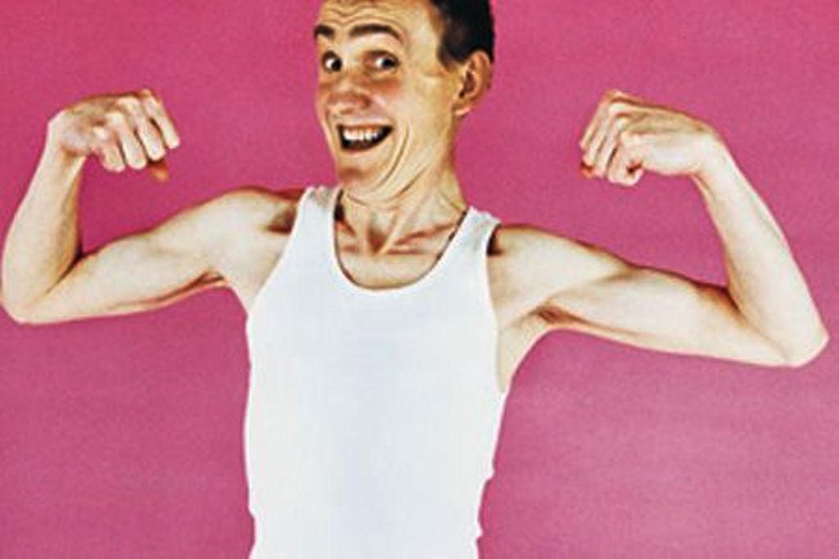
Muscle Strength
Muscle strength has mechanical & neural components :
(1) Mechanical strength: the maximum force a muscle can exert.
This depends upon the muscle cross-sectional area .
So if after a period of training, an athlete increases his muscle size by 50 % , he will also increase the force the muscle can develop by 50% .

Slide 4
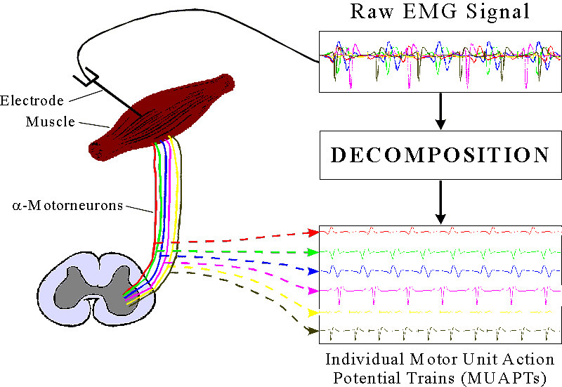
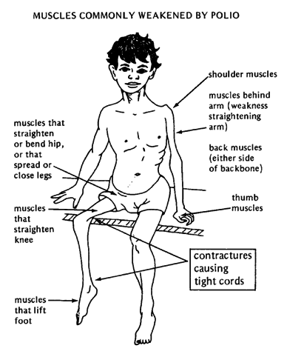
(2) Neurological strength : meaning how many of the AHC motor neurons supplying that muscle are recruited + frequency of action potentials in them → these two factors combine to increase the force of muscle contraction
In diseases involving the AHCs ( e.g., poliomyelitis , MND ) the number of active AHCs may be considerably reduced .
Notes:
MND group of neurological disorders that selectively affect motor that control voluntary muscle activity including speaking, walking, breathing, swallowing and general movement of the body
Alpha motor neurons (α-MNs) are large lower motor neurons of the brainstem and spinal cord. They innervate extrafusal muscle fibers of skeletal muscle and are directly responsible for initiating their contraction. Alpha motor neurons are distinct from gamma motor neurons which innervate intrafusal muscle fibers of muscle spindles

Slide 5
So!!!!

Slide 6
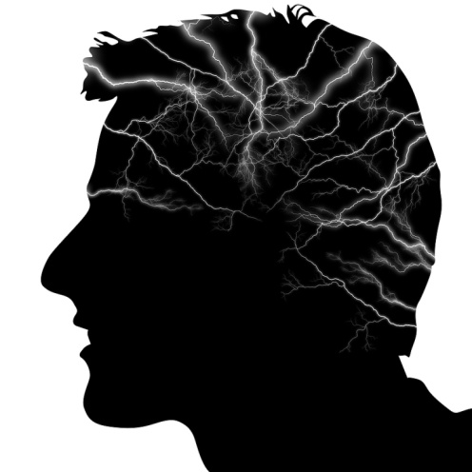
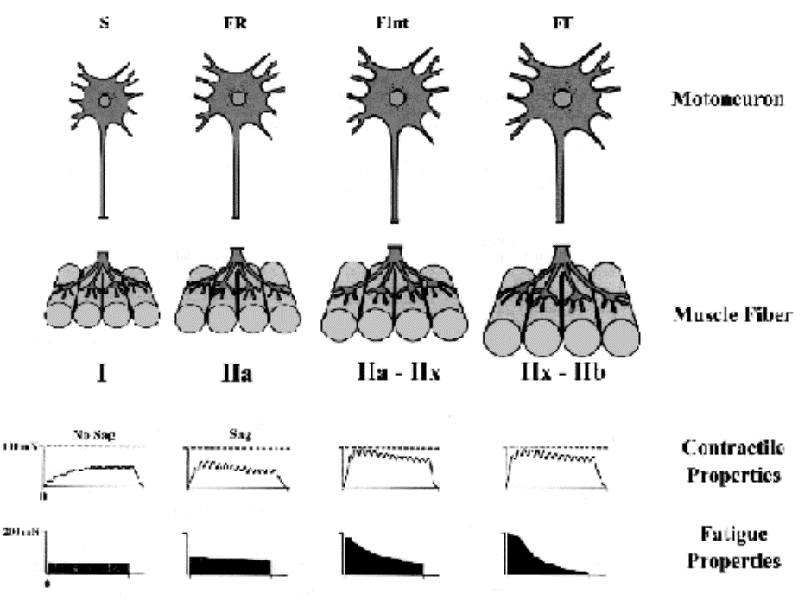
A severely depressed person ( or athlete ) , who lost his motivation , may , unconsciously , recruit less AHCs than normal → decreased performance

Slide 7
(I) Strength
Muscle strength is also a result of the combination of three factors:
(A) Physiological strength, which depends on factors such as (1) muscle size,
(2) muscle cross-sectional area , and
(3) responses to training.
(B) Neurological strength → how strong or how weak is the neuronal signal that tells the muscle to contract.
(C) Mechanical strength → The muscle’s pulling force , and
(D) The way (A) to ( C) above can be changed using bones and joints as levers.
When we talk about the strength or muscles, we are describing the maximum force a muscle can exert. Muscle strength is directly dependant upon the size of the cross-sectional area of muscle, so if after a period of training, you increase your muscle size by 50 percent, you will also increase the force the muscle can develop by 50 percent.
For every one square centimetre of cross sectional area, muscle fibres can exert a maximum force of approximately 30 to 40 Neutons (30 to 40 Neutons = 3 to 4 kg.)

Slide 8
Example → Emily can lift 21 kg (210 newtons force) using muscles that have a cross sectional area of 6 cm². To work out how many newtons per square centimetre her muscles can pull with:

Slide 9
Muscle Power
When muscles contract or stretch in moving a load they do work , and energy is transferred from one form to another.
The “ power ” of muscles refers to how quickly the muscles can do this work and transfer the energy.
Power = Work/Time , &
Work = Force X Distance
The shorter the time used to perform a piece of work , the more power is needed
Hence , if a weightlifter lifts a given weight explosively over a short time ( say 0.5 seconds ) he needs his muscles to produce much more power than if he did that while taking more time .

Slide 10
(II) Power
When muscles contract or stretch in moving a load they do work, and energy is transferred from one form to another. The power of muscles refers to how quickly the muscles can do this work and transfer the energy.
Example:
A weightlifter lifts 100 kg up a distance of 1.5 m, 100 kg has a weight force of 1000 newtons.
The work done (energy transferred) by the weightlifter is:
Notes:
JOULE :it is equal to the energy expended (or work done) in applying a force of one newton through a distance of one metre (1 newton metre or N·m)

Slide 11
Energy Availability
When humans utilize energy to perform muscular exercise , the energy is expended to
(1) doing work , &
(2) generating heat .

Slide 12
Energy Sources in Working muscle
(1) Energy needed to perform high-intensity , short-lasting bursts of exercise is derived from anaerobic sources within the cell , whereas
(2) Less-intense and longer –lasting effort ( Aerobic Exercise ) utilizes oxygen i.e., it is aerobic exercise .

Slide 13
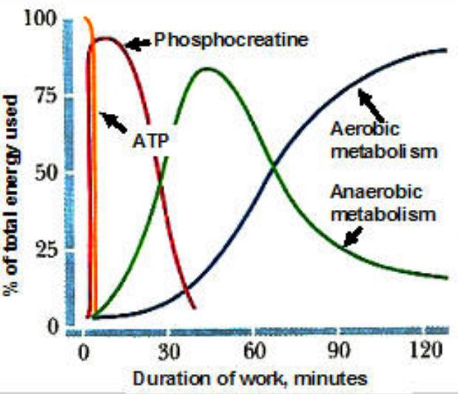
Energy Sources in Working muscle
The quick energy sources consist of the →
(1) Phosphocreatine system .
(2) Glycolysis ,
&
(3) Adenylate Kinase
The most rapid source, but the most readily depleted of the above sources is the Phosphocreatine .

Slide 14
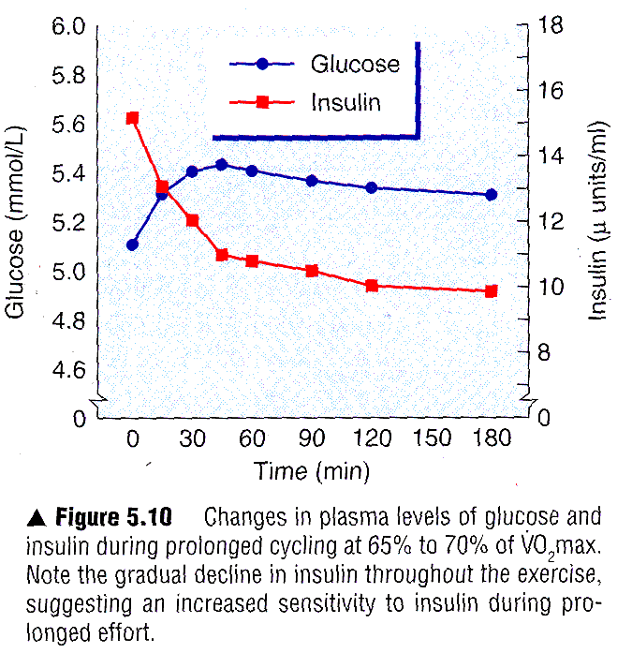
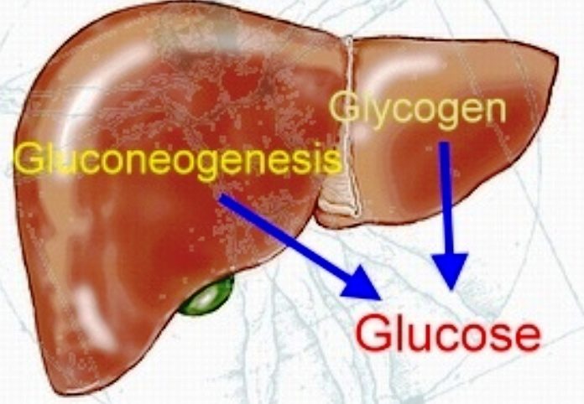
Glucose Availability
Plasma glucose is maintained by an equal rate of glucose appearance (entry into the blood) and glucose disposal (removal from the blood).
In the healthy individual, rate of appearance and disposal are essentially equal during exercise of moderate intensity and duration;
However, prolonged , intense exercise can result in a fall in blood glucose level and the onset of fatigue .
During exercise , rate of glucose appearance depends mainly on the liver ((glycogenloysis and gluconeogenesis ) , and to a lesser extent , on absorption from the gut .

Slide 15
https://www.youtube.com/watch?v=v7-h_w7bJrU

Slide 16
Oxygen Availability
Which depends upon →
(1) cardiac output (the quantity of blood distributed by the heart ) ,
(2) the ability of the lung to oxygenate the blood ,
(3) arterio-venous (a-v) oxygen difference ( i.e., the ability of the exercising muscle to take up oxygen from blood ).
https://www.youtube.com/watch?v=A2z0l9B6aGE

Slide 17
Degree of Hydration
Intense prolonged exercise produces metabolic waste heat . The heat is removed by sweating which , if intense , may cause dehydration .
A male marathon runner loses each hour around 0.8 L in cool weather and 1.2 L in warm weather.
A female marathon runner loses about 70% of what the male loses .
However , in hot weather , heavy exercise can cause much more losses of fluid from the body → dehydration .
Dehydration leads to constant rise in body temperature , increase in heart-rate , and decreased stroke volume and cardiac output .
Notes:
Dehydration: the excessive loss of body water

Slide 18
Gender ( Sex)
(i) Because of difference between genders of in body build and physical ability , men can perform better than women in contact sports such as boxing , rugby and wrestling .
(ii) Menstruation : women may perform differently at different times during their menstrual cycle .

Slide 19
Age
youth are better in sport performance than elderly e.g., a footballer getting old may retire or be a coach

Slide 20
Type of Personality
(i) Introverts
tend to like sports which require:, precision , self-motivation , need low arousal levels & Individual performances e.g., archery, golf and snooker

Slide 21
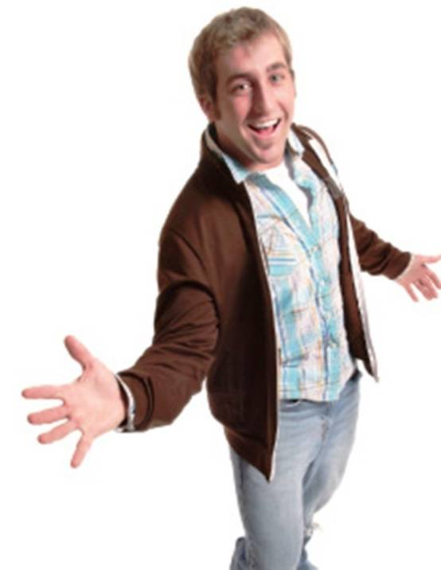
(ii) Extroverts ا
Prefer team sports, which are exciting , need high arousal level and require large, simple motor skills e.g. rugby and boxing

Slide 22
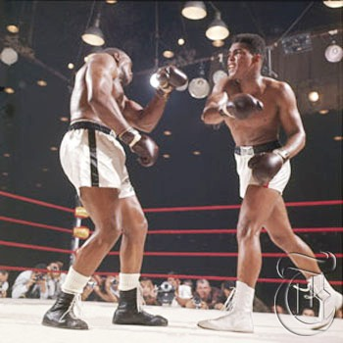
(iii) Aggression
Can sometimes be useful : some sports e.g. Rugby , Boxing need the player to have some aggression & not be placid and accomodating
But can sometimes be useful and sometimes harmful
Notes:
Aggression, in its broadest sense,

Slide 23
Depression + lack of self-esteem + lack of
motivation → always harmful

Slide 24
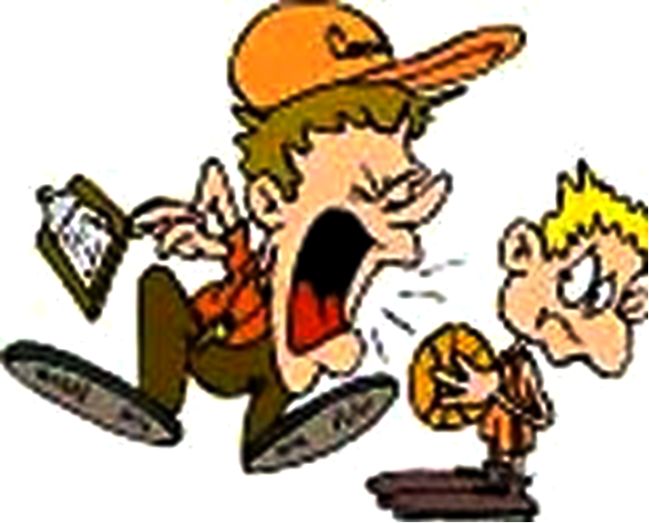
The Overtraining Syndrome

Slide 25
The Overtraining Syndrome
This is an important , mixed , psychosomatic/musculoskeletal condition being increasingly observed in competitive sport .
With increasing competitiveness in local , national & international sport, it may be on the rise .
Overtraining occurs when the athlete, while stale ( with impaired in vigor and effectiveness ) is pushed/forced ( e.g. by a coach ) to continue training at high intensity → leading to development of “Overtraining Syndrome ”
This syndrome is a chronic , debilitating ( body-weakening ) condition
Overtraining syndrome may impair an athlete during training or daily work, with signs of
(1) decreased concentration,
(2) irritability and increased anger,
(3) slowed mental function, and
(4) diminished self-esteem.
Symptoms of overtraining include fatigue ( feeling of tiredness ) , inability to exceed former levels of performance, and a decreased ability to recover are typical symptoms of overtraining
Notes:
vigor = activity

Slide 26
These conditions are not limited to mature adult athletes.
Young athletes are continuously confronted with increasing expectations, often resulting in unrealistic demands on time and physical performance
This may lead to early withdrawal from the sport environment.
Acoach of this type should be dismissed

Slide 27
Thank You

