Slide 1
Nose, Nasal cavity, Paranasal Sinuses & Pharynx
Dr. Zeenat Zaidi Dr. Essam Eldin Salama
Anatomy Department

Slide 2
Objectives
At the end of the lecture, the students should be able to:
Describe the boundaries of the nasal cavity.
Describe the nasal conchae and meati.
Demonstrate the openings in each meatus.
Describe the paranasal sinuses and their functions
Describe the pharynx and its parts

Slide 3
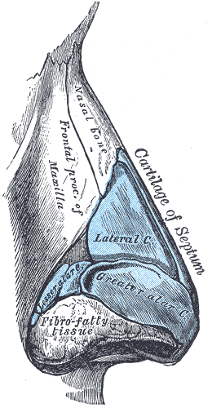
Nose
Nose, is the only visible part of the respiratory system and serves as the entrance to the respiratory tract
The nose has two cavities, separated from one another by a wall called the septum.
The external openings, known as external (anterior) nares or nostrils, lead to the nasal cavities.
root
tip
ala
septum
external nares
Formed:
above by bony skeleton &
below by plates of hyaline cartilage.

Slide 4
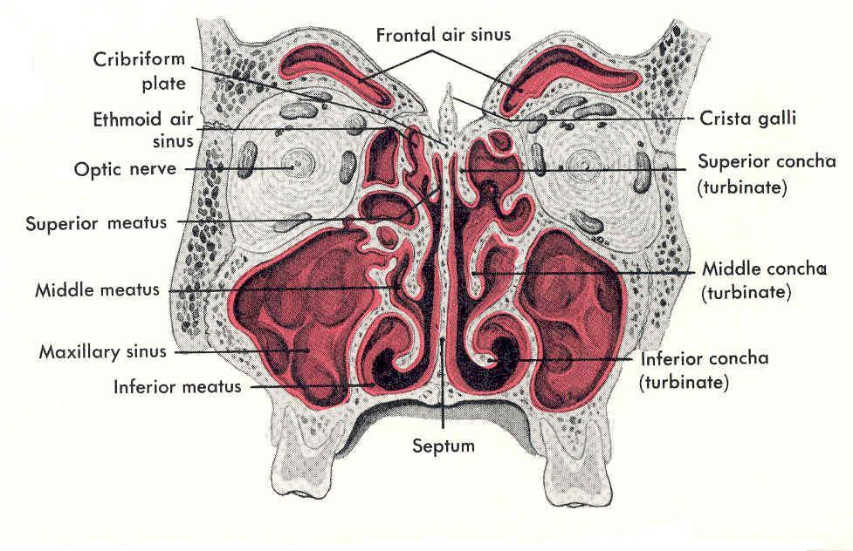
Nasal Cavity
Extends from the external (anterior) nares to the posterior nares (choanae).
Divided into right & left halves by the nasal septum.
Each half has a:
Roof
Lateral wall
Medial wall (septum)
Floor

Slide 5
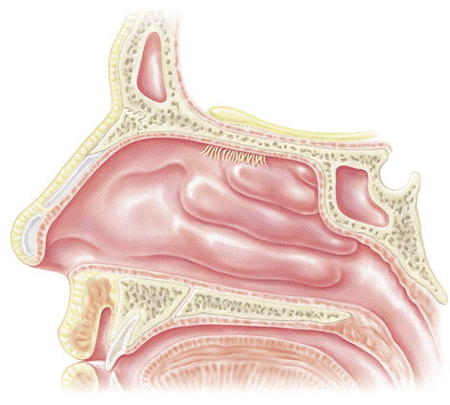
Roof
Narrow & formed (anteroposteriorly) by the:
Nasal bone & cartilage
Frontal bone.
Cribriform plate of ethmoid bone
Body of sphenoid.
2
1
3
4
Hard Palate
Oral cavity
Floor
Formed by the hard (bony) palate.
Separates it from the oral cavity.

Slide 6
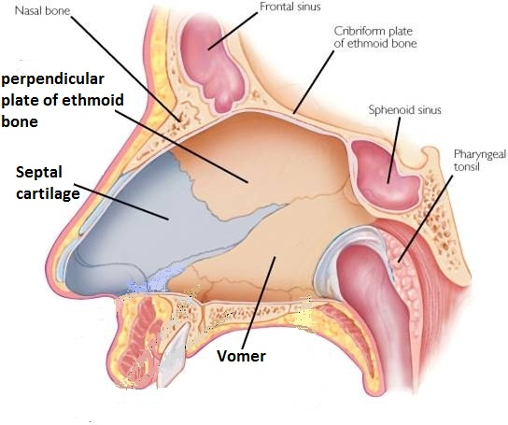
Medial Wall (Nasal Septum)
Osteo-cartilaginous partition between the two nasal cavities.
Formed by:
Septal cartilage.
Perpendicular plate of ethmoid bone.
Vomer.

Slide 7
Lateral Wall
Shows three horizontal bony projections, the superior, middle & inferior conchae.
The cavity below each concha is called a meatus and are named as superior, middle & inferior corresponding to the conchae.
The small space above the superior concha is the sphenoethmoidal (suprameatal) recess.
Sphenoethmoidal recess
Meati
Superior
concha
middle concha
Inferior concha
The conchae are covered by respiratory epithelium and thus increase the surface area of the nasal cavity.

Slide 8
The recess & meati receive the openings of the paranasal sinuses & naso-lacrimal duct.
Sphenoethmoidal recess | sphenoidal sinus
Superior meatus | posterior ethmoidal sinus
Middle meatus | middle ethmoidal, maxillary, frontal & the anterior ethmoidal sinuses
Inferior meatus | nasolacrimal duct.

Slide 9
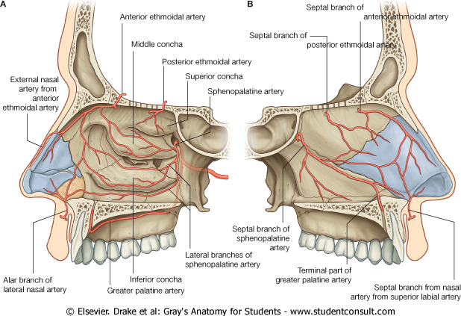
Nerve Supply
Olfactory mucosa supplied by olfactory nerves.
Nerves of general sensation are derived from ophthalmic & maxillary nerves.
Autonomic fibers.
Arterial Supply:
Branches of the maxillary, facial & ophthalmic arteries.
The arteries make a rich anastomosis in the region of the vestibule, and anterior portion of the septum.
Lymphatic Drainage:
To the submandibular and the upper deep cervical lymph nodes.
Venous Drainage: By the:
facial
ophthalmic and
spheno-palatine veins.

Slide 10
Paranasal Sinuses
Air filled cavities located in the bones around the nasal cavity (ethmoid, sphenoid, frontal bones & maxillae).
Lined by respiratory mucosa which is continuous with the mucosa of the nasal cavity.
Drain into the nasal cavity.
Functions
Lighten the skull.
Act as resonant chambers for speech.
Air conditioning: The respiratory mucosal lining helps in warming, cleaning and moistening the incoming air.

Slide 11
Pharynx
Muscular tube lying behind the nasal cavity, oral cavity & larynx.
Extends from the base of the skull to level of the 6th cervical vertebra, where it is continuous with the esophagus
Divided into three parts:
Nasopharynx:
Superior part, communicates with the nasal cavity through posterior nasal apertures
Oropharynx:
Middle part, communicates with the oral cavity through the oro-pharyngeal isthmus
Laryngopharynx:
Inferior part, communicates with the larynx through the laryngeal inlet
Nasal cavity
Naso-
pharynx
Oral cavity
Oro-
pharynx
Laryngo-
pharynx
larynx
Esophagus

Slide 12
Nasopharynx
Extends from the base of skull to the soft palate.
Contains Pharyngeal tonsils (adenoides) in its roof.
Lateral wall shows:
Opening of auditory tube.
Tubal elevation (produced by posterior margin of the auditory tube).
Tubal tonsil.
Salpingopharyngeal fold (raised by salpingo-pharyngeus muscle).
Pharyngeal tonsil
Tubal tonsil
*
Tubal elevation
Salpingo-pharyngeal
fold

Slide 13
Oropharynx
Extends from soft palate to upper border of epiglottis.
Lateral wall shows:
Palatoglossal fold
Palatopharyngeal fold.
Palatine tonsil located in ‘tonsillar fossa’, a depression between the two folds
Palatopharyngeal fold
Palatine tonsil in tonsillar fossa
Palatoglossal
fold

Slide 14
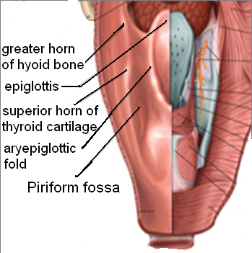
Laryngopharynx
Extends from upper border of epiglottis to lower border of cricoid cartilage.
‘Piriform fossa’. A small depression situated on either side of the laryngeal inlet
It is a common site for the lodging of foreign bodies.
Branches of internal laryngeal & recurrent laryngeal nerves lie deep to the mucous membrane of the fossa and are vulnerable to injury during removal of a foreign body.

Slide 15
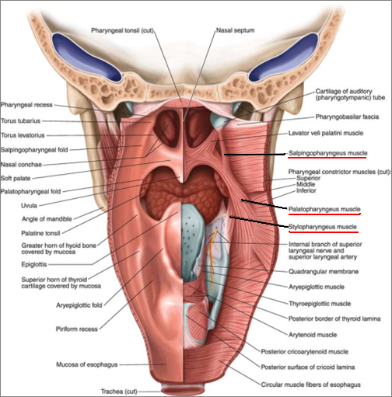
Muscles of Pharynx
The muscles of the pharynx are arranged in circular and longitudinal layers
Circular (Constrictor)
Three muscles, overlap each other: Superior, Middle & Inferior
Propel the bolus of food down into the esophagus
Longitudinal Muscles
Three muscles:
Stylopharyngeus
Salpingopharyngeus
Palatpharyngeous
Elevate the larynx & pharynx during swallowing
S
M
I

Slide 16
Nerve Supply
Sensory:
Nasopharynx: Maxillary nerve
Oropharynx: Glossopharyngeal nerve
Laryngopharynx: Vagus nerve
Motor:
All the muscles of pharynx, except the stylopharyngeus, are supplied by the pharyngeal plexus.
Stylopharyngeus is supplied by the glossopharyngeal nerve
Pharyngeal plexus
A network of nerves located on the surface of the middle pharyngeal constrictor muscle, is formed by pharyngeal branches of glossopharyngeal nerve (sensory), pharyngeal branch of vagus nerve (motor) and sympathetic fibers from superior cervical ganglion (vasomotor)

Slide 17
Arterial supply: From branches of:
Ascending pharyngeal artery
Ascending palatine artery
Facial artery
Maxillary artery
Lingual artery
The Veins drain into pharyngeal venous plexus, which drains into the internal jugular vein
The Lymphatics drain into the:
Deep cervical
Retropharyngeal &
Paratracheal lymph nodes

Slide 18
Thank You & Good Luck

